Slide 1
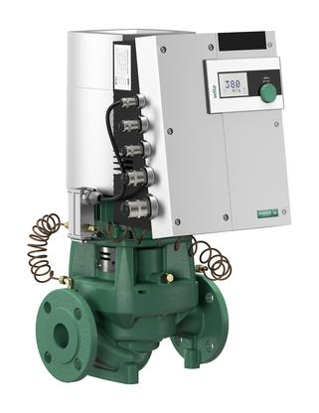
Wilo Stratos GIGA the most advanced commercial
HVAC pump in the world
2020

Slide 2
System Efficiency
means more than Energy Savings
Seals Pump Repairs
System Valves
Valve operators
Air Vents
Leaks
Boiler Ignition Parts
Boiler Venting
Cycles
Comfort
Pipe Noise
Inconvenience
Cost
Balance of Production with Consumption

Slide 3
GPM = BTU’s
500 x Delta T
Delta psig x 2.31 = Feet TDH
Rocket Science

Slide 4
50 – 80% savings in energy in the pump alone with ECM and a little common sense.
Easy to install and easy to prove.
Direct the WILO energy towards the schools with 1,000,000 to 5,000,000BTU/HR systems and the infamous 1510-2.5BB – 5-7.5hp pumps.
If you only get 50% savings with ECM/DC over the existing AC constant speed your payback is less than 3 years PERIOD. WHY NOT
Even if you have the perfect system with VFD’s ECM will save at least 30%. I’ve never seen that perfect system yet.
You also get all the repair parts and labor savings for free.

Slide 5
ECM technology with wire to water savings up to 80%, at very effective cost points with Variable Speed, ECM motor and system control built into the pump itself.
These pumps are the one stop solution to system efficiency, correcting the system and distribution efficiency with boiler efficiency.

Slide 6

How Big do they Go ECM?

Slide 7
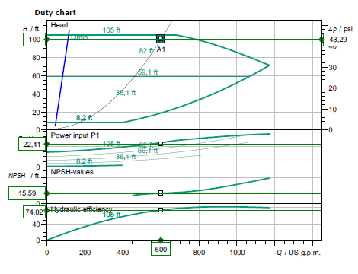
Call for
sizing

Slide 8
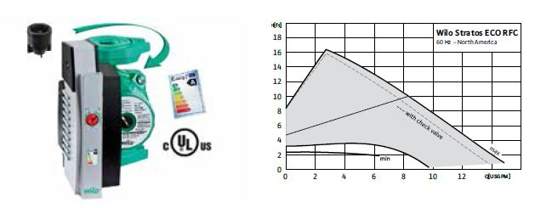
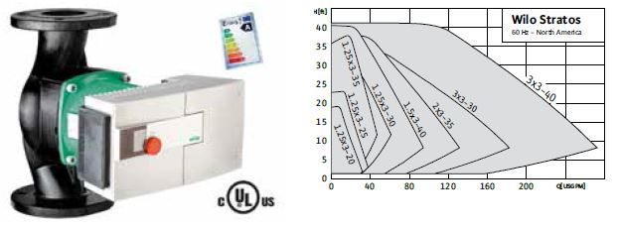
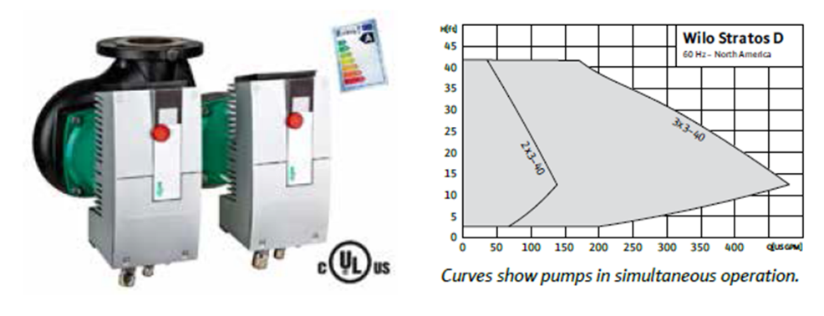
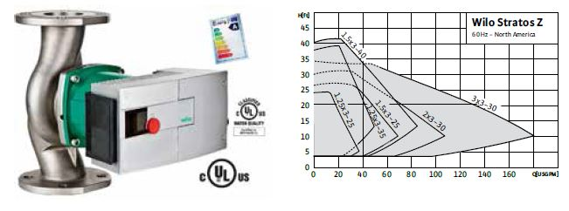
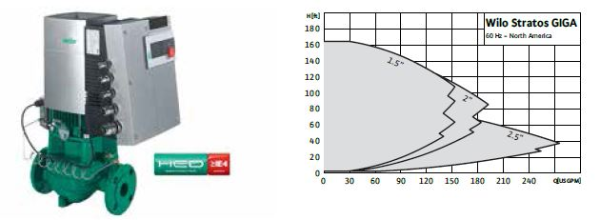
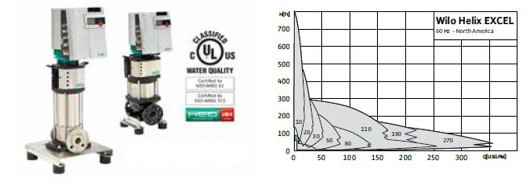
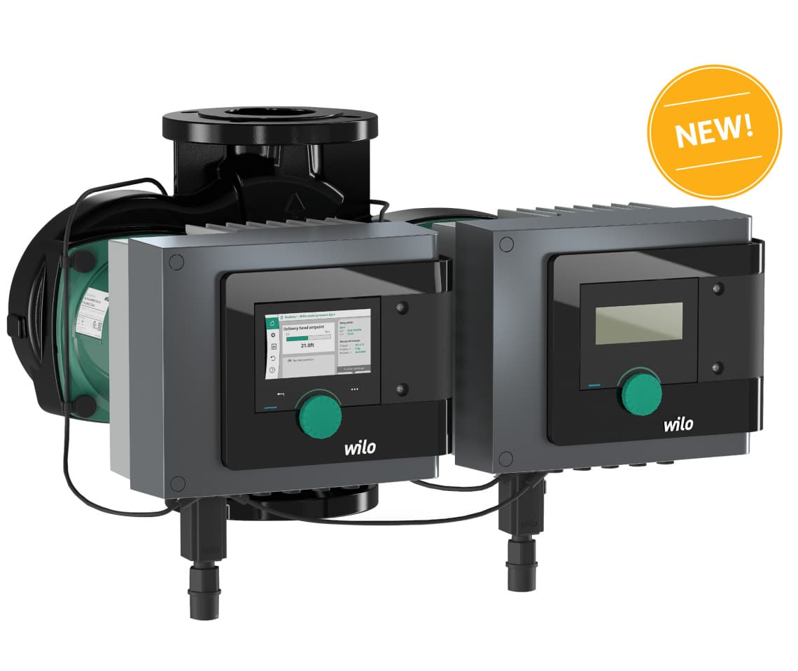
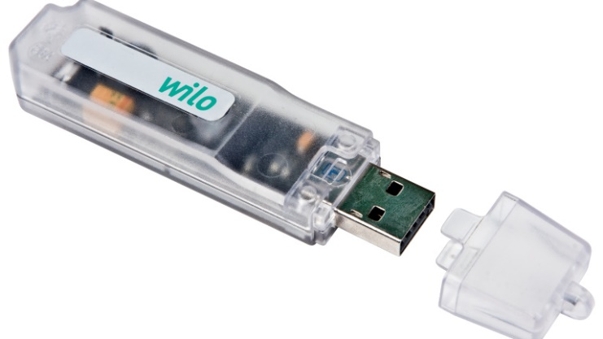
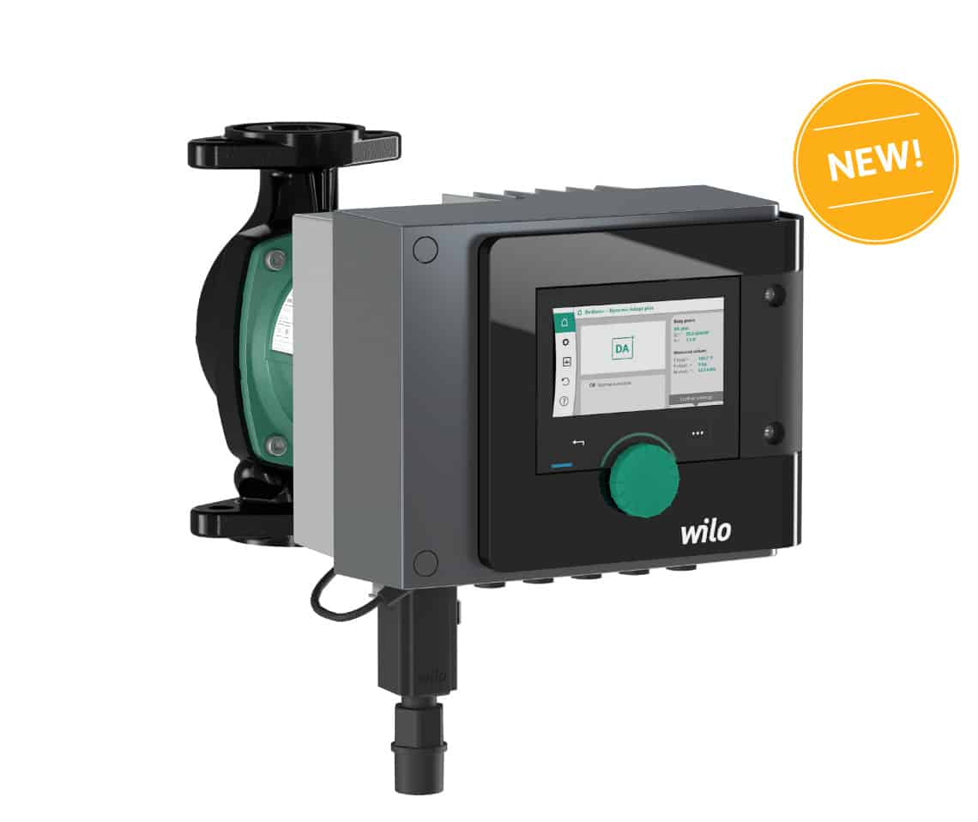
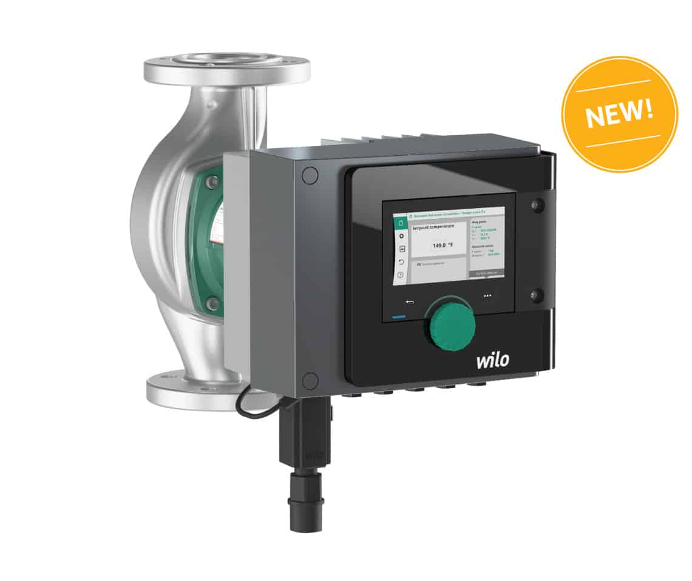

Slide 9
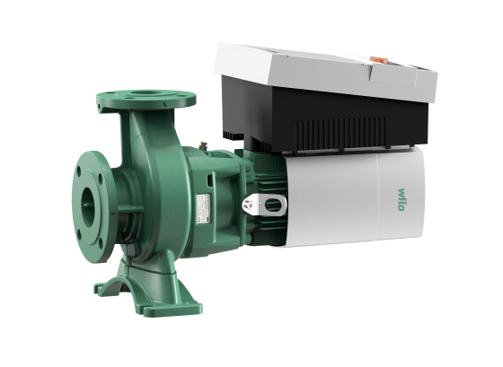

Slide 10
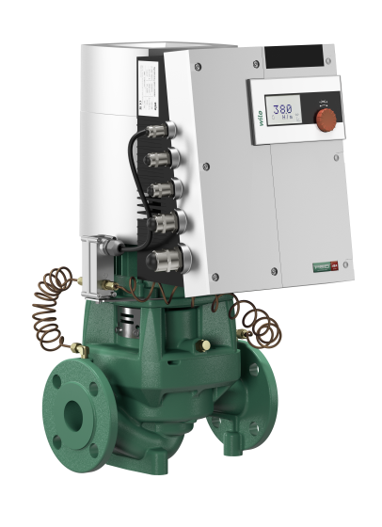

Slide 11
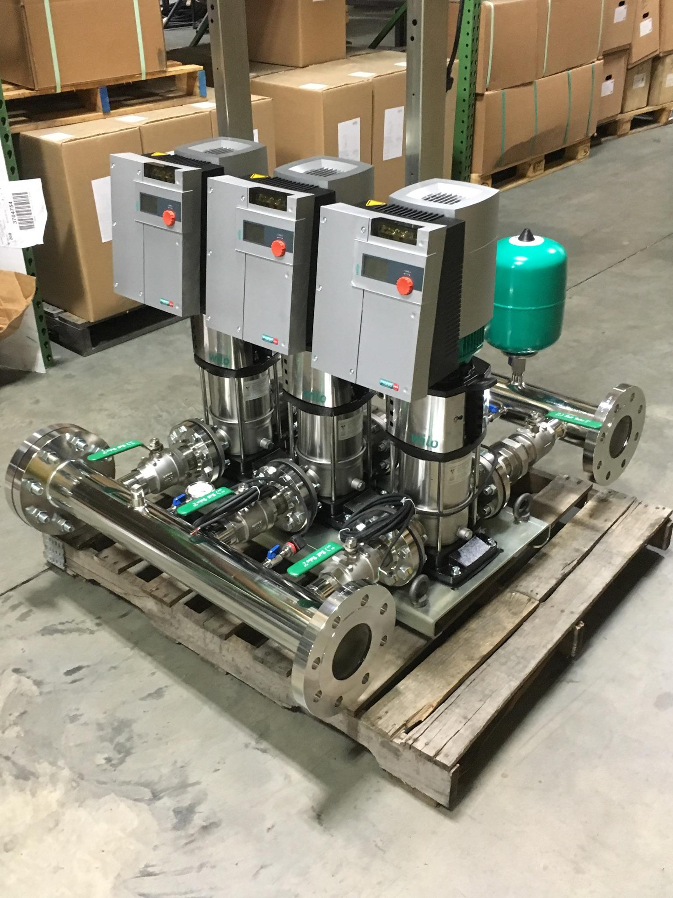

Slide 12
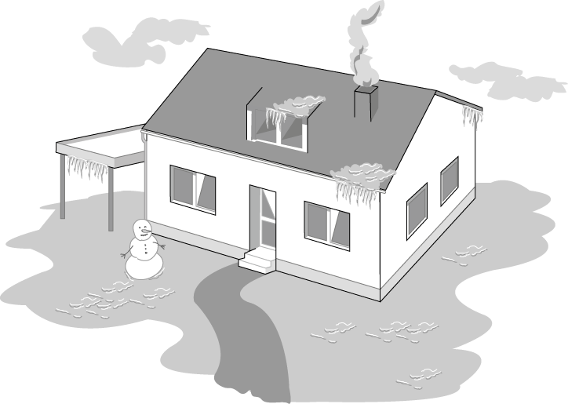

(coldest design day)
For the coldest day of the year ~2 % of the total operating period
Notes:
Load-controlled pumps - Why?
Standard pumps must be selected to meet maximum design load conditions which only occurs during 2-5 % of the total operating time. The normal operating status of the pump thus remains to meet partial and low load requirements. Non controlled pumps are incapable to adjust to such load variations and operate at their relatively high pump performance with the consequence of the thus related excess power consumption.
Consquence:
Excess power consumption
Generation of flow noise
(continued next page)

Slide 13

Transition period
But how is the system working during the remaining 98 % of the operating period?
Notes:
Load controlled pumps meet the requirements for increasing or at least constant pumping head. Two kinds of load controlled pumps are at present available .
Energy saving pumps had been conceived to keep abreast of the steadily further developing mechanical building services technology (thermostatic radiator valves, etc.) and to meet the growing sensibility towards energy conservation. There are three main reasons for the development and application of control systems for heating circulating pumps.
• Adapting flow rate/heat flow to the actual load
• Reducing power consumption and operating costs
• Avoiding noise generation in the system
High-efficiency pumps are the latest generation of pumps which, on top of the the benefits of energy-saving pumps, achieve enormous power savings in line with excellent efficiency. The revolutionary ECM-technology does furthermore provide more compact housings/motors, quieter operation and extended life expectancies.

Slide 14
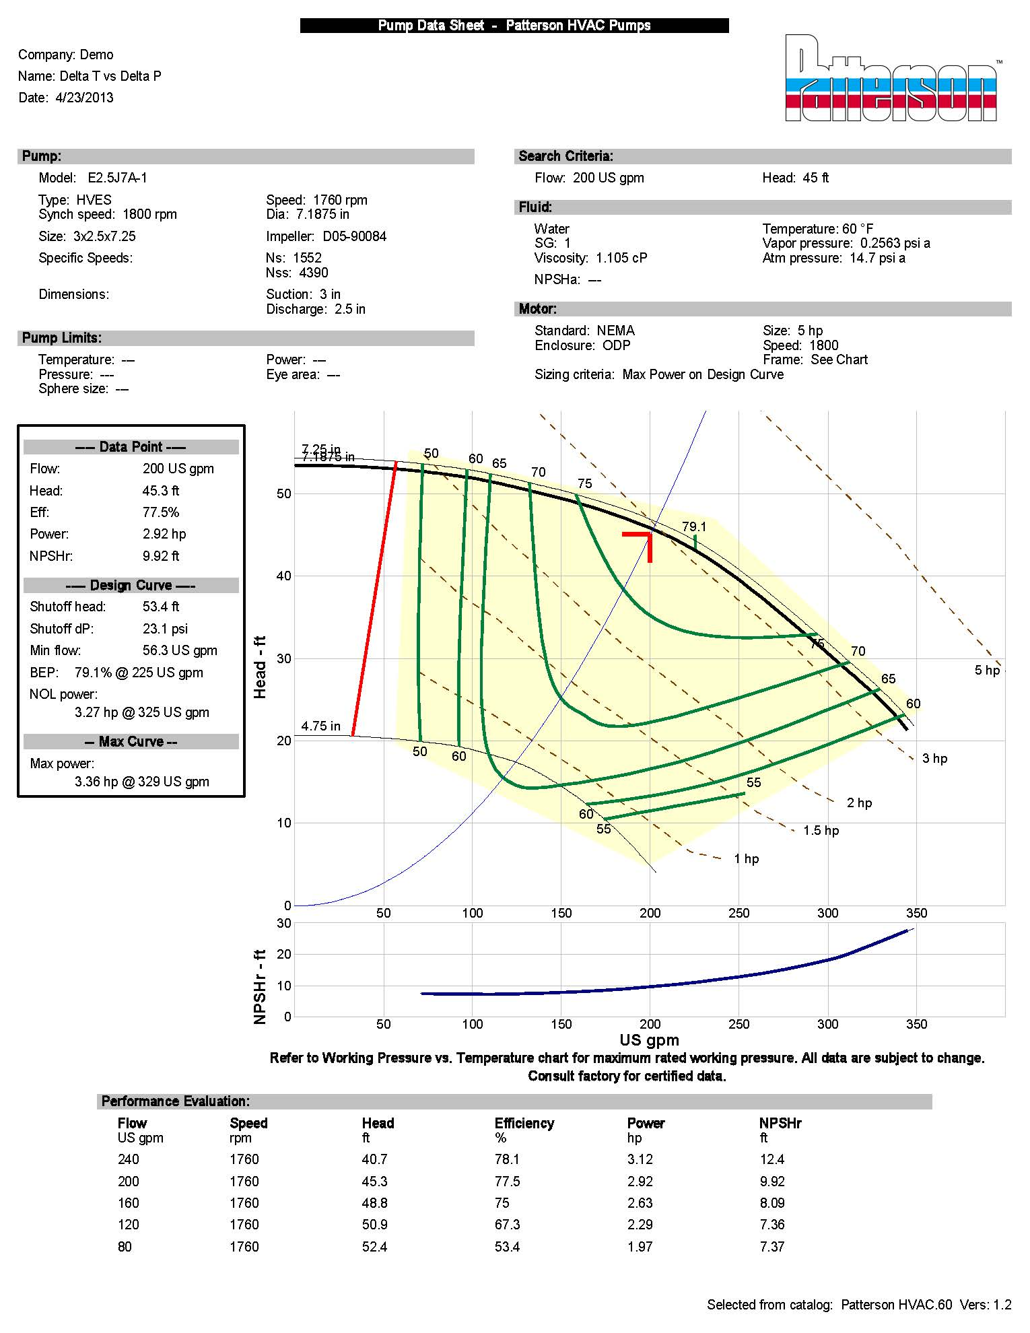

200 gpm = 2,000,000 Btu/Hr
500 x 20
300 gpm = 2,000,000 Btu/Hr
500 x 15
400 gpm = 2,000,000 Btu/Hr
500 x 10
Checking the system Delta T can suggest the system Load
Checking the Boiler Delta T vs gas consumption gives the real efficiency.
System Curve vs the Pump curve.

Slide 15
ΔT review
Heating fluid standard is 20 degree ΔT
  Today with Energy Conservation this will vary.
  Heating systems 20 – 40 is standard, and engineers tend to use boiler efficiency standards where higher ΔT relates to higher efficiency.
  Higher ΔT relates to lower flows and lower pumping cost and lower distribution cost.
  Cooling fluid standard is 10 degree ΔT
    You have to watch for humidification issues.

Slide 16
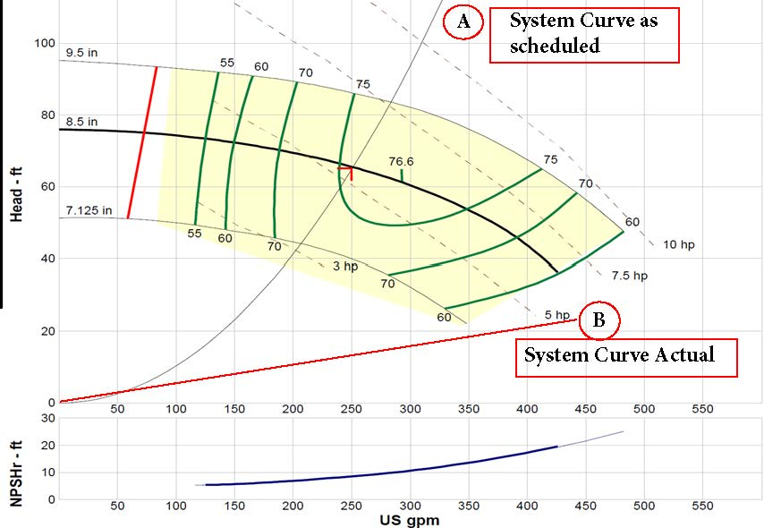
Note that if you reduce the flow by half you reduce the head by a factor of 4>>>
If you’re over pumping at 24’ when you reduce the flow you’re head drops from that point
You can’t get an AC pump and Drive to operate in that area but an ECM-DC CAN.

Slide 17
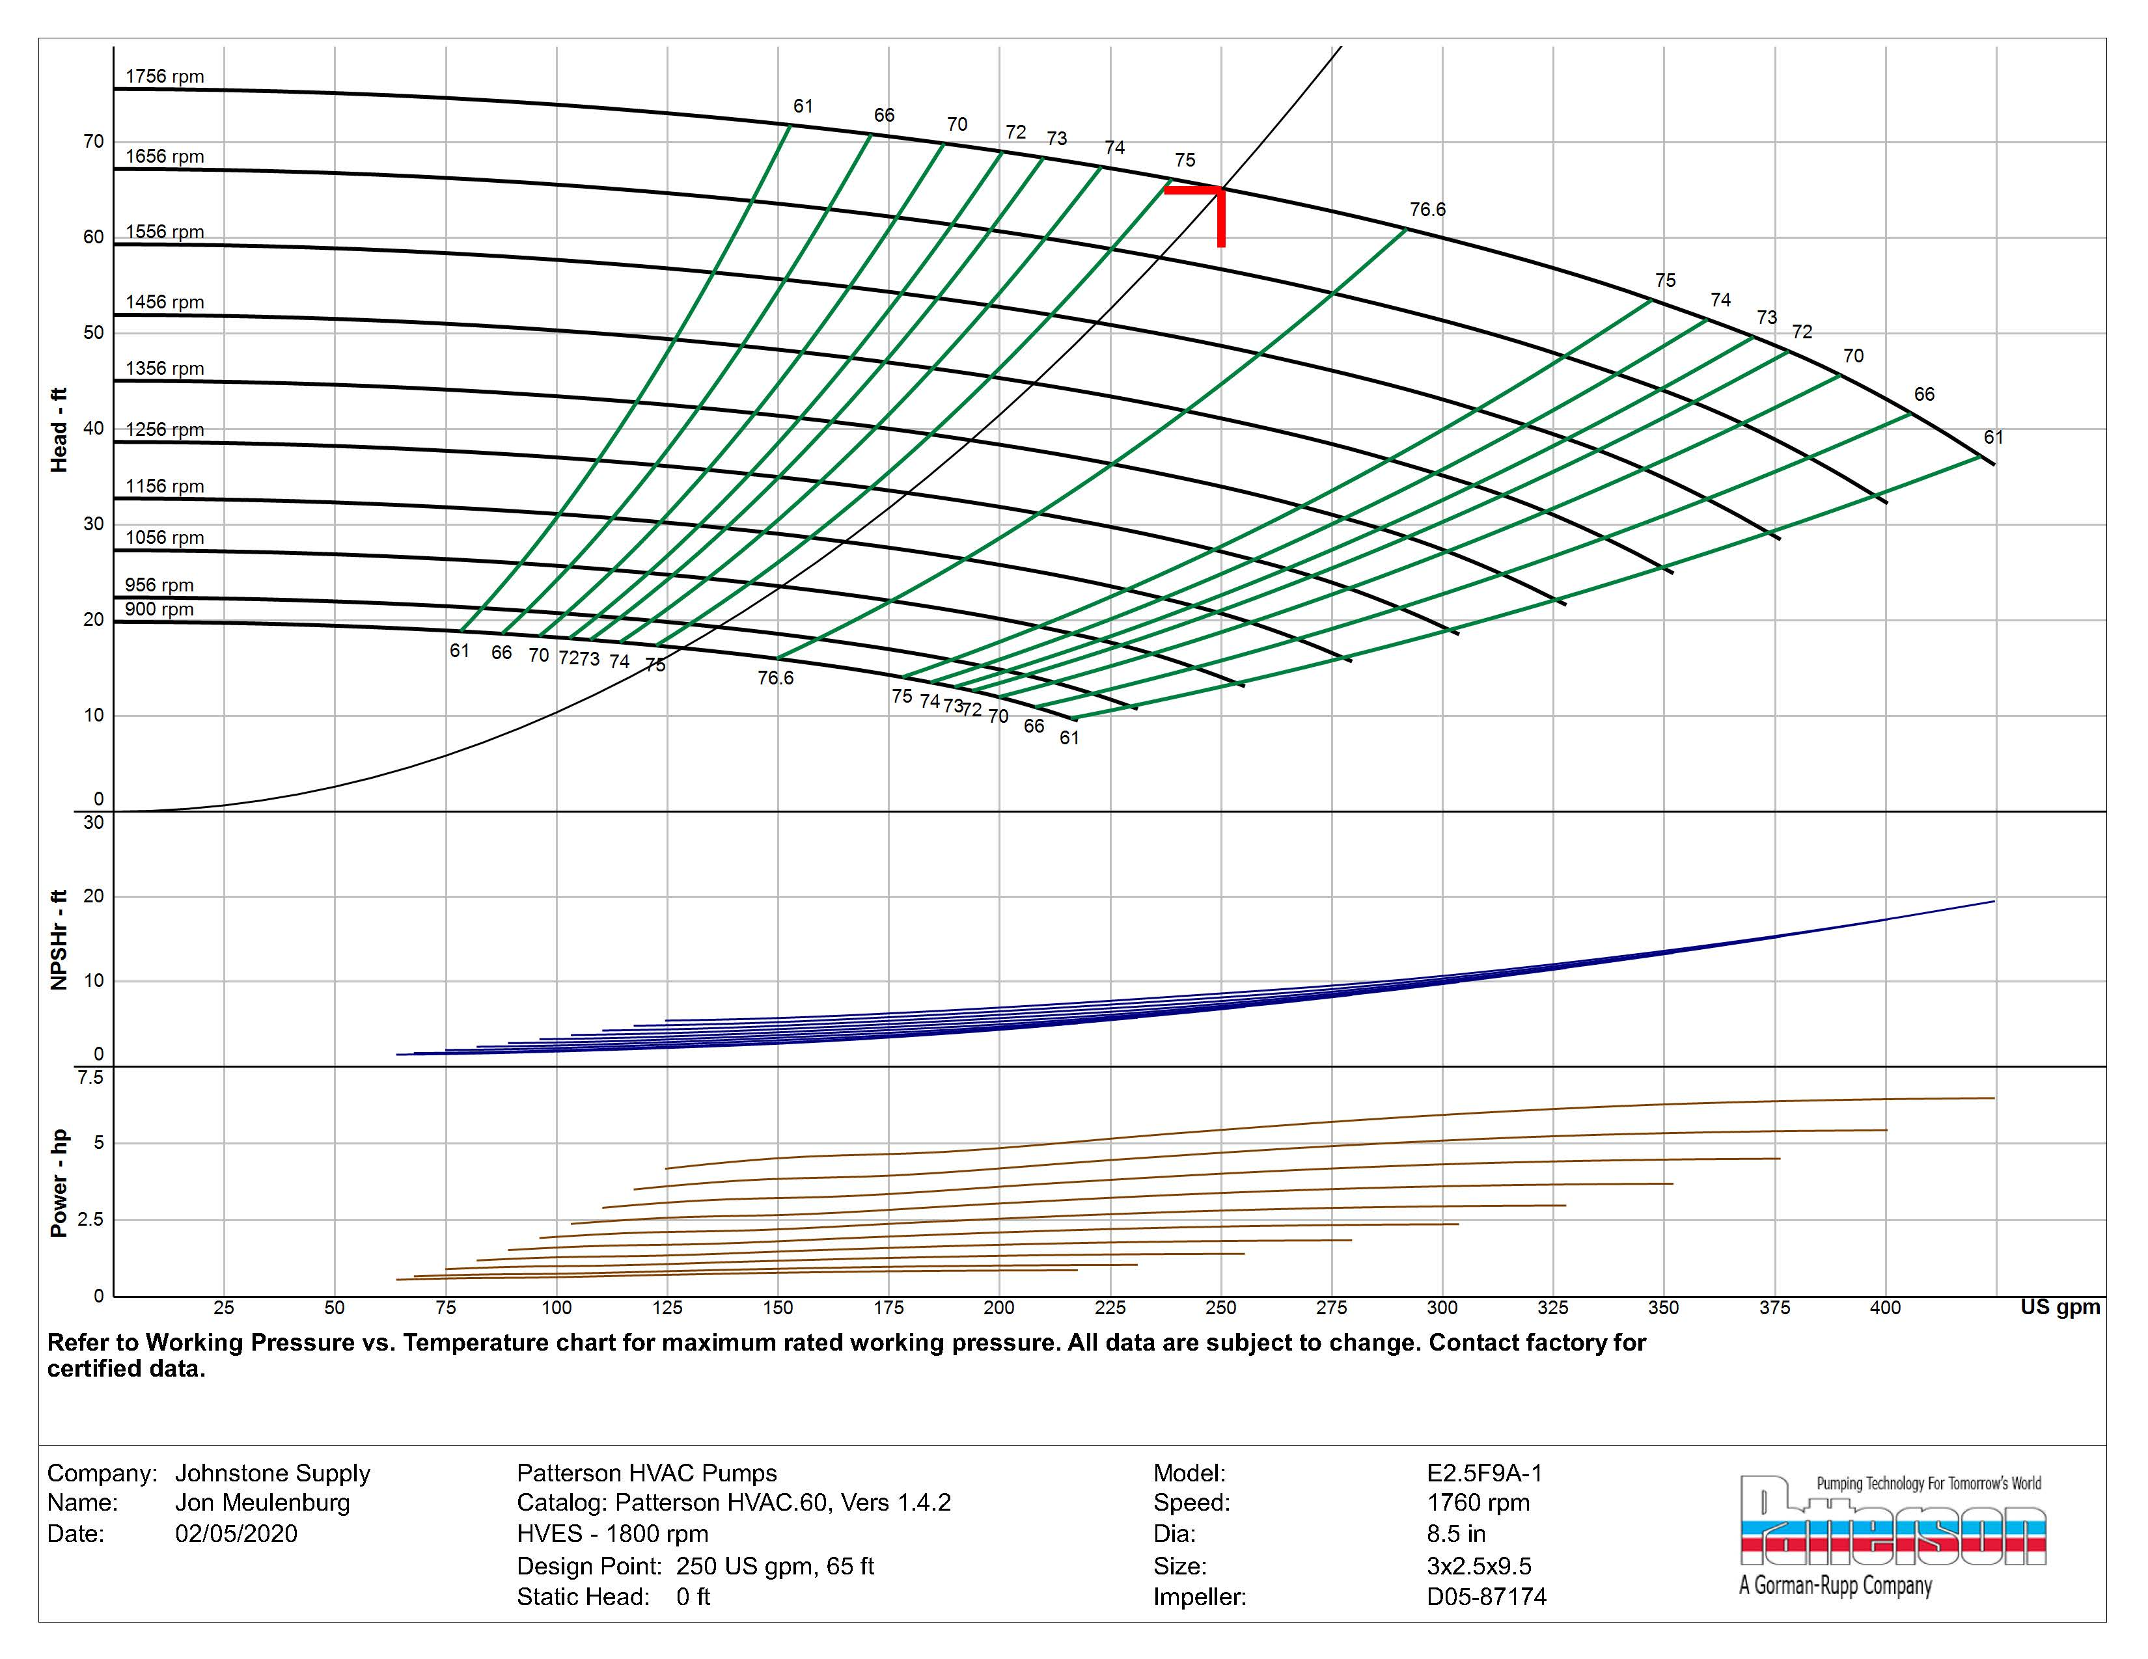

Slide 18
If your actual system curve is right of design and off the
right side of the pump operational curve as determined
at 60hz and pressure readings. Confirm with Delta T.
How can a VFD bring it back to the designed and scheduled
system curve?
It can’t and only ECM has the ability to track the actual
SYSTEM CURVE.
Scheduled System Curve
  Artifical pressure drop needed to get back on the curve.
Actual System Curve
  Note the low head required and still off the curve.

Slide 19
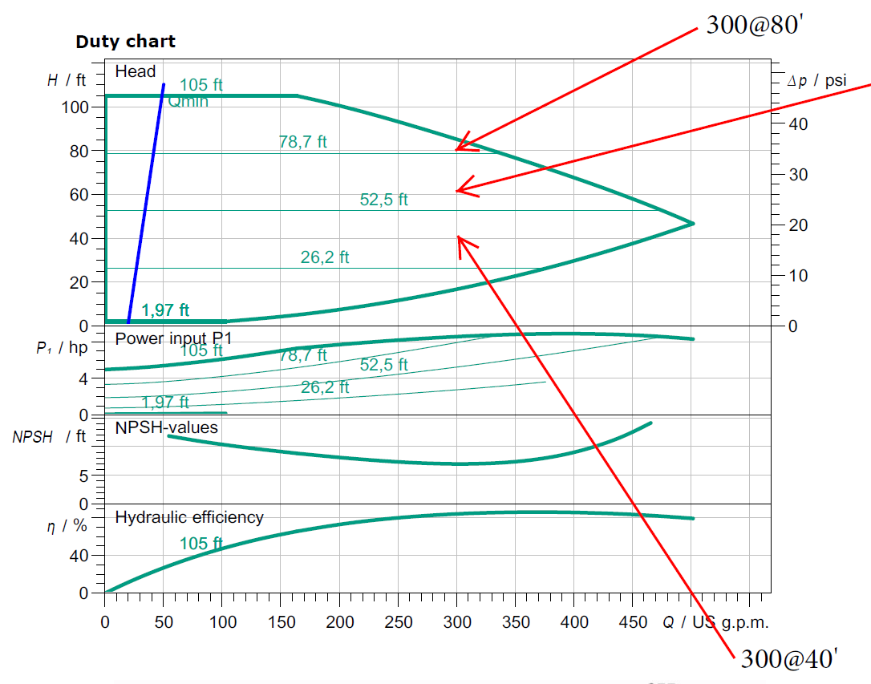

Slide 20
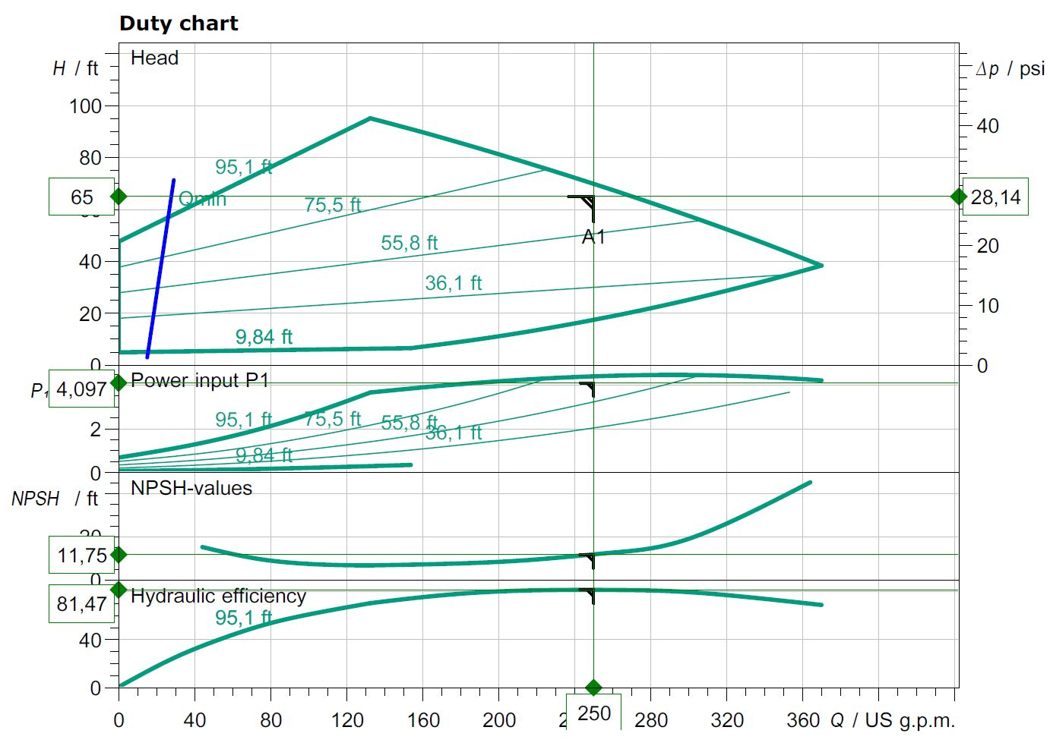
With ECM even if you want the safety of higher head pressure
for scheduling you can operate on a curve that can operate
within the System needs.

Slide 21
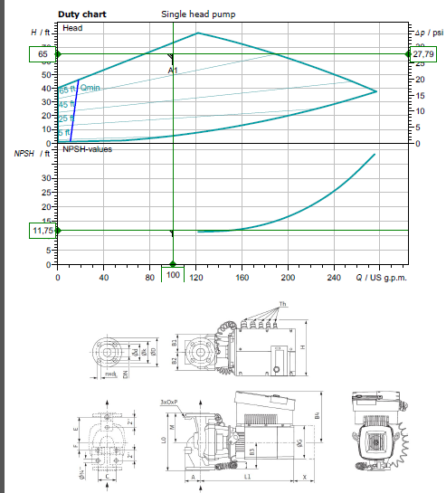

Slide 22
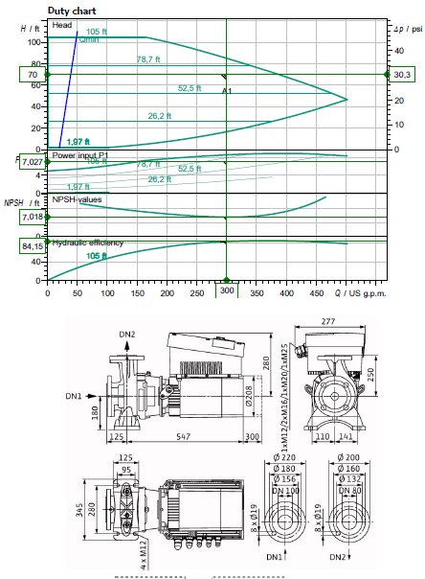

Slide 23
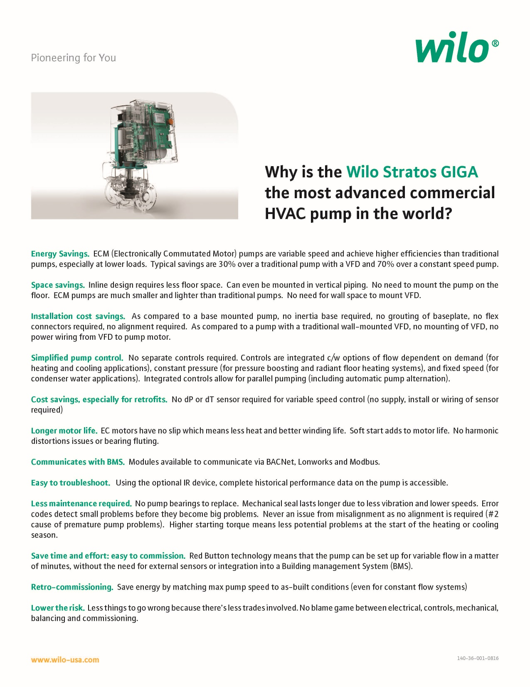

Slide 24
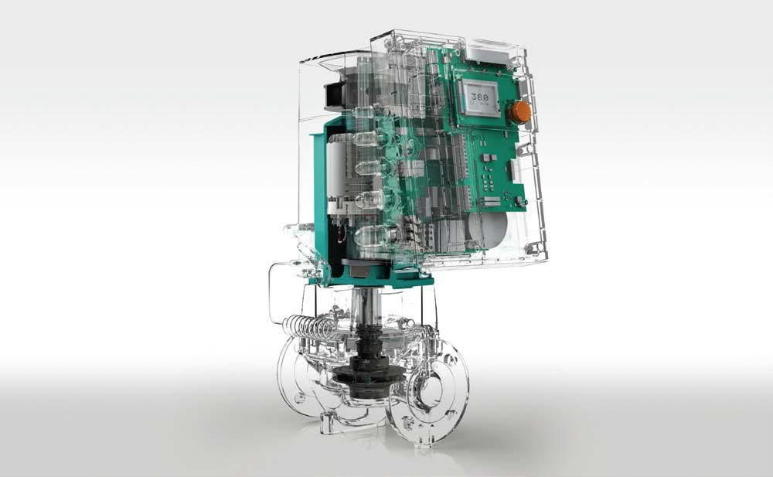
EASY Replacement selection for GIGA from Base Mounted End Suction.
Note:
Using B&G as the Reference but all will have similar capacities.
Looking at the industries most common selections from 1,000,000 – 5,000,000 BTU/HR The most common End Suction pumps have a 7” impeller or 9.5” impeller.
You can tell by the TAG or how big the opening the impeller will have to slide through.
The B&G will show the 7” as an (A) with the 9.5” as an (B). Most will be trimmed to a smaller diameter, determined by the Motor HP and RPM.
The second digit on the B&G (B,C,D, now E) will indicate the generation. (1510-2.5BB) The discharge flange size will let you know the pump size. With the suction 1 size larger. Piping revisions will be common and your local distributor can make simple suggestions.
Should the HP be less than MAX per pump you may be able to select the next smaller pump. The GIGA pumps will all be 460v/3 phase so transformers may be required.
GIGA 2 3-85 | 1510-1.5A | 1510-2A
GIGA 2.5 3-110 | 1510-1.5B | 1510-2A
GIGA 4 3-100 | 1510-2B | 1510-3A
GIGA 4 3-105 | 1510-2B | 1510-4A
GIGA B 80 1-32 | 1510-3B/10hp | 1510-4B/15hp
If you notice from the curves you can usually use the next size larger pump going ECM and still operating with a SYSTEM curve. (ie: GIGA 4 3-105 will cover 1510-2B, 3A, 4A and a lot of 3B). Let us help till you get used to how the curves work and see how oversized the existing selections really are.
This is the simple selection process we have options to cover most any application you can find. All AC motors with VFD’s still operate with pump curves not the system curves as shown prior.
Some installers can install a new ECM-DC GIGA pump cheaper than repairing or replacing an existing.
Now you have a SYSTEM Sensing variable flow pump improving SYSTEM efficiency vs a repair that may last a couple years.
Remember apples to apples flow you save 50% electrically going from AC to DC. We can cover 90% of the systems out there with 2 Giga’s.
100 – 200gpm Pick the head is the standard GIGA inline 2.5 3/87
200 – 300gpm Pick the head is the Standard GIGA B end suction 80 B 1/32 Giga B we add the pressure sensor.
Replace all the 1510-3AB to the 1510-3BB 90% of the school jobs.

Slide 25
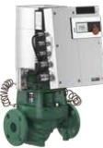
Wile-Stratos GIGA
High-Efficiency n-Line Circulators
Model Des ignation, Stratos GIGA 1.5/3-165 1.5 flange Size (in)
3 Min. Suction Pressure
165 Max. He.ad
Wilo-Stratos GIGA
Model | Volute | Flange | Power | Voltage | Skid | Approx. | Article
 |  | Type | (HP) | :15% (v) | Qty | \'.'eight (lbs) | Number
Stratos GIGA 1.5/3-80 | C,,st Iron | lYz" ANSI Oass 125 | 2.3 | 3-460V | 6 | 95 | 2124484
Stratos GIGA 1.5/3-105 | C,,st Iron | lYz" ANSI Oass 125 | 3.1 | 3-460V | 6 | 95 | 2124483
Stratos GIGA 1.5/3-125 | C,,st Iron | lYz" ANSI Oass 125 | 4.4 | 3-460V | 6 | 95 | 2124482
Stratos GIGA 1.5/3-145 | C,,st Iron | lYz" ANSI Oass 125 | 5.6 | 3-460V | 6 | 95 | 2124481
Stratos GIGA 1.5/3-165 | C,,st Iron | lYz" ANSI Oass 125 | 6.4 | 3-460V | 6 | 95 | 2124480
Stratos GIGA 2/3 -45 | C,,st Iron | 2"ANSI Class 125 | 1.2 | 3-460V | 6 | 93 | 2124488
Stratos GIGA 2/3 -65 | C,,st Iron | 2"ANSI Class 125 | 2 | 3-460V | 6 | 93 | 2124487
Stratos GIGA 2/3 -85 | C,,st Iron | 2"ANSI Class 125 | 2.7 | 3-460V | 6 | 93 | 2124486
Stratos GIGA 2/3 -105 | C,,st Iron | 2"ANSI Class 125 | 4 | 3-460V | 6 | 93 | 2124485
Stratos GIGA 2/3 -120 | C,,st Iron | 2"ANSI Class 125 | 4 | 3-460V | 6 | 97 | 2124491
Stratos GIGA 2/3 -140 | C,,st Iron | 2"ANSI Class 125 | 5 | 3-460V | 6 | 97 | 2124490
Stratos GIGA 2/3 -160 | C,,st Iron | 2"ANSI Class 125 | 6.6 | 3-460V | 6 | 97 | 2124489
Stratos GIGA 2.S/3-26 | C,,st Iron | 2Yz. ANSI Oass 125 | 0.8 | 3-460V | 6 | 106 | 2124494
Stratos GIGA 2.S/3-39 | C,,st Iron | 2Yz. ANSI Oass 125 | 1.7 | 3-460V | 6 | 106 | 2124493
Stratos GIGA 2.S/3-55 | C,,st Iron | 2Yz. ANSI Oass 125 | 2.6 | 3-460V | 6 | 106 | 2124492
Stratos GIGA 2.S/3-70 | C,,st Iron | 2Yz. ANSI Oass 125 | 3.4 | 3-460V | 6 | 108 | 2124496
Stratos GIGA 2.S/3-87 | C,,st Iron | 2Yz. ANSI Oass 125 | 4.6 | 3-460V | 6 | 108 | 2124495
Stratos GIGA 2.S/3-110 | C,,st Iron | 2Yz. ANSI Oass 125 | 4.7 | 3-460V | 6 | 108 | 2124499
Stratos GIGA 2 .5/3-125 | C,,st Iron | 2Yz. ANSI Oass 125 | 5.9 | 3-460V | 6 | 108 | 2124498
Stratos GIGA 2.S/3-135 | C,,st Iron | 2Yz. ANSI Oass 125 | 7.1 | 3-460V | 6 | 126 | 2124497
Stratos GIGA 3/3 -50 | C,,st Iron | 3 ANSI Class 125 | 3.5 | 3-460V | 6 | 123 | 2124501
Stratos GIGA 3/3 -70 | C,,st Iron | 3 ANSI Class 125 | 5.4 | 3-460V | 6 | 123 | 2124500
Stratos GIGA 3/3 -105 | C,,st Iron | 3 ANSI Class 125 | 6 | 3-460V | 6 | 148 | 2124503
Stratos GIGA 3/3 -120 | C,,st Iron | 3 ANSI Class 125 | 7.8 | 3-460V | 6 | 159 | 2124502
Stratos GIGA 4/3 -50 | C,,st Iron | 4" ANSI Class 125 | 3.5 | 3-460V | 6 | 172 | 2124505
Stratos GIGA 4/3 -55 | C,,st Iron | 4" ANSI Class 125 | 5.6 | 3-460V | 6 | 172 | 2124504
Stratos GIGA 4/3 -100 | C,,st Iron | 4" ANSI Class 125 | 7.1 | 3-460V | 6 | 174 | 2124507
Stratos GIGA 4/3 -105 | C,,st Iron | 4" ANSI Class 125 | 9.1 | 3-460V | 6 | 185 | 2124506

Slide 26
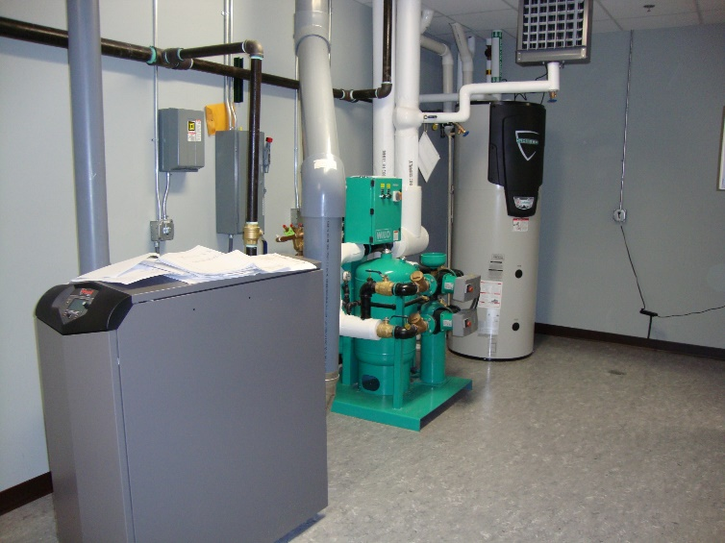
WILO Engineering 101
Click on photo

Slide 27
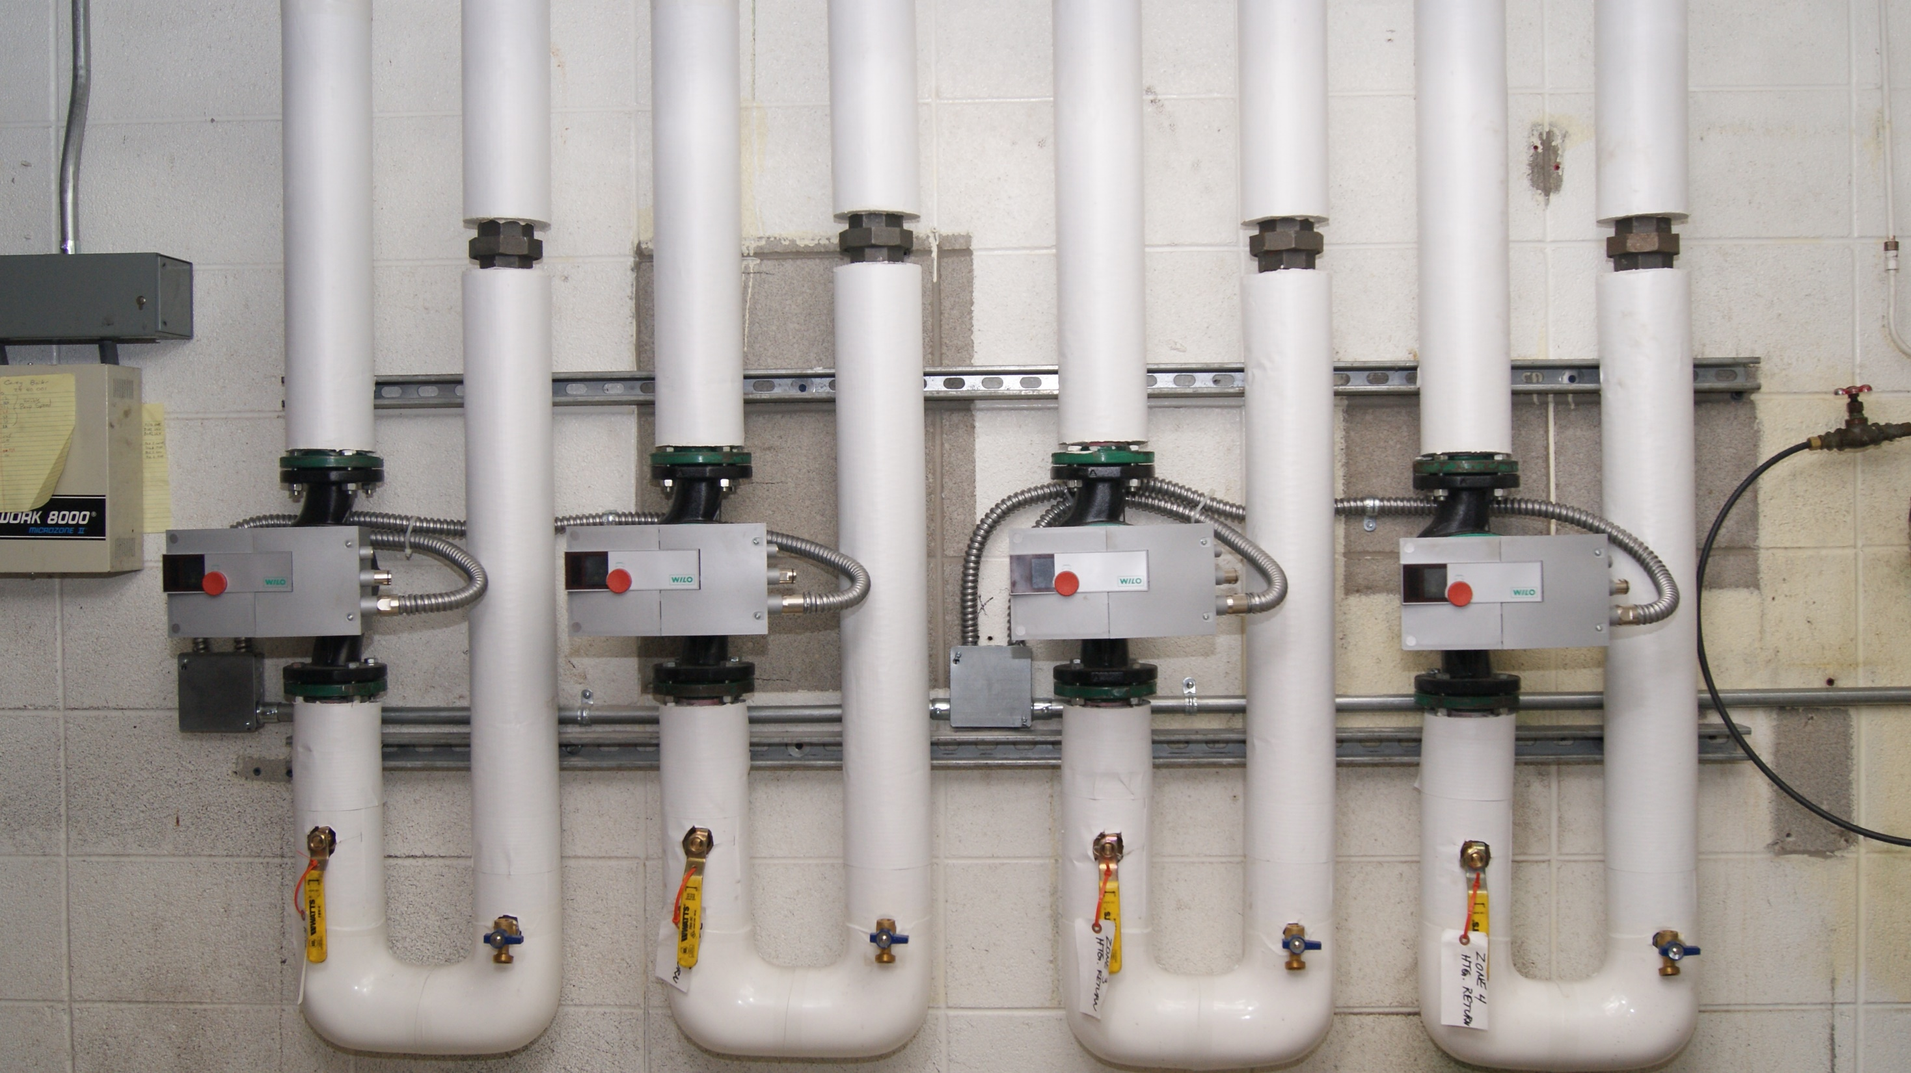
Add a Slide Title - 1

Slide 28
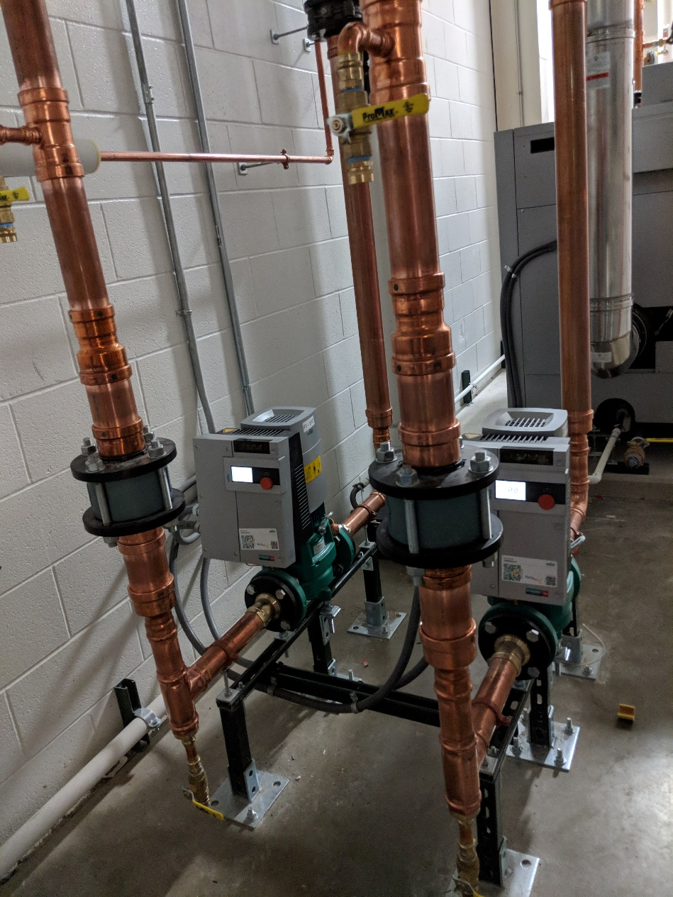
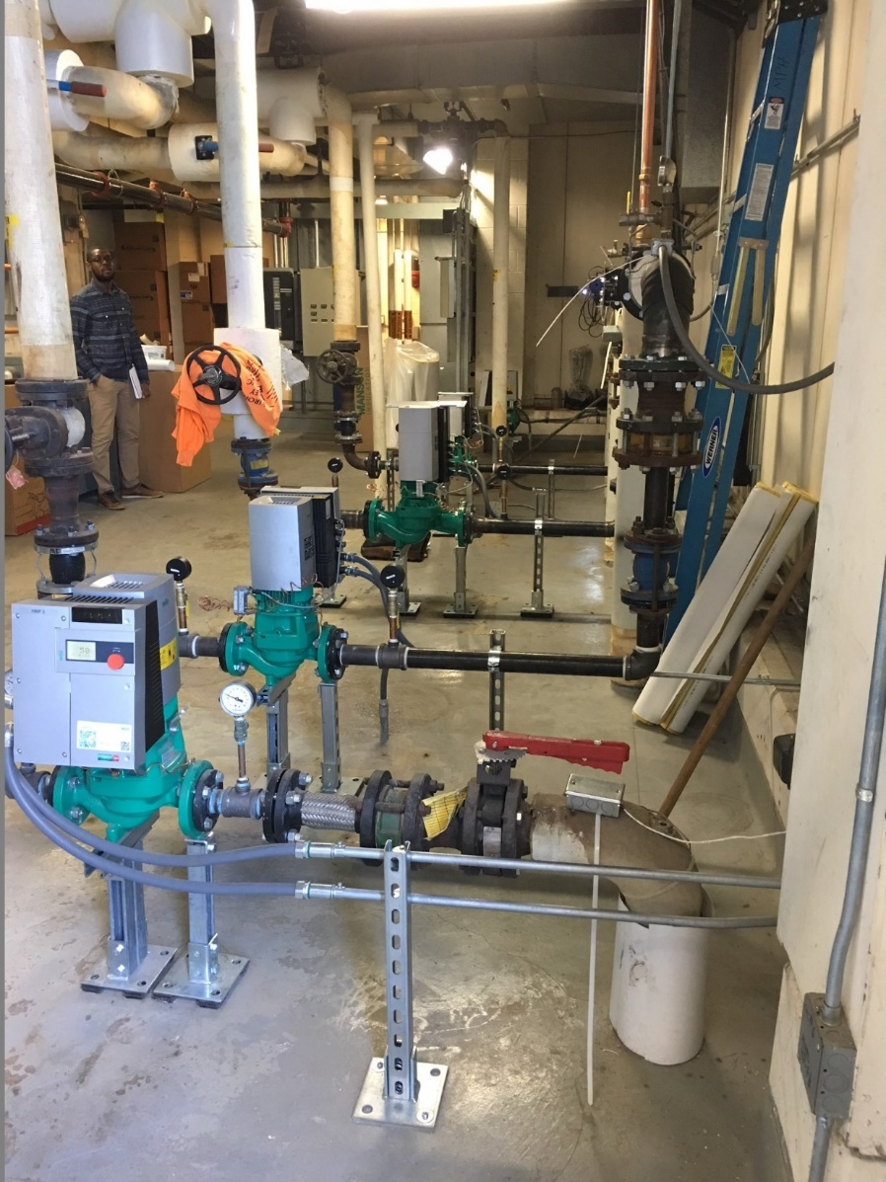
rEFERENCE
LANE AUTOMOTIVE
UniversitY OF MICHIGAN

Slide 29
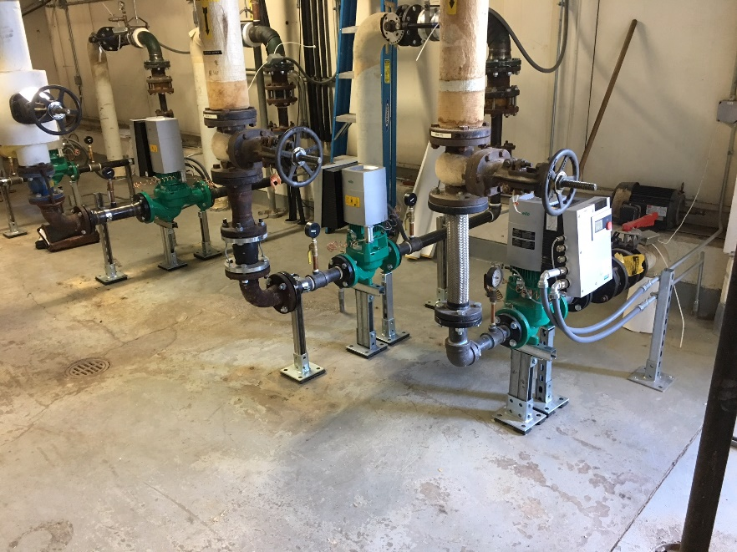
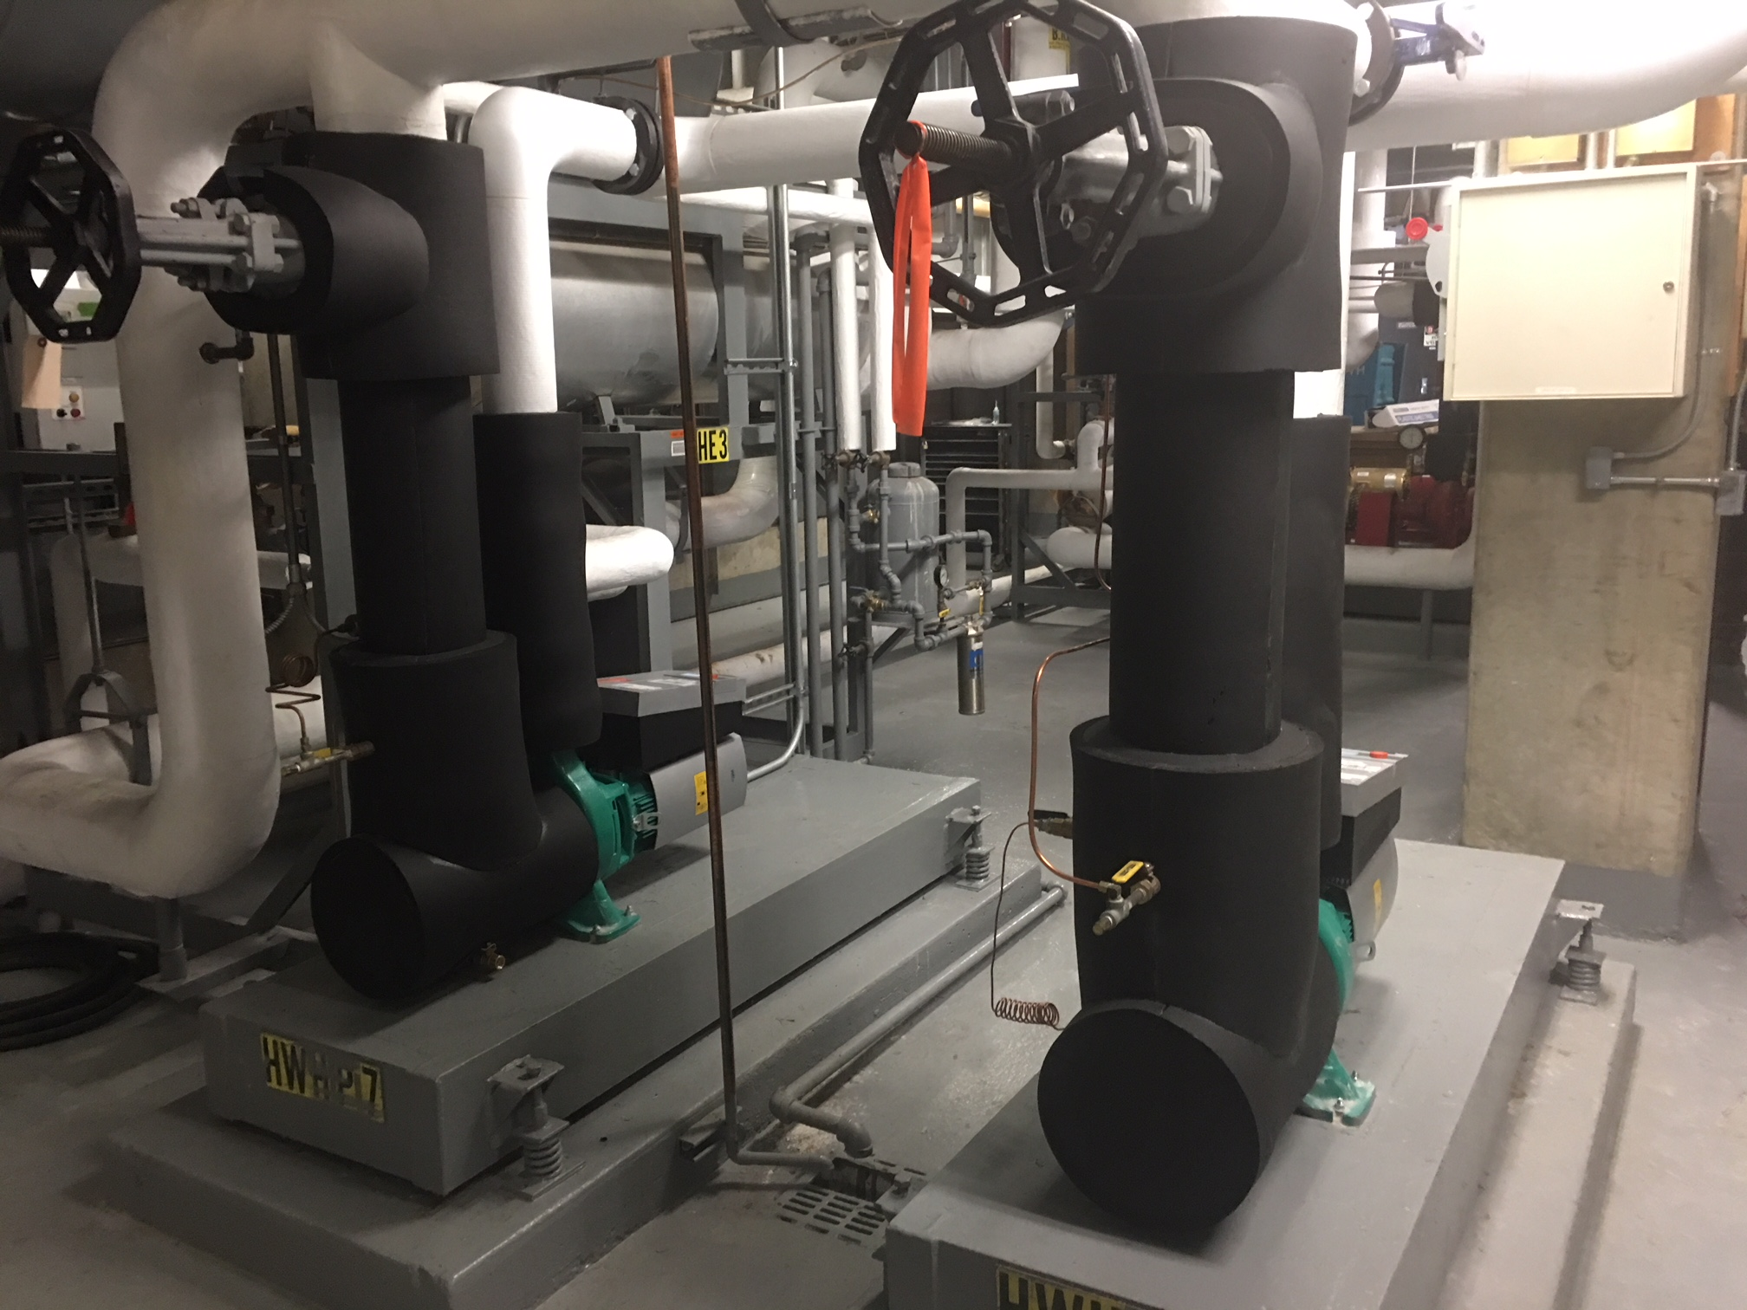
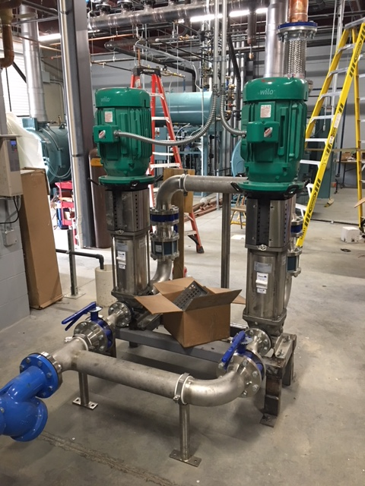

Slide 30
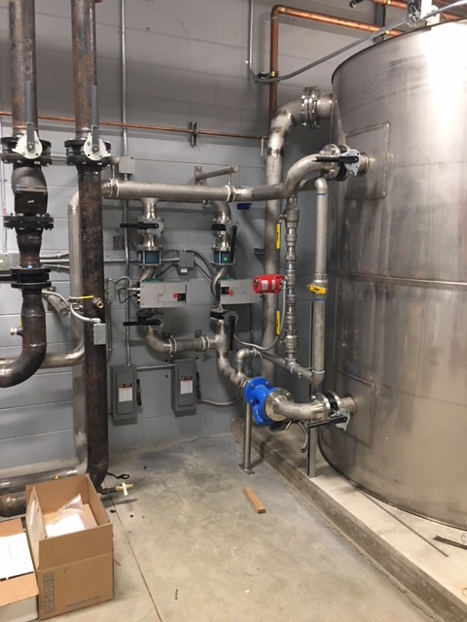
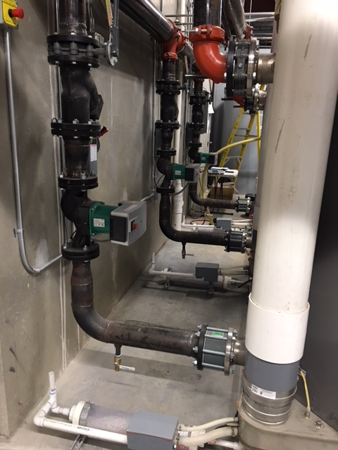

Slide 31
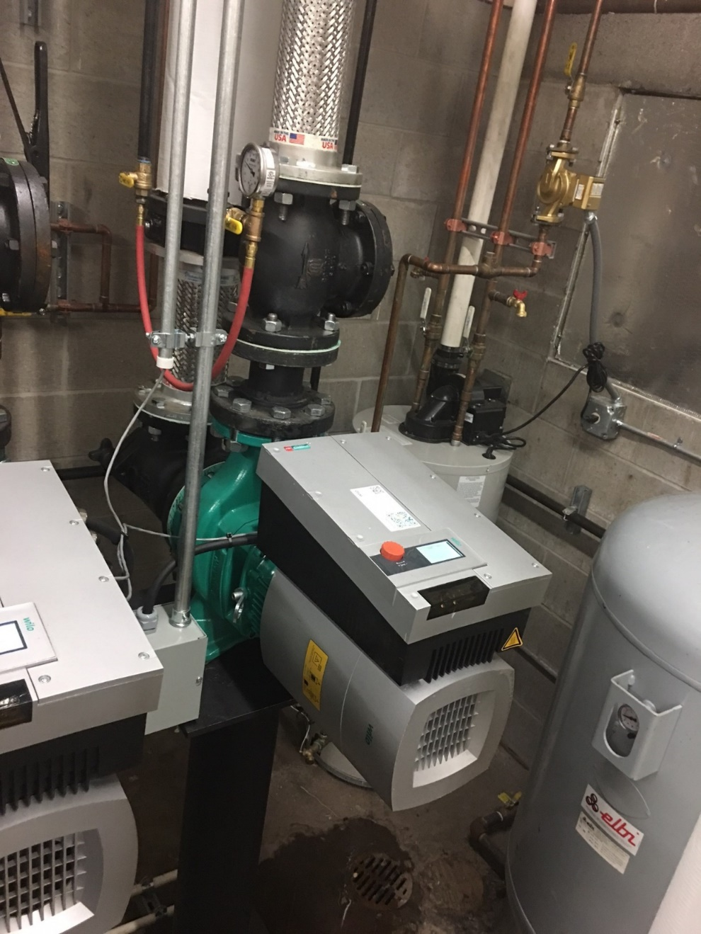
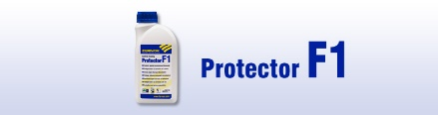
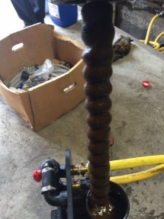

Slide 32
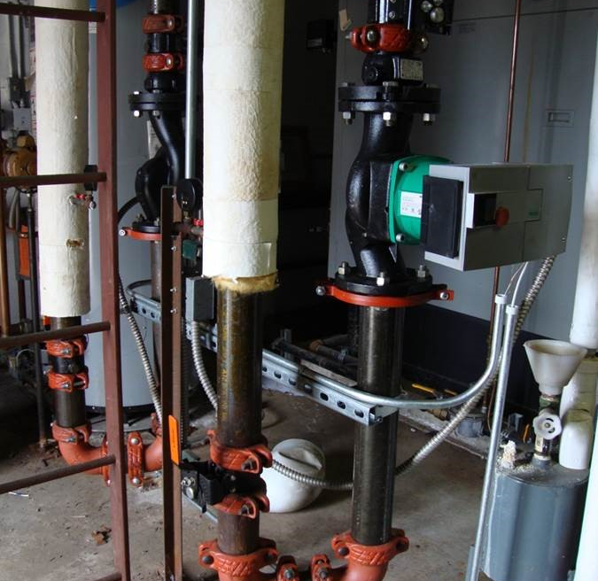
Alma
Base Mounted replaced by inline SIMPLE for anyone.

Slide 33
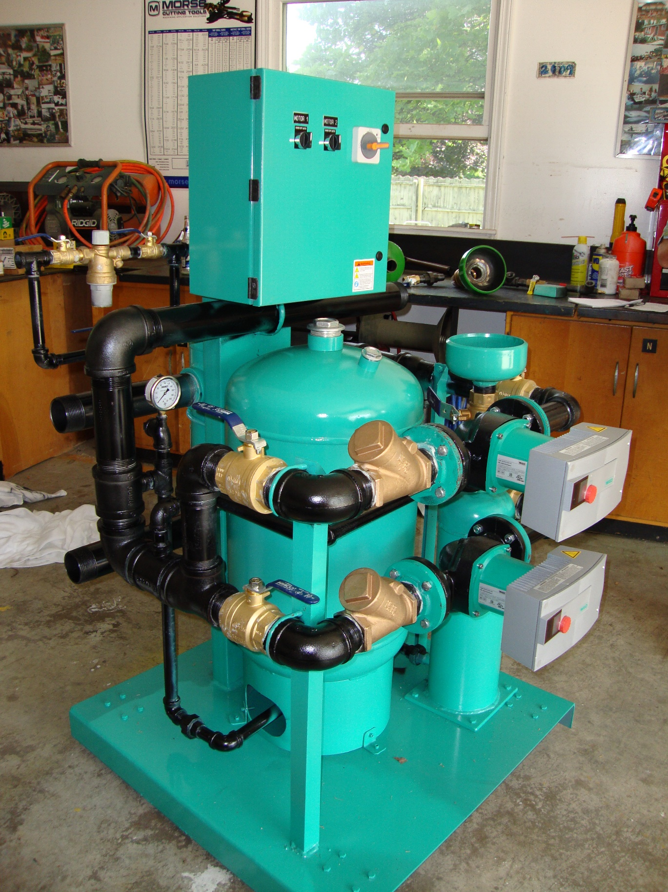

Slide 34
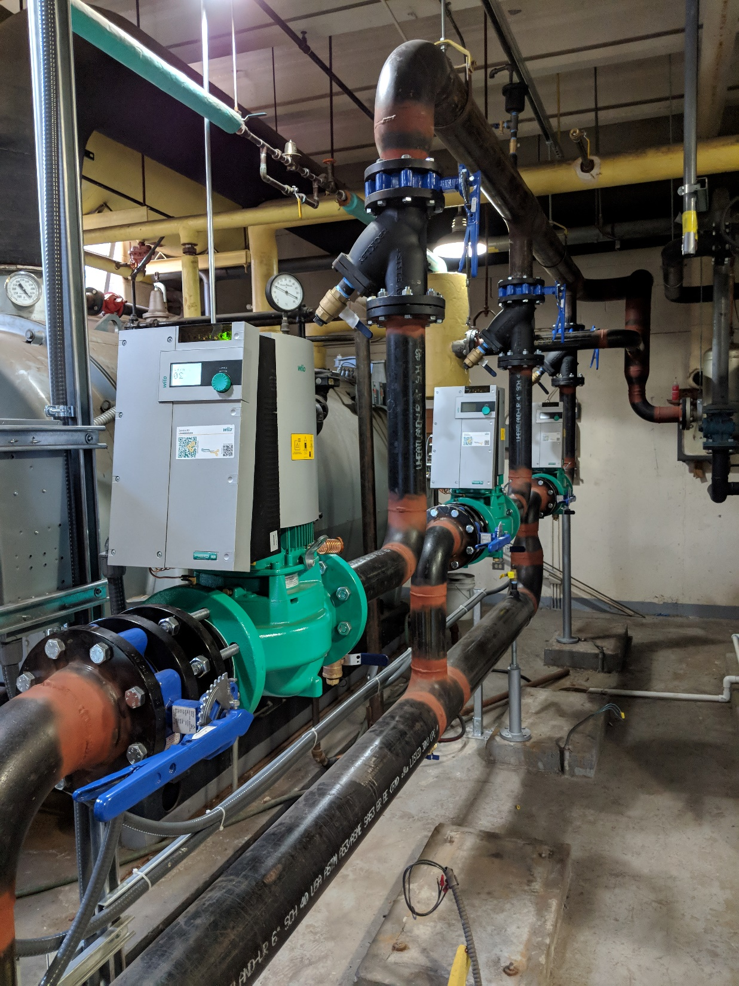
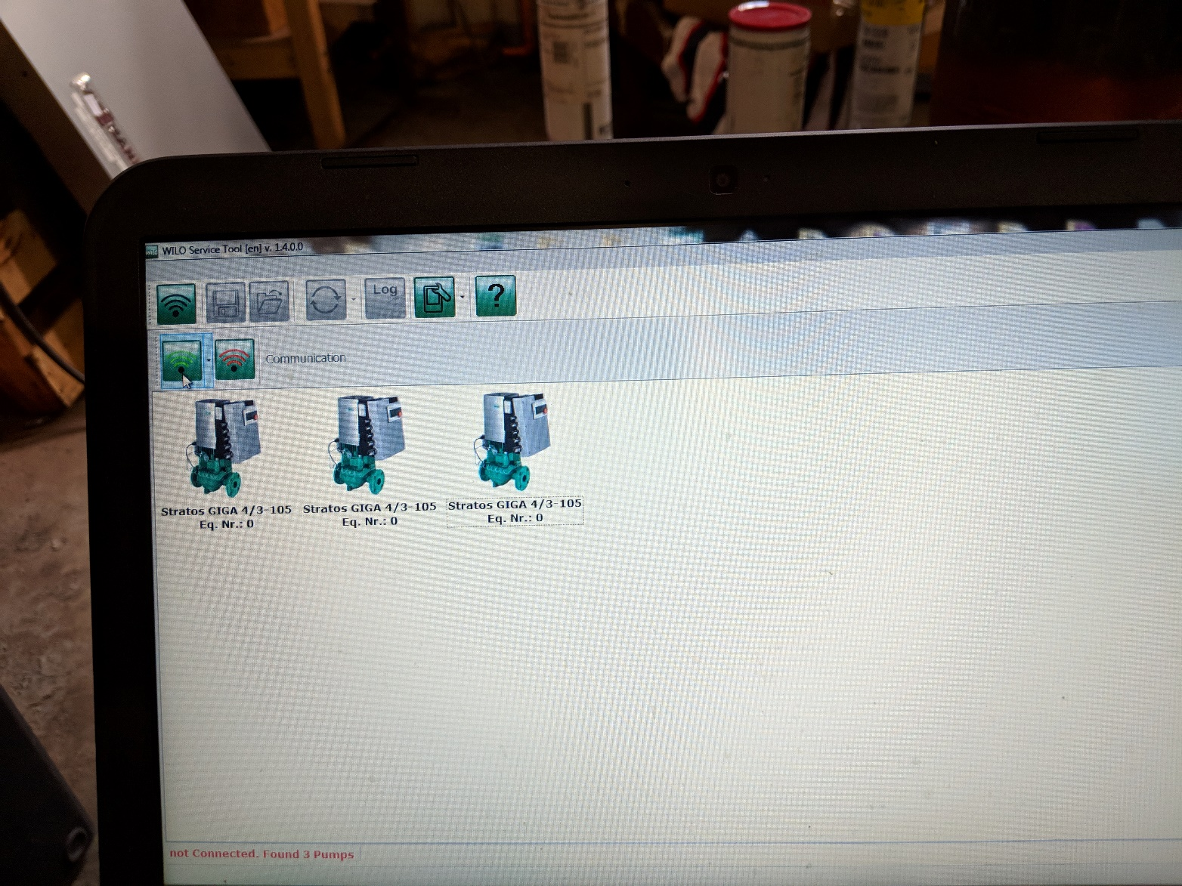
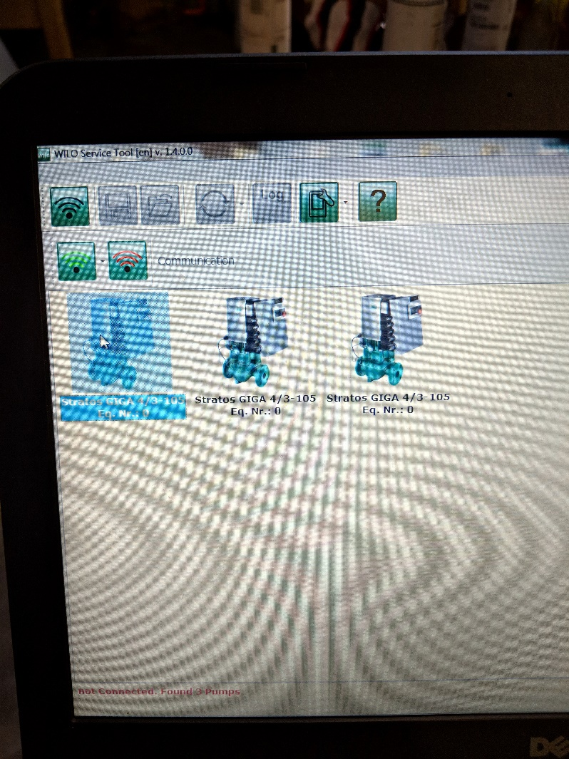

Slide 35
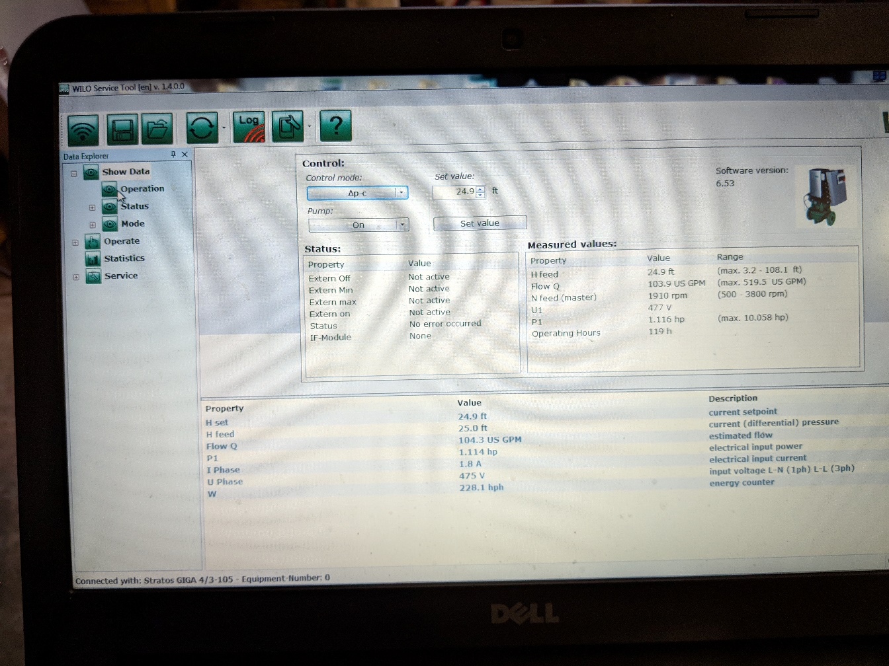
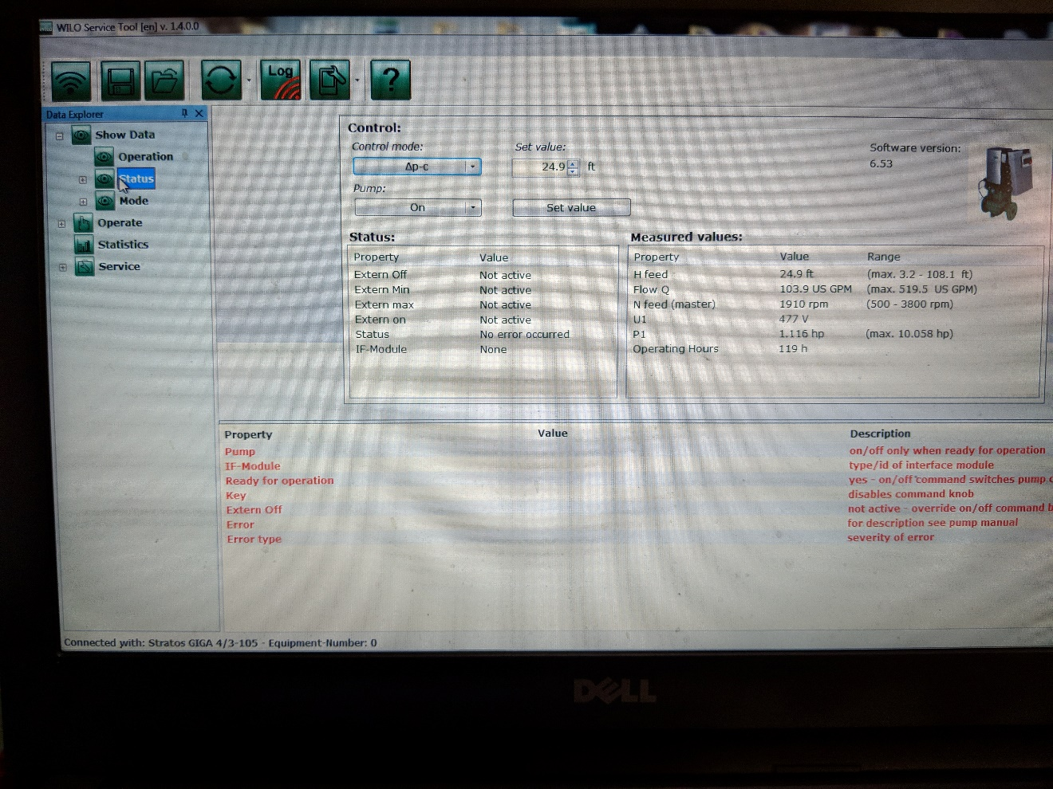
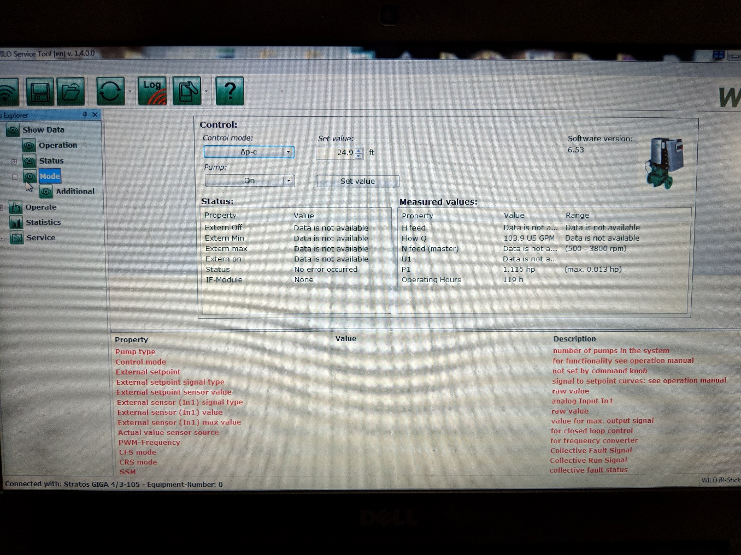

Slide 36
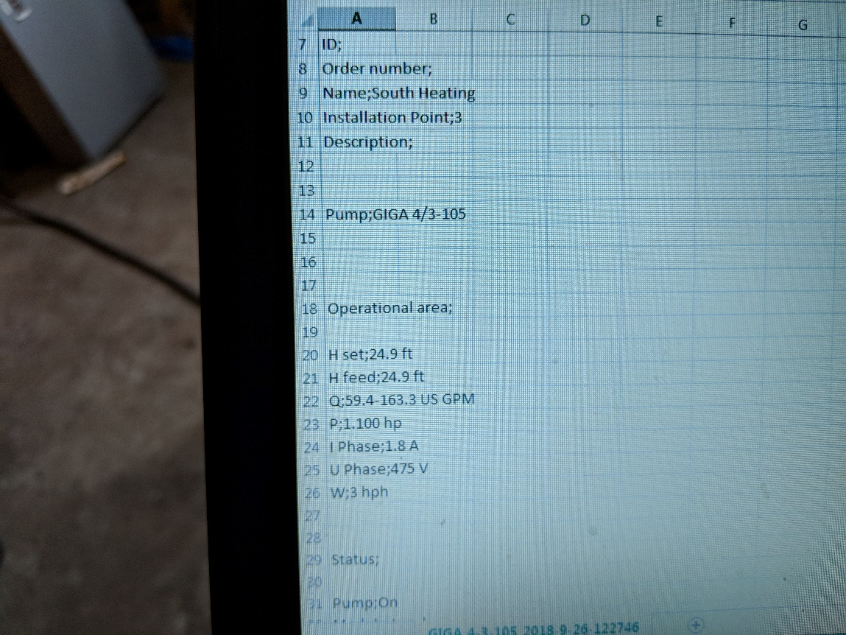
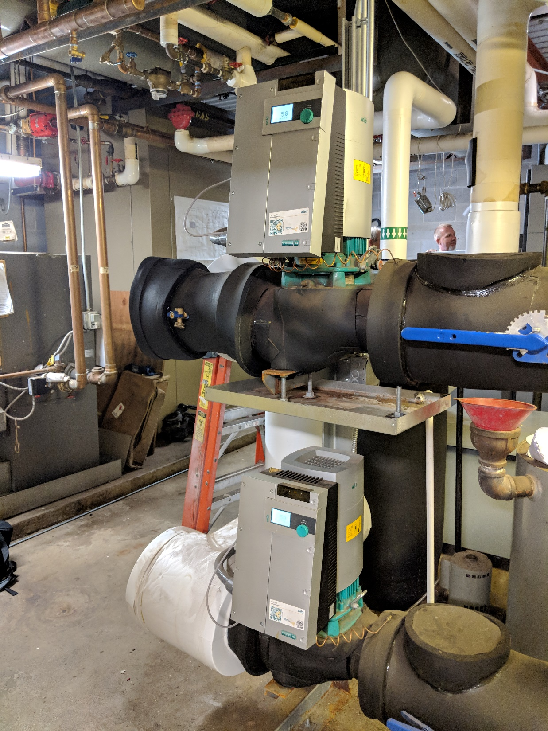

Slide 37
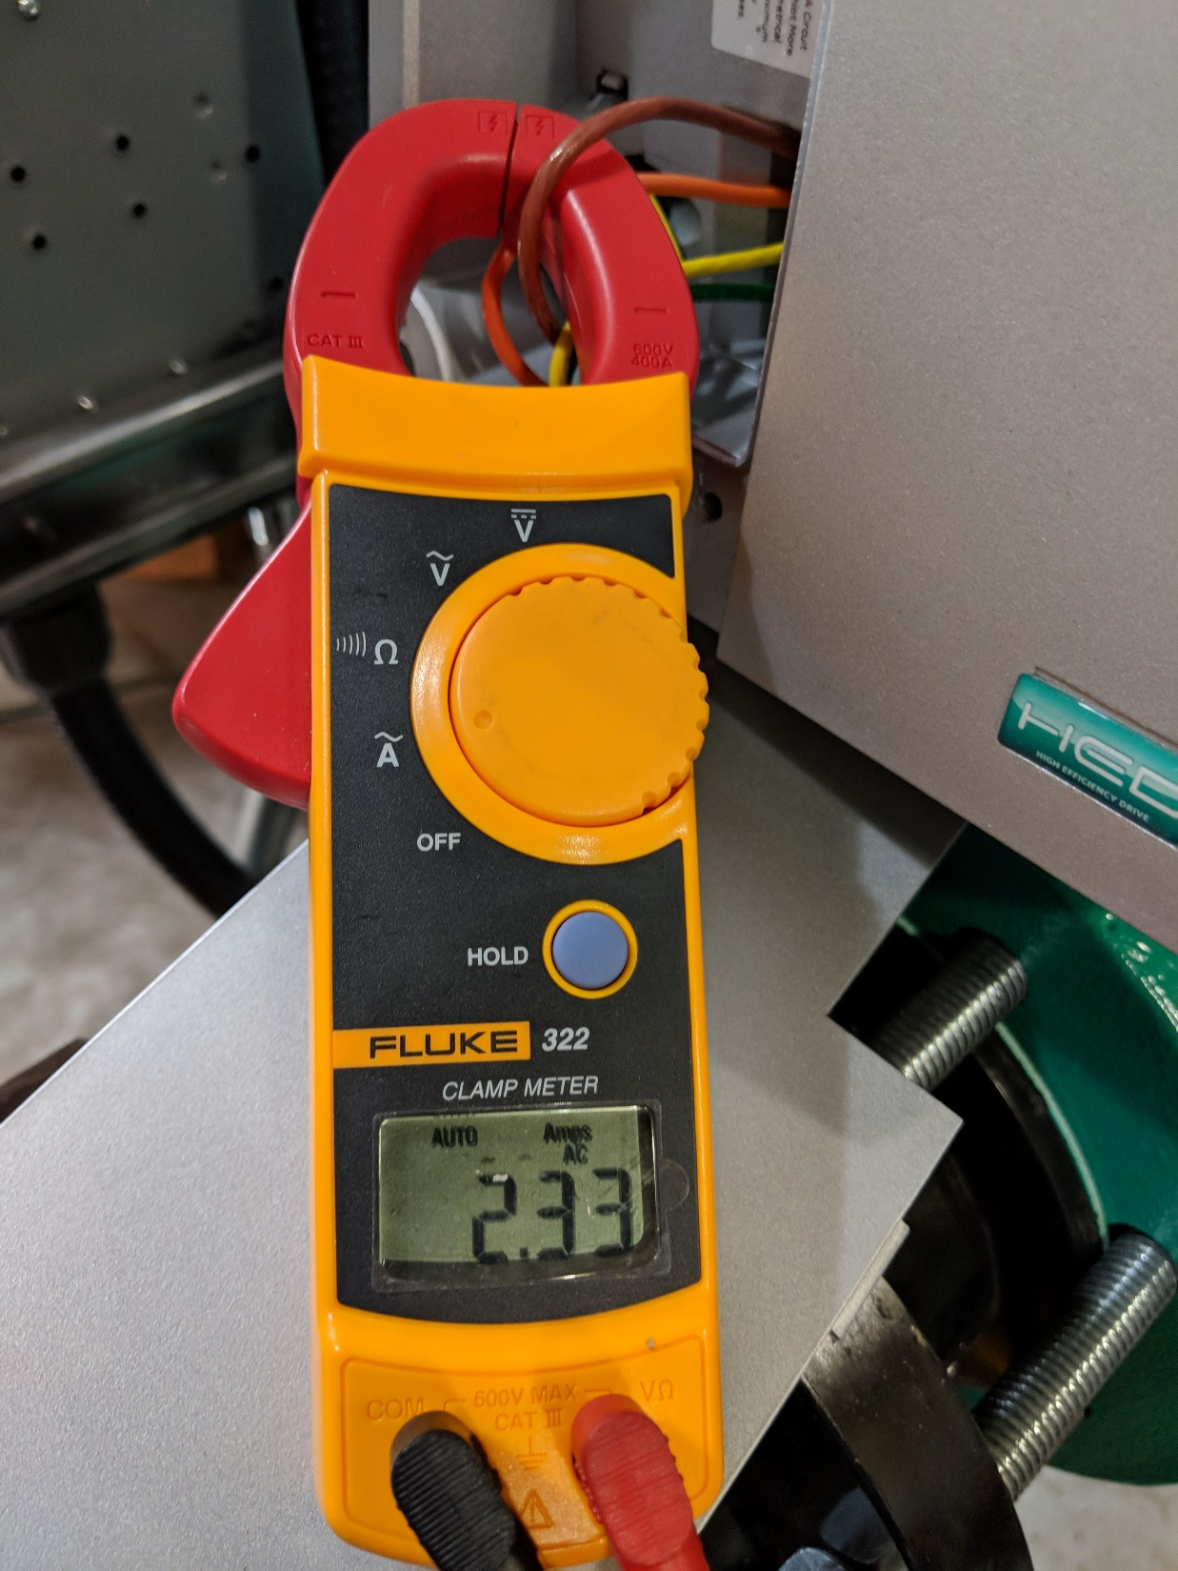
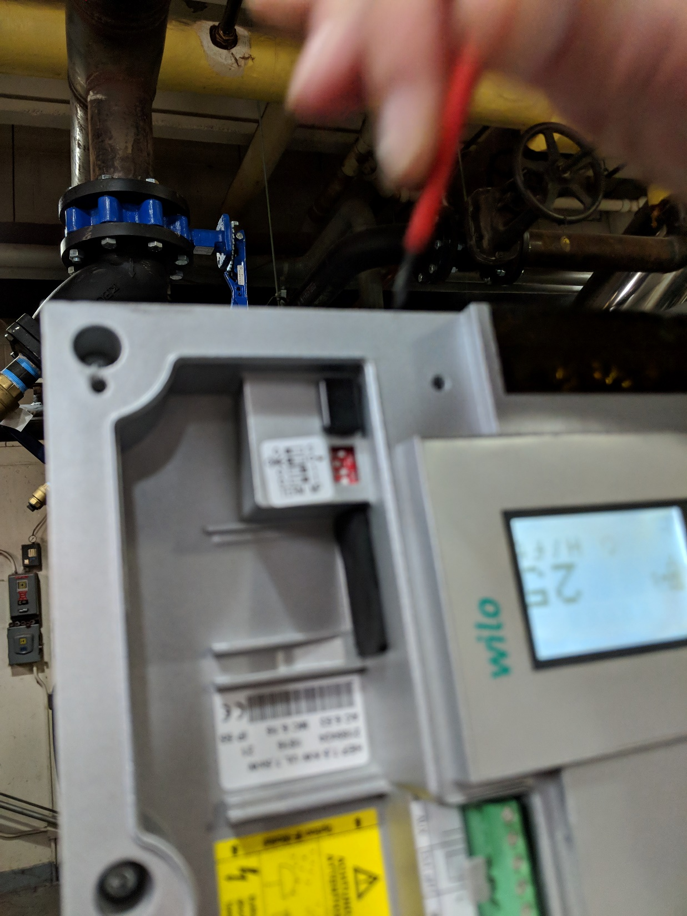

Slide 38


Slide 39


