Slide 1



Why do we always FIX what broke.
We need to FIX what BROKE IT.
Why did it break?
Doing More With Less:
A Systems Approach to your Water, Heat, Steam, and Piping Design

Slide 2
Agenda
Review Examples of College Campus
Why are we so FAR oversized?
2% - 98%
Pipe sizing
Engineering Cut and Paste
Existing Systems at 20-30% Efficient, so they just keep getting bigger
How do we fix it?
VFD or ECM
VFD
30Hz as low as you can go? (50%)
Coupling, Premium Efficient Motor, Agis Rings, AC Motor
ECM
Easy Button
Best Way?
When a component fails fix it or replace it?
Domestic Hot Water Return?
Lowest hanging fruit energy reducer?

Slide 3













Slide 4
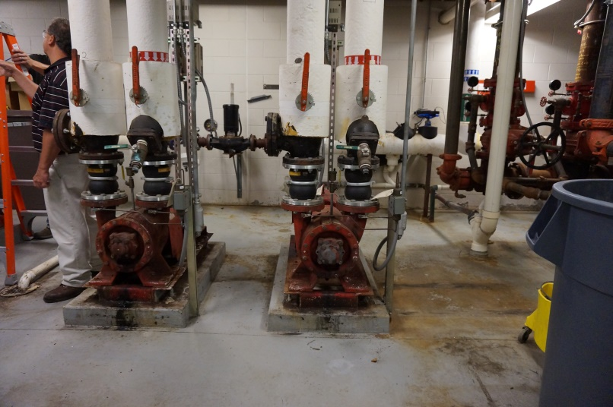
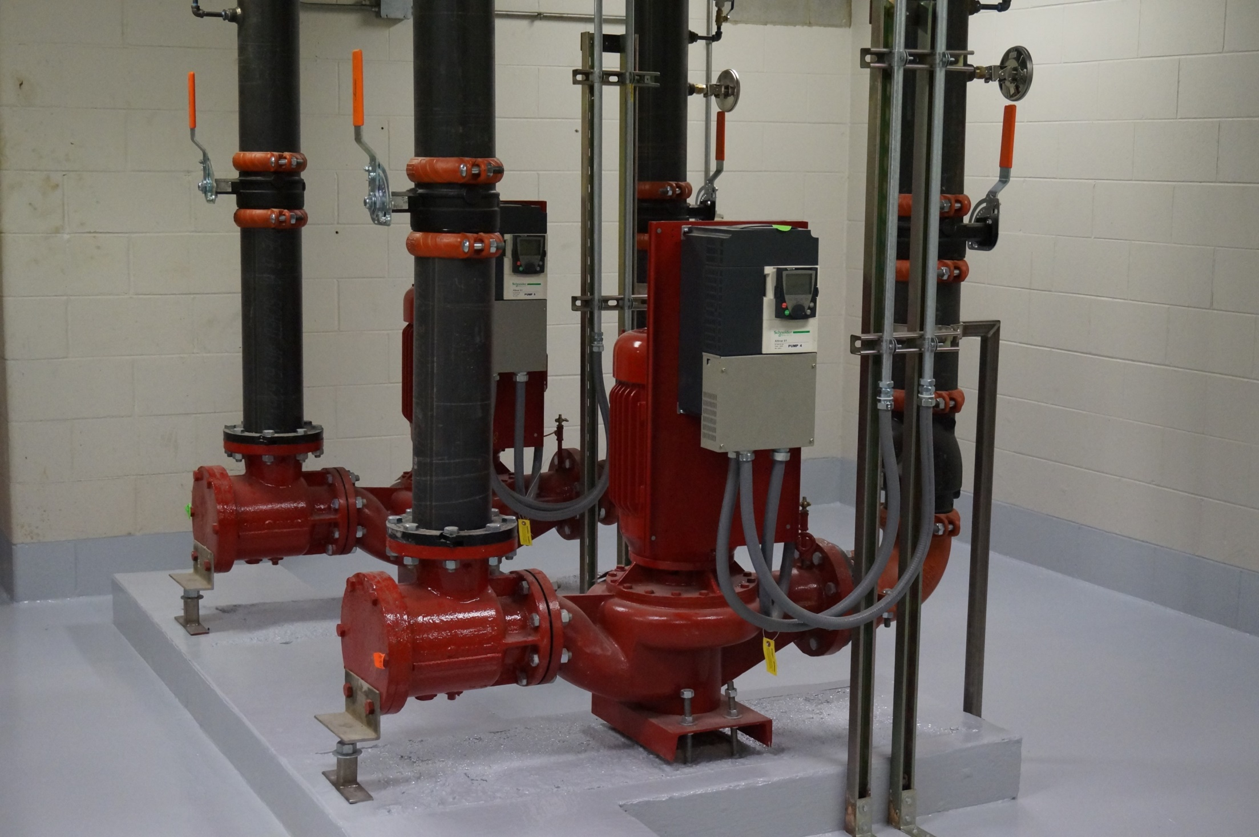

Slide 5
ALMA COLLEGE
BRANDON SMITH
OBVIOUS REASONS STUDENT LIVING CENTERS NEED A HEATING SYSTEM UPGRADE:
WINDOWS OPEN WHEN THE HEAT IS ON
DIFFERENTIAL TEMPERATURE ON THE HEATING SYSTEM IS LESS THAN 10 DEG F
PUMP FAILURES , SEALS AND BEARINGS
ZONE AND SELF OP CONTROL VALVES FAILING AND MAKING NOISE
SOLUTIONS FOR THE LIVING CENTERS:
CONTROL THE HEATING LOOP WITH AN OUTSIDE RESET TO LOWER THE SYSTEM TEMPERATURE BASED ON THE OUTSIDE TEMPERATURE
ON A STEAM SYSTEM JUST ADD AN OUTSIDE RESET CONTROLER
ON A BOILER SYSTEM WITH A 90PLUS EFFICIENCY BOILER WITH OUTSIDE RESET CAPABILITY
VARIABLE SPEED PUMPING WITH A CONSTANT PRESSURE CONTROL SO WE DON’T OVER PRESSUREIZE THE CONTROL VALVES
SET THE SYSTEM UP TO OPERATE WITH A 20 DEG DIFFERENTIAL TEMPERATURE

Slide 6
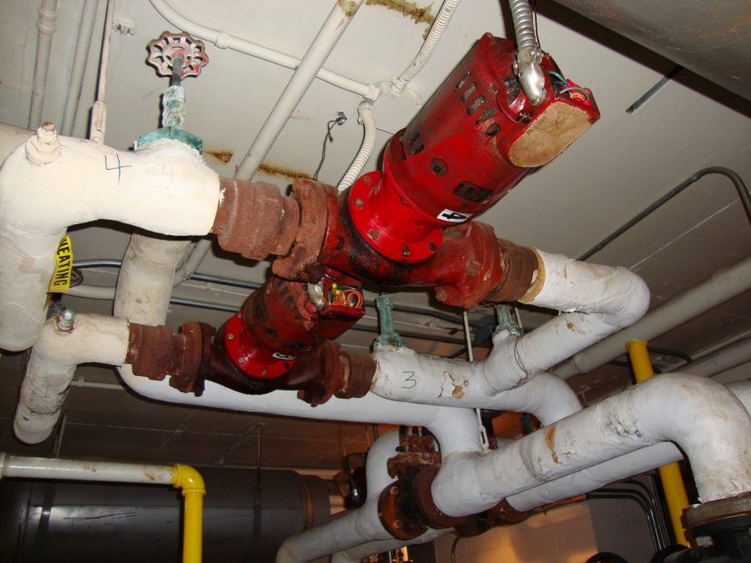
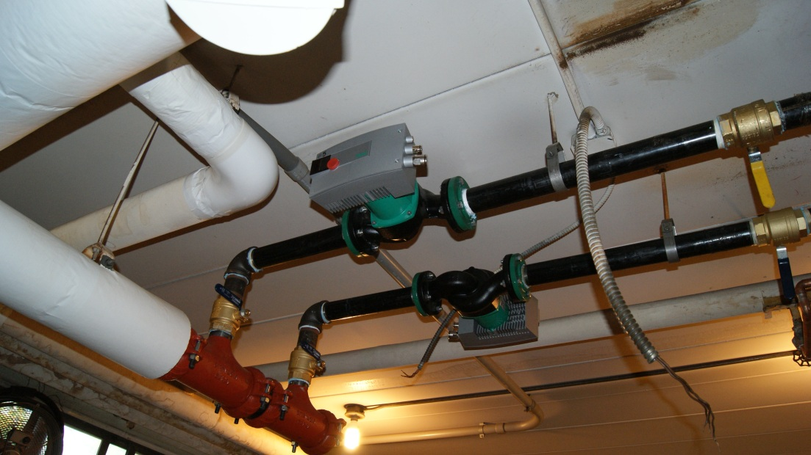
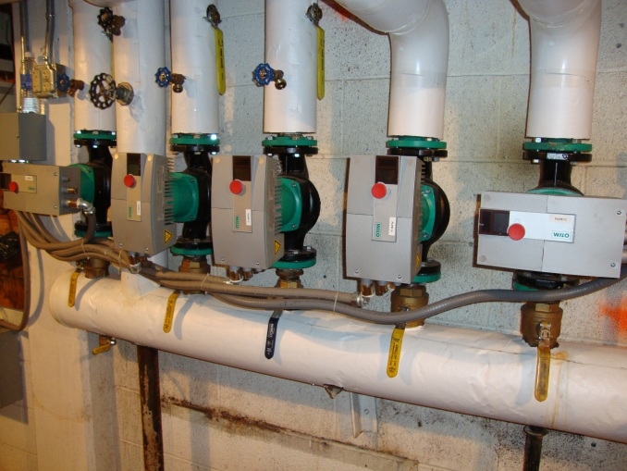
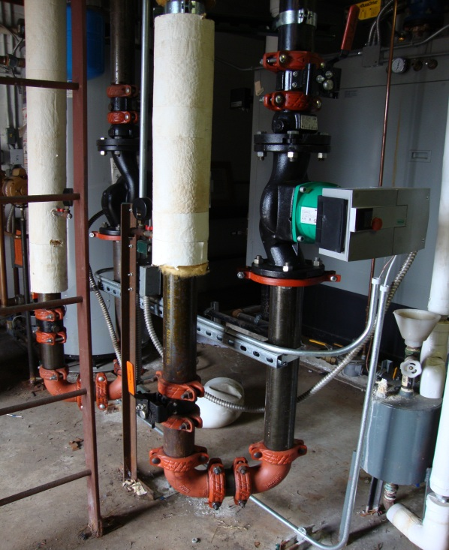
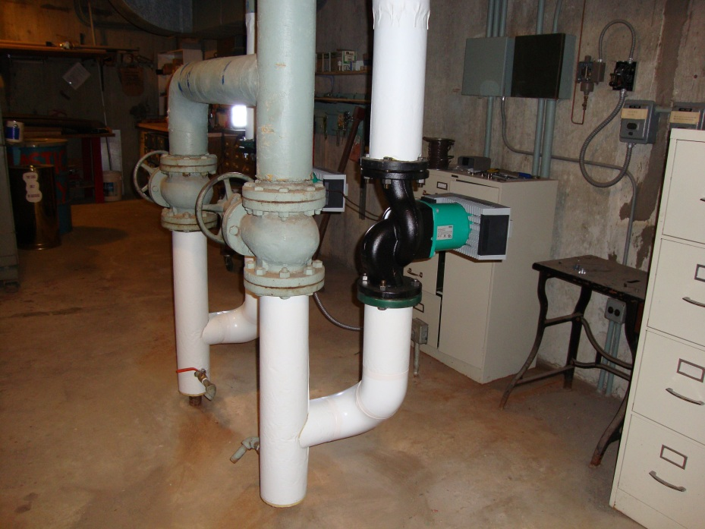
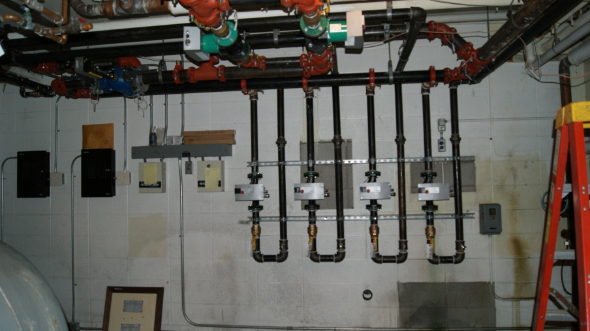
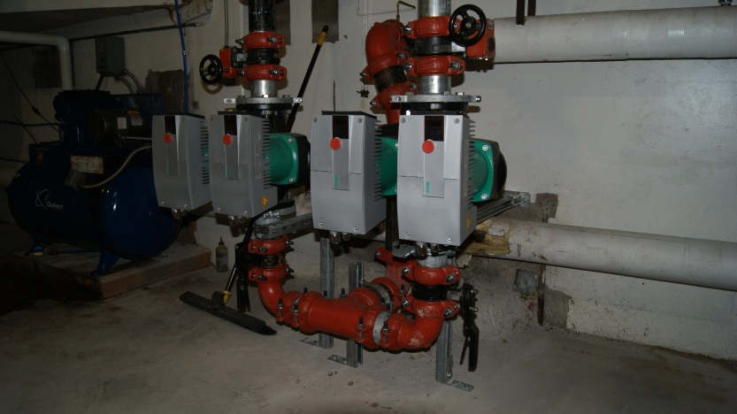
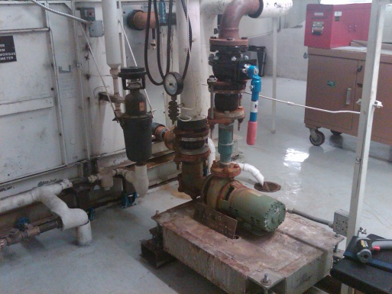

Slide 7
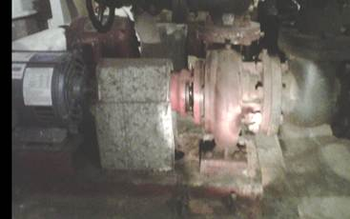
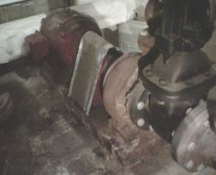
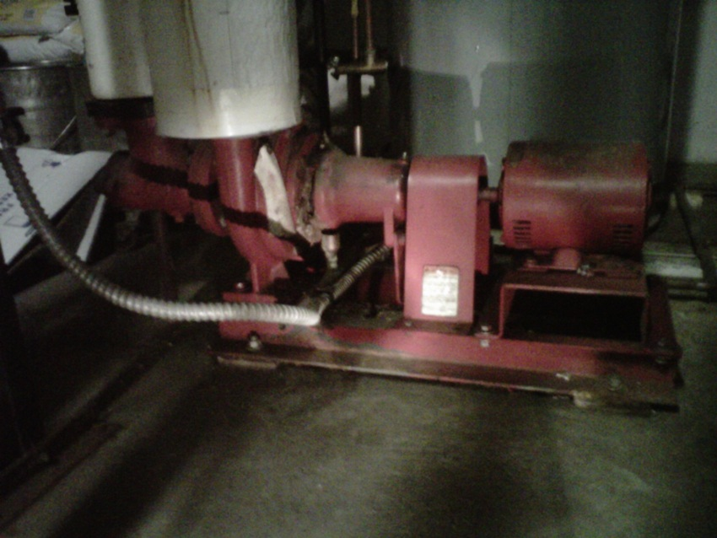
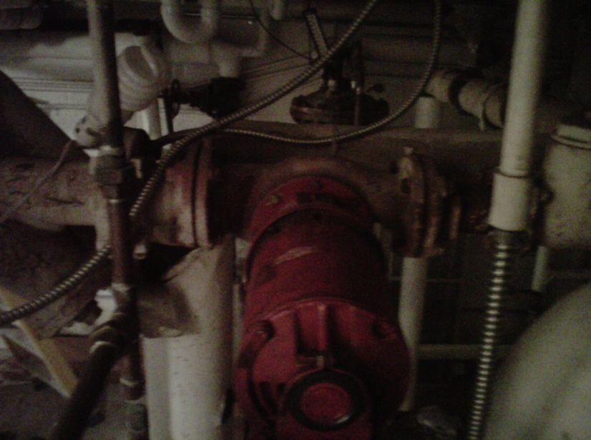
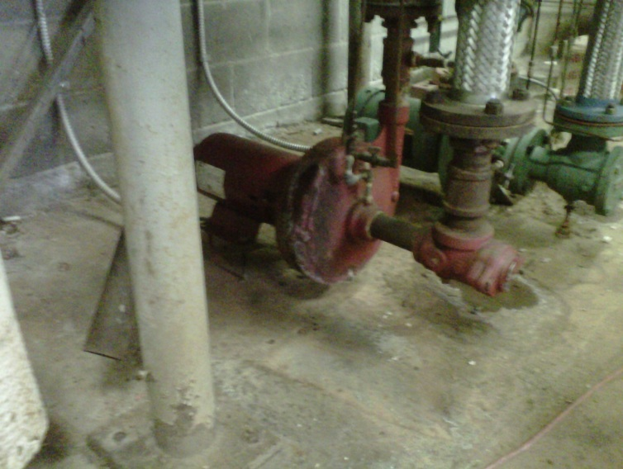
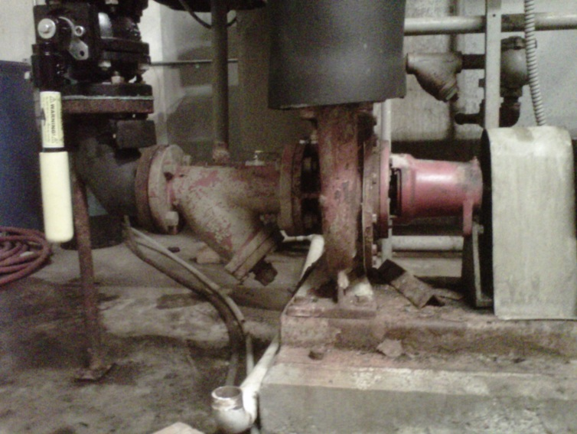
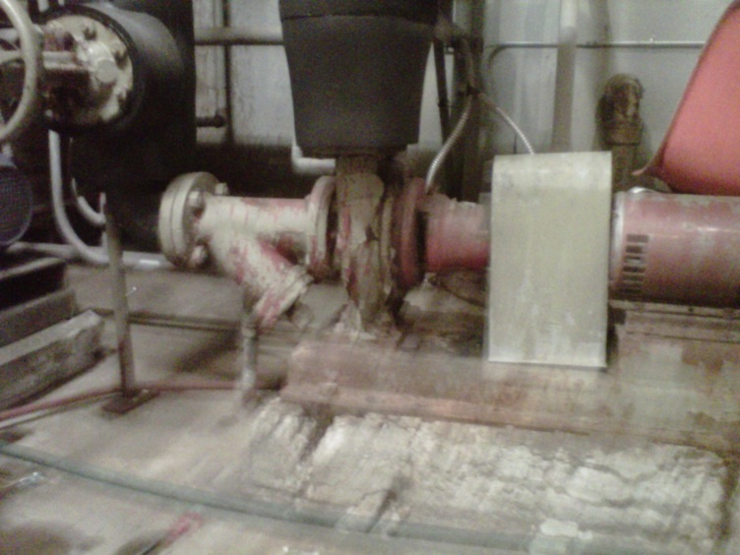
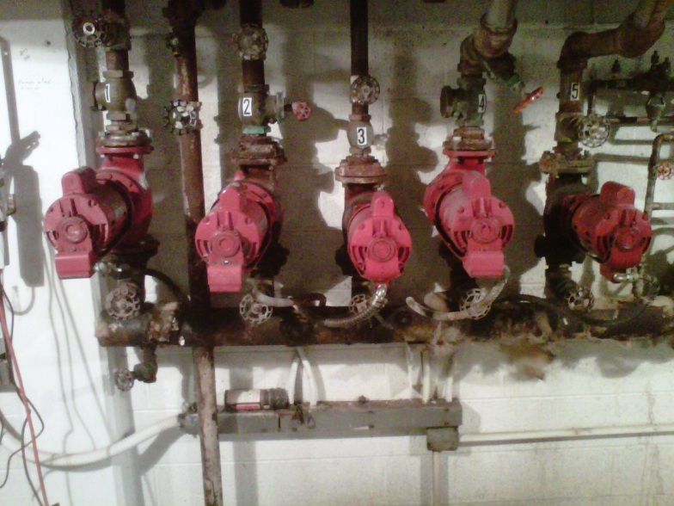
Cost of Parts
Vs
New Premium Efficiency

Slide 8
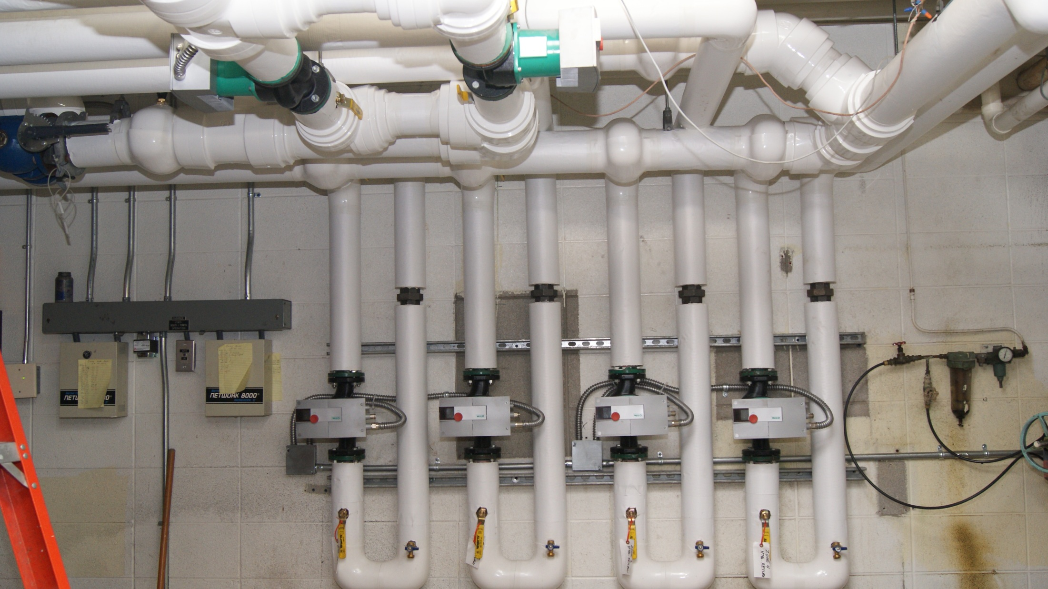

Slide 9
GRANVALLEY STATE UNIVERSITY
RENCE MEREDITH
OBVIOUS REASONS STUDENT LIVING CENTERS NEED A HEATING SYSTEM UPGRADE:
WINDOWS OPEN WHEN THE HEAT IS ON
DIFFERENTIAL TEMPERATURE ON THE HEATING SYSTEM IS LESS THAN 10 DEG F
PUMP FAILURES , SEALS AND BEARINGS
SELF OP CONTROL VALVES FAILING AND MAKING NOISE
SOLUTIONS FOR THE LIVING CENTERS:
REPLACE THE EXISTING NON CONDENSING 80 PERCENT BOILER SYSTEM WITH A 90PLUS EFFICIENCY BOILER WITH OUTSIDE RESET CAPABILITY
ADD VARIABLE SPEED PUMPING WITH A CONSTANT PRESSURE CONTROL SO WE DON’T OVER PRESSUREIZE THE CONTROL VALVES
SET THE SYSTEM UP TO OPERATE WITH A 20 DEG DIFFERENTIAL TEMPERATURE
ADD AN EFFICIENT AIR REMOVAL SYSTEM
ADD WATER FILTRATION AND CHEMICAL FEED TO MAKE SURE THE NEW EQUIPMENT STAYS AT PEAK PERFORMANCE

Slide 10
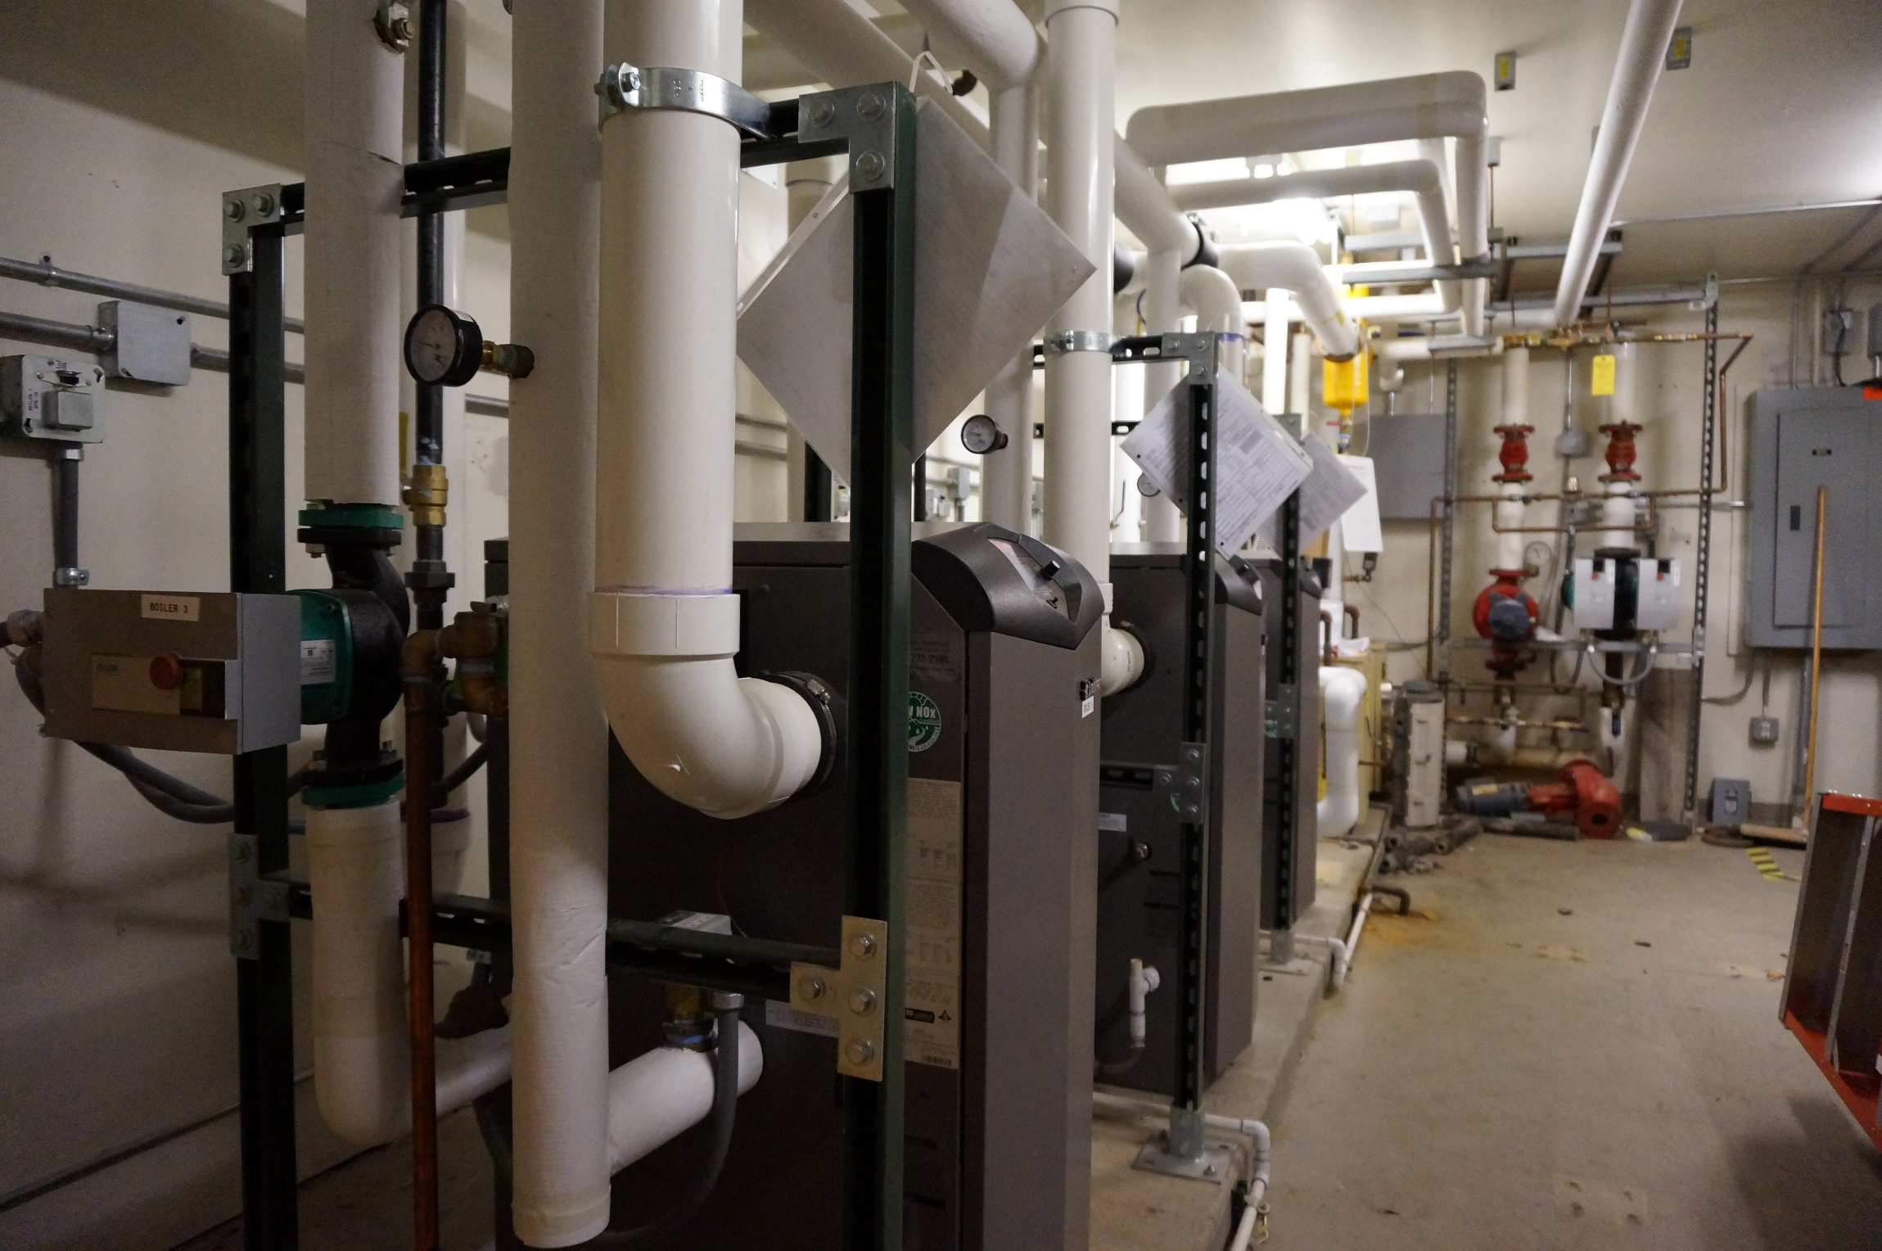

Slide 11
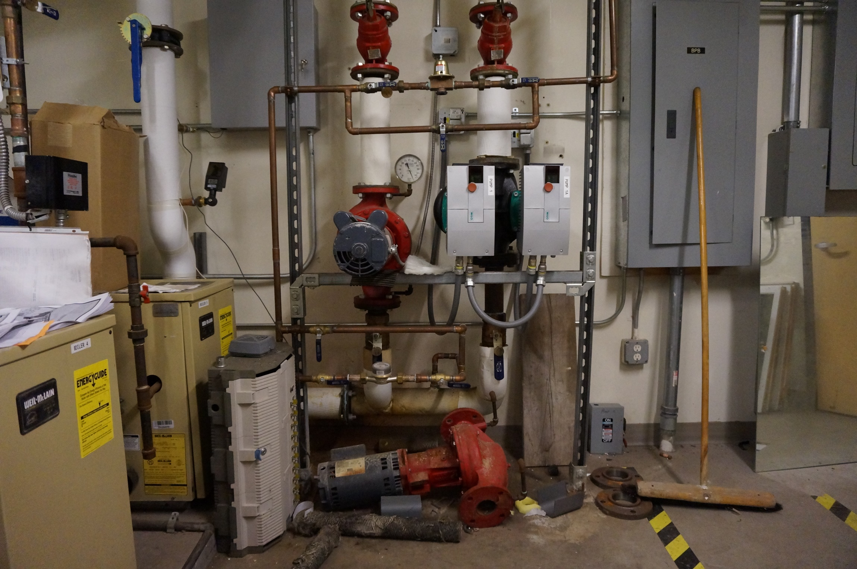

Slide 12
WAYNE STATE UNIVERSITY
DAVE KUFFNER
OBVIOUS REASONS EXISTING SYSTEMS GROWING OLD WITH OLD TECHNOLOGY
WINDOWS OPEN WHEN THE HEAT IS ON
DIFFERENTIAL TEMPERATURE ON THE HEATING SYSTEM IS LESS THAN 10 DEG F
PUMP FAILURES , SEALS AND BEARINGS
ZONE AND SELF OP CONTROL VALVES FAILING AND MAKING NOISE
BOOSTER SYSTEMS LEAKING AND RUNNING 24/7
SOLUTIONS FOR THE LIVING CENTERS:
CONTROL THE HEATING LOOP WITH AN OUTSIDE RESET TO LOWER THE SYSTEM TEMPERATURE BASED ON THE OUTSIDE TEMPERATURE
ON A STEAM SYSTEM JUST ADD AN OUTSIDE RESET CONTROLER
ON A BOILER SYSTEM WITH A 90PLUS EFFICIENCY BOILER WITH OUTSIDE RESET CAPABILITY
VARIABLE SPEED PUMPING WITH A CONSTANT PRESSURE CONTROL SO WE DON’T OVER PRESSUREIZE THE CONTROL VALVES
SET THE SYSTEM UP TO OPERATE WITH A 20 DEG DIFFERENTIAL TEMPERATURE
UPDATE BOOSTERS TO VFD AND NEW HIGH EFFICIENCY PUMPS

Slide 13
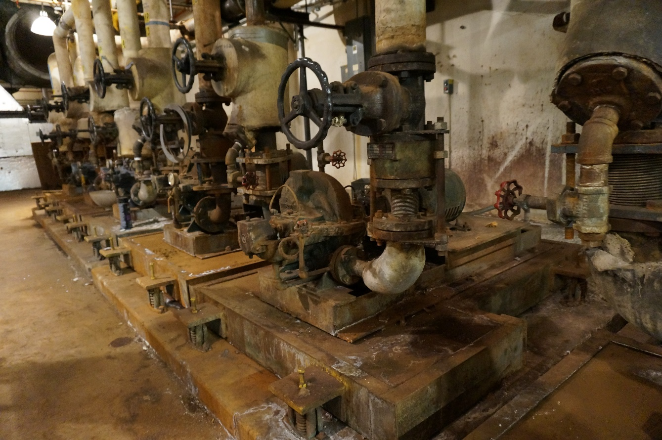
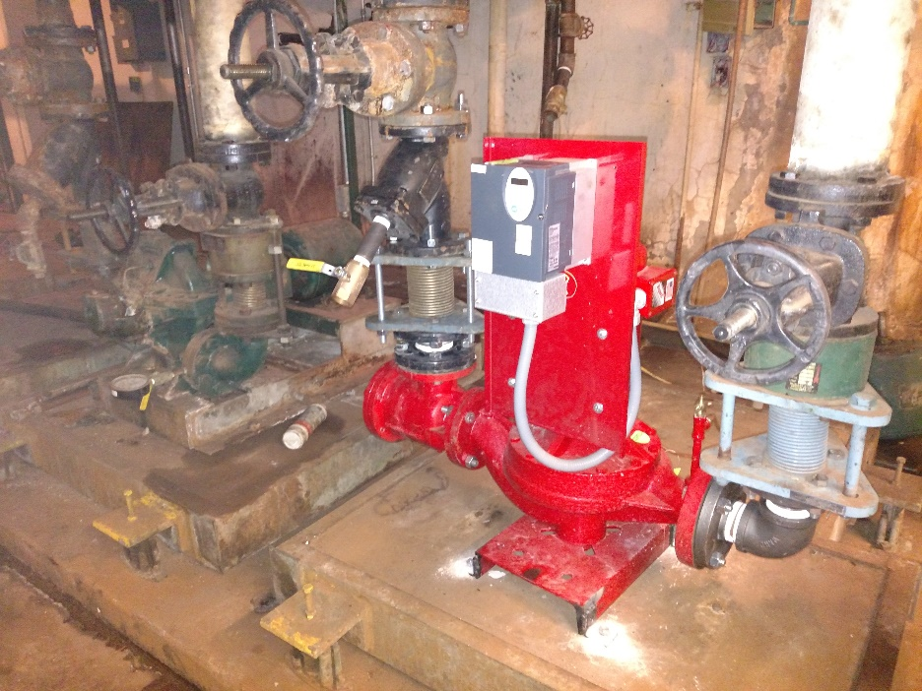
What broke?
Pump
Temperature Control Valve
Balance Valve
Service Valve
Boiler component
Chiller component
Temperature control Valve Operator
What caused it to break?
Seal Leaking
Plug seat eroded
Won’t move
Stuck
Stack corroding, igniter
Runs non stop, can’t keep up
Operators keep failing
How do I fix it?

Slide 14
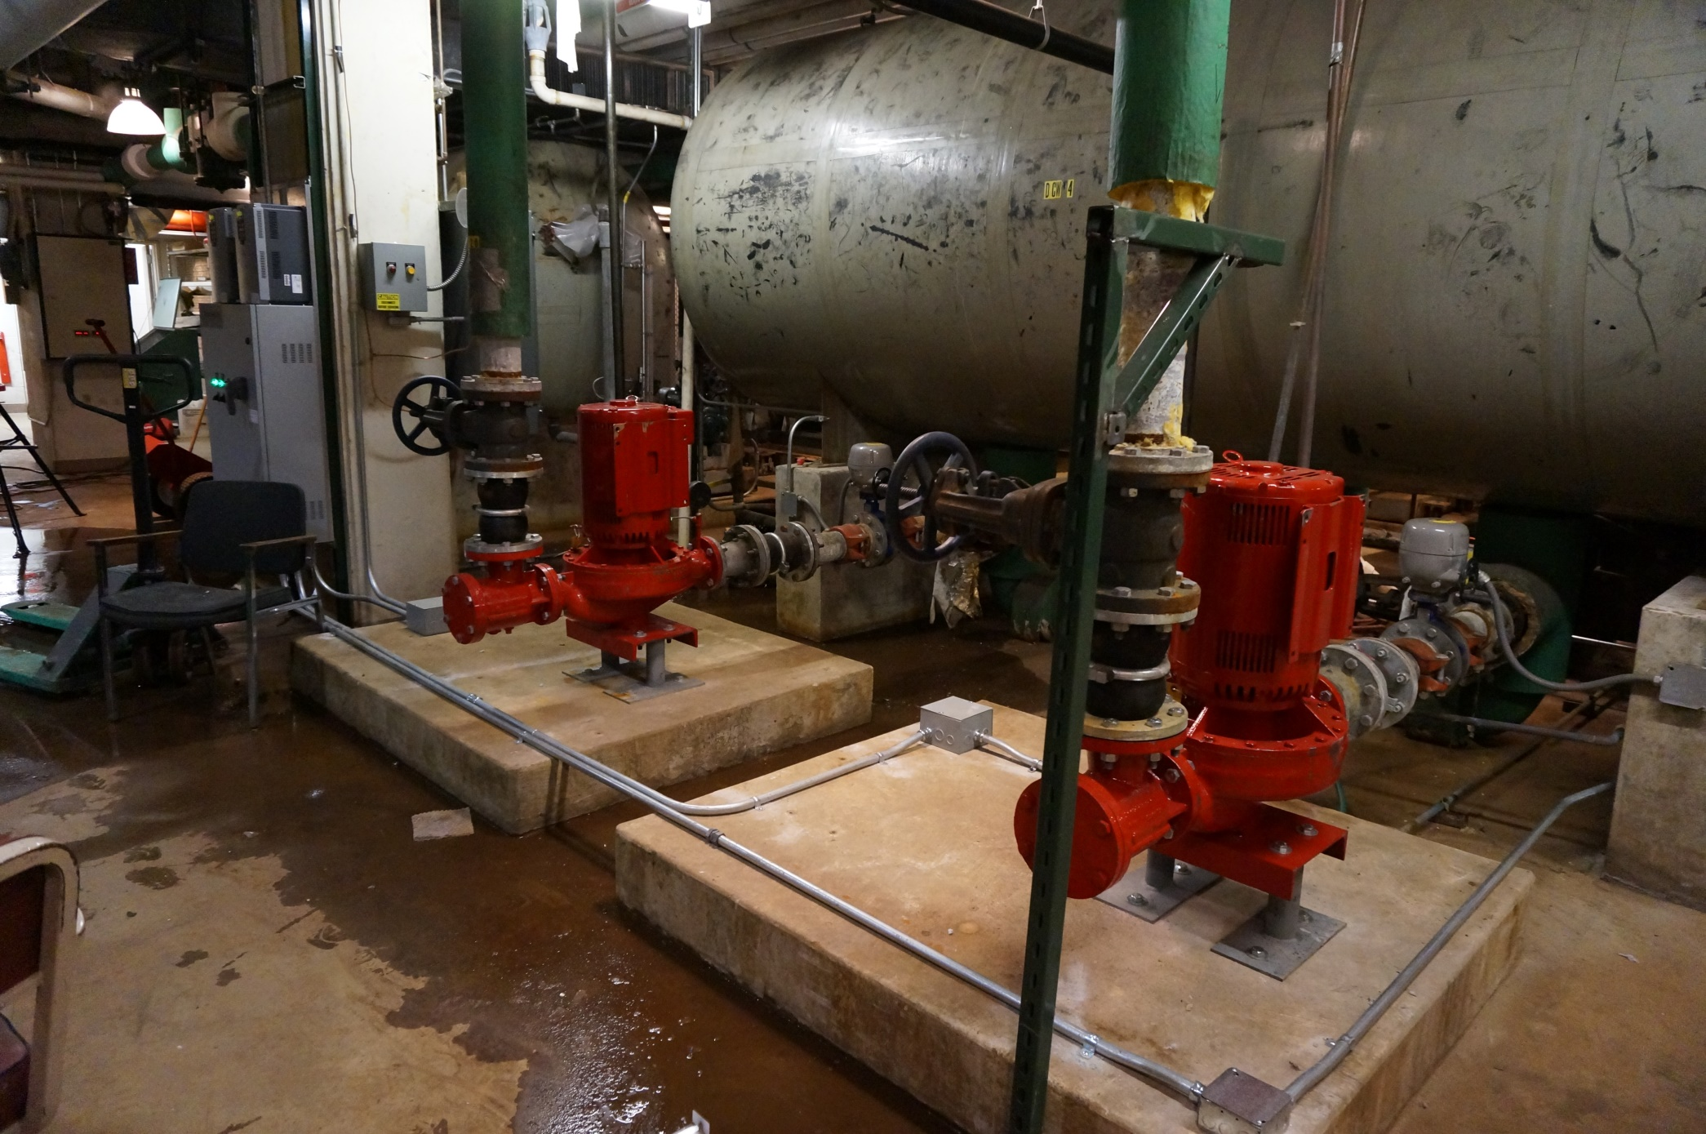

Slide 15
Why are we so FAR oversized? How do we tell?
2% - 98%
Pipe sizing
Engineering Cut and Paste
Existing Systems at 20-30% Efficient, so they just keep getting bigger

Slide 16
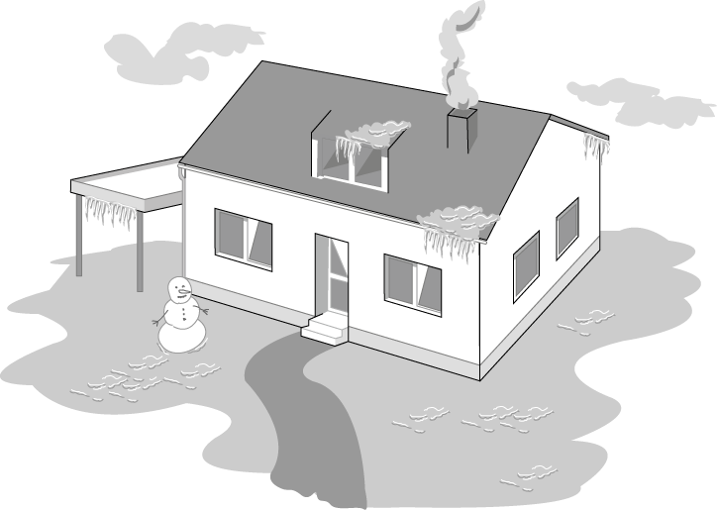

Transition period (coldest design day)
For the coldest day of the year ~2 % of the total operating period
Notes:
Load-controlled pumps - Why?
Standard pumps must be selected to meet maximum design load conditions which only occurs during 2-5 % of the total operating time. The normal operating status of the pump thus remains to meet partial and low load requirements. Non controlled pumps are incapable to adjust to such load variations and operate at their relatively high pump performance with the consequence of the thus related excess power consumption.
Consquence:
Excess power consumption
Generation of flow noise
(continued next page)

Slide 17

Transition period
But how is the system working during the remaining 98 % of the operating period?
Notes:
Load controlled pumps meet the requirements for increasing or at least constant pumping head. Two kinds of load controlled pumps are at present available .
Energy saving pumps had been conceived to keep abreast of the steadily further developing mechanical building services technology (thermostatic radiator valves, etc.) and to meet the growing sensibility towards energy conservation. There are three main reasons for the development and application of control systems for heating circulating pumps.
• Adapting flow rate/heat flow to the actual load
• Reducing power consumption and operating costs
• Avoiding noise generation in the system
High-efficiency pumps are the latest generation of pumps which, on top of the the benefits of energy-saving pumps, achieve enormous power savings in line with excellent efficiency. The revolutionary ECM-technology does furthermore provide more compact housings/motors, quieter operation and extended life expectancies.

Slide 18
Pump
Temperature Control Valve
Balance Valve
Service Valve
Boiler component
Chiller component
Temperature control Valve Operator

Slide 19
I have never seen a defective Mechanical Seal!!!!
What causes one to fail?
Starting with the Pump.
Every Pump is over SIZED.

Slide 20
Most Important Formula in Hydronic HVAC
BTU/HR
GPM = 500 X delta T
Energy Production
Energy Distribution
Energy Consumption

Slide 21
Formula’s
GPM = BTU/HR
500 x ΔT
1,000 #/hr = 1,000,000 Btu/Hr
1 #/hr = 1,000 Btu/Hr
1 ton = 12000 Btu/Hr.

Slide 22
98% of the TIME is Transition
Cut the flow in half and cut the pressure drop by a factor of 4 (FOUR)
How do we tell? Look at the DELTA T (Temperature difference).
We’re talking design BTU/HR and flows that happen 2% of the time so actual needed flows are always lower
1,000,000 BTU/Hr Boiler set at 180F
If my return is 170 what happens?
1,000,000 BTU/Hr Boiler set at 180F
If my return is 160 what happens?
200gpm = 1,000,000
500 x 10
500 x 10 x 200 = 1,000,000
100gpm = 1,000,000
500 x 20
500 x 20 x 100 = 1,000,000

Slide 23
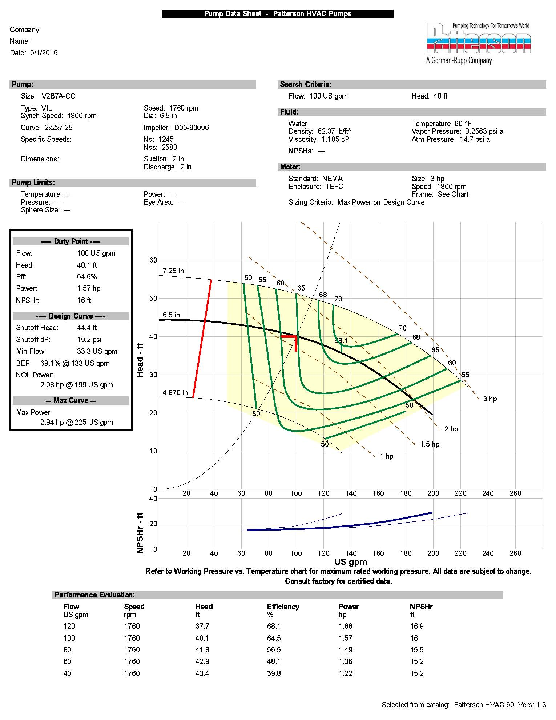
100 gpm = 1,000,000 Btu/Hr
500 x 20
150 gpm = 1,000,000 Btu/Hr
500 x 15
200 gpm = 1,000,000 Btu/Hr
500 x 10
Checking the system Delta T can suggest the system Load
Checking the Boiler Delta T vs gas consumption gives the real efficiency.
System Curve vs the Pump curve.
Remember at design max flow.
100gpm should be seen only two
Days a year Max…………..at design delta T.

Slide 24
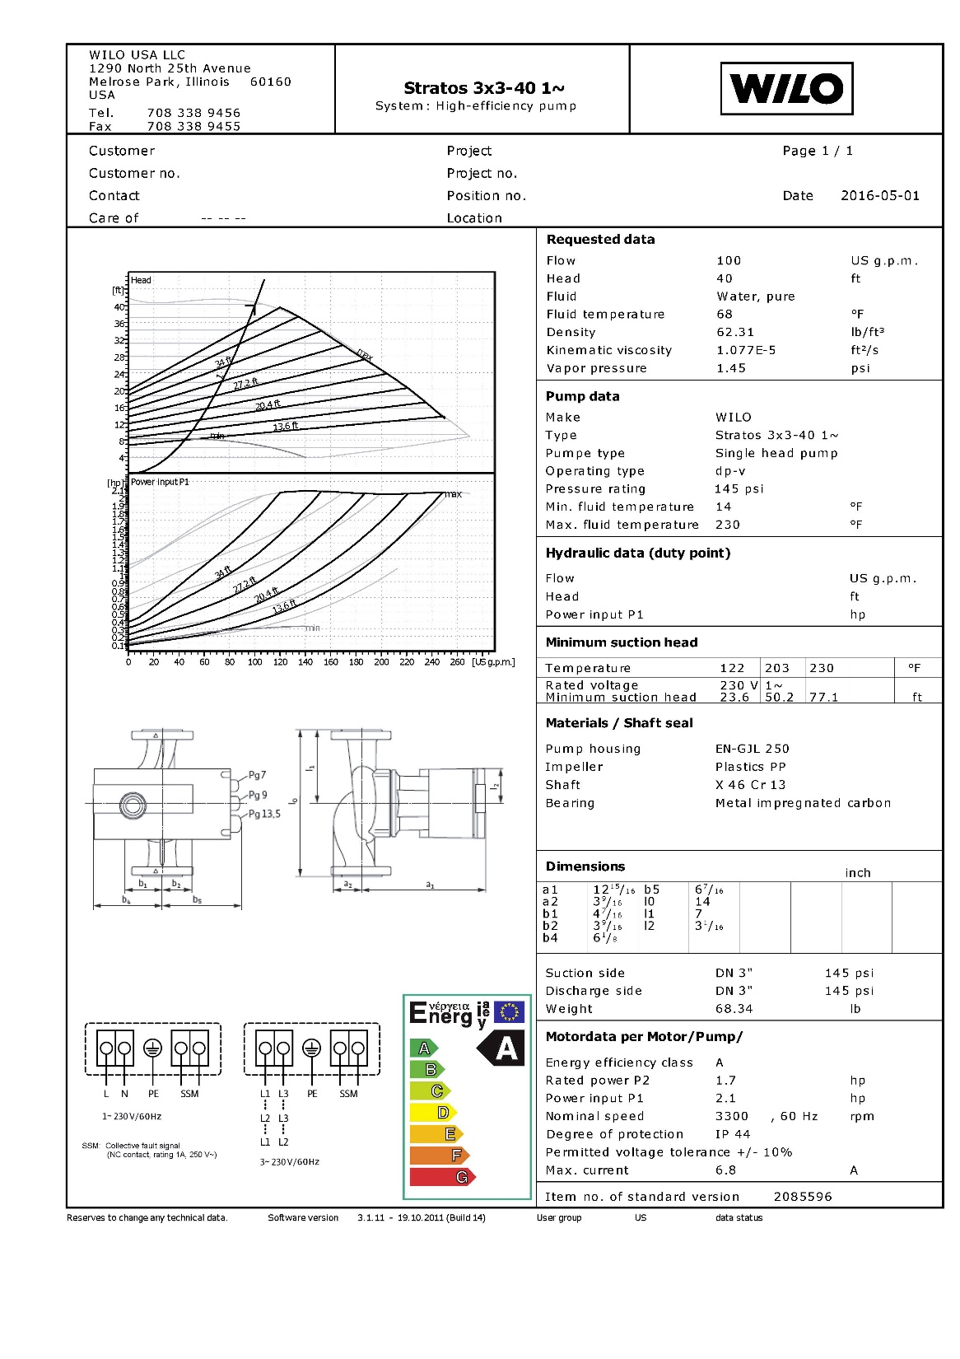
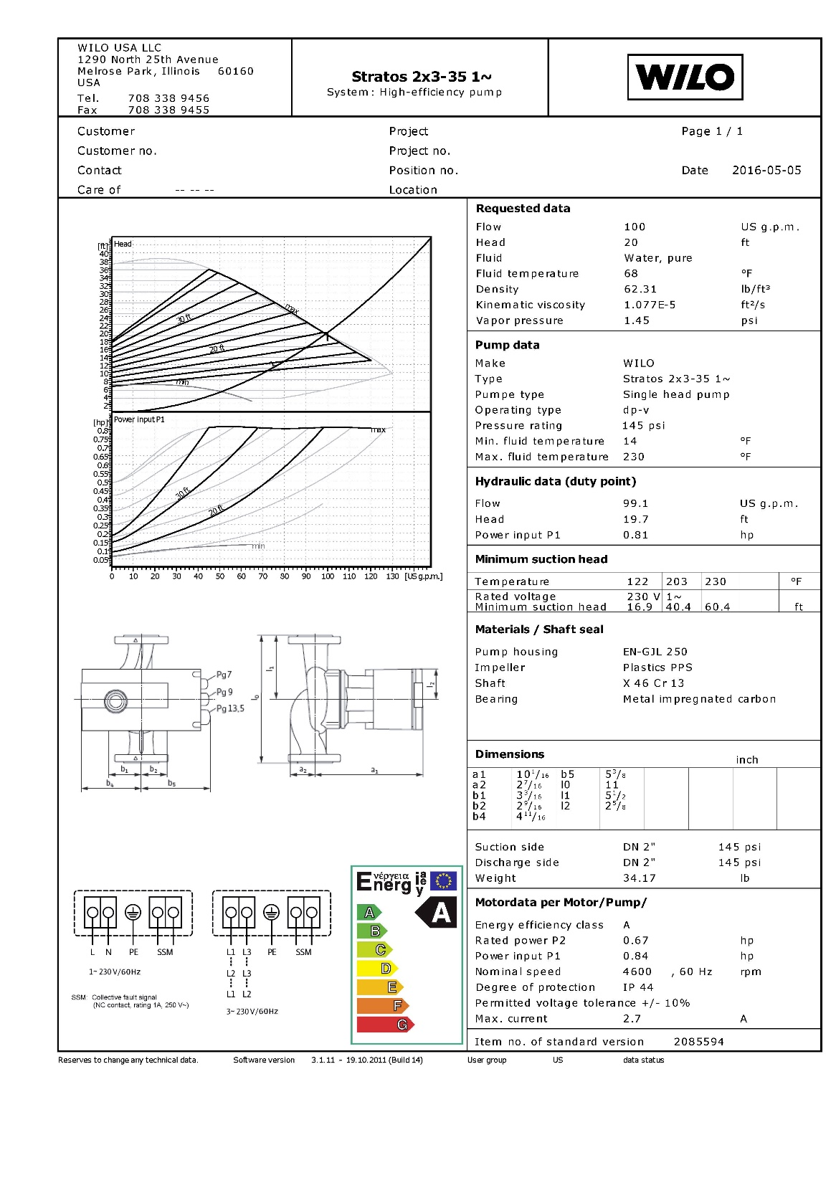
Stratos 2 x 3-35 Cast Iron* 2” Four-Bolt HV ¾ 1** 230 37.2 12 2085594 1,690
Stratos 3 x 3-40 Cast Iron* 3” ANSI 1¾ 1** 230 68.3 4 2085596 2,400

Slide 25
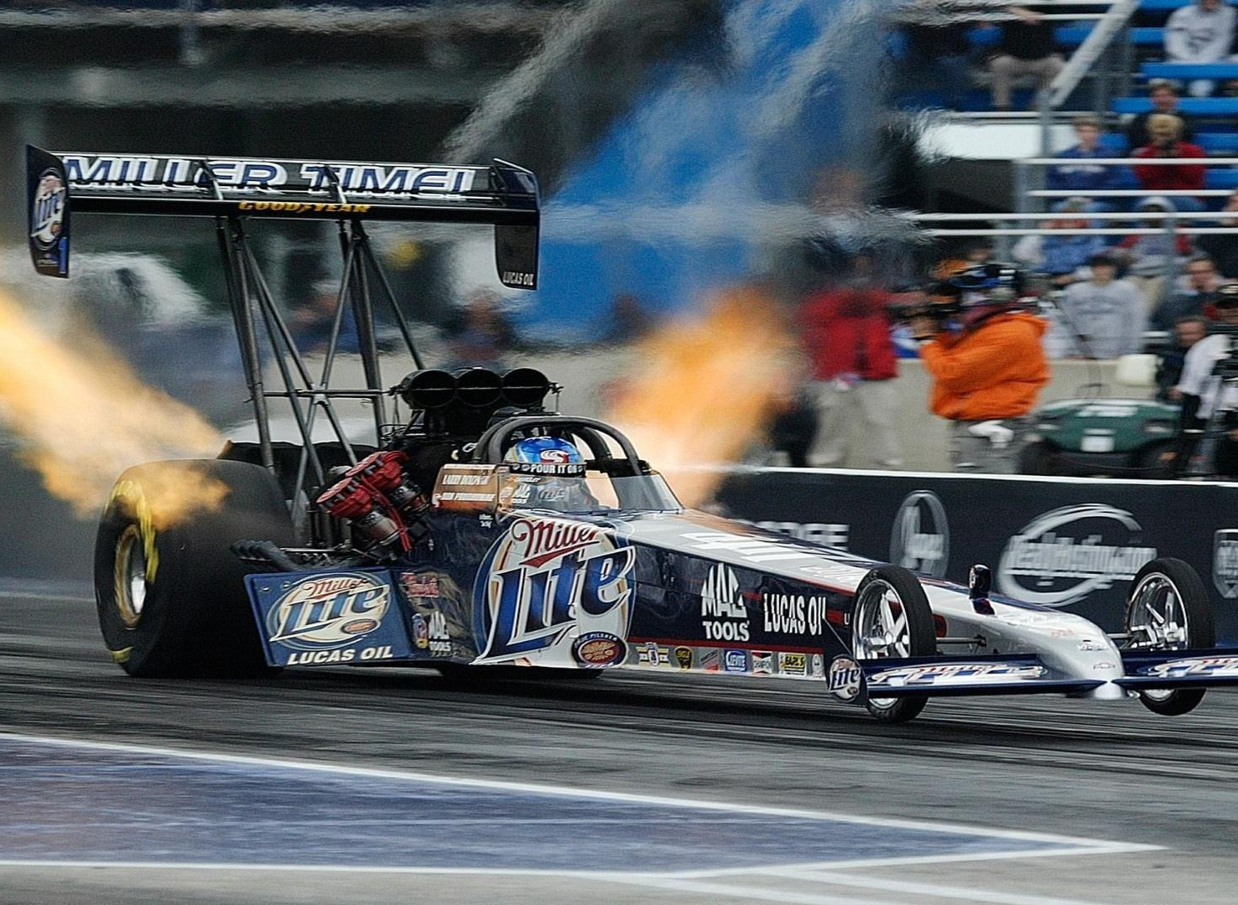

Slide 26
How long would the Brakes or front tires last on your car if every time you used it
you floored the GAS and used the brakes to control your speed?
Same thing you see every time you see a constant speed pump on a variable system.
Don’t forget that this system spends 98% of the time in Transition.
It’s balanced for the 2% of the time the VERY oversized system may never see.
Now remember that 98% efficient Boiler or Chiller that was specified for that 2% of the time?
It also was specified to operate at 20 – 30 degree delta T for a boiler and 10 – 12 degree delta T for a chiller!
Now look at the efficiency of the Boiler or Chiller operating at a much lower DELTA T

Slide 27
AC motor and pump limitations and efficiency’s.
30hz or 50% minimum why
even odd frequency
Couplers
Seal lubrication
Agis Rings, grease
Premium Efficiency
Trimmed Impellers

Slide 28
Back to why did the Pump break????
Bad Bearings, coupler broke, seal leaks, wrong oil, cheap A@# pump, motor fried
Probably only the wrong oil is the biggest thing I see
Running off either end of the pump curve causes all of the above.
Some pumps are built to take the abuse of improper application for long periods of time.
MOST ARE NOT
Remember all manufacturers ASSUME you are utilizing their product as designed

Slide 29
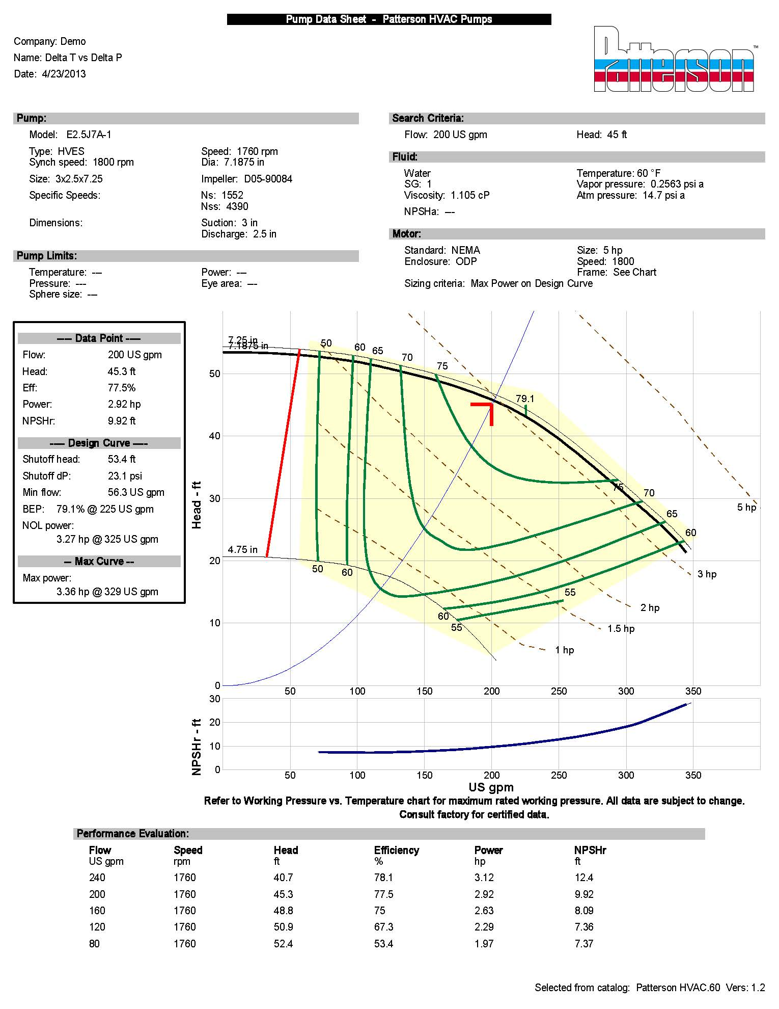
200 gpm = 2,000,000 Btu/Hr
500 x 20
300 gpm = 2,000,000 Btu/Hr
500 x 15
400 gpm = 2,000,000 Btu/Hr
500 x 10
Checking the system Delta T can suggest the system Load
Checking the Boiler Delta T vs gas consumption gives the real efficiency.
System Curve vs the Pump curve.
Remember at design max flow.
200gpm should be seen only two
Days a year Max…………..at design delta T.

Slide 31
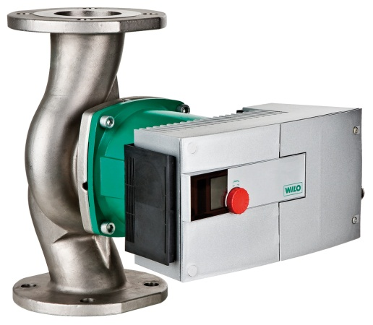
We’ll Talk about ECM a little later
Don’t forget to look at all the details
2 way valves or 3 way valves
Primary Secondary or just a primary circuit
Is there a bypass somewhere?
Always ask if your not sure.
I call it the easy BUTTON

Slide 32
ALWAYS STAND BACK AND LOOK AT HOW THE SYSTEM WAS DESIGNED AND WHAT HAPPENED IN REALITY
Every time someone is looking for a bigger pump, boiler or chiller I find the SYSTEM is operating at a very low efficiency.
Why are we so FAR oversized?
2% - 98%
Pipe sizing
Engineering Cut and Paste
Existing Systems at 20-30% Efficient, so they just keep getting bigger
One piece or all of the SYSTEM COMPONENTS are operating below 30%
My Reminder to talk about Carrollton Schools, Wayne State University Chiller
You can guess it: the pump is the CORE of a properly operating SYSTEM
systecore

Slide 33
Temperature Control Valve
Balance Valve
Service Valve
Boiler component
Chiller component
Temperature control Valve Operator
Let’s just talk about Valves and Igniters as examples.

Slide 34
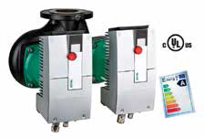
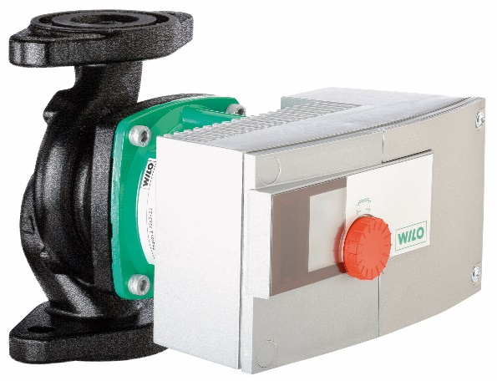
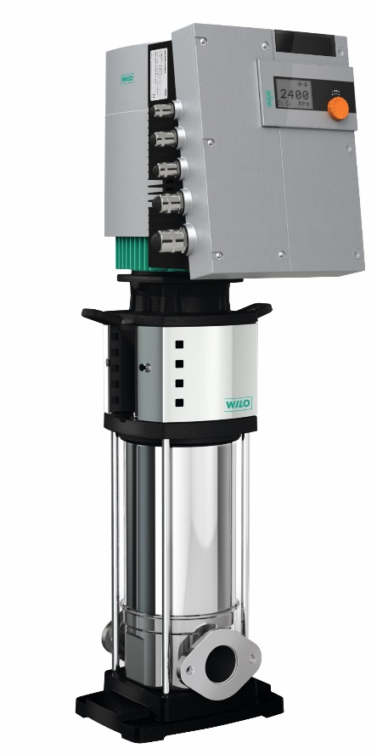
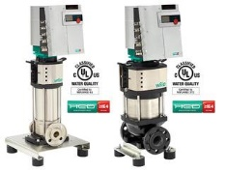
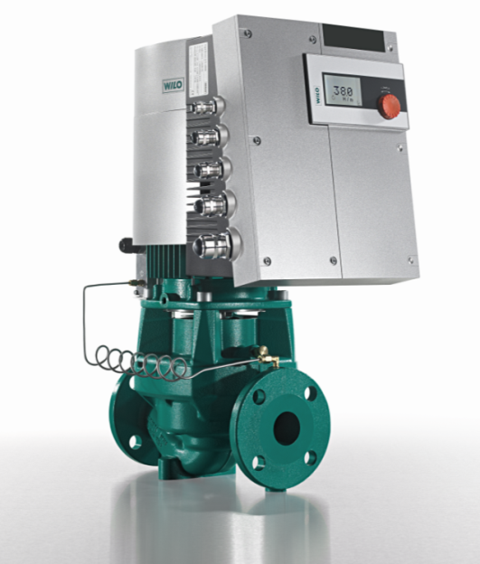
See an EASY Button?

Slide 35
What is ECM?
Q: What does ECM stand for?
A: Electronically Commutated Motor
Q: Is it a new technology?
A: No. it was actually created by GE in 1969 and ever since have been used in applications from aerospace to automotive to HVAC!!!
Q: What does that mean?
A: To commutate means to reverse every other half cycle of an alternating current so to form a unidirectional current (per dictionary)

Slide 36
What is ECM?
Q: Why is a EC/DC motor more efficient?
A: One main reason, simply stated, is that the EC motor uses a permanent magnet rotor and varies the polarity of the stator magnetic fields where as a standard AC motor has to induce power into the rotor to create opposing magnetic fields which can add up to a considerable amount of loss. ECM rotor loss=0.
Q: OK, but what about rotor slip? Aren’t there still losses there?
A: NO, an EC motor acts as a synchronous motor, there is no slip loss which means primarily no excess heat generation so considerably less dissipation is required

Slide 37
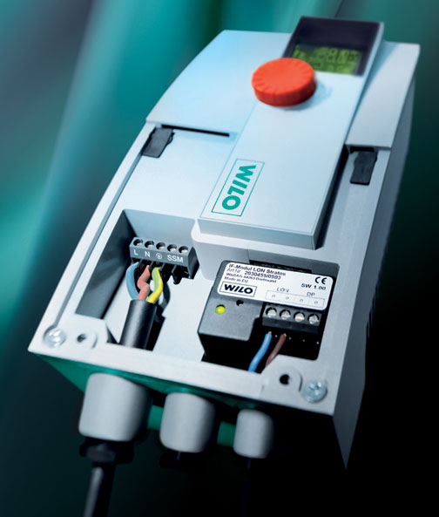
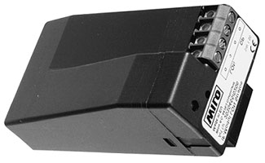
What is ECM?
Q: At full speed on an AC motor the typical slip really doesn’t generate that much heat because slip is minimal and part of the design so how is the ECM that much better here?
A: This is true at full speed but what about at turndown?
While the design of the ECM is (at full speed) 30% to 50% more efficient than the typical AC motor the real difference starts to come in during variable speed conditions, as a typical AC motor begins to slow down it becomes less and less efficient due to several reasons such as excess slip compensation, increased heat from this compensation generates considerable losses (typical turndown Max of an AC motor is 50%). EC motors, being synchronous throughout the full speed range allows the unit to maintain its efficiencies throughout the full speed range and with no additional thermal load meaning increased efficiencies of up to 80% overall compared to the standard AC motors

Slide 38
What is ECM?
Q: Why does the ECM not require external sensors for the process control of the pump?
A: In short, the “brain” of the ECM is maintaining a synchronization between the spinning magnetic fields of the stator and the rotor. As zones open and close in the system, the impeller/rotor “see” more or less resistance. The “brain” monitors the synchronization between the opposing poles of the stator and the rotor and adjusts the stator speed via PWM to match the rotor speed, eliminating slip.

Slide 39
Delta Pressure Variant Mode (DPv)
40’
25’
Feet of Head
20’
12.5’
0’
0
50
100
Gallons Per Minute

Slide 40
Delta Pressure Constant Mode (DPc)
40’
25’
Feet of Head
20’
0’
0
50
100
Gallons Per Minute

Slide 41
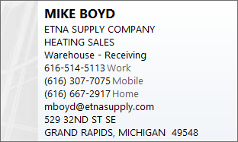
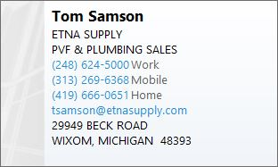

Slide 42
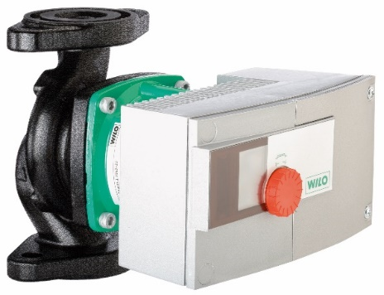
An Example of Over Pumping
Original Circulator
Stratos 3 x 3-40
7.5 H.P, 3 Phase motor
Original pump drew 6426 watts
Circulator ran 24/7 from October 1st to April 30th.
5040 hours x 6426 watts = 32,387,468 w/h per season.
32,387,468/1000 = 32,387 Kwh.
32,387 x $0.22/Kwh =
$7,125 per season for ONE circulator!
2 H.P, 230v, 1 Phase motor
Circulator set to 25 feet of head.
360 watts.
Pump history indicated head setting could be lowered.
Set point lowered to 13 feet of head.
Power consumption dropped to 250 watts.
250 x 5040 = 1,260,000 w/h
1,260,000/1000 = 1,260 Kwh.
1,260 x $0.22 = $277.20
790 Kwh x $0.22 = $174.00

Slide 43
Assuming existing Pumps at 1 HP for easy math
& most small commercial buildings or AHU’s.
LED 12 watts x 10 hrs x 365 = 44 kwh/yr
11 kwh/yr savings
CFL 15 watts x 10 hrs x 365 = 55 kwh/yr
ECM 1/4 46 watts x 24 hrs x 365 = 402,960 kwh/yr
6,132,000 kwh/yr savings /pump
AC 1HP 746 watts x 24 hrs x 365 = 6,534,960 kwh/yr

Slide 44
Their way changing light bulbs
CFL to LED
11 kwh x 0.077 = $ 0.847 / year
Assuming we continue to have very cheap electricity???? 0.077/kwh
Our Way changing old worn out PUMPS
AC pumps to ECM
3,066 kwh x 0.077 = $ 236.082/year

Slide 45
60 watt light bulb converted to florescent then to led
66w to 15w to 11w $20.00/bulb
55wh x 2080 (avg 8hour work week) = 114,400w / year
4wh x 2080 = 8,320w / year
This is watt savings per YEAR
Wilo pump
15kwh x (365 x 24) 8760 = 131,400,000w / year
Existing pump
552kwh x (365 x 24) 8760 = 4,835,520,000w / year
Savings per year 4,704,120,000w /year

Slide 46
DOWN THE DRAIN!
D.O.E AND U.S CENSUS BUREAU ESTIMATE BETWEEN 400 BILLION AND 1.3 TRILLION GALLONS OF WATER ARE WASTED BY HOUSEHOLDS PER YEAR!
D.O.E ESTMATES THAT A “MODESTLY SIZED” RE-CIRC PUMP WILL USE 400 – 800 KWh/year (90 watts x 8760/ 1000)
MANY STATES ARE LOOKING AT PASSING LAWS REQUIRING DOMESTIC RECIRCULATION IN ALL NEW CONSTRUCTION PROJECTS (DEMAND TYPE)
TREMENDOUS ENERGY SAVING POTENTIAL WITH ECM
LOW HANGING FRUIT ¼ HP AND UP.
EASILY THE MOST OVERSIZED CIRCULATORS IN USE TODAY!

Slide 47

HOW MUCH DID YOU SAY?!?!

Slide 48
NO…..REALLY!
150,000 GALLONS PER SECOND FLOW OVER THE AMERICAN FALLS AND THE BRIDAL FALLS AT NIAGARA
600,000 GALLONS PER SECOND FLOW OVER THE HORSESHOE FALLS ON THE CANADIAN SIDE OF NAIGARA
750,000 GALLONS PER SECOND TOTAL
750,000 GPS X 60 SECONDS = 45 MILLION GALLONS PER MINUTE
45 MILLION GPM X 60 MINUTES = 2.7 TRILLION GALLONS PER HOUR
AMERICAN HOMES WASTE IN ONE YEAR THE EQUIVALENT OF WHAT GOES OVER NIAGARA FALLS IN A HALF HOUR!

Slide 49

COST IN BTU’S
BTU = BRITISH THERMAL UNIT
THOMAS TREDGOLD INTRODUCED THE MEASUREMENT TO THE WORLD IN 1827
IT IS THE AMOUNT OF ENERGY REQUIRED TO RAISE ONE POUND OF WATER ONE DEGREE FARENHEIT FROM 62 DEGREES TO 63 DEGREES
ONE GALLON OF WATER EQUALS 8.33 POUNDS
1.3 TRILLION GALLONS X 8.33 = 10,829,000,000,000 POUNDS
HEATING WATER FROM 100 DEGREES TO 120 DEGREES = 2O DEGREE DELTA TEE
10,829,000,000,000 POUNDS X 20 DEGREE RISE = 216,580,000,000,000 BTU’S USED TO HEAT THE WASTE WATER (63,473,335,228 KW OR 63,473.335 GW) (( Palo Verde produces 3.3 GW annually))
ONE CUBIC FOOT OF NATURAL GAS HAS 1,000 BTU’S (THEORETICAL)
AVERAGE COST PER CUBIC FOOT = $0.016
216,580,000,000,000 X $0.016 = $3.5 TRILLION ANNUALY

Slide 50
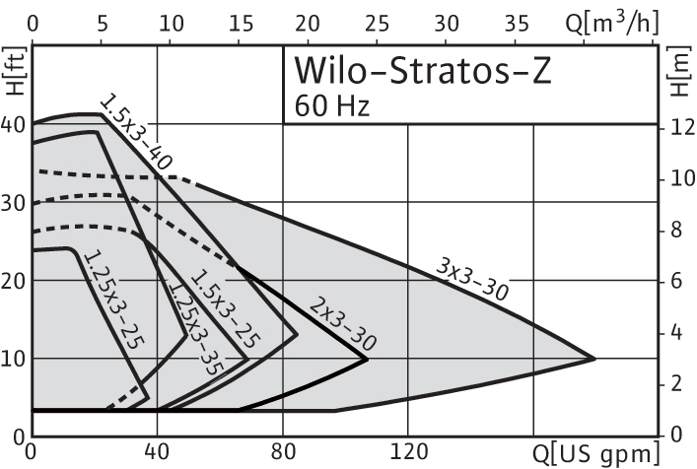
ECM Products: Stratos Z
Stratos Z (Stainless Steel Volute)
NSF 61, Annex G certified (NSF 372)
Domestic recirculation
Soft start high torque permanent magnet rotor
6 sizes available
Max head: 30 feet
Max flow: 200 GPM
208/ 230 volt single phase only
Smart pump adjusts flow to system changes (∆p-v, ∆p-c and ∆p-t)
Non-volatile memory
Flange sizes:1 ¼”, 1 ½”, 2” & 3” (High velocity)
Interface modules for 0-10Vdc, LON, BACnet and external control
Dual pump mode (Duty/Stand by, Dual pump)
Infrared service/diagnostic tool available
Pump performance and system data logging
Overload protection (voltage, dry run, locked rotor, over temperature)
Class “A” energy rating

Slide 51
Delta Pressure Temperature Mode (DPt)
T min = 60° F
P min = 36.1 Ft.
T max = 110°
P max = 12.1 Ft.
43.3
35.3
Ft
27.3
19.3
11.3
3.3
14
60
110
160
210
° F

Slide 52
Wilo Stratos Z vs. standard three piece bronze domestic recirc pump
This is a preliminary analysis of Wilo Z Domestic hot water re-circulating pumps. Following is a comparison of a Wilo Z pump with a standard pump operating at the exact same flow and head. More savings found with proper setup.
Building 1506
Wilo Z: 1/8Hp, Single Phase, 208V
Meter Installed Date: 2/10/2012
Meter Reading(03/29/2012):15KWh; $1.15
Pump Installed Cost: TFW
Electrical Rate:$.077/kwh
Building 1511
½ Hp, Single Phase, 110 V
Meter Installed Date:2/13/2012
Meter Reading(03/29/2012): 552KWh; $42.5
Pump Installed Cost: TFW
Electrical Rate:$.077/kwh

Slide 53
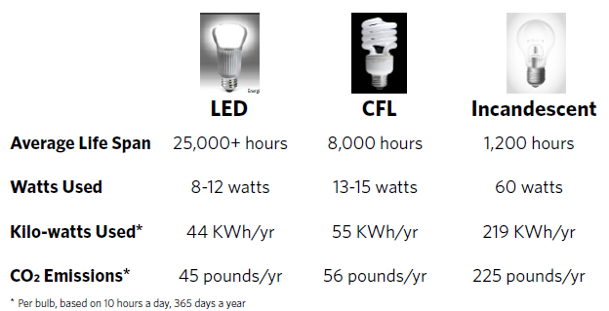

Slide 54
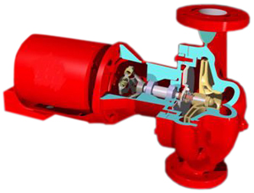
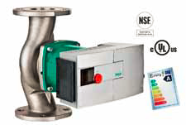
1 hp of energy = 746 Watts of energy AC
50% less ECM
1/2hp AC
AC Centrifugal Pump Domestic HW
Operation 24/7-8760 hours / year
Average Life Span 5 YEARS
Watts Used 373 watts
Kilo Watts Used 3267.48 kwh/yr
CO2 Emissions 3357 #/yr
System Efficiency ??
System Life ??
1/8hp ECM
ECM Centrifugal Pump Domestic HW
Operation 24/7-8760 hours / year
Average Life Span 25 YEARS
Watts Used 23.3 watts
Kilo Watts Used 233 kwh/yr
CO2 Emissions 226 #/yr
System Efficiency 100
System Life 25 years

Slide 55
You would have to change 279 CFL’s to LED’s
to save the same as ONE DHW Pump
Electrical Rate:$.077/kwh
Hearing $.30/kwh in near future???
LED 12 watts x 10 hrs x 365 = 44 kwh/yr
11 kwh/yr savings
CFL 15 watts x 10 hrs x 365 = 55 kwh/yr
ECM 1/8 23 watts x 24 hrs x 365 = 202 kwh/yr
3,066 kwh/yr savings /pump
AC ½ 373 watts x 24 hrs x 365 = 3268 kwh/yr
11 kwh x 0.077 = $ 0.847 / year
3,066 kwh x 0.077 = $ 236.082/year
11 kwh x 0.30 = $ 3.30 / year
3,066 kwh x 0.30 = $ 919.80/year

Slide 56
Now figure the cost to repair the old AC pump and compare it to a NEW ECM pump.
You have payback of a few months plus you get
free proper system design and lower maintenance cost>
Last thought
How many light bulbs have to be changed to equal the savings of ONE pump?
Over 279 and what is the upfront cost of the bulbs.
Now you improve the system efficiency as a by-product,
NSF-61 and no more bearing assemblies or seals to leak.

Slide 58
Cost of Parts
Vs
New Premium Efficiency

Slide 59


Slide 60
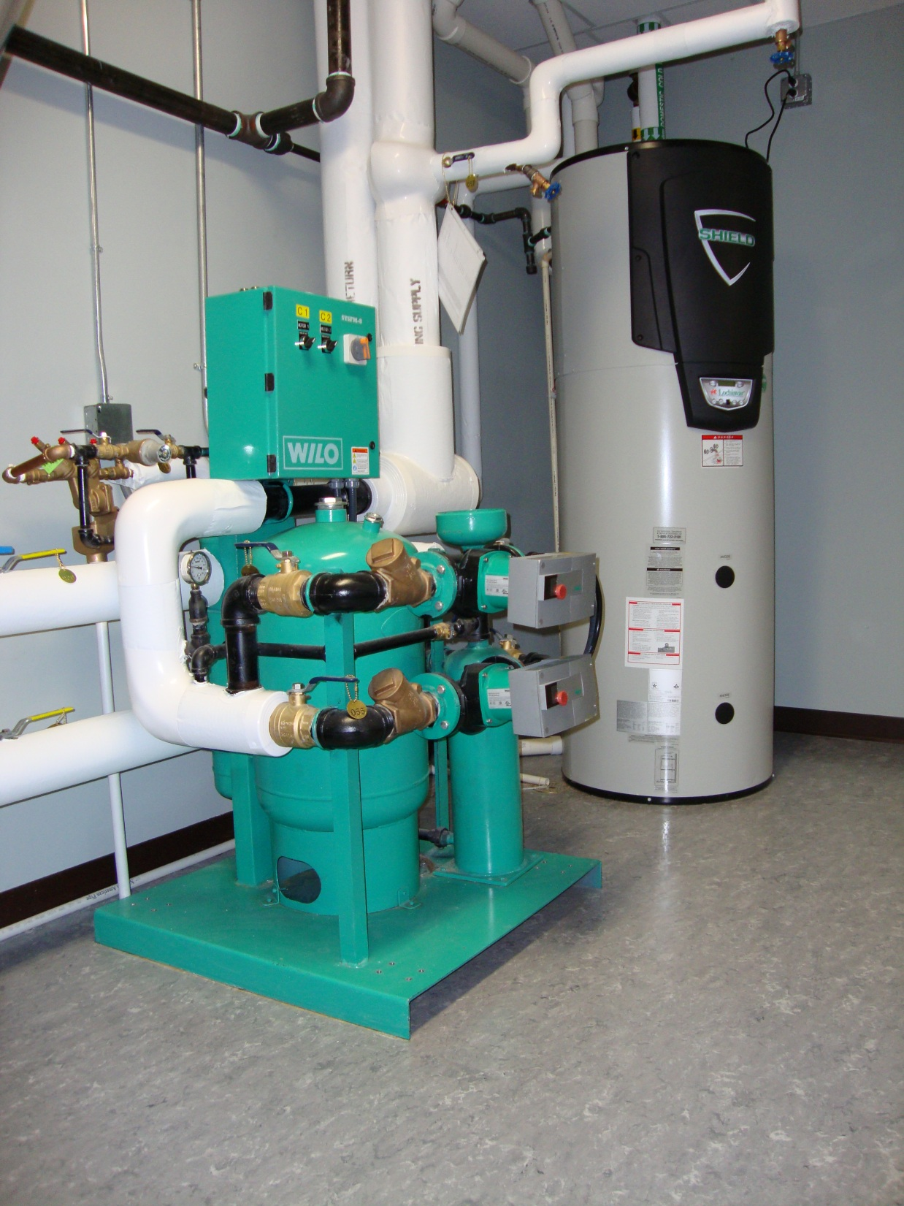

Slide 61
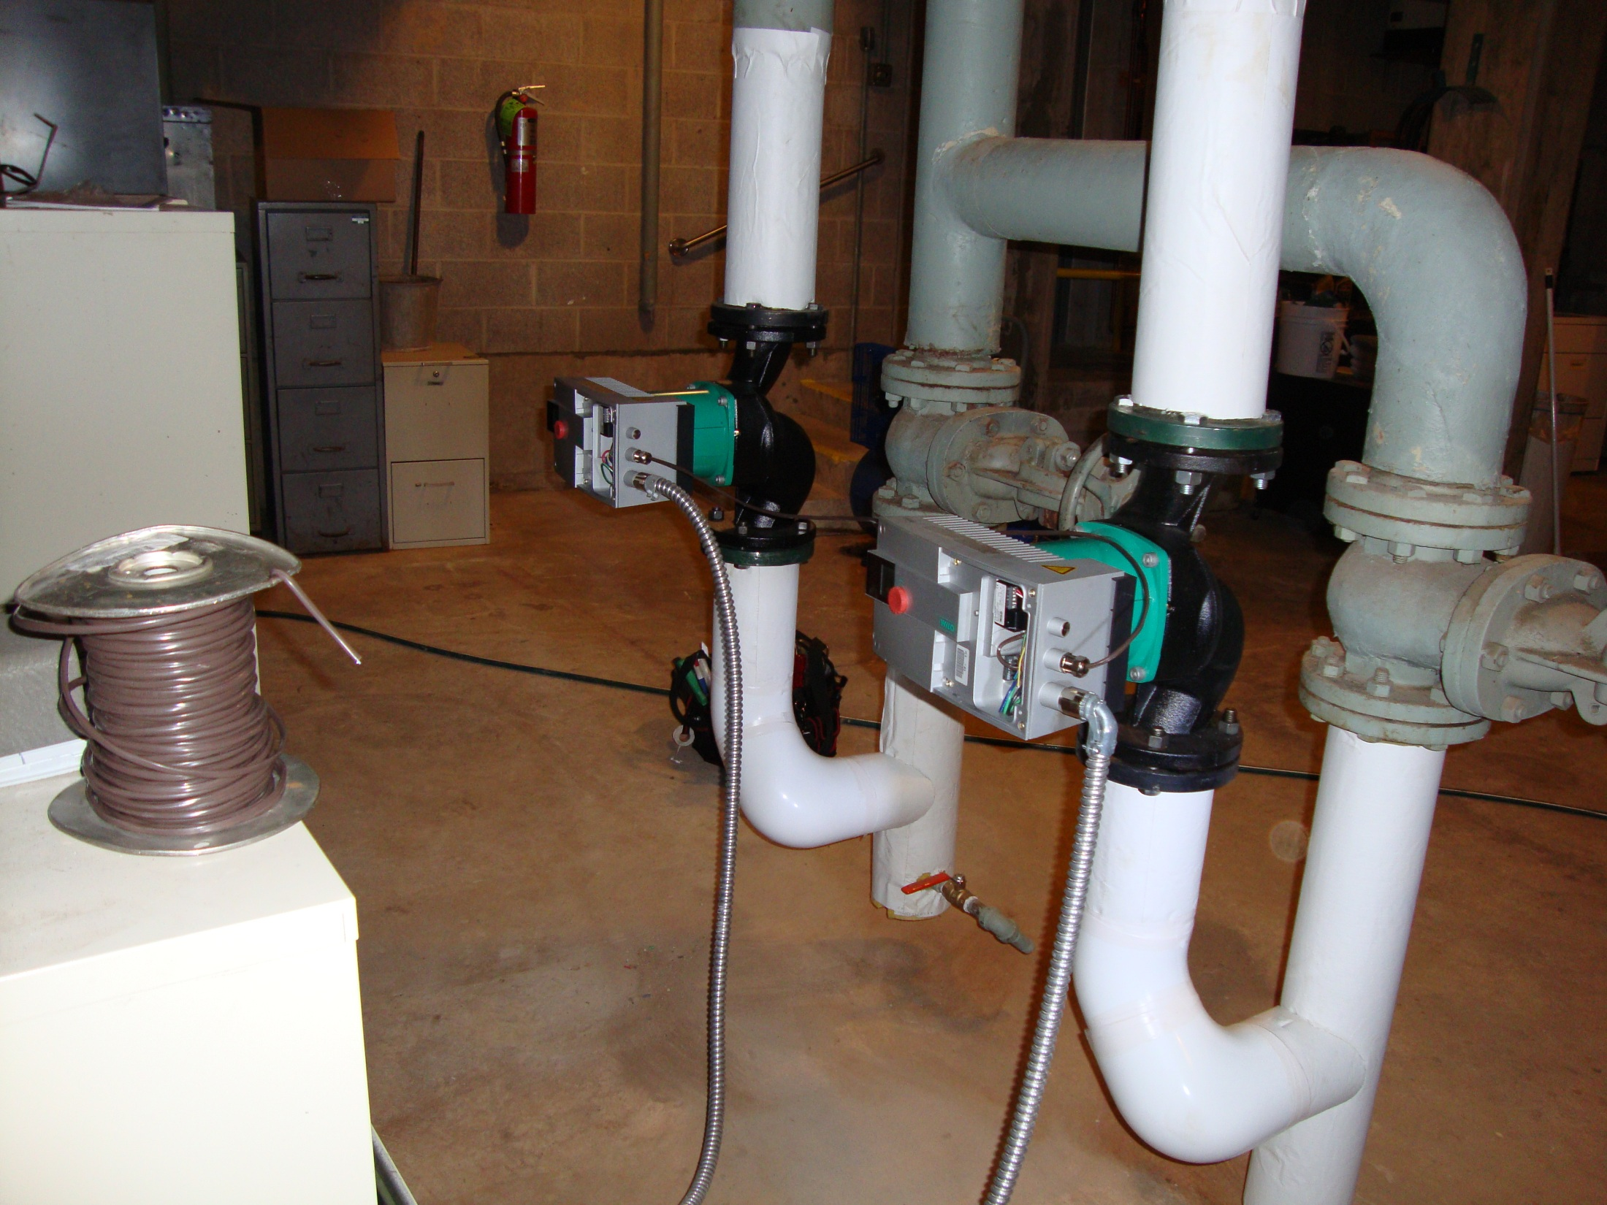

Slide 62
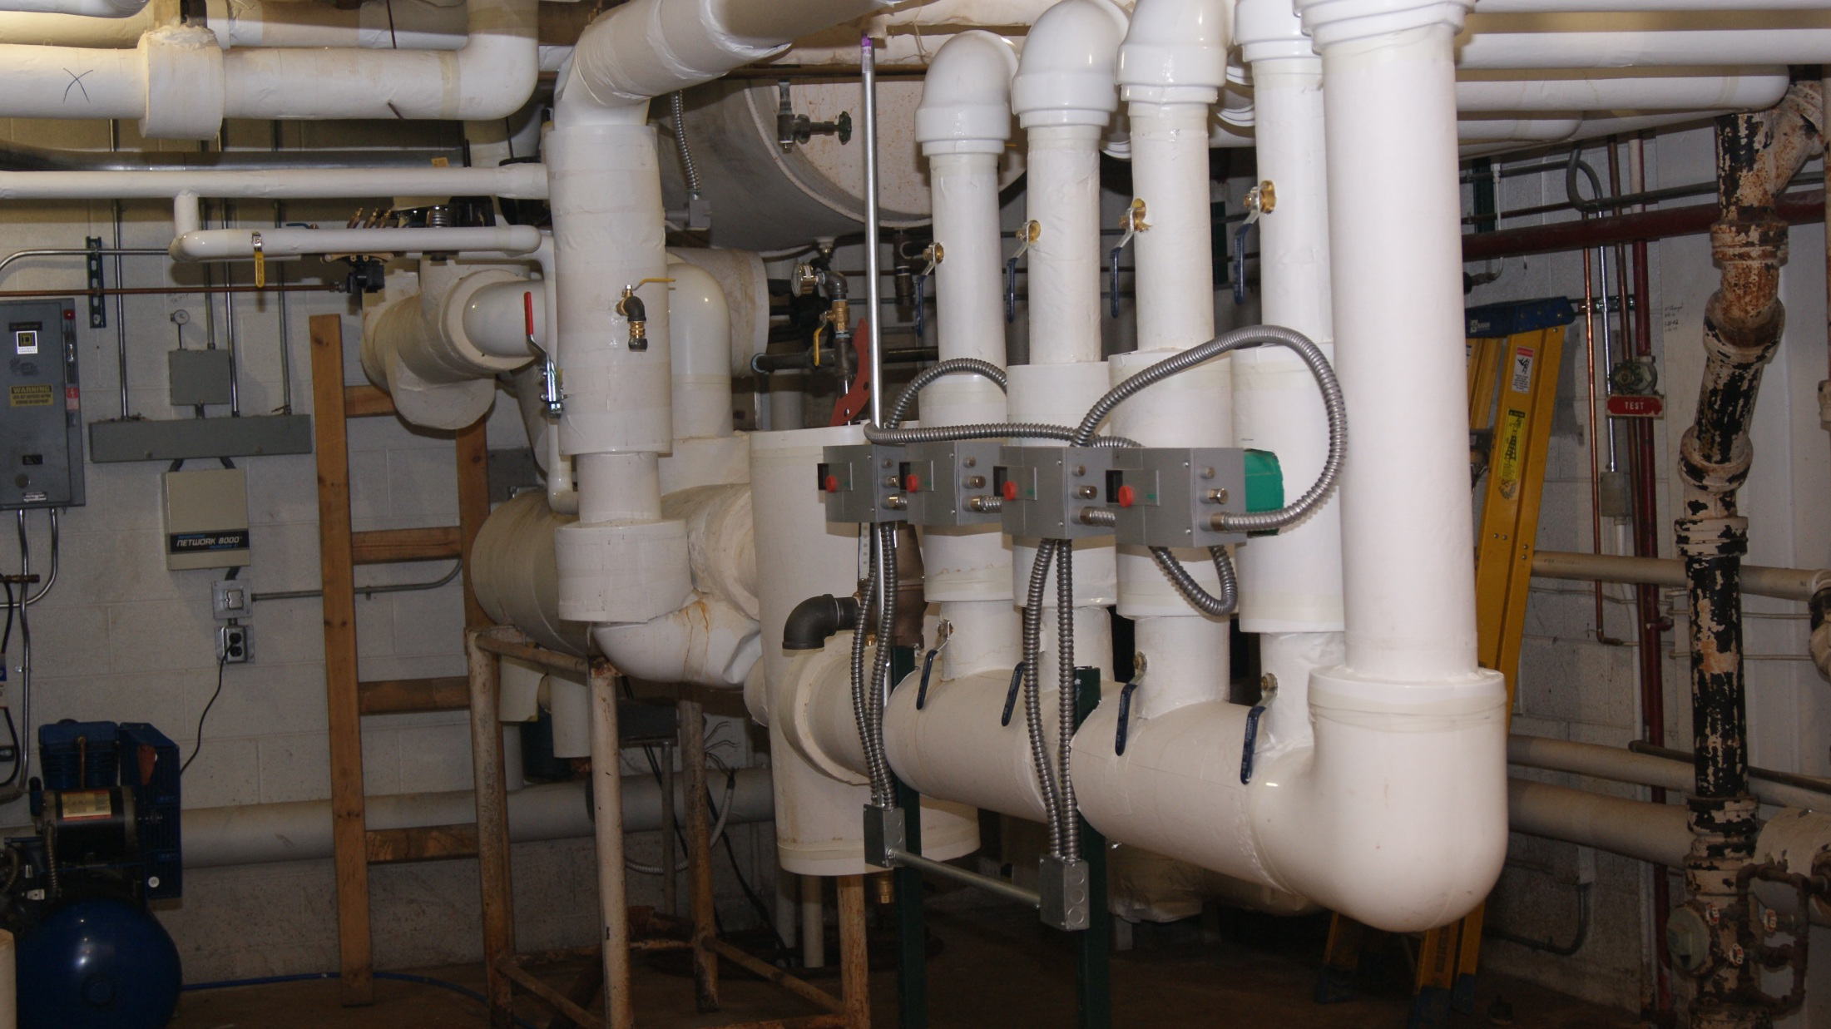

Slide 63


Slide 64
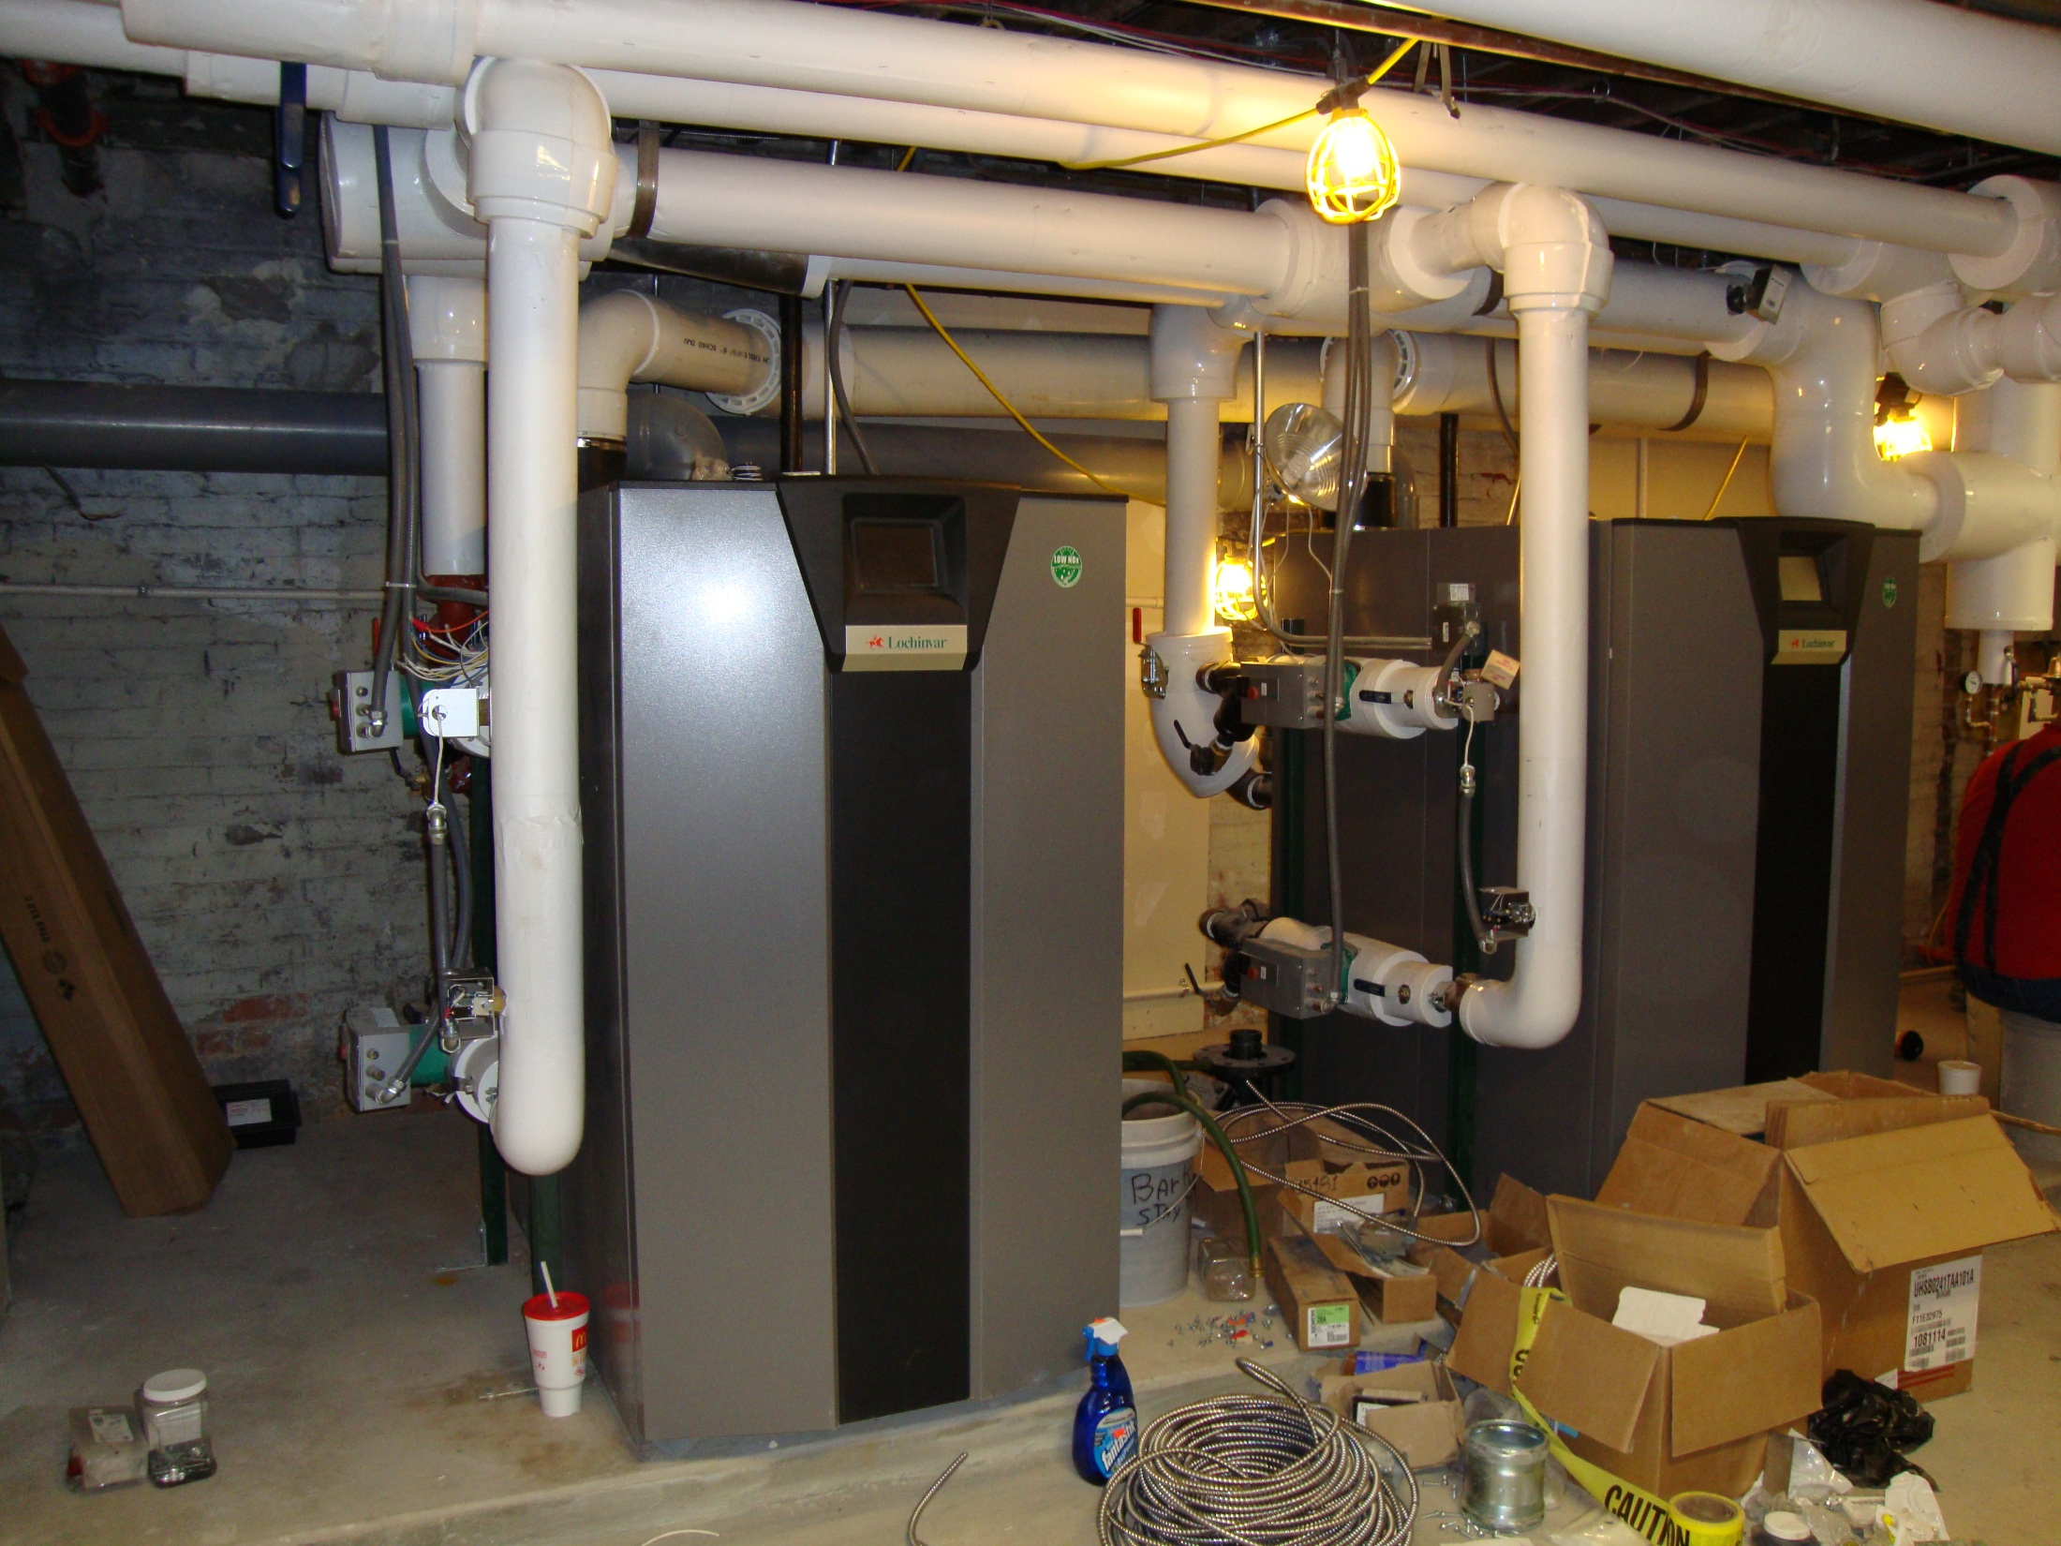

Slide 65
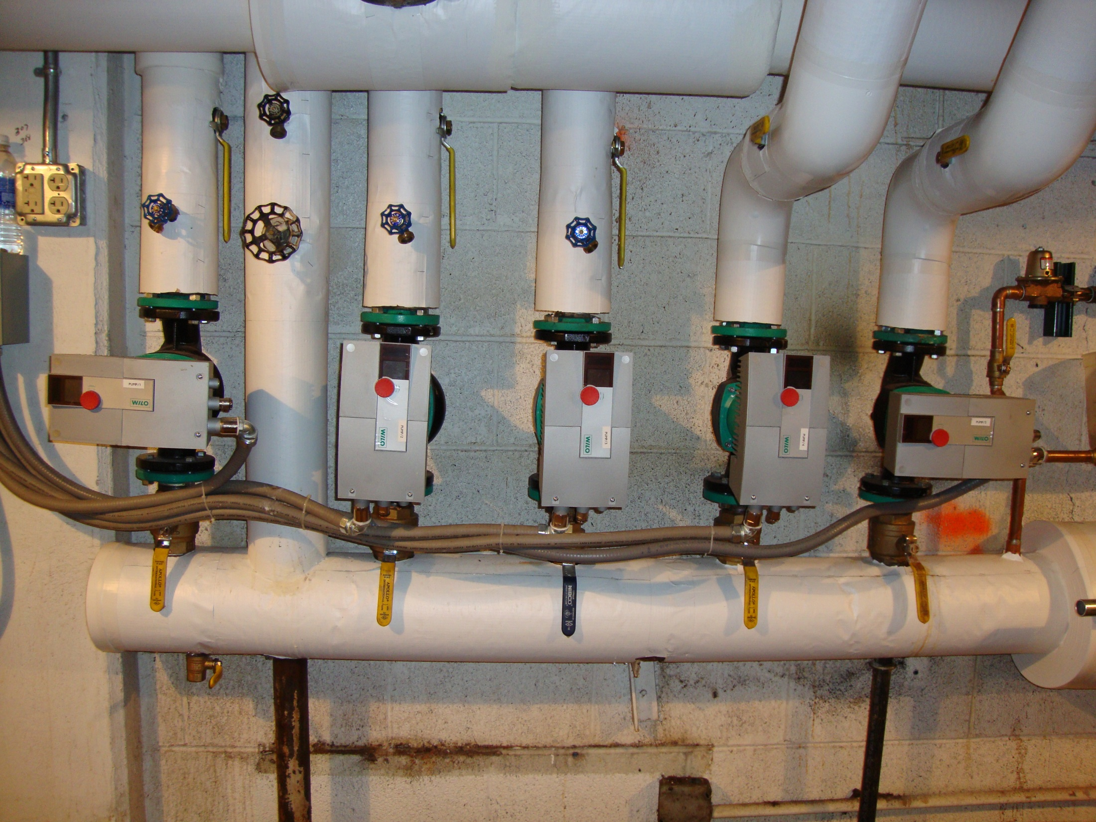

Slide 66


