Slide 1
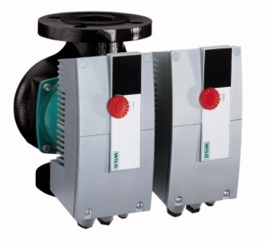
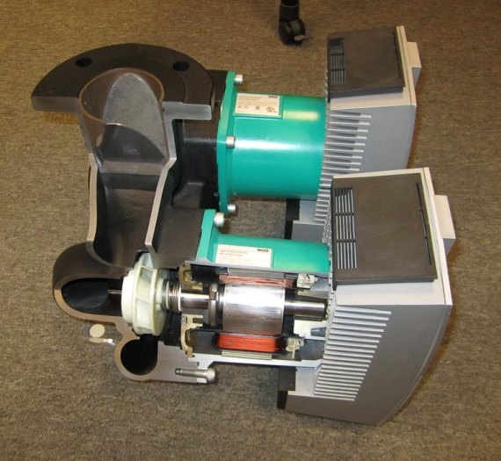
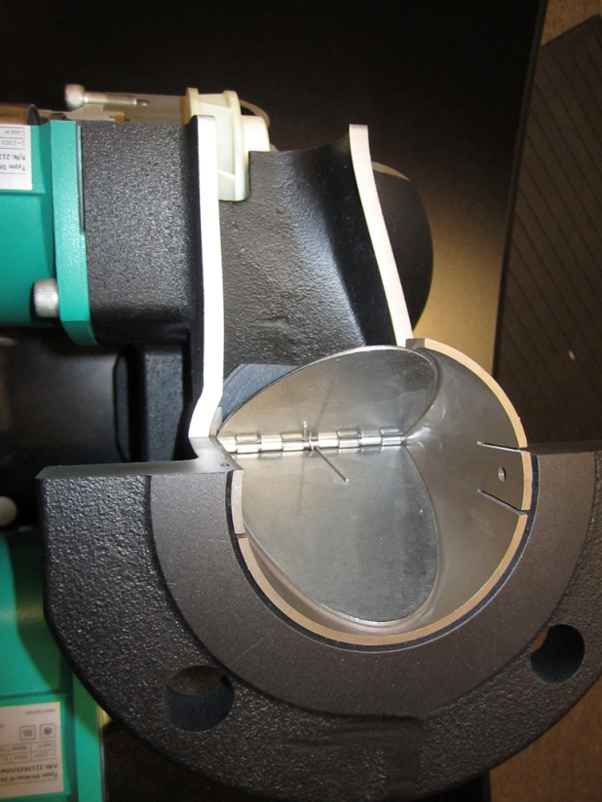
Stratos D
Stratos D
  Dual Volute
  2 Models
    Stratos D 2.0 3 x 40 (two 1.5 3 x 40)
    Stratos D 3.0 3 x 40
  Built in “check” valve
  IF Modules Extra
  EFFICIENT!
    ECM Product – Electrical
    Variable flow – System
    Installation
  Launch at ASHRAE/AHR

Slide 2
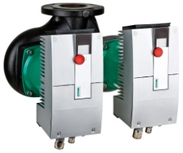
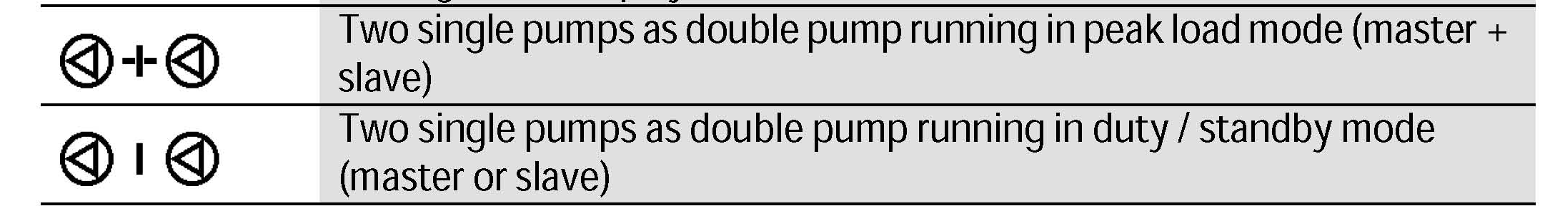
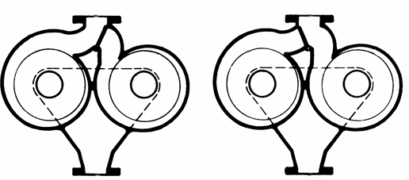
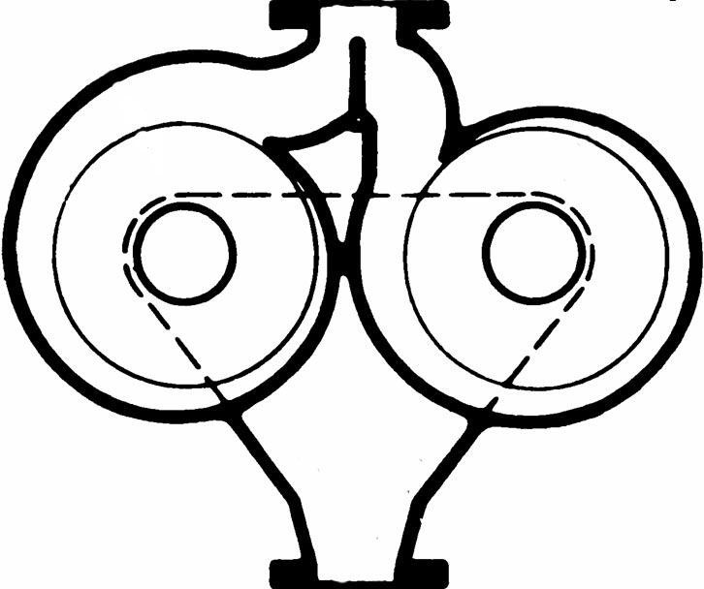
Stratos D
Two parallel pumps (powerheads) in one volute.
  Single operation, one main, one standby (factory default)
  Parallel operation, both pumps running when needed (set via red button or Infra-Red device)
NOTE: Position of integrated diverting check valve

Slide 3
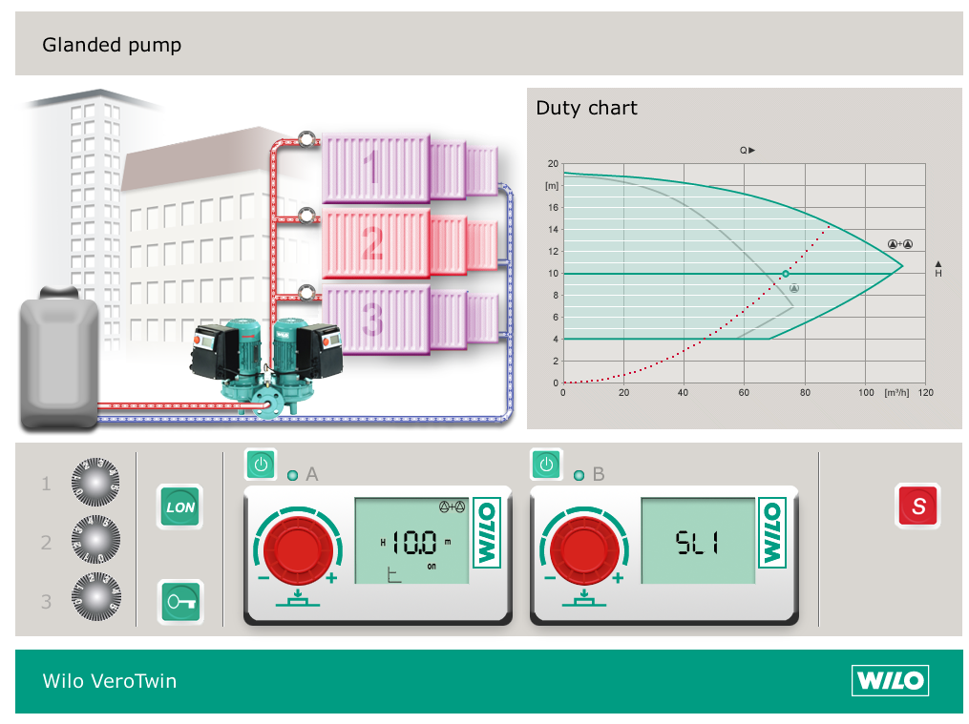
Stratos D

Slide 4
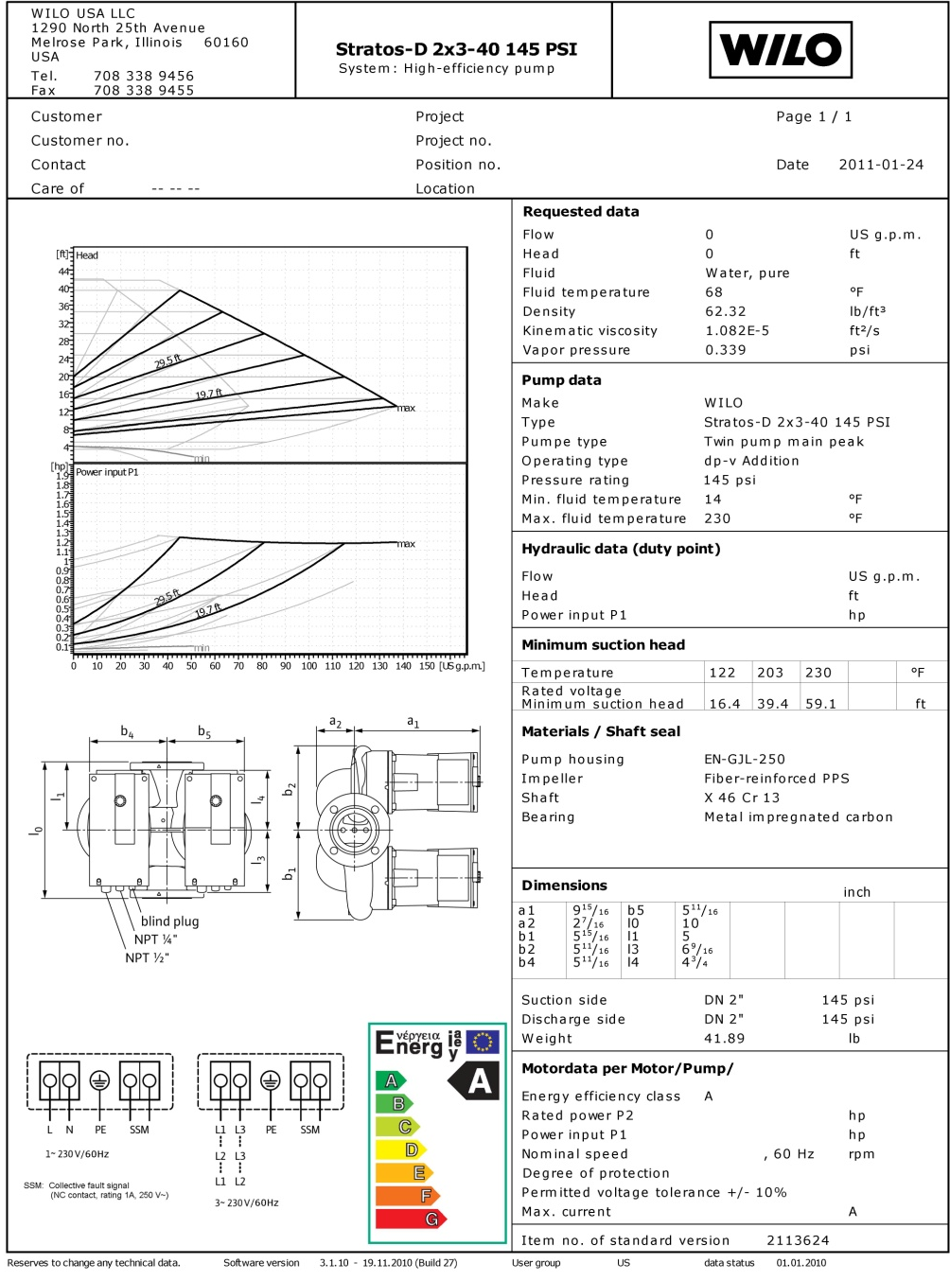
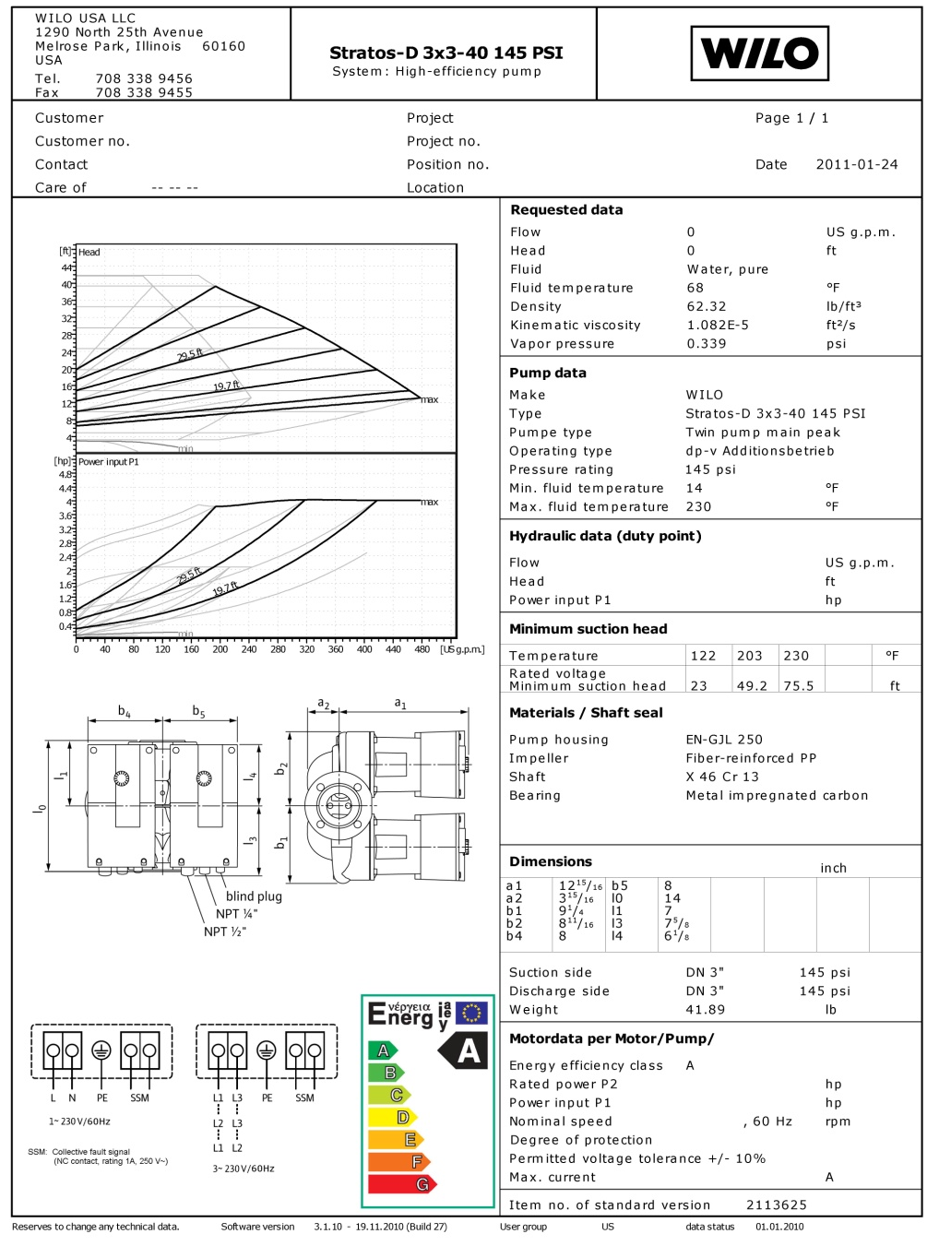
Stratos D – WILO Select

Slide 5
Stratos D
The Stratos D twin-head pump provides the following functions:
  Dual pump management
    Energy management
  Automatic fault actuated changeover
    On fault of one of the two pump heads
  Parallel operation
    High flow operation with both pump heads running as required
  Main / standby operation
  Daily duty alternation
    Even operation time of both pump heads (alternation ever 24 hours of run time)
  Master/ Slave Function
    Automatic control of the twin-head pump by the master (control inputs into the master only)

Slide 6
Stratos D – Introductory Training
  Mounting positions
Single-head pumps
Twin-head pumps
Notes:
No problems with the installation of single-head pumps.
Disregarding whether the direction of flow is horizontal or vertical the Wilo-Stratos is suitable for use on either alternative. Flexible module attachment positions ensure the optimum solution for any kind of application.
At cramped installation conditions the module can be taken to a vertical position by turning the engine.

Slide 7
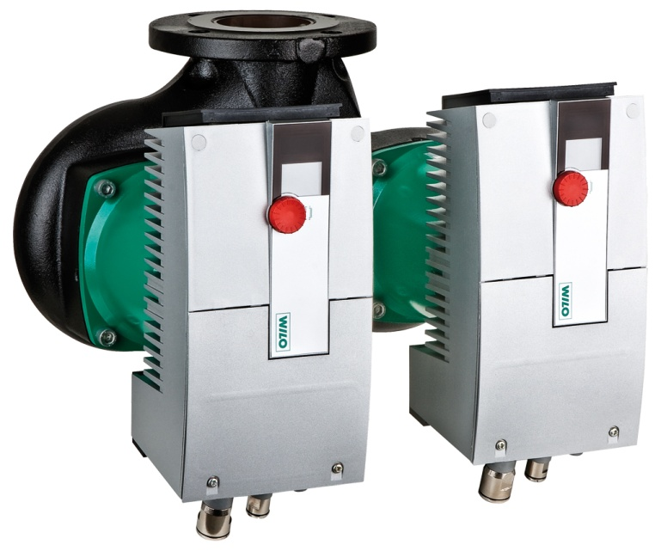
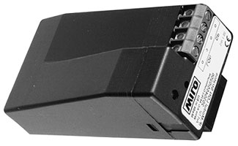
Stratos D

Slide 8
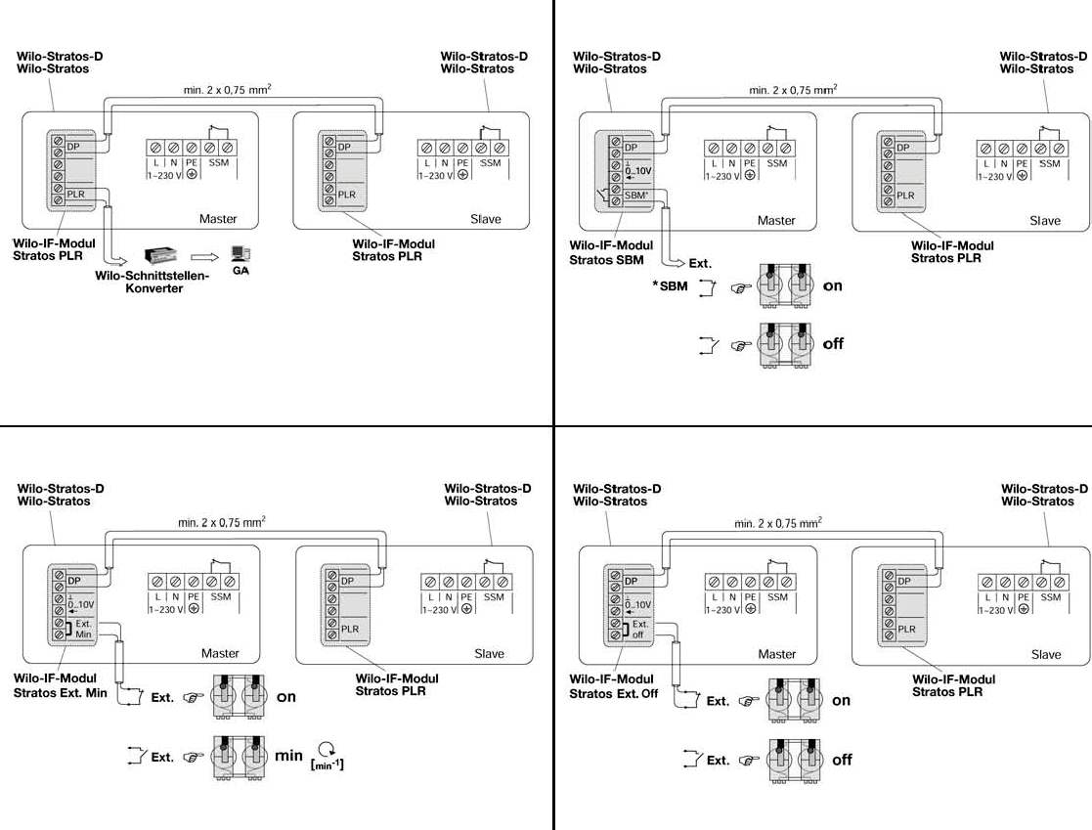
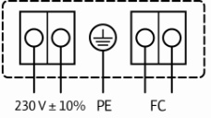
Stratos D – IF Module Wiring
All IF modules have the capability of connection / communication to one other Stratos (IF module required for both pumps). This enables dual control (master/slave) in parallel applications. Benefits include:
Stand-by operation in the event of a failure (5 min delay)
24 hour run time automatic alternation
Optional operation of both pumps when necessary
Master/Slave function
  On start-up both controllers flash “MA”
  Press in either red button to set master
  Slave pump follows adjustments made by master
  Ext control wired to master IF Module

