Slide 1
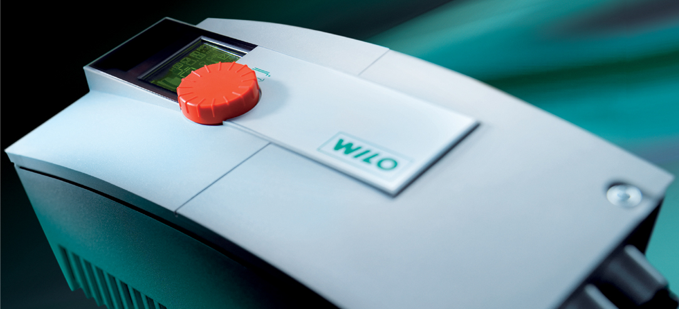
WILO Stratos Commercial Wet Rotor Training
Commercial Variable Speed Wet Rotor Circulators for Heating & Cooling
Presentation Date – Revised January 2009
Stratos

Slide 2
WILO Commercial Wet Rotor Circulators ECM “Smart” Automatically Controlled Circulators
Stratos (Cast Iron Only)
ECM (Electronically Commutated) technology
Soft start high torque permanent magnet rotor
8 Models available – interchangeable with Top S
Smart pump adjusts flow to system changes (∆p-v, ∆p-c and ∆p-t)
Temperature control for condensing boilers
Auto setback “fuzzy logic”
Non-volatile memory – no battery required
Standard industry flanges 1 ¼”, 1 ½”, 2” & 3”
Cataphoresis coating
Interface modules for 0-10Vdc, LON and external control
Dual pump mode (lead/lag, primary/secondary and back-up)
Infrared service/diagnostic tool available
Power consumption data logging
Ability to lock out red button
Single page start-up manual
230 volt +/- 10%, single phase (2 x 115, 230/1, 230/3 all OK)
Overload protection (voltage, dry run, locked rotor, over temperature)
No external sensors
Class “A” energy rating

Slide 3
Stratos vs. Stratos ECO
 | Stratos (max 285 Usgpm) | Stratos Eco (max 14 Usgpm)
Field of application | Large Residential / Commercial buildings | Residential and Secondary System Applications
Temperature range | +14 °F to +230 °F | +60 °F to +230 °F
Field of application | Heating, AC, Solar, Geothermal, | Heating
Operating concept | Extensive: Red Button (IR-Monitoring / LC-Display) | Simple: Red button 3 - 17 Ft
Communication capability | Communication compatible for BA | Not Av
Control / operating modes | ∆p-v, ∆p-c, ∆p-T, Auto Setback | ∆p-v, Auto Setback

Slide 4
WILO Stratos Model Number System
Stratos 1.5 x 3 - 40
Stratos
1.5
Flange size in Inches
3” ANSI, 125 # raised face, 4 bolt
2” pump flange - 4 bolt “grooved” pump type
1 ½” and 1 ¼” pump flange - oval 2 bolt “grooved” commercial type
3
Minimum head (ft)
40
Maximum head (ft)

Slide 5
Stratos North American Models All Stratos are 230/1/60 Volt (230/3/60 OK – wire 2 of 3 leads)
Stratos vs. Top S Interchangeability
Stratos 1.25 x 3 - 20 & 25 (6 1/2”) Top S 1.25 x 15 & 25
Stratos 1.25 x 3 - 30 & 35 (8 1/2”) Top S 1.25 x 35
Stratos 1.5 x 3 – 40 (10”) Top S 1.5 x 20,30 & 40
Stratos 2.0 x 3 – 35 (11”) Top 2.0 x 25, 35 & 40
Stratos 3.0 x 30 & 40 (14”) Top S 3.0 x 25 & 50 (voltage?)

Slide 6
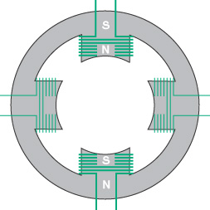
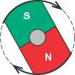
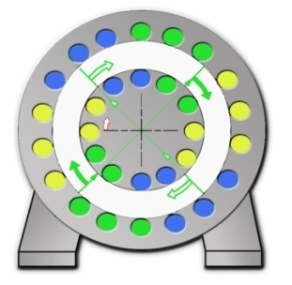
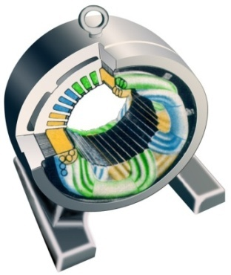
Efficient – Comparrison AC- / EC-Motor
AC-motor
Non controlled or VFD controlled pump
Asynchronous-squirrel-cage motor
Rotor is a sheet steel pack with nail like rods parallel to the rotor shaft
The rotor movement is caused by the rotating stator magnetic field
EC-motor
WILO Stratos (and ECO)
Brushless electronically commutated synchronous motor using a permanent magnet rotor
The rotor magnetic field “grabs” the rotating stator magnetic field, causing rotor rotation
Rotor (impeller) speed is determined by the pre-programmed drive software.
EC-Motor Requires Controller
Notes:
Comparison AC-/EC-Motor
On an AC-motor, as up to now used in conjunction with glandless pumps, the magnetic rotor flux is induced by stator flux.
On the Wilo-Stratos the rotor is equipped with a strong permanent magnet. The rotating stator flux is generated by electronic commutation.
One does thus speak of an electronically commutated or EC (Electronically Commutated)-Motor. This motor principle is also the basis for naming the ECM-technology..

Slide 7
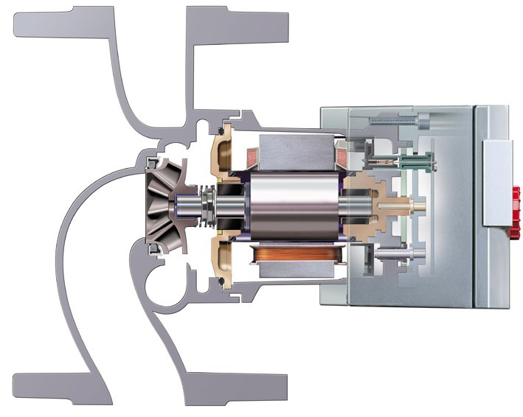
Improving Hydraulic Efficiency
Engineering design of the Wilo-Stratos
Smooth internal surfaces
Suction throat seal
3D-impeller
Lip seal
3D-spirale volute
Notes:
Improved hydrailic efficiency
3D-spirale improve the flow pattern in the pump housing.
hydraulically smooth internal surface of the pump housing by electrophoretical coating
3D-impellers of reduced blade thickness to achieve an optimum cross-sectional flow pattern .
suction throat seal at the pump housing minimizing radial gap losses.
lip seal at the front face of the suction throat minimizing axial gap losses
Why does the Stratos exchange motor not fit into a TOP-E-Pp. housing ?
Objective Wilo-Stratos: High-efficiency pump with optimum efficiency
thus: an additional pump series with a completely newly developed and optimally matched production parts:
- motor - wet rotor encapsulation - hydraulics (pump body, impeller)

Slide 8
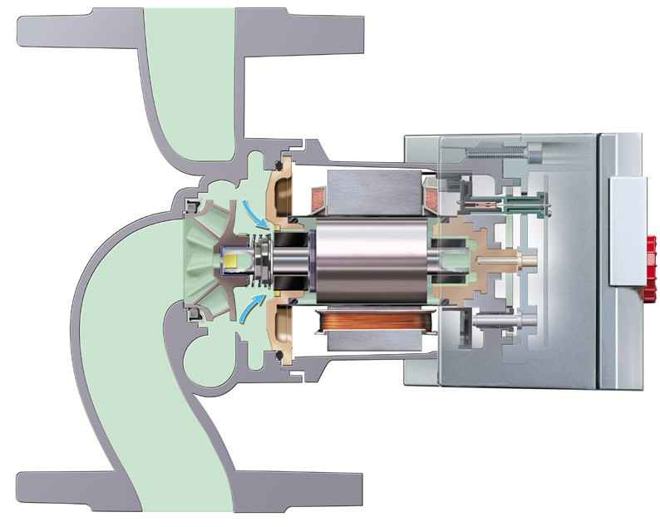
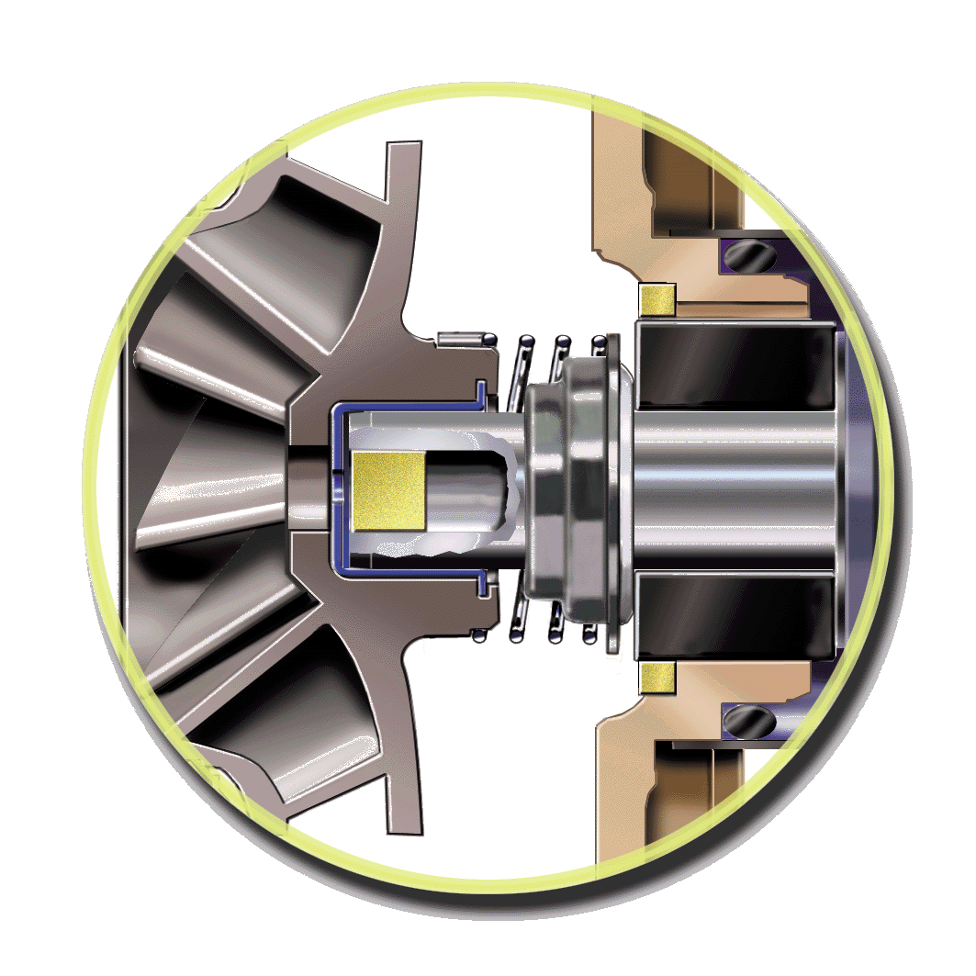
Improving Hydraulic Efficiency
Initial startup
1. Filling
Filter disc
2. Filtration
3. Lubricate
Filter plug
4. Air venting
Seal
Notes:
Filling the pump
On filling the fluid will flow via the filter plug of the hollow shaft and the filter disk in the bearing plate. The fluid will then be equally distributed in the entire rotor space via the flow channels of bearing plate and B bearing.
Operation of the pump
During operation the generated pump head displaces and filters the fluid through the filter disc. By way of the flow channels in the bearing plate it reaches the rotor space, flows through the gap between can and rotor cage and then through the B-bearing via the channels in the B-bearing plate. From there it continues through the shaft in the direction to the impeller.
Wear of mechanical seal = zero as there is a pressure balance between both sides.
Clogging up of the sinter metal is prevented by back flushing from the rotor (standstill).

Slide 9
Functional - Variable Mounting Positions
Mounting positions
Notes:
No problems with the installation of single-head pumps.
Disregarding whether the direction of flow is horizontal or vertical the Wilo-Stratos is suitable for use on either alternative. Flexible module attachment positions ensure the optimum solution for any kind of application.

Slide 10
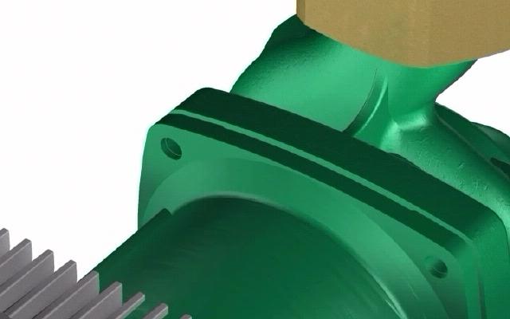
Functional - Variable Mounting Positions
Click Here to Play Video

Slide 11
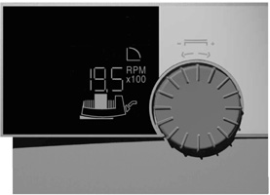
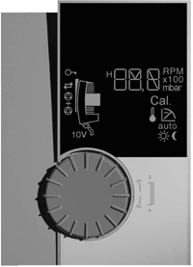
Functional - ‘Any Way‘ Positioned Display
All symbols for horizontal mounting.
All symbols for vertical mounting.
Notes:
More operating safety due to ‘any way‘ positioned display
Optimum operating and monitoring possibilities of the Wilo-Stratos due to variable pump and module positioning alternatives. The front facing pump display with its rotating screen ensure that all important informations can be accessed at any time and without any trouble.
Extension of the manual operating capabilities for special applications is possible when using wireless communication by means of the Wilo-IR Monitor operating and service unit.

Slide 12
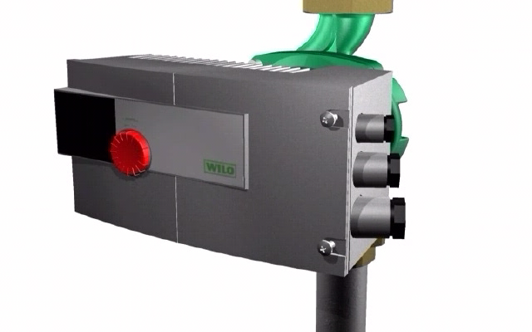
Functional – Electrical Wiring Connections
Click Here to Play Video

Slide 13
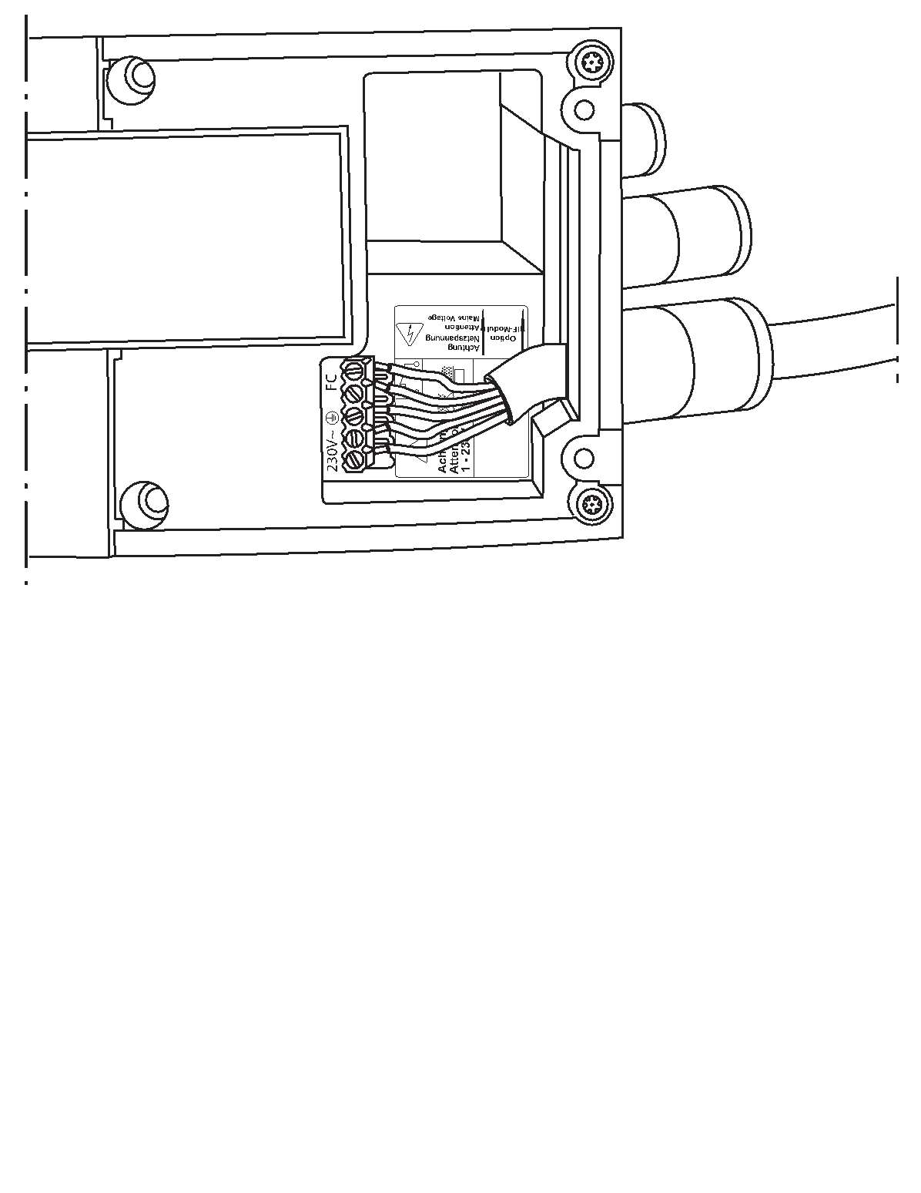
Functional – Electrical Wiring Connections
How to Wire
Stratos Technology Makes it Simple
Stratos Converts Power
Single Phase AC to DC
DC to Three Phase AC
Total Voltage 230 +/- 10% (208 OK)
230 volt “hot” and neutral OK
Two 115 volt ‘hots” with no neutral OK
Wire from opposite sides of 115 volt panel
FC Fault Contact
Potential free, normally closed contact
Minimum contact load – 12 Vdc, 10 mA
Maximum contact load – 250 Vac, 1 Amp

Slide 15
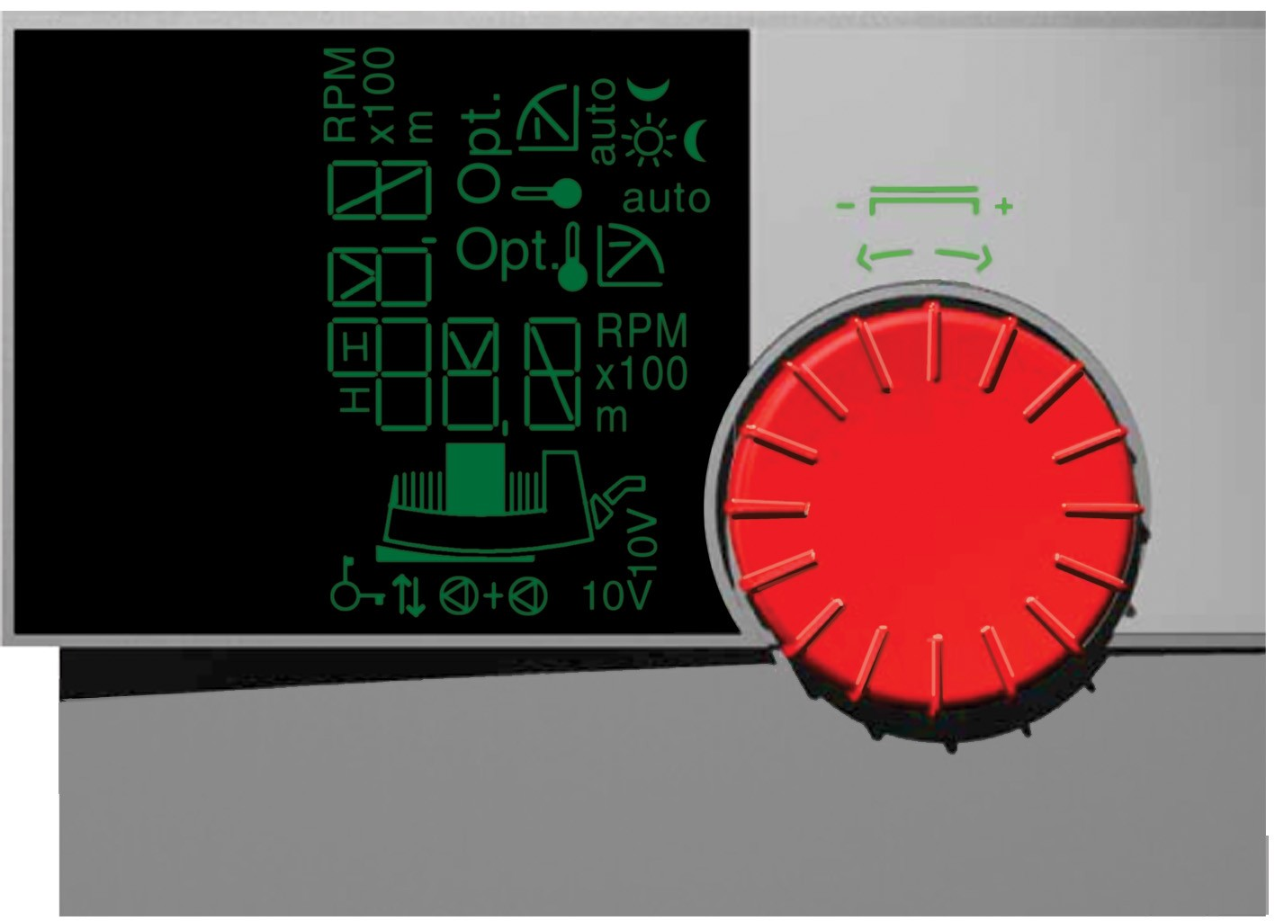
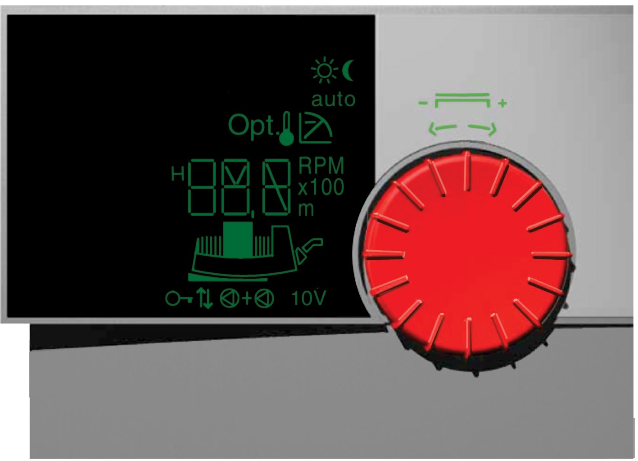
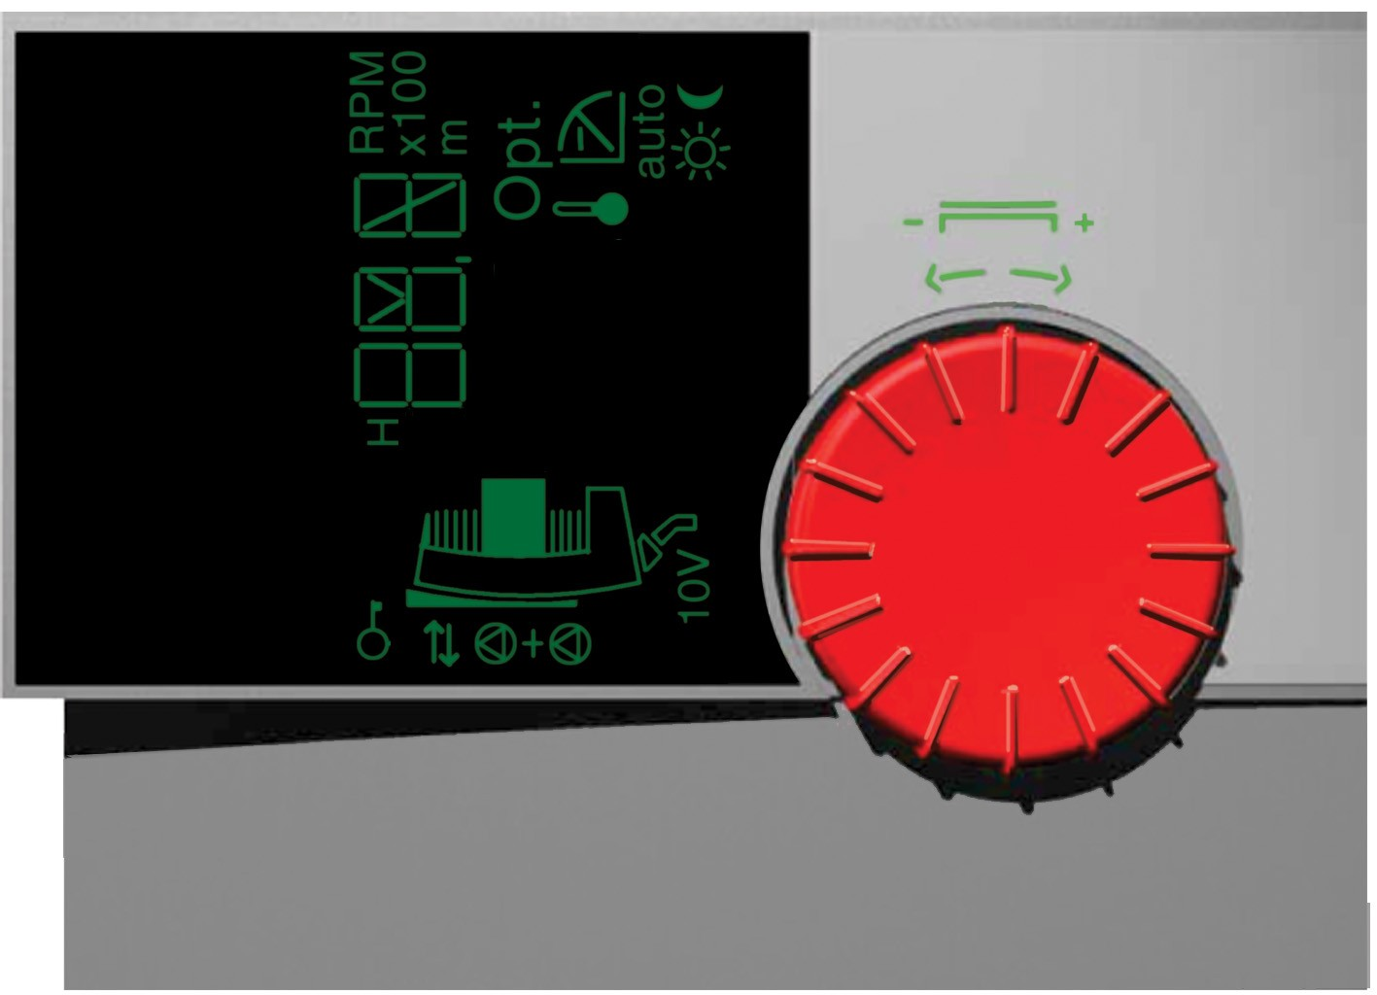
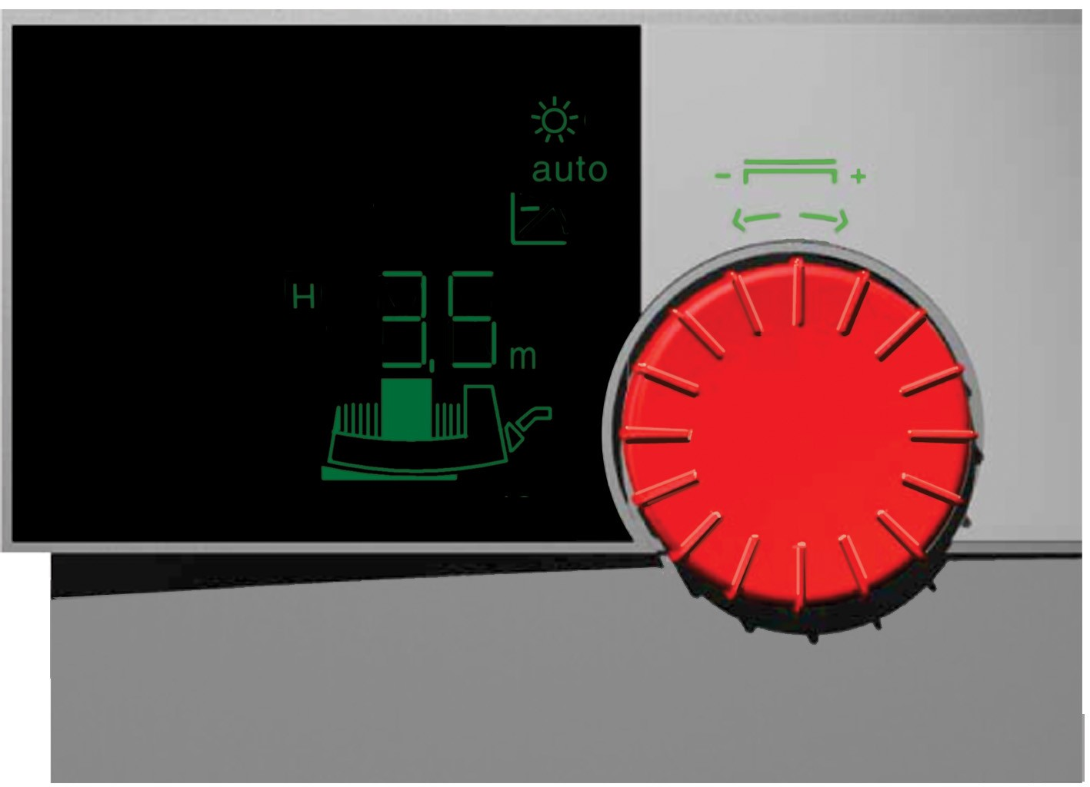
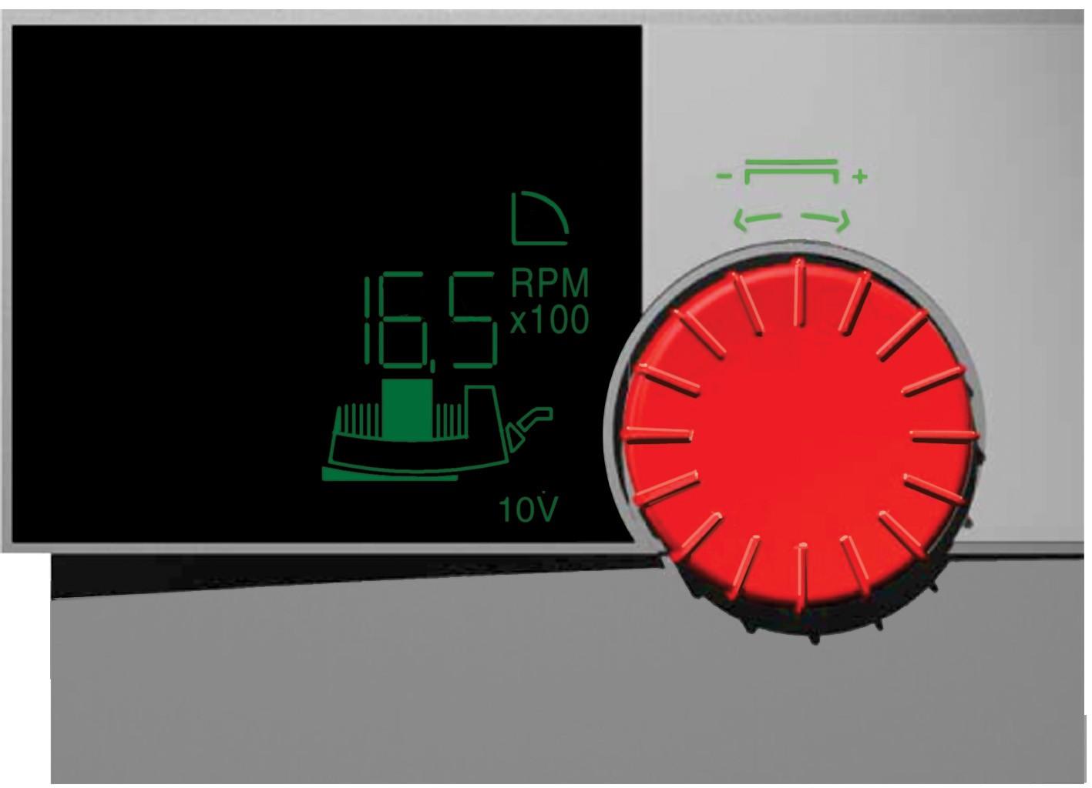

Functional – Operating Control Via Red Button and Display

Slide 16
Functional – Operating Control Via Red Button and Display
Click Here to Play Video

Slide 17
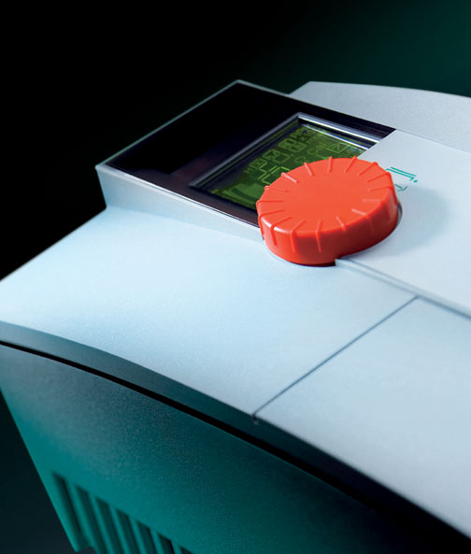
Manual Control Mode
The manual control mode deactivates the control in the electronic module.
The speed can be manually adjusted to a preselected constant level
Adjustable in 10 RPM increments!
Notes:
Manual control mode
In the manual control mode the control function in the electronic module becomes deactivated. The pump speed can be manually set to a constant level.

Slide 18
Speed Control
Electronic continuous speed control (Constant Pressure)
Automatic differential pressure control
n_{max}
1. The „brain“ determined the actual pumping head. (actual value)
H₂
2
Constant speed pump
2. The „drive“ sees the difference between the set value (point 1) and the actual value. (point 2)
3
1
3. Via ECM smart technology the controller reduces the speed and reduced the pumping head to match the system curve. (point 3)
H₁
Pumping Head H [Ft]
Q₁
Q₂
Flow Q [USGPM]

Slide 19
Automatic Control Mode
Electronic continuous speed control
control modes
∆p-c  differential pressure constant
∆p-v  differential pressure variable (max head is twice min head)
∆p-T  temperature guided differential pressure control
∆p-cv  combination from differential pressure constant (second and third area of characteristic) and differential pressure variable (first area of characteristics)
Operation modes
Automatic → night setback (let down function)
Manual regulation
DDC (Direct Digital Control)

Slide 20
Delta PC vs Delta PV
Delta PC or Constant Pressure (differential) – low head systems
Delta PV or Pressure Variant (max head twice min) – high head systems
H
Δpc
Saves energy, because the load-controlled
pump adjusts to system changes
Δpv
Q

Slide 21
Delta P-T
Change in temperature at the pump changes the pressure setpoint
IR tool required to activate and set parameters
Stratos installed on return
T Max: 150 F H @ Max T: 10’
T Min: 100 F H @ Max T: 30’
T Max: 190 F H @ Max T: 7’
T Min: 140 F H @ Max T: 25’
Head
Head
30‘
25‘
10‘
7‘
100 F
150 F
Temp
140 F
190 F
Temp
Condensing Boiler Application
(Increases delta T on temp rise)
Non-Condensing Boiler Application
(Decreases delta T on temp rise)

Slide 22
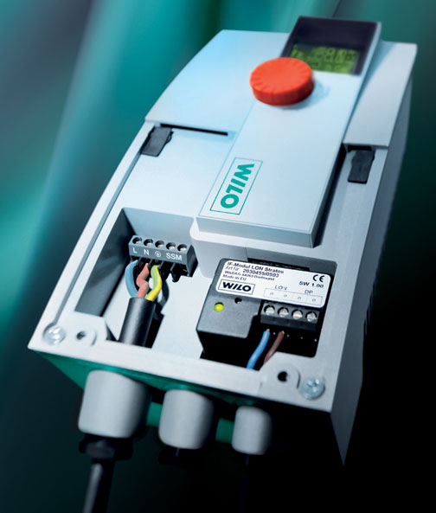
Functional – Inter Face Modules
Front access (Face-to-Face)
Freely accessible wiring connections - NPT
Large terminal box
Plug-in IF-Modules
Notes:
Electrical wiring connections (Face to Face)
The axially positioned control module allows easy frontal access to the terminal space of the Wilo-Stratos.
The installation of the pump thus becomes uncomplicated for the installer as the terminal space is easily accessible from the front and thus the power and control wiring can easily be connected ‘face to face‘.
Electrical wiring to existing power supply:
1~230V ± 10%, 50Hz: L, N, PE
3~230V ± 10%, 50Hz: L₁/L_{2 or} L₂/L_{3 or} L₁/L_{3, PE}

Slide 23
Functional – Inter Face Modules
External Min/0 – 10 Vdc/DP
0 – 10 Volt DC External Input
Sets either pump speed or head set point (over rides electronic control)
Input resistance greater than 100k Ohm, Dielectric strength 24 V, Accuracy +/- 5%
External Minimum – potential free closed input terminals
Closed contact normal operation – open contact pump runs at min speed
Max contact load 24 Vdc/10mA, Dielectric strength 250 Vac
DP double pump terminals – hook up second (slave) pump
External Off/0 – 10 Vdc/DP (DP and 0 – 10 Vdc same as Ext Min)
External Off – potential free closed input terminals
Closed contact normal operation – open contact pump off (electronics on)
Max contact load 24 Vdc/10mA, Dielectric strength 250 Vac
SBM (run signal)/0 – 10 Vdc/DP (DP and 0 – 10 Vdc same as Ext Min)
RC Run Circuit remote sensing of pump operation
Closed contact normal operation – open contact pump off
Max contact load of potential free normally open contact – 24 Vac, 1 A

Slide 24
Functional – Inter Face Modules
LON interface for link-up to LONWORKS-networks, Transceiver FTT 10 A
PLR interface for link-up to BMS via über WILO- interface converter or onsite coupling modules
DP interface for an integrated dual pump management of 2 single-head pumps
Control input ‘ =...10V‘ for remote speed control or head setpoint adjustments
Control input ‘Ext.Off‘ for volt-free normally closed contacts
Control input ‘Ext.Min‘ for volt-free normally closed contacts
Run signal SBM as volt-free normally open contacts
Function
Module type
Ext. Off
Ext. Min
LON
PLR
SBM
•
•
•
•
•
•
•
•
•
•
•
•
•
Notes:
Plug-in module types ffor single- and twin-head pumps:
1 x Wilo-IF-Modul Stratos PLR for single-head pumps
1 x Wilo-IF-Modul Stratos LON for single-head pumps
1 x Wilo-IF-Modul Stratos Ext.Off for single-head pumps
1 x Wilo-IF-Modul Stratos Ext.Min for single-head pumps
1 x Wilo-IF-Modul Stratos SBM for single-head pumps
2 x Wilo-IF-Modul Stratos PLR for dual pump units
2 x Wilo-IF-Modul Stratos LON/PLR for dual pump units
2 x Wilo-IF-Modul Stratos Ext.Off/PLR for dual pump units
2 x Wilo-IF-Modul Stratos Ext.Min/PLR for dual pump units
2 x Wilo-IF-Modul Stratos SBM/PLR for dual pump units

Slide 25
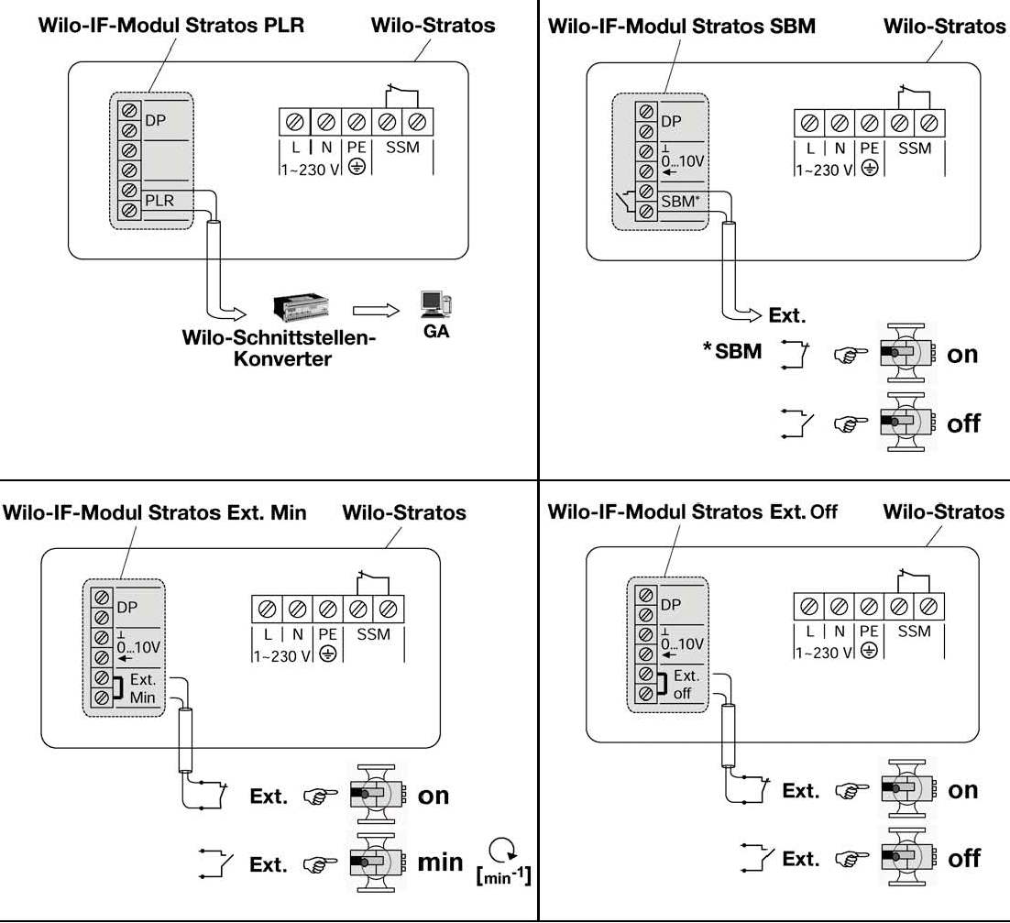
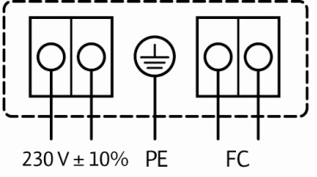
Functional – Inter Face Modules

Slide 26
0 – 10 Vdc Speed Control Mode
Remote speed adjustments
n [RPM]
3.0 V = min.
n max
1.5 V = Off
1.0 V = On, min.
n min
Off
1 1,5 3 10
Vdc
Notes:
DDC Control Mode (0-10V)
The interface standards recommendations to VDI 3814 are still valid today; analogue signals (current, voltage) and volt-free contacts (normally closed, normally open).
In the DDC control mode the for the automatic control required setpoint/actual balance will be taken over by an external controller. An analogue signal (0-10V) will be transmitted from the external controller to the Wilo-Stratos as the manipulated variable. The actual motor speed can be read off the pump display; other operations on the pump are blocked.
Required accessory: IF-Module Stratos*
* See adaption Table ‘IF-Module Wilo-Stratos‘
Wilo-Stratos features standard supplied and optionally available interface equipment for linking up to remotely located monitoring stations (e.g. building management or DDC systems)

Slide 27
0 – 10 Vdc Speed Control Mode
Remote setpoint adjustment
H [ft]
H max
H min
1 10
Vdc
Notes:
Remote setpoint control mode (0-10V)
The setpoint level for the internal differential pressure (Δp-c) control can be adjusted by an overriding control variable from an external source.
.
Required accessory: IF-Module Stratos*
* See adaption Table ‘IF-Module Wilo-Stratos‘
Wilo-Stratos features standard supplied and optionally available interface equipment for linking up to remotely located monitoring stations (e.g. building management or DDC systems)

Slide 28
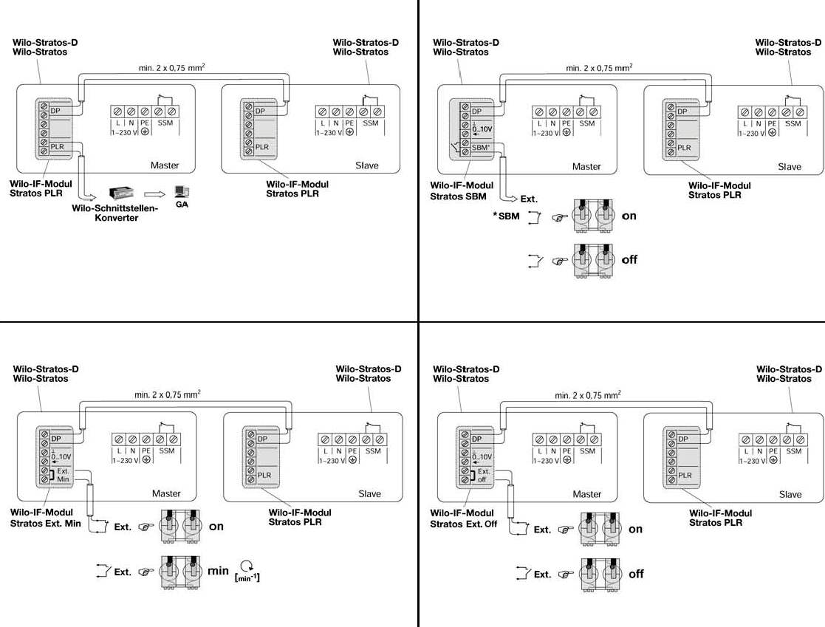
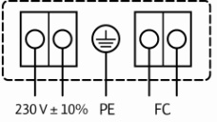
IF Module (Inter Face) - Dual
All IF modules have the capability of connection / communication to one other Stratos (IF module required for both pumps). This enables dual control (master/slave) in parallel applications. Benefits include:
Stand-by operation in the event of a failure (5 min delay)
24 hour run time automatic alternation
Optional operation of both pumps when necessary
Master/Slave function
On start-up both controllers flash “MA”
Press in either red button to set master
Slave pump follows adjustments made by master
Ext control wired to master IF Module

Slide 29
DDC Speed Control Mode
Remote speed adjustments
n [RPM]
3.0 V = min.
n max
1.5 V = Off
1.0 V = On, min.
n min
Off
1 1,5 3 10
Vdc
Notes:
DDC Control Mode (0-10V)
The interface standards recommendations to VDI 3814 are still valid today; analogue signals (current, voltage) and volt-free contacts (normally closed, normally open).
In the DDC control mode the for the automatic control required setpoint/actual balance will be taken over by an external controller. An analogue signal (0-10V) will be transmitted from the external controller to the Wilo-Stratos as the manipulated variable. The actual motor speed can be read off the pump display; other operations on the pump are blocked.
Required accessory: IF-Module Stratos*
* See adaption Table ‘IF-Module Wilo-Stratos‘
Wilo-Stratos features standard supplied and optionally available interface equipment for linking up to remotely located monitoring stations (e.g. building management or DDC systems)

Slide 30
Remote Head Setpoint Control Mode
Remote setpoint adjustment
H [ft]
H max
H min
1 10
Vdc
Notes:
Remote setpoint control mode (0-10V)
The setpoint level for the internal differential pressure (Δp-c) control can be adjusted by an overriding control variable from an external source.
.
Required accessory: IF-Module Stratos*
* See adaption Table ‘IF-Module Wilo-Stratos‘
Wilo-Stratos features standard supplied and optionally available interface equipment for linking up to remotely located monitoring stations (e.g. building management or DDC systems)

Slide 31
LON IF Module (Inter Face)
LON/DP
LON interface for LonWorks BMS building automations – FTT 10 A - LONTalk
DP double pump terminals – hook up second (slave) pump
Data points LON-Protocol
Pumps w/o external Sensor
Pump Setpoint
Requested Pump-Operating Mode
Pump Pressure
Pump Flow
Pump Speed
Runtime
Fault States of the Pump
Maintenance States
Fluid Temperature
Power Consumption in Watts
Power Consumption in Kilowatts
Energy Consumption
Control Mode for Normal Operation
Pumps with external Sensor additional
Remote Pressure-Sensor Input
Remote Temperature-Sensor Input
Remote Pressure-Sensor Minimum Value
Remote Pressure-Sensor Maximum Value
Remote Temperature-Sensor Minimum Value
Remote Temperature-Sensor Maximum Value

Slide 32
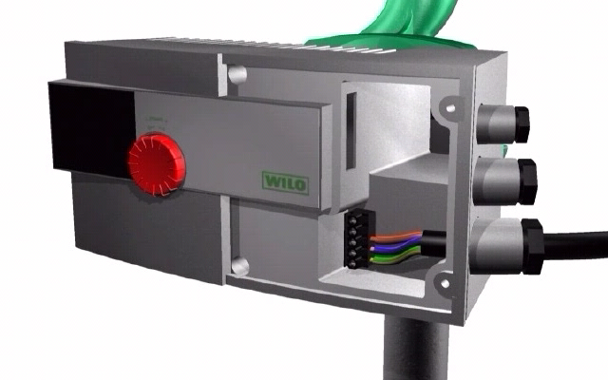
Functional – Electrical Wiring Connections to Optional Modules
Click Here to Play Video

Slide 33
Application Drawings (Click immage to access „pdf“ drawings)

Slide 34
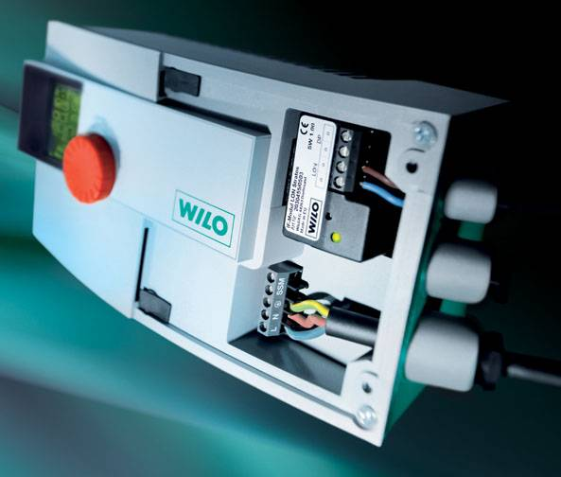
Functional – Collective Fault Signaling (FC) FC is a Normally Closed Volt Free Contact for Remote Failure Sensing
The following faults will cause contact to open:
Over temperature motor
Over temperature control module
Over current
Pump shaft seizure
Short or grounding
Contact failure between motor and module
Power supply - undervoltage ( < 195 V )
Power supply – overvoltage ( > 253 V )
Notes:
Collective fault signals (SSM)
For the signal transmission to external monitoring units all Wilo-Stratos pumps are standard equipped with a collective fault signalling system, acting as volt-free normally closed contacs to VDI 3814.
Contakts are closed on the following conditions:
the pump is deenergized,
there is no fault event,
the control modul has failed completely
Contakts are open on the following conditions:
Mains power is available and one of the above listed faults had occured.
Switch rating: 250 VAC, 1A

Slide 35
Faults, Causes and Remedial Actions
Fault signals
If a fault occurs the pump is deactivated, the red fault LED in the IR-window (display left side) is on and the fault code is indicated on the display.
Following a 5-minutes interval the pump will be automatically re-activated.
The pump will only be switched off permanently after the 6th fault event of the same type. The fault must then be manually reset.
Note! Note exceptions E10 (locked rotor) and E25 (module contact failure). Here the pump will be switched off following the 1st fault event.

Slide 36
Faults, Causes and Remedial Actions
Warning signals
The fault will be shown on the display as a warning signal, however fault light and the SSM relay do not respond.
The pump continues operation the fault can occur repeatedly .
The indicated faulty operating condition should not be occurring over an extended period.
The cause must be attended to and be remedied.
Note! Note exceptions E04 and E05 (low or high voltage). These will be further processed as fault signals if these alarm signals remain activated for longer than 5 minutes.

Slide 37
Faults, Causes and Remedial Actions
Fault | Remedy | Remedy
Pump does not run despite power being on | Defect electrical fuse | Check fuses
 | No power at the pump | Rectify contact failure
Noises from the pump | Cavitation due to insufficient inlet pressure | Increase superimposed system pressure within permissible limits
 |  | Check adjustable head setting, if required reduce pumping head

Slide 38
Faults, Causes and Remedial Actions
Fault signals: Fault-LED “continuous light”
Code-No. | Symbol flashes | Fault | Cause | Remedy
E04 | Power terminals | Power undervoltage | Mains overloaded | Check electrical installation
E05 | Power terminals | Power overvoltage
E10 | Motor | Locked rotor | e.g. due to dirt deposits | Delocking procedure starts automatically. The pump will switch off if delocking is not effective after 10 s. call service.
E20 | Motor | Overtemperature windings | Motor overloaded | Leave motor to cool down, check settings
 |  |  | Fluid temperature to high | Lower fluid temperature
E21 | Motor | Motor overloaded | Sediment deposits in the pump | Remove head and clean

Slide 39
Faults, Causes and Remedial Actions
Fault signals: Fault-LED “continuous light”
Code-No. | Symbol flashes | Fault | Cause | Remedy
E23 | Motor | Short/Earth circuit | Motor defect | Call service
E25 | Motor | Contacting failure | Module not correctly plugged in | Remove module and replug
E30 | Module | Over temperature | Insufficient air access to cooling body of module | Ensure proper ventilation
 |  |  | Ambient temperature to high | Improve room ventilation
E31 | Module | Over temperature power pack | Ambient temperature to high | Improve room ventilation
E36 | Module | Defect Module components | Defect electronic | Call service/exchange module

Slide 40
Faults, Causes and Remedial Actions
Warning Signals: Fault-LED “off”
Code-No. | Symbol flashes | Fault | Cause | Remedy
E03 |  | Fluid temperature > 230 °F | Heating controls incorrectly set | Reset to lower temperature level
E04 |  | Mains overvoltage | Overloaded power mains | Check electrical installation
E05 |  | Mains overvoltage
E07 |  | Generating operation | Driven by primary circuit pump | Balance pump duty control
E11 |  | Idling pump | Air entrainment in pump | Vent pump duty system
E38 | Motor | Defect fluid temperature sensor | Defect module (setback operation) | Call service

Slide 41
Faults, Causes and Remedial Actions
Warning Signals: Fault-LED “off”
Code-No. | Symbol flashes | Fault | Cause | Remedy
E50 |  | Fault PLR/LON communication | Defect interface/wiring IF-Module not correctly plugged-in, defect cable | Switchover after 5 minutes from PLR-mode to Local-Mode control
E51 |  | Inadmissible combination | Different pump types | Plug modules in again.
E52 |  | Fault communication Master/Slave Pump changes from controlled to fixed speed operation (depending on selected setpoint, see Figure 7) | IF-Module Stratos not correctly plugged-in, defect cable | After 5 min the modules switch to single-pump operation. Plug modules in again. Check cable
MA |  | Master/Slave selection not set |  | Set Master/Slave selection

Slide 42
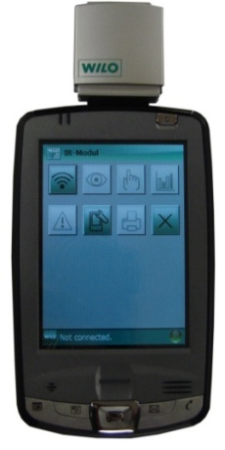
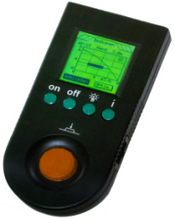
Infra-Red Monitor
Automatic communication – up to 16 pumps – 30’ Away
Manual coding not required
Always the right ‘wire‘ to the right pump.
Notes:
Automatic communications built-up by means of the Wilo-IR Monitor
Communications exchange between IR-Monitor and the pump is effected wireless by means of infrared light. An automatic communications built-up in narrow or cramped locations avoids a simultaneous reaction of different pumps (a row of pumps one next to the other) and thus establishes the correct data exchange between the selected pump and the IR-Monitor. Manual coding of individual pumps is not required.

Slide 43

Infra-Red Monitor
PDA Specifications - Secure Digital I/O slot
Windows Mobile version 5
Bluetooth for wireless printing
300 Mhz CPU
5 MB free memory
64 MB ROM
32 MB RAM
240 x 320 pixel display
Notes:
Automatic communications built-up by means of the Wilo-IR Monitor
Communications exchange between IR-Monitor and the pump is effected wireless by means of infrared light. An automatic communications built-up in narrow or cramped locations avoids a simultaneous reaction of different pumps (a row of pumps one next to the other) and thus establishes the correct data exchange between the selected pump and the IR-Monitor. Manual coding of individual pumps is not required.

Slide 44
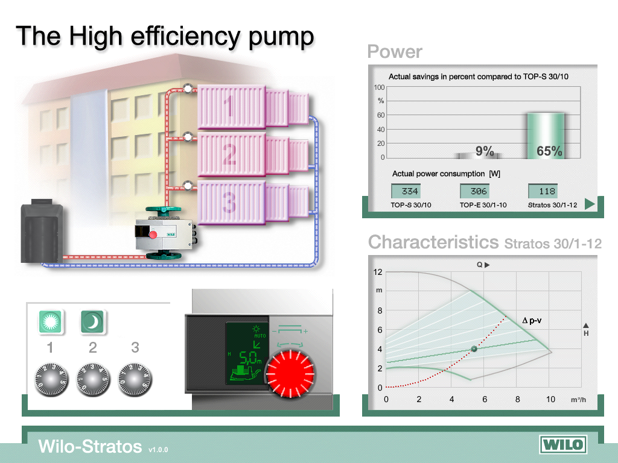
Training tools – Stratos Simulator

Slide 45
Questions / Comments?

