Slide 1
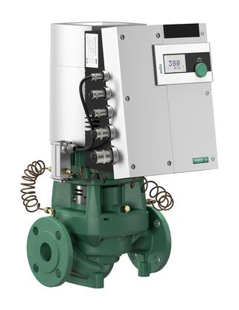
Excitement for an industry that needs real excitement.
Understanding why ECM/DC is mandatory
In the rest of the WORLD today.
2018

Slide 2
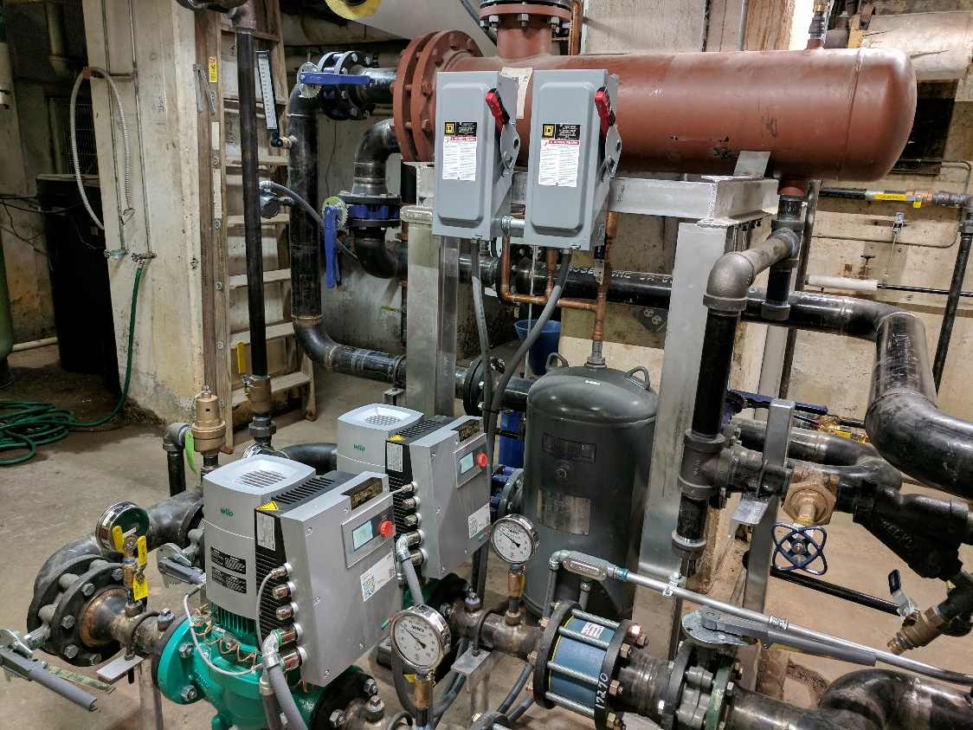
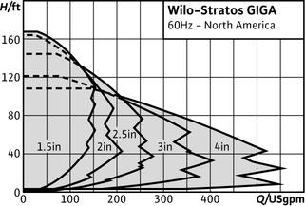
pumping creates the core of system efficiency

Slide 3
KISS WILO starts the new era of pumping creates the core of system efficiency
And let’s be the one to talk about CORE SYSTEM EFFICIENCY getting all the components to work together through the entire transition range.
Let’s talk about the water quality issues that affect/effect all the components of a system.
Let’s talk about the required safety factor put on engineers to make sure the systems function and how WILO GIGA can make that SYSTEM WORK. (no one else can).

Slide 4
50 – 80% savings in energy in the pump alone with ECM and a little common sense.
Easy to install and easy to prove.
Direct the WILO energy towards the schools with 1,000,000 to 5,000,000BTU/HR systems and the infamous 3x2.5x9 – 5-7.5hp pumps.
If you only get 50% savings with ECM/DC over the existing AC constant speed your payback is less than 3 years PERIOD. WHY NOT
Even if you have the perfect system with VFD’s ECM will save at least 30%. I’ve never seen that perfect system yet.
You also get all the repair parts and labor savings for free.

Slide 5
Do you meet your CORE System Efficiency
Or just a few component Efficiencies?
Do you assume you’re starting from a perfect base of design?
-10F day GPM and Delta T as designed?
Can you reduce capacity to match load and keep high Efficiency?
Do you have a good ph and water quality?

Slide 6
It is very often a 98% efficient boiler is placed in a 20% efficient system resulting in little to no savings in energy consumption.
We suggest putting your energy toward balancing production (boilers) with consumption (Air Handling Units, fin tube radiation, etc) by providing the proper distribution (pumping and balance).

Slide 7
What to look for:
System supply water temperature _____________
System return water temperature _____________
Boiler Stack Temperature ____________________
Pump Suction Pressure ______________________
Pump Discharge Pressure ____________________
Pump Design/Size __________________________
Pump Horse Power and Voltage _______________
2 – Way or 3 – Way control valves _____________
Any on going system problems ________________
Any on going component problems _____________
Building comfort issues_______________________

Slide 8
ECM technology with wire to water savings up to 80%, at very effective cost points with Variable Speed, ECM/DC motor and system control built into the pump itself.
These pumps are the one stop solution to system efficiency, correcting the system and distribution efficiency with boiler efficiency.

Slide 9

How Big do they Go ECM?

Slide 10
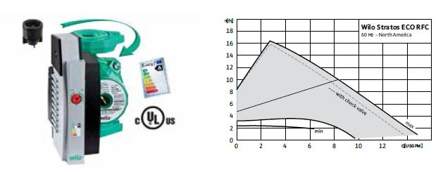
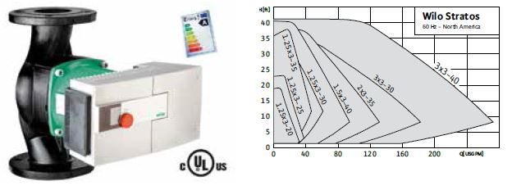
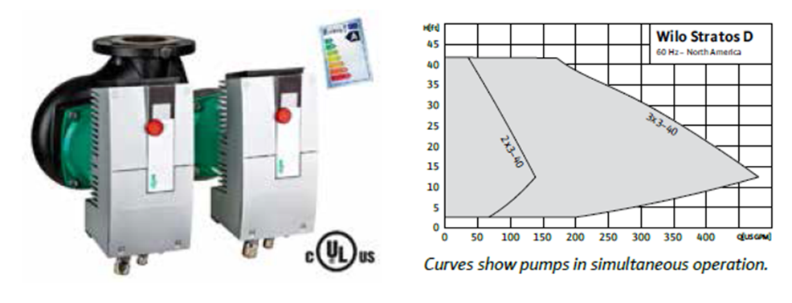
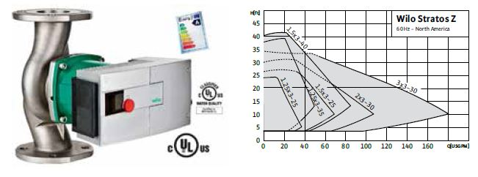
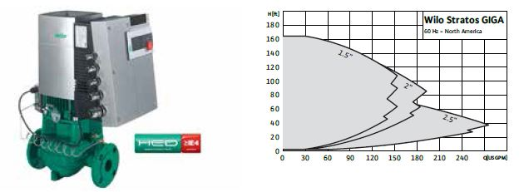
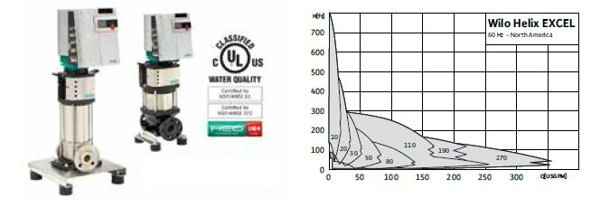

Slide 11
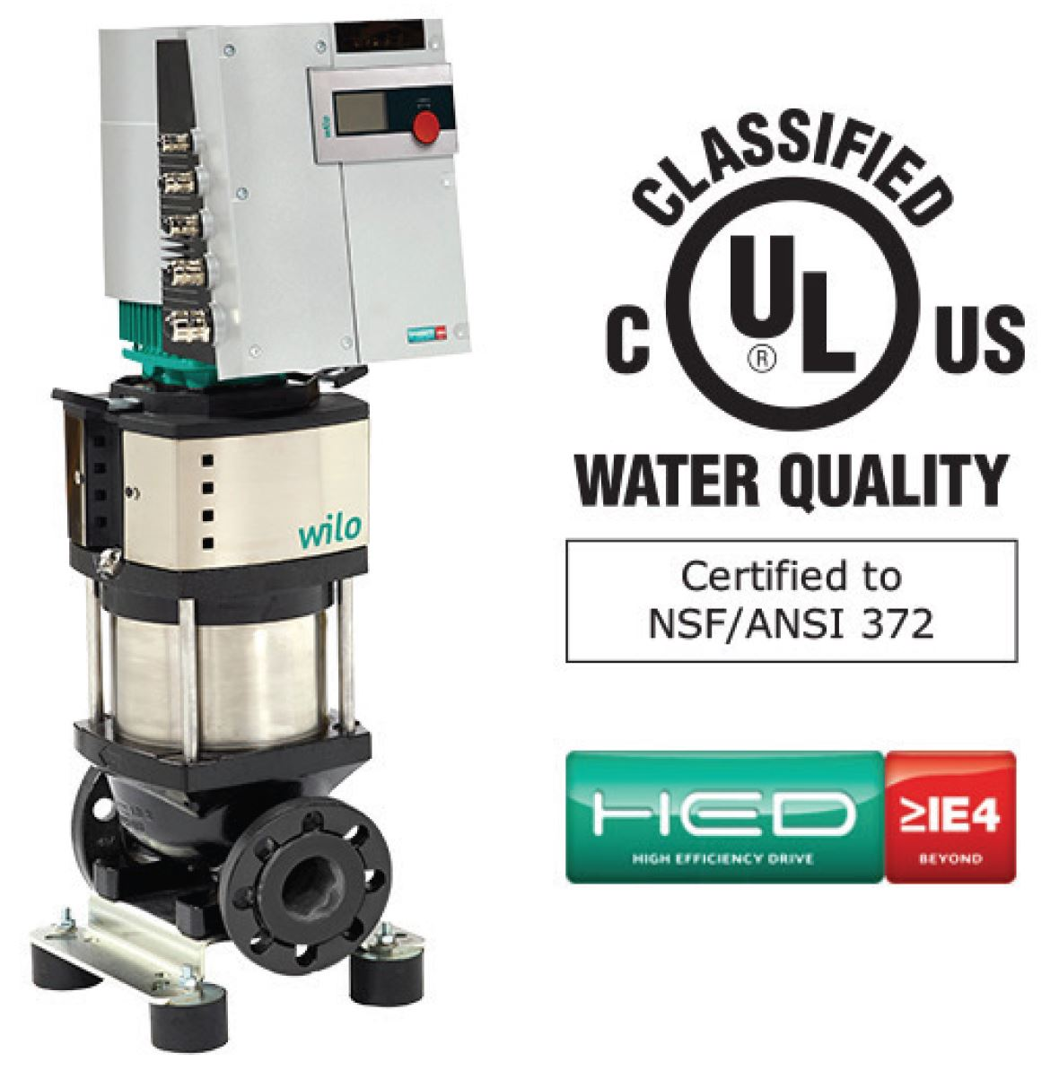
ECM or VFD
Both serve a real purpose but VFD
Must be properly applied to save
SYSTEM energy or efficiency.
ECM can operate with a very large
Window of SYSTEM Efficiency
Where VFD has a small window with
Many associated problems.
Pressureized seals.
Minimum speeds.
Pump VFD cutting odd freq’s.
And the list goes on, but not with ECM
Designed for HVAC or boosting app’s.

Slide 12
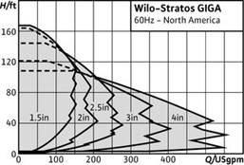

Slide 13
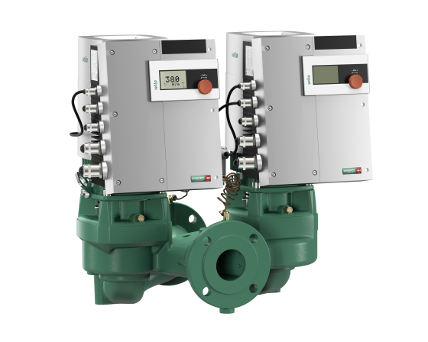

Slide 14
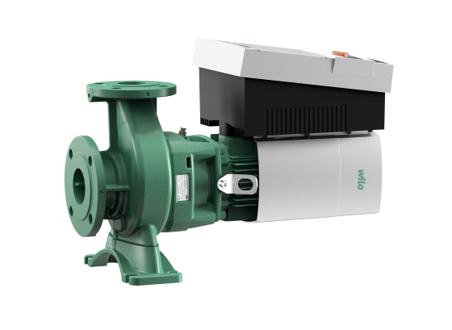

Slide 15
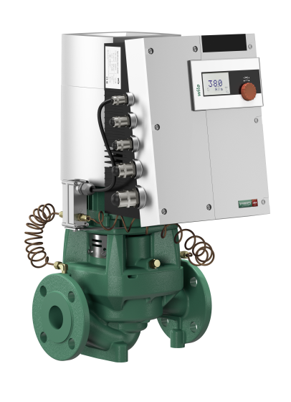

Slide 16
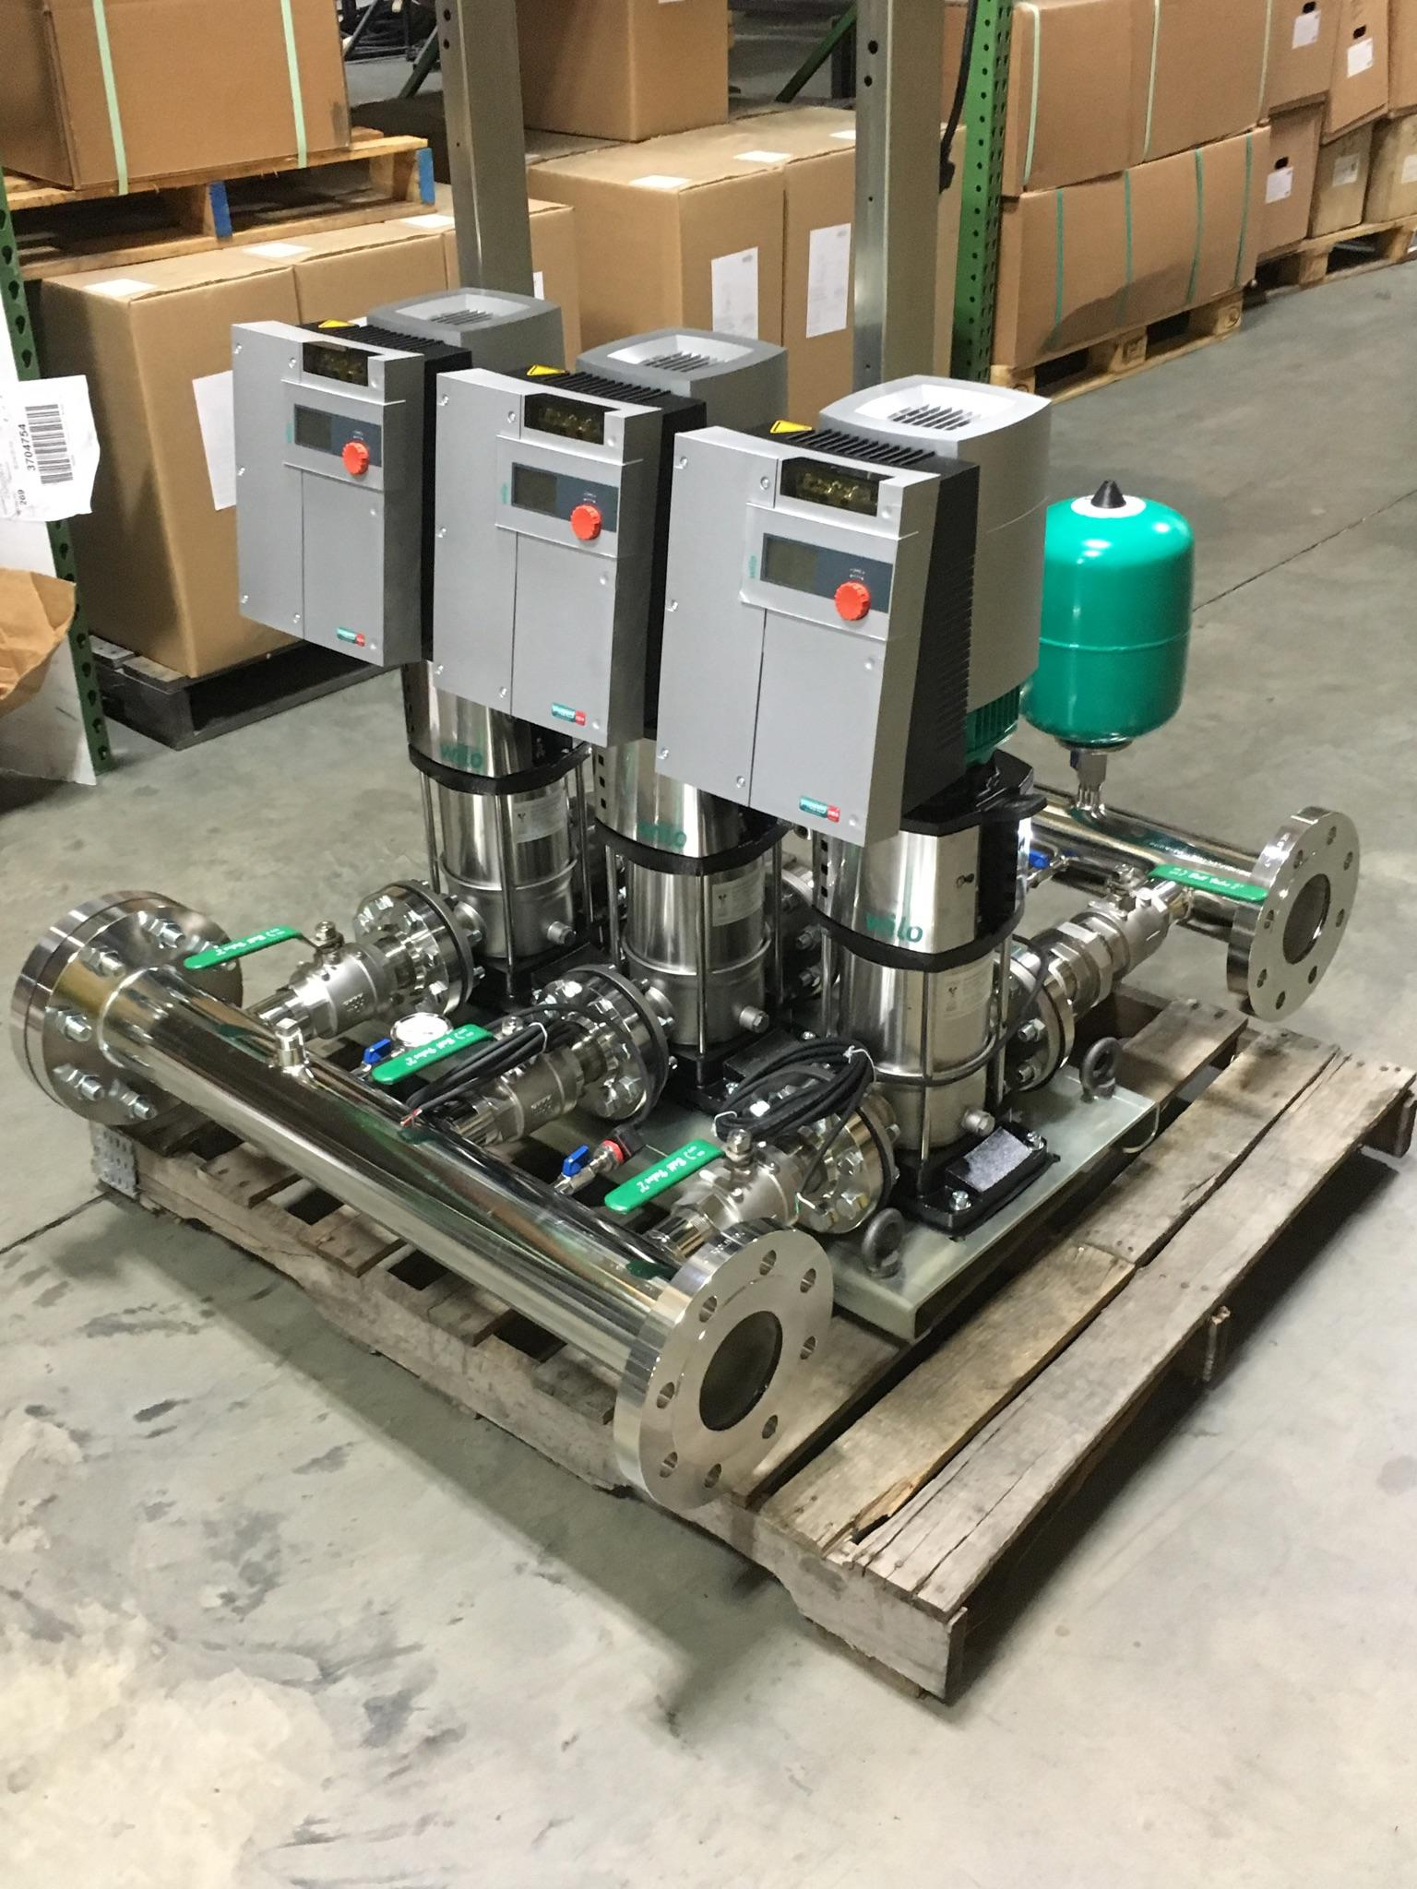

Slide 17

http://www.wilo-usa.com/wilo-usa-llc-home/#.W0ZouvZFzgA

Slide 18

Train
Consumption
Production
Distribution
Variable Speed Pumping
Variable Volume Pumping
Cv’s / GPM of Coil or slightly greater 1#
Coils etc / Importance of Flow Limiting
Cv =gpm/delta P square root

Slide 19
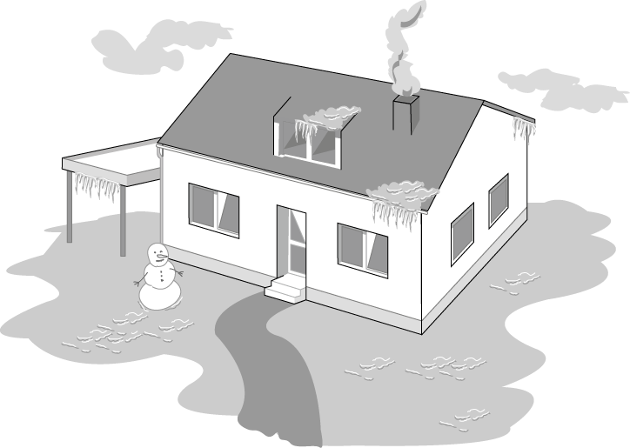

(coldest design day)
For the coldest day of the year ~2 % of the total operating period
Notes:
Load-controlled pumps - Why?
Standard pumps must be selected to meet maximum design load conditions which only occurs during 2-5 % of the total operating time. The normal operating status of the pump thus remains to meet partial and low load requirements. Non controlled pumps are incapable to adjust to such load variations and operate at their relatively high pump performance with the consequence of the thus related excess power consumption.
Consquence:
Excess power consumption
Generation of flow noise
(continued next page)

Slide 20

Transition period
But how is the system working during the remaining 98 % of the operating period?
Notes:
Load controlled pumps meet the requirements for increasing or at least constant pumping head. Two kinds of load controlled pumps are at present available .
Energy saving pumps had been conceived to keep abreast of the steadily further developing mechanical building services technology (thermostatic radiator valves, etc.) and to meet the growing sensibility towards energy conservation. There are three main reasons for the development and application of control systems for heating circulating pumps.
• Adapting flow rate/heat flow to the actual load
• Reducing power consumption and operating costs
• Avoiding noise generation in the system
High-efficiency pumps are the latest generation of pumps which, on top of the the benefits of energy-saving pumps, achieve enormous power savings in line with excellent efficiency. The revolutionary ECM-technology does furthermore provide more compact housings/motors, quieter operation and extended life expectancies.

Slide 21
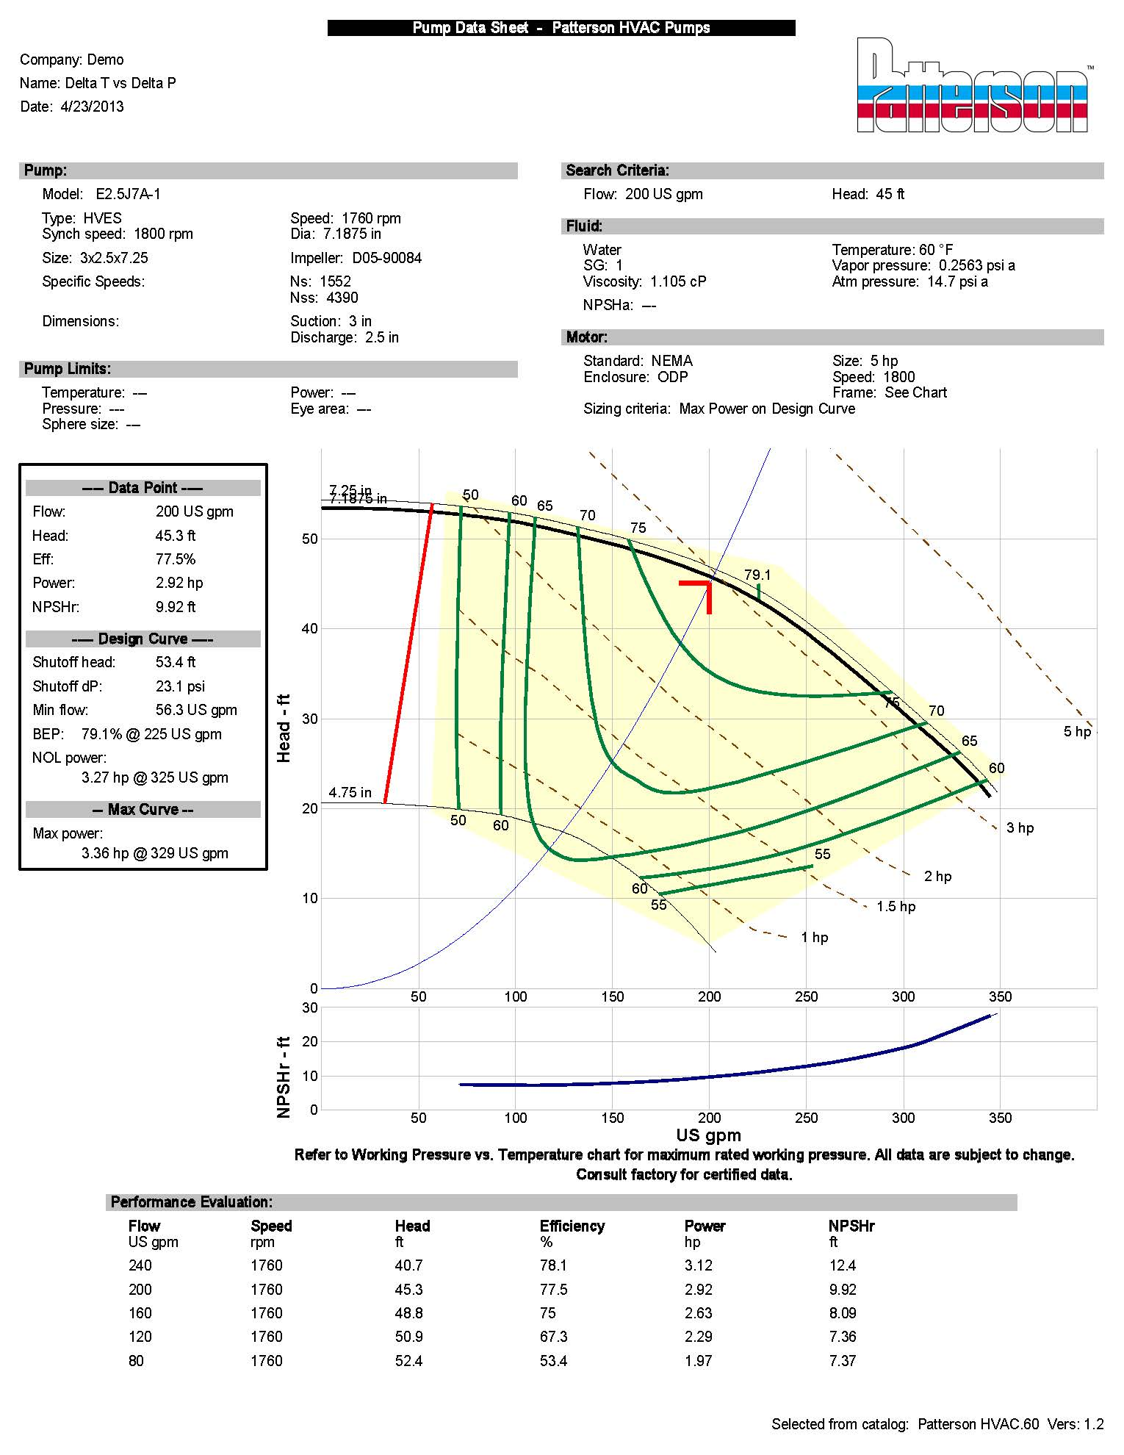

200 gpm = 2,000,000 Btu/Hr
500 x 20
300 gpm = 2,000,000 Btu/Hr
500 x 15
400 gpm = 2,000,000 Btu/Hr
500 x 10
Checking the system Delta T can suggest the system Load
Checking the Boiler Delta T vs gas consumption gives the real efficiency.
System Curve vs the Pump curve.

Slide 22
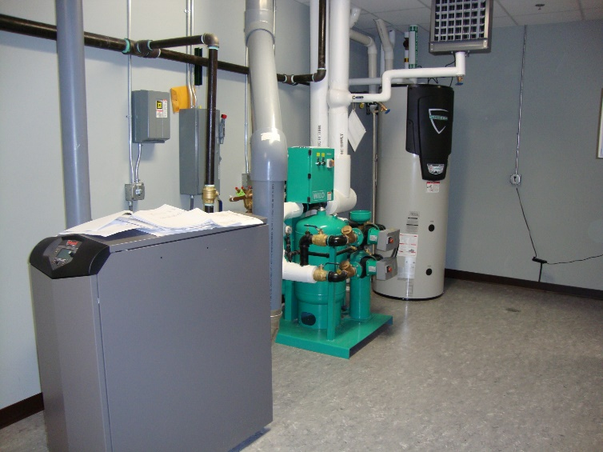
Pumps save electrical energy by properly applying them, check the HP of 200 gpm @ 45’ vs the HP of 200 gpm @ 12’.
This is really nice.
Now check out the Boiler operating at 30% vs. the Boiler operating at 85 – 95% Efficient.
Really Really REALLY NICE Savings.

Slide 23
ΔT review
Heating fluid standard is 20 degree ΔT
Today with Energy Conservation this will vary.
Heating systems 20 – 40 is standard, and engineers tend to use boiler efficiency standards where higher ΔT relates to higher efficiency.
Higher ΔT relates to lower flows and lower pumping cost and lower distribution cost.
Cooling fluid standard is 10 degree ΔT
You have to watch for humidification issues.

Slide 24
Will Self-Sensing or Temperature control operation of VFD pumping work?
Yes with the proper set-up.
For this example I will use the most common system of HVAC heating for 2,500,000 BTU/HR.
20F Delta T, with variable outlet temperature the return will by design be 20F cooler.
(note the same principle applies to chilled water with 10-12F warmer return than supply)
Primary-Secondary with 2-Way control valves. (again other designs will also have the same principles)
Note that design depends on where your located and how the building will be used. For this example we are using a School building in Michigan designed for -10F. In Michigan alone there are thousands of buildings meeting this exact or very close design conditions.
(there are variables, this is where the research is needed as some systems with condensing boilers may be designed for lower temperatures to bring the return water back cooler so the boilers can condense).
250gpm = 2,500,000Btu/Hr
500 x 20F

Slide 25
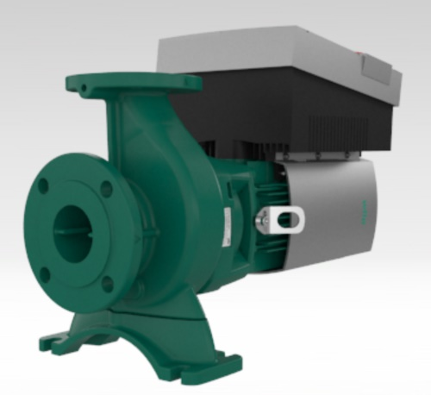
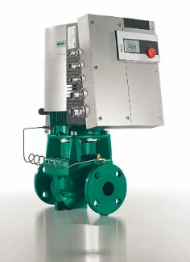
Existing retrofit
The existing system has old fire-tube boilers and we are looking to upgrade to condensing boilers.
First you can get a base line of current operation and System Efficiency. This confirms if you currently have all the components operating at peak efficiency from design through transition.
So at design we should see outlet water going to the building at 180F and returning to the boiler plant at 160F. The existing pumps were designed for 250gpm @ 65’TDH.
It is close to a design day so we should see design operation or less due to the mass of the building and all of the safety factors used during design.
Here’s what we see 90% of the time we really look.
System delta T of 10F or less and pump differential pressure of 10 – 14#.
250 gpm = 2,500,000 Btu/Hr
500 x 20
334 gpm = 2,500,000 Btu/Hr
500 x 15
500 gpm = 2,500,000 Btu/Hr
500 x 10
Checking the system Delta T can suggest the system Load
Checking the Boiler Delta T vs gas consumption gives the real efficiency.
System Curve vs the Pump curve.

Slide 26

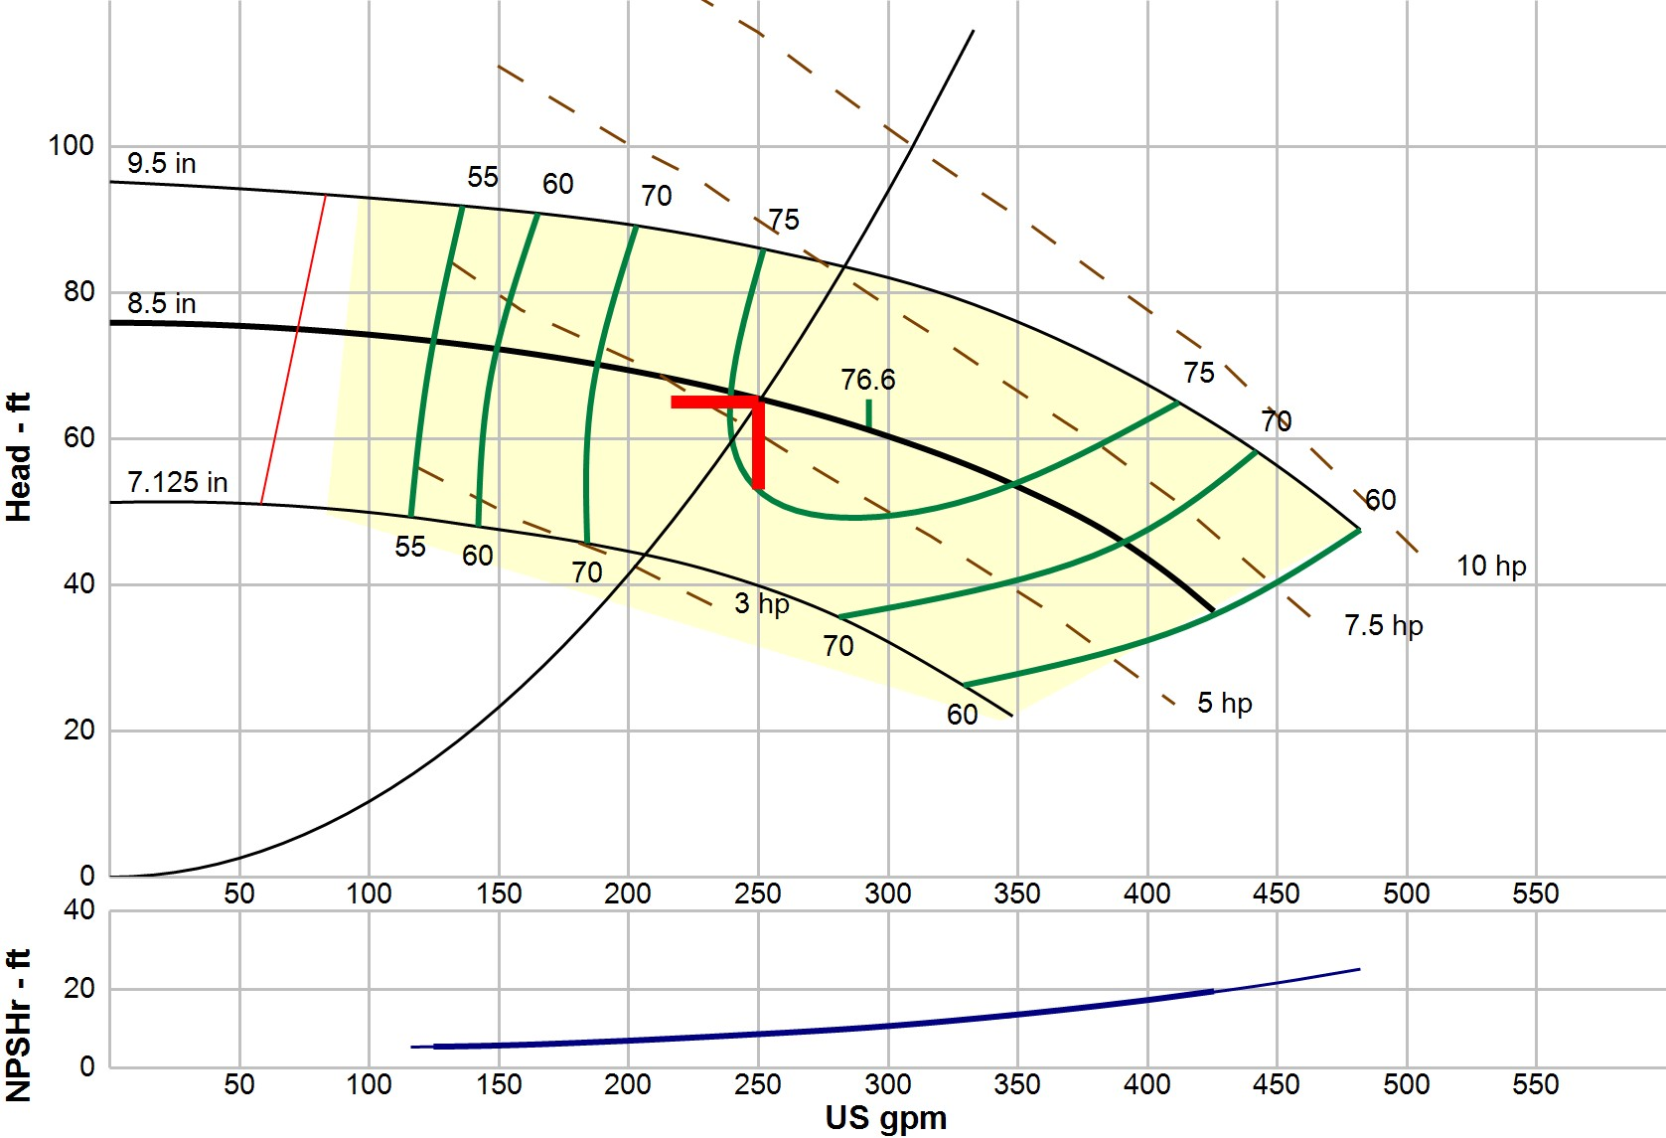
Pump Data Sheet - Patterson HVAC Pumps
Company: 250at65 AC Name:
Date: 11/03/2018
Pump:
Fluid:
Model: Type:
Synch Speed: Dia:
Size: Impeller:
E2.5F9A-1 HVES
1800 rpm
8.5 in
3x2.5x9.5 D05-87174
Dimensions: Suction: 3 in
Discharge: 2.5 in
Name: SG:
Density: Viscosity:
Temperature:
Water 0.984
61.3 lb/ft³
0.46 cP 140 °F
Vapor Pressure: Atm Pressure:
2.89 psi a
14.7 psi a
Specific Speeds: Ns:
Nss:
1216
4996
Pump Limits:
Search Criteria:
Temperature: Wkg Pressure:
--- Sphere Size: ---
---
Flow: Head:
250 US gpm
65 ft
Near Miss: Static Head:
---
0 ft
Motor:
Standard: Enclosure: Frame:
Sizing Criteria:
NEMA ODP
See Chart
Size: Speed:
7.5 hp 1800 rpm
Pump Selection Warnings:
Max Power on Design Curve
None
--- Duty Point ---
Flow: Head: Eff: Power: NPSHr:
Speed:
251 US gpm
65.3 ft 75.3%
5.38 hp
8.71 ft 1760 rpm
--- Design Curve ---
Shutoff Head: 75.9 ft Shutoff dP: 32.3 psi
Min Flow: 73.1 US gpm BEP: 76.6% @ 293 US gpm
NOL Power:
6.41 hp @ 426 US gpm
Max Power:
9.49 hp @ 482 US gpm
--- Max Curve ---
Refer to Working Pressure vs. Temperature chart for maximum rated working pressure. All data are subject to change. Contact factory for certified data.
Performance Evaluation:
Flow | Speed | Head | Efficiency | Power | NPSHr
US gpm | rpm | ft | % | hp | ft
300 | 1760 | 60.2 | 76.4 | 5.86 | 10.8
250 | 1760 | 65.4 | 75.3 | 5.38 | 8.68
200 | 1760 | 69.3 | 71.2 | 4.82 | 7.02
150 | 1760 | 72.3 | 60.2 | 4.47 | 5.75
100 | 1760 | 73.9 | 49.9 | 3.8 | 5.37
Selected from catalog: Patterson HVAC.60, Vers 1.4.1

Slide 27
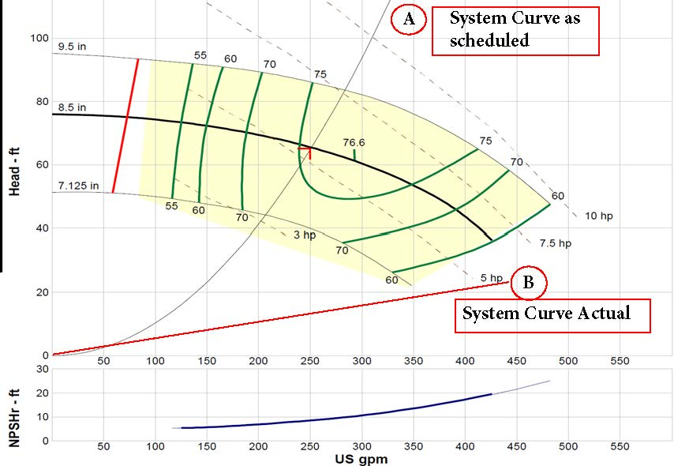

Slide 28
Existing Pump
12 x 2.31 = 27.72’TDH
You can see by the curve and temperatures we are not operating at design.
First would be to contact the Boiler Manufacture and find out what efficiency it’s operating at with over 400gpm and 170F return water.
This can be amazing, just look at the stack temperature.
30% efficiency can be expected with a system output of 750,000btu/hr vs design of 2,500,000.
Yet the system still works.
With such a high flow can the temperature control valves work?

Slide 29
If your actual system curve is right of design and off the
right side of the pump operational curve as determined
at 60hz and pressure readings. Confirm with Delta T.
How can a VFD bring it back to the designed and scheduled
system curve?
It can’t and only ECM has the ability to track the actual
SYSTEM CURVE.
Scheduled System Curve
Artifical pressure drop needed to get back on the curve.
Actual System Curve
Note the low head required and still off the curve.

Slide 31
Here’s what we see 90% of the time we really look.
System delta T of 10F or less and pump differential pressure of 10 – 14#.
12# x 2.31 = 27.72’TDH

Slide 32
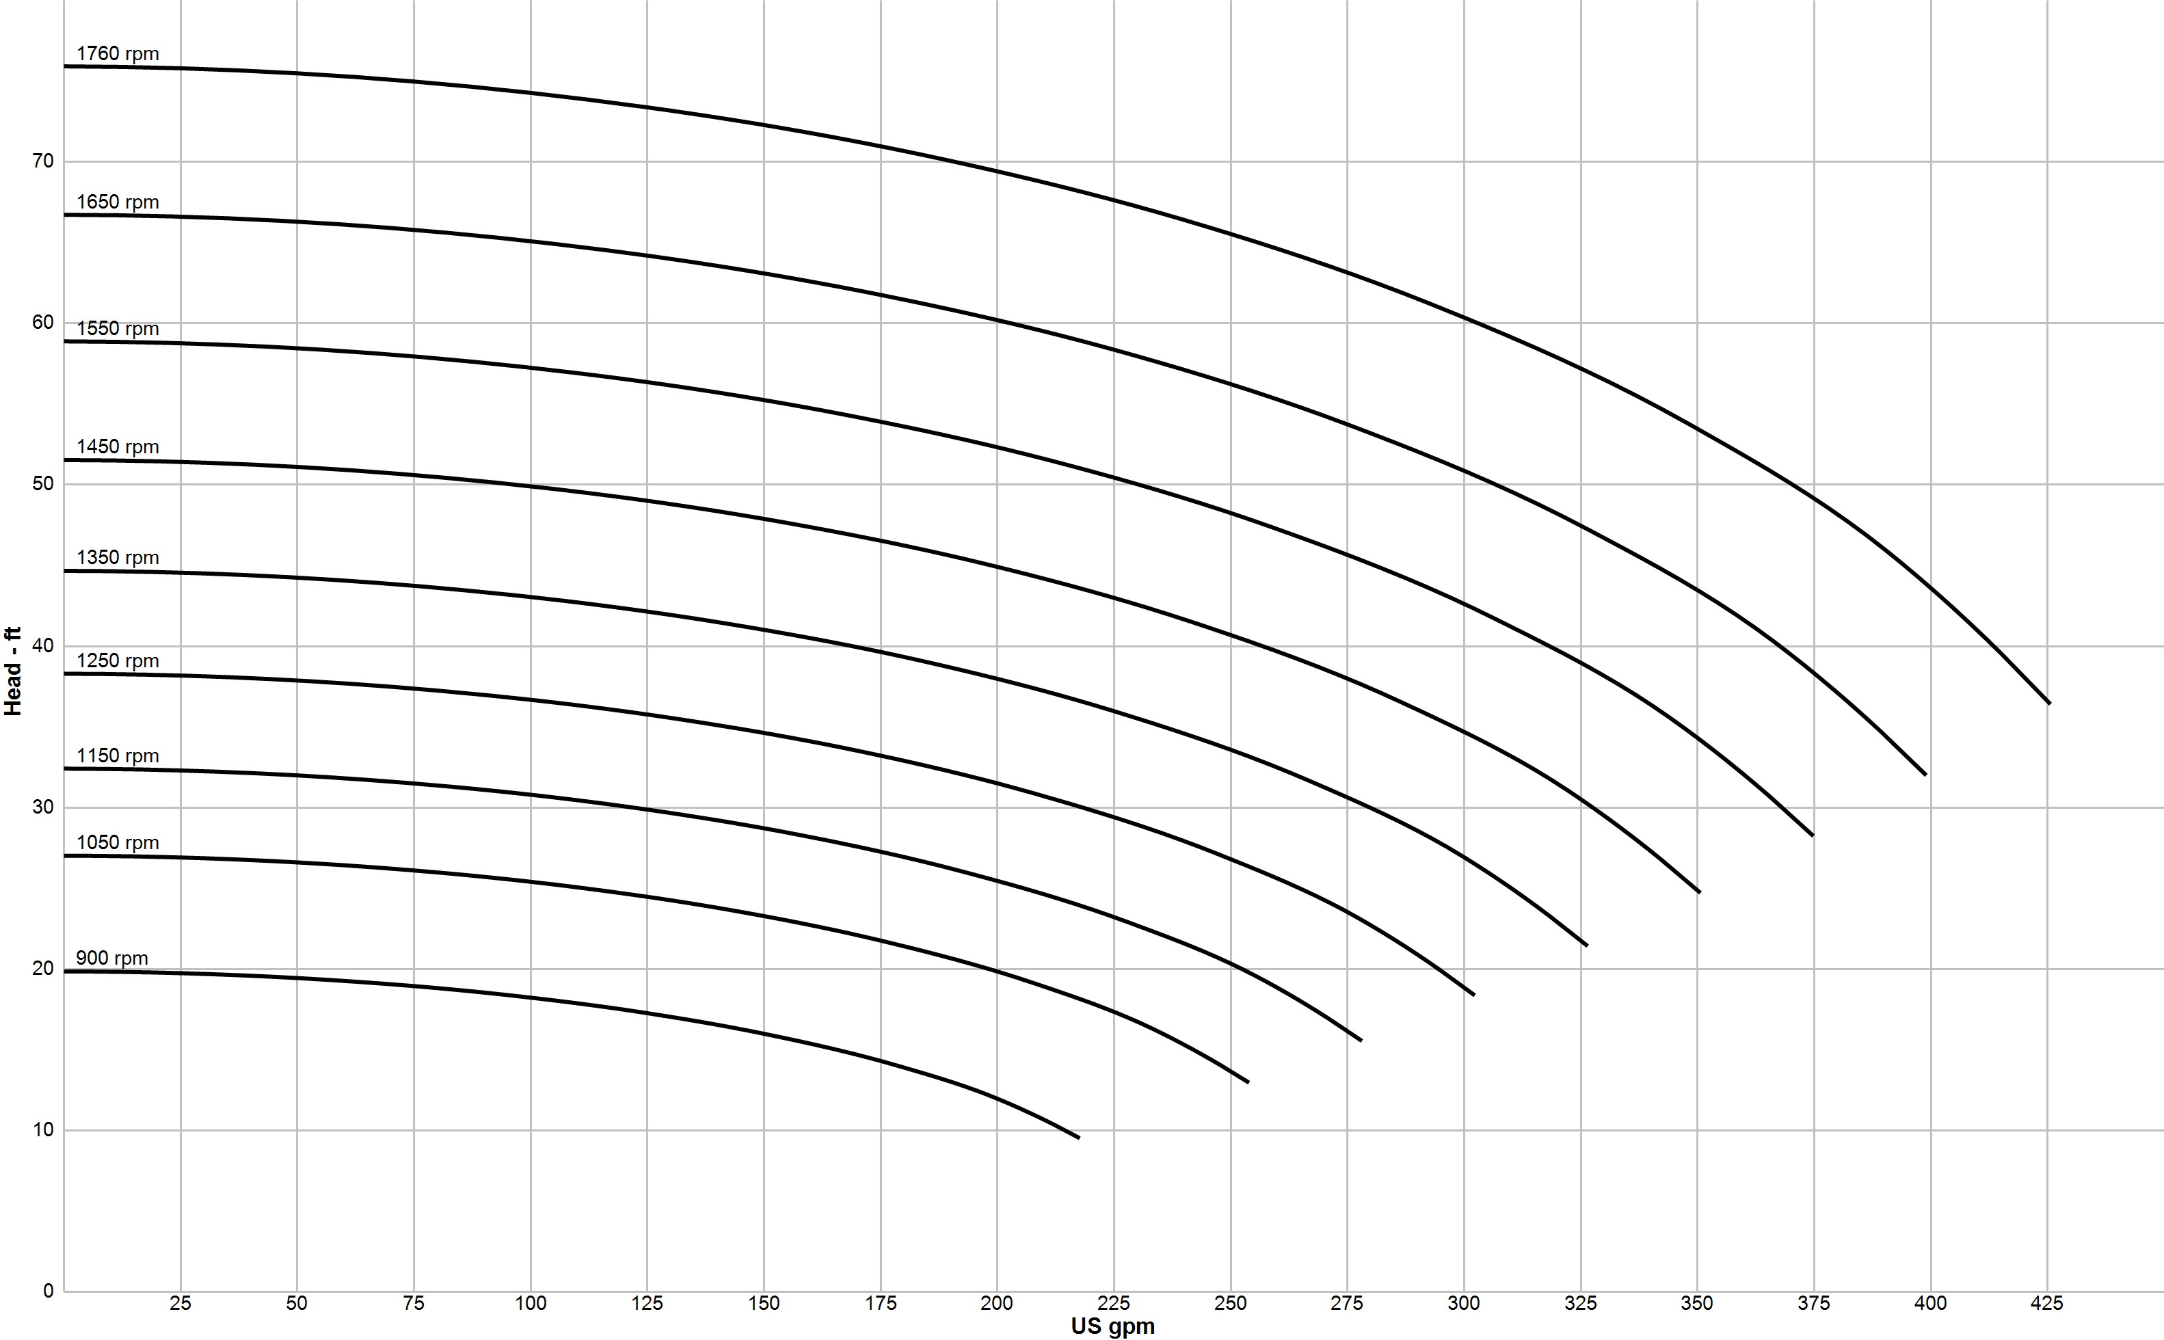
250gpm @ 65'TDH
27.72'TDH
REMEMBER CUT THE FLOW IN HALF REDUCE THE HEAD BY A FACTOR OF 4
Refer to Working Pressure vs. Temperature chart for maximum rated working pressure. All data are subject to change. Contact factory for certified data.
Company: 250at65multi Name:
Date: 11/03/2018
Patterson HVAC Pumps
Catalog: Patterson HVAC.60, Vers 1.4.1
HVES - 1800 rpm
Design Point: 250 US gpm, 65 ft Static Head: 0 ft
Model: Speed: Dia: Size: Impeller:
E2.5F9A-1
1760 rpm
8.5 in
3x2.5x9.5 D05-87174

Slide 33
Now if this is maximum design day and we need to get the pump back to 250gpm we need to slow the pump down or create artificial pressure drop with a main balance valve.
If you reduce the flow by ½ you reduce the head by a factor of 4.
Guessing (since we’re off the curve) we need to get from 450 back to 250 so we’re currenty at 28’; we only need 250gpm @ 18’TDH. This means 65 – 47 = 18’, we have to waist 47’TDH just to get to the max design what about lower say 100gpm?
We should see max design no more than 2% of the operational season with the remainder operation at transition.
Now how slow can we operate the VFD? Are we limited to 50% or 30hz? If we use the max capacity of the VFD turndown for getting back to design do we have enough left for transition? Would transition be the self-sensing or Temperature controls operations control point?
We’re seeing pumping systems over 100’TDH because the engineer has to add safety because he knows the BTU’s should cover a building but don’t so he thinks the pumps are too small. That the poor operational efficiency of the boiler is the cause not under pumping.
Beware the self-sensing over-sized pump.

Slide 34
Customer Reference
:
:
Pump Performance Curve
Wilo Quotation System 18.4.5.0
8
6
Power - hp
4
Power
2
0
150
Allowable operating region
100
135
90
120
3779 rpm
80
105
3674 rpm
70
Efficiency - %
Head - ft
90
60
75
Efficiency
50
60
40
45
30
30
20
15
10
0
0
NPSHr - ft
NPSHr
50
0
0
50
100
150
200 250
Flow - USgpm
300
350
400
450
Item number | : 001 | Size | : GIGA 3 3-105 | Flow, rated | : 250.0 USgpm
Service | : | Stages | : 1 | Head, rated | : 65.00 ft
Quantity | : 1 | Speed | : 3674 rpm | NPSH required | : 11.79 ft
Quote number | : 790310 | Based on curve number | : GIGA 3 3-105 Rev O | Fluid density | : 1.000 / 1.000 SG
Date last saved | : 03 Nov 2018 7:41 AM | Efficiency | : 75.08 % | Viscosity | : 1.00 cP
 |  | Power, rated | : 5.46 hp | Cq/Ch/Ce/Cn [ANSI/HI 9.6.7-2010] | : 1.00 / 1.00 / 1.00 / 1.00

Slide 35
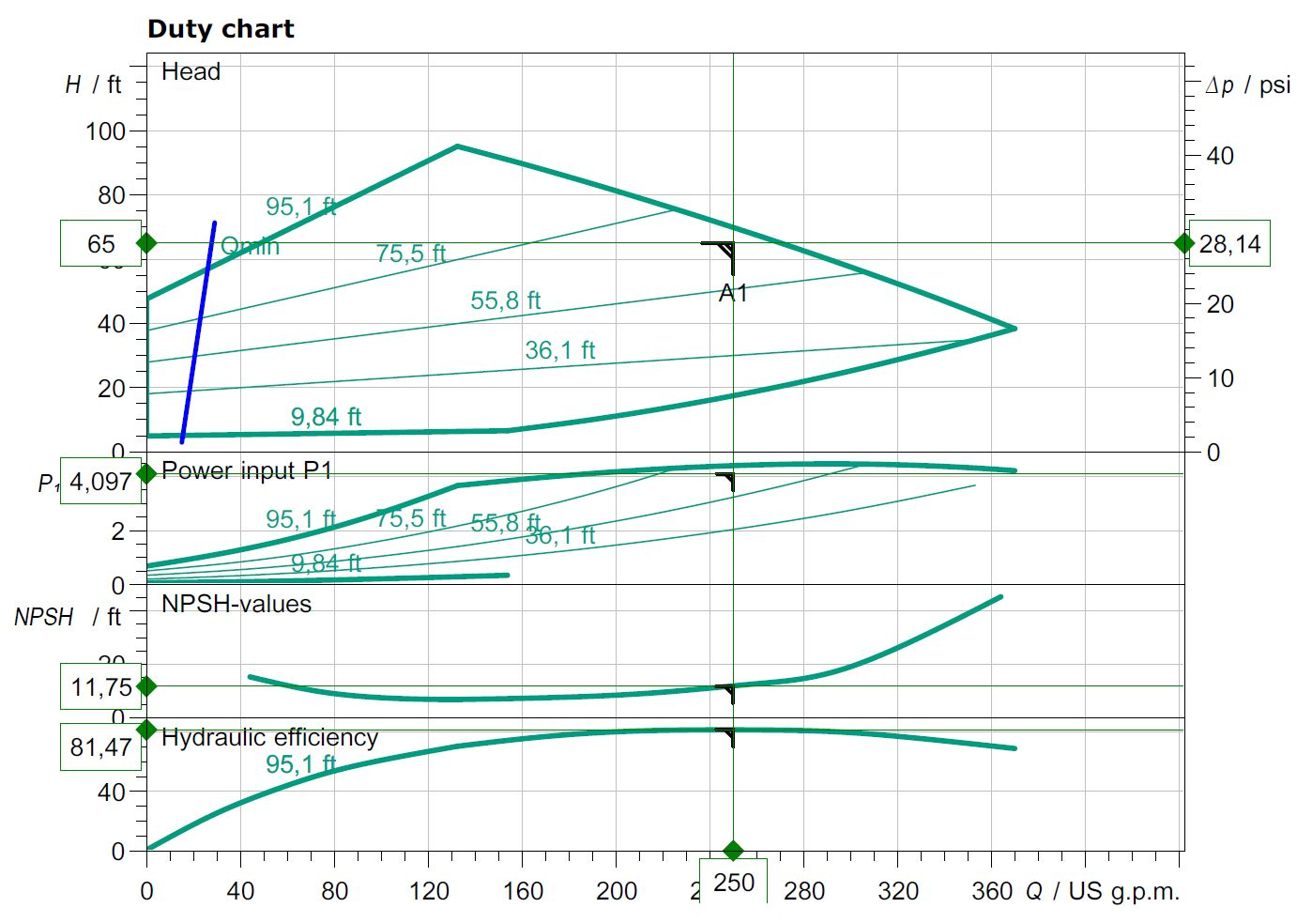
With ECM even if you want the safety of higher head pressure
for scheduling you can operate on a curve that can operate
within the System needs.

Slide 36
Don’t forget as licensed engineers they have to cover all possibilities due to air entrapment, many more elbows than planned and other possibilities.
So the rest of the world has looked to ECM/DC pumps to cover the possibilities at worse case and still be able to work into the real world of transitional flows to keep the SYSTEM at peak efficiency at all times possible.
The part often overlooked is the 92% of the time SYSTEMS operate at transition.
What is your delta T ???????

Slide 37
Customer Reference
:
:
Pump Performance Datasheet
Wilo Quotation System 18.4.5.0
Item number Service Quantity Quote number
: 001
:
: 1
: 790310
Size Stages
Based on curve number Article Number
Date last saved
: GIGA 3 3-105
: 1
: GIGA 3 3-105 Rev O
: 2124503
: 03 Nov 2018 7:41 AM
Operating Conditions
Liquid
Flow, rated
Head, rated (requested) Head, rated (actual)
Suction pressure, rated / max NPSH available
Frequency
Performance
: 250.0 USgpm
: 65.00 ft
: 65.00 ft
: 0.00 / 0.00 psi.g
: Ample
: 60 Hz
Liquid type
Additional liquid description Solids diameter, max
Solids concentration, by volume Temperature
Fluid density Viscosity
Vapor pressure, rated
Material
: Water
:
: 0.00 in
: 0.00 %
: 68.00 deg F
: 1.000 / 1.000 SG
: 1.00 cP
: 0.34 psi.a
Speed
Speed, maximum Speed, minimum Efficiency
NPSH required / margin required
Ns (imp. eye flow) / Nss (imp. eye flow) MCSF
Head maximum, rated speed Head rise to shutoff
Flow, best eff. point Flow ratio, rated / BEP
Speed ratio (rated / max)
Head ratio (rated speed / max speed) Cq/Ch/Ce/Cn [ANSI/HI 9.6.7-2010]
Selection status
: 3674 rpm
: 3779 rpm
: 500 rpm
: 75.08 %
: 11.79 / 0.00 ft
: 2,521 / 9,213 US Units
: 39.54 USgpm
: 106.0 ft
: 63.00 %
: 249.1 USgpm
: 100.36 %
: 97.22 %
: 92.41 %
: 1.00 / 1.00 / 1.00 / 1.00
: Acceptable
Material selected
Pressure Data
: Standard
Maximum working pressure Maximum allowable working pressure Maximum allowable suction pressure Hydrostatic test pressure
Driver & Power Data (@Max density)
: 45.85 psi.g
: 232.0 psi.g
: N/A
: N/A
Driver sizing specification Margin over specification Service factor
Power, hydraulic Power, rated
Power, maximum (at relief pressure) Motor rating
: Rated power
: 0.00 %
: 1.00
: 4.10 hp
: 5.46 hp
: 5.52 hp
: 6.00 hp / 4.47 kW (Fixed)

Slide 38
Customer Reference
:
:
Multi-Speed Performance Curve
Wilo Quotation System 18.4.5.0
8
6
Power - hp
3674 rpm
4
3307 rpm
2
2572 rpm
2939 rpm
0
1837 rpm
2204 rpm
150
Allowable operating region
135
120
105
90
75
60
45
30
Head - ft
15
2939 rpm
3307 rpm
3674 rpm
1837 rpm
2204 rpm
2572 rpm
0
0
50
100
150
200 250
Flow - USgpm
300
350
400
450
Item number | : 001 | Size | : GIGA 3 3-105 | Flow, rated | : 250.0 USgpm
Service | : | Stages | : 1 | Head, rated | : 65.00 ft
Quantity | : 1 | Efficiency | : 75.08 % | Speed | : 3674 rpm
Quote number | : 790310 | Power, rated | : 5.46 hp | Fluid density | : 1.000 / 1.000 SG
Based on curve | : GIGA 3 3-105 Rev O | NPSH required | : 11.79 ft | Viscosity | : 1.00 cP
number Date last saved | : 03 Nov 2018 7:41 AM | Frequency Nominal speed | : 60 Hz : 3779 rpm | Cq/Ch/Ce/Cn [ANSI/HI 9.6.7-2010] | : 1.00 / 1.00 / 1.00 / 1.00

Slide 39
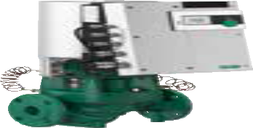
Submittal Data Sheet
Wilo-Stratos GIGA - High-Efficiency In-Line Pumps
Wilo-Stratos GIGA 3/3-105
 |  | Project:
 |  | Engineer:
 |  | Contractor:
 |  | Submitted By: | Date:
 |  | Approved By: | Date:
Tag # | Model # | Flow | Head | Control Mode | Cycle | Phase | Voltage
 | Wilo-Stratos GIGA 3/3-105 |  |  |  |  | 3 | 460
H/ft
0
20
40
60 80 Q/m³/h
Wilo-Stratos GIGA 3/3-105
60 Hz - North America
H/m
40
H/ft
0
20
40
60
80 Q/m³/h
H/m
40
120
^{Q}min
120
Qmin
Wilo-Stratos GIGA 3/3-105
60 Hz - North America
100
n=const. 100%
30
100
Δp-c
max.
30
80
90%
80
Δp-v
60
80%
20
60
20
70%
40
10
40
60%
10
20
20
50%
40%
0
0
50
100
150 200
250
300
Q/US gpm
0
0
0
13%
Q/US gpm
0
0
0
4
8
12
40
16
60
20
Q/l/s
80 Q/m³/h
0
0
50
4
100
8
150 200
250
300
Q/l/s
80 Q/m³/h
20
20
12
40
16
60
20
Δp-c
P1/hp
4
2
0
105'/32m
Δp-c
P1/kW
4
2
0
^{P}1^{/hp}
^{P}1^{/kW}
52
/
'/16m
78
/
'/24m
1 ₂
'/8m
3 ₄
26
/
6
3
/
'/1m
1 ₄
100%
4
0
50
100
1 ₄
150 200
250
300
Q/US gpm
4
80%
90%
NPSH/ft
40
30
20
10
0
20
40
60
80 Q/m³/h
NPSH/m
12
8
4
0
2
60%
70%
2
0
0
50
13%
100
40%
50%
0
0
150 200 250
300
Q/US gpm
0
50
100
150 200
250
300
Q/US gpm
Technical Data
Liquid Temp Range | -4°F to 248°F (-20°C to +120°C)
Fluid Capability | Water 50/50 Water-Glycol Mixtures
Max Operating Pressure | 232 PSI 248°F (water only) 194°F (50% propylene)
Mains Voltage | 3~ 380-480V ±10% 50/60Hz
Protection Class | IP 55, Class F Insulation
Ambient Temp Range | 32°F to 104°F (0°C to 40°C)
Max Relative Humidity | 32°F to 86°F (0°C to 30°C): 90% 87°F to 104°F (31°C to 40°C): 60%
Sound Level | < 74 dBA
Materials of Construction
Pump Volute | Cast Iron Cataphoresis Coated (ASTM A48 / EN-GJL-250)
Impeller | Composite (PPS-GF40) Integral Stainless Inlet
Shaft | Stainless Steel (AISI 420 / 1.4122)
Mechanical Seal | Sic/SiC-NBR (Q7Q7X4GG)
Applications
Hot Water Heating • Closed Cooling Circuits Systems
Industrial Circulation Systems
Air-conditioning Systems
Solar
Geothermal
IR Module Selection
Approval Stamp
Module 1 Module Article Number BACnet / Dual Pump 2097811
LONworks / Dual Pump 2022530
MODBus 2097809
None None
WILO_SUB_STRATOSGIGA_0318

Slide 40
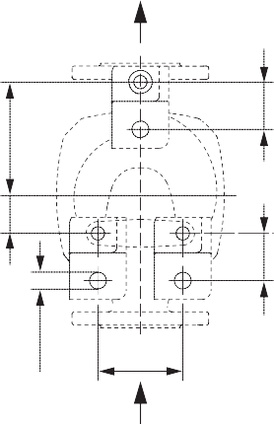
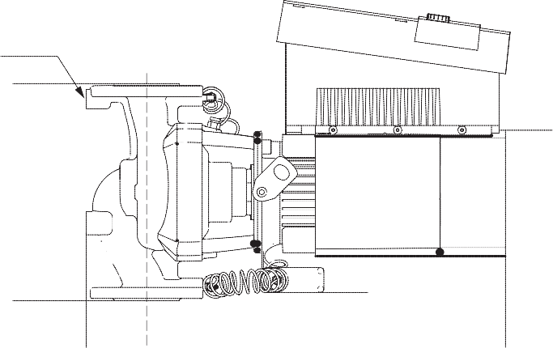
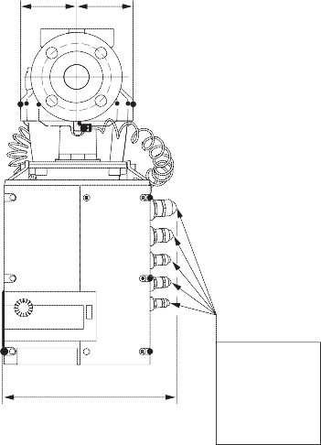
Submittal Data Sheet
Wilo-Stratos GIGA - High-Efficiency In-Line Pumps
Dimensions & Weights
3 x ½ x - ¾
2''
B4
E
M
F
L₀
ØG
2''
B3
Ø¾''
C
A
L1
X
Dimensions and Weights
Dimensions - Inches (mm)
Weight lbs (kg)
Model | l₀ | A | B1 | B2 | B3 | B4 | C | E | F | ØG | H | L1 | M | X
Wilo-Stratos GIGA 3/3-105 | 18 | 4¼ | 4^{5/}16 | 4½ | 5^{1/}16 | 10^{9/}16 | 4¾ | 8 | 3½ | ₆7_{/8} | 10^{7/8} | 21¾ | 9 | ₁₁13_{/16} | 148
 | (457) | (108) | (110) | (114) | (129) | (268) | (121) | (203) | (89) | (175) | (276) | (552) | (229) | (300) | (67)
Flange Dimensions - 125#ANSI
nxdL
Dimensions - Inches (mm)
Dia. ØD Ød Øk n x Ød_{L}
DN
Ød
3”
8¼
₅11_{/16}
6 4 x ¾
(152) (4 x 19)
Øk
(210)
(144)
ØD
B2 B1
EC Motor Data (Single Motor Operation)
P₂ Rated P₁ Speed FLA
Model | hp | kW | RPM | 3~480V
Wilo-Stratos GIGA 3/3-105 | 7.51 | 4.5 | 500-2300 | 5.8
L1 L2 L3 PE
PE
SBM
SSM
AUX Ext. off
L H In2 GND In1 GND +24V MP
 | (1) | (2) | (3)
DDG
H
M12 x 1.5 NPT ¾” NPT ½”
2 x NPT ¼”
O OFF
S ON
Wilo USA
Wilo Canada Inc.
Wilo Mexico
T +1 888 945 6872 | www.wilo-usa.com | T +1 866 945 6236 | www.wilo-canada.com | T +52 55 5586 3209 | www.wilo-mexico.com.mx
F +1 888 945 6873 | info@wilo-usa.com | F +1 403 277 9456 | info@wilo-canada.com | F +52 1 55 5413 4165 | info@wilo.com.mx

Slide 41
1 hp(I) = 745.699872 W = 0.745699872 kW
At scheduled 3.8 x 0.7457 = 5.09hp
Non over-loading 4.10 x 0.7457 = 5.49hp

Slide 42
ECM / DC
Opens many options for SYSTEM EFFICIENCY
Can the rest of the world be wrong?

Slide 43
Customer Reference
:
:
Pump Performance Datasheet
Wilo Quotation System 18.4.5.0
Item number Service Quantity Quote number
: 001
:
: 1
: 790310
Size Stages
Based on curve number Article Number
Date last saved
: GIGA 4 3-105
: 1
: GIGA 4 3-105 Rev O
: 2124506
: 03 Nov 2018 8:28 AM
Operating Conditions
Liquid
Flow, rated
Head, rated (requested) Head, rated (actual)
Suction pressure, rated / max NPSH available
Frequency
Performance
: 800.0 USgpm
: 65.00 ft
: 65.02 ft
: 0.00 / 0.00 psi.g
: Ample
: 60 Hz
Liquid type
Additional liquid description Solids diameter, max
Solids concentration, by volume Temperature
Fluid density Viscosity
Vapor pressure, rated
Material
: Water
:
: 0.00 in
: 0.00 %
: 140.0 deg F
: 0.986 / 0.986 SG
: 0.46 cP
: 3.08 psi.a
Speed
Speed, maximum Speed, minimum Efficiency
NPSH required / margin required
Ns (imp. eye flow) / Nss (imp. eye flow) MCSF
Head maximum, rated speed Head rise to shutoff
Flow, best eff. point Flow ratio, rated / BEP
Speed ratio (rated / max)
Head ratio (rated speed / max speed) Cq/Ch/Ce/Cn [ANSI/HI 9.6.7-2010]
Selection status
: 3756 rpm
: 3799 rpm
: 500 rpm
: 75.37 %
: 16.26 / 0.00 ft
: 2,876 / 9,369 US Units
: 55.22 USgpm
: 112.5 ft
: 71.79 %
: 360.2 USgpm
: 111.04 %
: 98.87 %
: 96.49 %
: 1.00 / 1.00 / 1.00 / 1.00
: Acceptable
Material selected
Pressure Data
: Standard
Maximum working pressure Maximum allowable working pressure Maximum allowable suction pressure Hydrostatic test pressure
Driver & Power Data (@Max density)
: 48.01 psi.g
: 232.0 psi.g
: N/A
: N/A
Driver sizing specification Margin over specification Service factor
Power, hydraulic Power, rated
Power, maximum (at relief pressure) Motor rating
: Rated power
: 0.00 %
: 1.00
: 6.47 hp
: 8.59 hp
: 8.59 hp
: 9.10 hp / 6.79 kW (Fixed)
NOW LETS SAY WE WANT 800GPM @ 65’

Slide 44
Customer Reference
:
:
Pump Performance Curve
Wilo Quotation System 18.4.5.0
20
Power - hp
15
(2)
10
Power (1)
0
150
Allowable operating region
100
135
90
120
3799 rpm
80
105
3756 rpm
70
Efficiency - %
Head - ft
90
Efficiency
60
75
50
60
40
45
(1)
(2)
30
30
20
15
10
NPSHr - ft
0
0
60
NPSHr (1)
(2)
30
0
0
100
200
300
400
500
600 700
Flow - USgpm
800
900
1,000
1,100
1,200
1,300
Item number | : 001 | Size | : GIGA 4 3-105 | Flow, rated | : 800.0 USgpm
Service | : | Stages | : 1 | Head, rated | : 65.00 ft
Quantity | : 1 | Speed | : 3756 rpm | NPSH required | : 16.26 ft
Quote number | : 790310 | Based on curve number | : GIGA 4 3-105 Rev O | Fluid density | : 0.986 / 0.986 SG
Date last saved | : 03 Nov 2018 8:28 AM | Efficiency | : 75.37 % | Viscosity | : 0.46 cP
 |  | Power, rated | : 8.59 hp | Cq/Ch/Ce/Cn [ANSI/HI 9.6.7-2010] | : 1.00 / 1.00 / 1.00 / 1.00

Slide 45
Customer Reference
:
:
Multi-Speed Performance Curve
Wilo Quotation System 18.4.5.0
20
Power - hp
15
(2)
10
(2)
(2)
3756 rpm (1)
(2)
5
3380 rpm (1)
(2)
₂₂₅₄ 2629 rpm (1)
3005 rpm (1₍)₂₎
0
1878 rpm (1^{r})^{pm (1)}
150
Allowable operating region
135
120
3756 rpm
105
3380 rpm
Head - ft
90
75 3005 rpm
60
2629 rpm
45
2254 rpm
(1)
(2)
30
1878 rpm
(1)
(1)
(2)
(2)
15
(1)
(1)
(1)
(2)
(2)
(2)
0
0
100
200
300
400
500
600 700
Flow - USgpm
800
900
1,000
1,100
1,200
1,300
Item number | : 001 | Size | : GIGA 4 3-105 | Flow, rated | : 800.0 USgpm
Service | : | Stages | : 1 | Head, rated | : 65.00 ft
Quantity | : 1 | Efficiency | : 75.37 % | Speed | : 3756 rpm
Quote number | : 790310 | Power, rated | : 8.59 hp | Fluid density | : 0.986 / 0.986 SG
Based on curve | : GIGA 4 3-105 Rev O | NPSH required | : 16.26 ft | Viscosity | : 0.46 cP
number Date last saved | : 03 Nov 2018 8:28 AM | Frequency Nominal speed | : 60 Hz : 3799 rpm | Cq/Ch/Ce/Cn [ANSI/HI 9.6.7-2010] | : 1.00 / 1.00 / 1.00 / 1.00

Slide 46
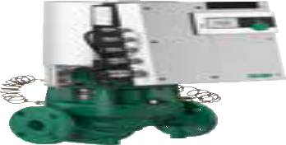
Submittal Data Sheet
Wilo-Stratos GIGA - High-Efficiency In-Line Pumps
Wilo-Stratos GIGA 4/3-105
 |  | Project:
 |  | Engineer:
 |  | Contractor:
 |  | Submitted By: | Date:
 |  | Approved By: | Date:
Tag # | Model # | Flow | Head | Control Mode | Cycle | Phase | Voltage
 | Wilo-Stratos GIGA 4/3-105 |  |  |  |  | 3 | 460
H/ft
0
20
40
60
80 100 120Q/m³/h
Wilo-Stratos GIGA 4/3-105
60 Hz - North America
H/m
40
H/ft
0
20
40
60
80 100
120Q/m³/h
H/m
40
120
^{Q}min
120
^{Q}min
Wilo-Stratos GIGA 4/3-105
60 Hz - North America
n=const. 100%
100
Δp-c
30
100
90%
30
80
Δp-v
max.
80
80%
20
60
20
60
70%
40
10
40
60%
10
20
50%
20
40%
0
0
100
200
300
400
500 Q/US gpm
0
0
13%
0
0
0
5
20
10
40
15
20
25
30
35Q/l/s
120Q/m³/h
0 | 100 | 200 | 300 | 400
0 | 5 | 10 15 | 20 | 25
500 Q/US gpm
60
80
100
30
35Q/l/s
120Q/m³/h
Δp-c
^{P}1^{/hp}
8
4
0
108 '/33m
Δp-c
^{P}1^{/kW}
4
/
^{P}1^{/hp}
0
20
40
60
80
100
^{P}1^{/kW}
8
82'/25m
55
/
'/17m
1 ₄
3 ₄
29
1 ₂
'/9m
3
/
'/1m
/
8
100%
0
100
1 ₄
200
300
400
500 Q/US gpm
0
80%
90%
4
NPSH/ft
30
20
10
0
20
40
60
80
100
120Q/m³/h
NPSH/m
8
4
60%
70%
4
0
0
100
13%
200
40%
50%
0
0
0
100
200
300
400
500 Q/US gpm
0
300
400
500 Q/US gpm
Technical Data
Liquid Temp Range | -4°F to 248°F (-20°C to +120°C)
Fluid Capability | Water 50/50 Water-Glycol Mixtures
Max Operating Pressure | 232 PSI 248°F (water only) 194°F (50% propylene)
Mains Voltage | 3~ 380-480V ±10% 50/60Hz
Protection Class | IP 55, Class F Insulation
Ambient Temp Range | 32°F to 104°F (0°C to 40°C)
Max Relative Humidity | 32°F to 86°F (0°C to 30°C): 90% 87°F to 104°F (31°C to 40°C): 60%
Sound Level | < 74 dBA
Materials of Construction
Pump Volute | Cast Iron Cataphoresis Coated (ASTM A48 / EN-GJL-250)
Impeller | Composite (PPS-GF40) Integral Stainless Inlet
Shaft | Stainless Steel (AISI 420 / 1.4122)
Mechanical Seal | Sic/SiC-NBR (Q7Q7X4GG)
Applications
Hot Water Heating • Closed Cooling Circuits Systems
Industrial Circulation Systems
Air-conditioning Systems
Solar
Geothermal
IR Module Selection
Approval Stamp
Module 1 Module Article Number BACnet / Dual Pump 2097811
LONworks / Dual Pump 2022530
MODBus 2097809
None None
WILO_SUB_STRATOSGIGA_0318

Slide 47
Submittal Data Sheet
Wilo-Stratos GIGA - High-Efficiency In-Line Pumps
Dimensions & Weights
3 x ½ x - ¾
2''
B4
E
M
F
L₀
ØG
2''
B3
Ø¾''
C
A
L1
X
Dimensions and Weights
Dimensions - Inches (mm)
Weight lbs (kg)
Model | l₀ | A | B1 | B2 | B3 | B4 | C | E | F | ØG | H | L1 | M | X
Wilo-Stratos GIGA 4/3-105 | 19 | 5½ | 5 | 5^{9/}16 | 5^{1/}16 | 11 | 5½ | 8½ | 3½ | ₇13_{/16} | 10^{7/8} | 21^{9/}16 | 9½ | ₁₁13_{/16} | 185
 | (482) | (140) | (127) | (141) | (129) | (279) | (140) | (216) | (89) | (198) | (276) | (548) | (241) | (300) | (84)
Flange Dimensions - 125#ANSI
nxdL
Dimensions - Inches (mm)
Dia. ØD Ød Øk n x Ød_{L}
DN
Ød
4”
10
₆15_{/16}
7½ 8 x ¾
(191) (8 x 19)
Øk
(254)
(176)
ØD
B2 B1
EC Motor Data (Single Motor Operation)
P₂ Rated P₁ Speed FLA
Model | hp | kW | RPM | 3~480V
Wilo-Stratos GIGA 4/3-105 | 11 | 6.8 | 500-2300 | 8.5
L1 L2 L3 PE
PE
SBM
SSM
AUX Ext. off
L H In2 GND In1 GND +24V MP
 | (1) | (2) | (3)
DDG
H
M12 x 1.5 NPT ¾” NPT ½”
2 x NPT ¼”
O OFF
S ON
Wilo USA
Wilo Canada Inc.
Wilo Mexico
T +1 888 945 6872 | www.wilo-usa.com | T +1 866 945 6236 | www.wilo-canada.com | T +52 55 5586 3209 | www.wilo-mexico.com.mx
F +1 888 945 6873 | info@wilo-usa.com | F +1 403 277 9456 | info@wilo-canada.com | F +52 1 55 5413 4165 | info@wilo.com.mx

Slide 48
Energy Rebate Template - Custom
Template A -- (Tertiary Coil/Unit Pumps)
Before Retrofit
The existing pump _Taco Model CC250C, 5.5, A4B2C1TL, _75_gpm @ _25_’tdh,
Supply _var_F, Return _+4_F 4∆T
1.0_hp _460_Voltage, _3_Phase, Actual _3.2_ Amp Draw, Average Hours Operation_8760__
After Retrofit
New WILO Stratos Model __2 x 3 – 35 __, _75gpm @ _13_’tdh
Supply __var_F, Return _+9__F 9∆T
_3/4_hp _230_Voltage, _1_Phase, Actual _0.5_ Amp Draw, Average Hours Operation_8760__
TWO-PHASE
KILOWATT (kW) = VOLTS x AMPERES x POWER FACTOR x 2 1000
THREE-PHASE
KILOWATT (kW) = VOLTS x AMPERES x POWER FACTOR x 1.73 1000
New WILO Pump
0.21kW = 0.5 x 230 x .91 x 2
0.21 x 24 x 365 x 0.07 = $129.00/year
Old Taco Pump
2.32kW = 3.2 x 460 x .91 x 1.73
2.32 x 24 x 365 x 0.07 = $1,423.00/year Savings Per Year $1,294.00

Slide 49
Boiler Manufacturer _____________________, Model ___________________________
BTU Output ________________, Current ∆T Supply F______Return F_________
Efficiency at Current ______∆T, and ________Return Water Temperature.
After WILO Stratos VFD programming to Design Conditions
New Operating ∆T Supply F______Return F_______
Boiler Efficiency at Design ∆T __________________
MCF average usage at _____% Boiler Efficiency operation at lower than design ∆T and higher Return Temp.
MCF proposed usage at ____% Boiler Efficiency at Design.
All Boiler Manufacturers state their efficiency based upon given ∆T and inlet water temperature, each manufacturer will have many different designs so it is imperitave to get this information from them to deturmine design and current operating conditions. It is not uncommon to find most boilers designed to 20 degree ∆T for 80% efficiency operating at under 10 degree ∆T and 50% or lower efficiency.
The WILO Stratos VFD controller built in can correct this deficiency with no external inputs required. This pump utilizes ECM technologies for electrical savings as well as Variable Speed control and management to improve boiler efficiencies as well as pump efficiency.

Slide 50
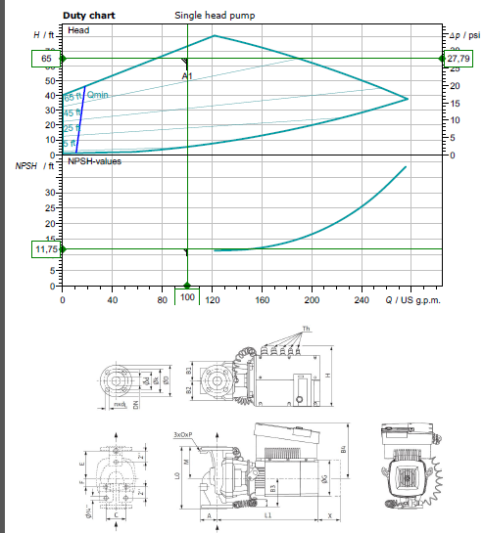

Slide 51
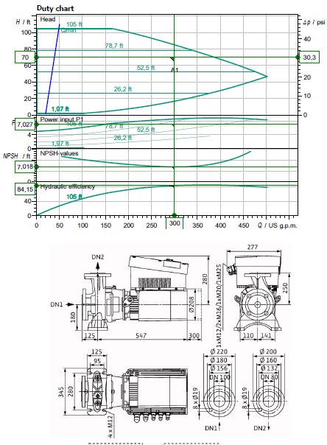

Slide 52
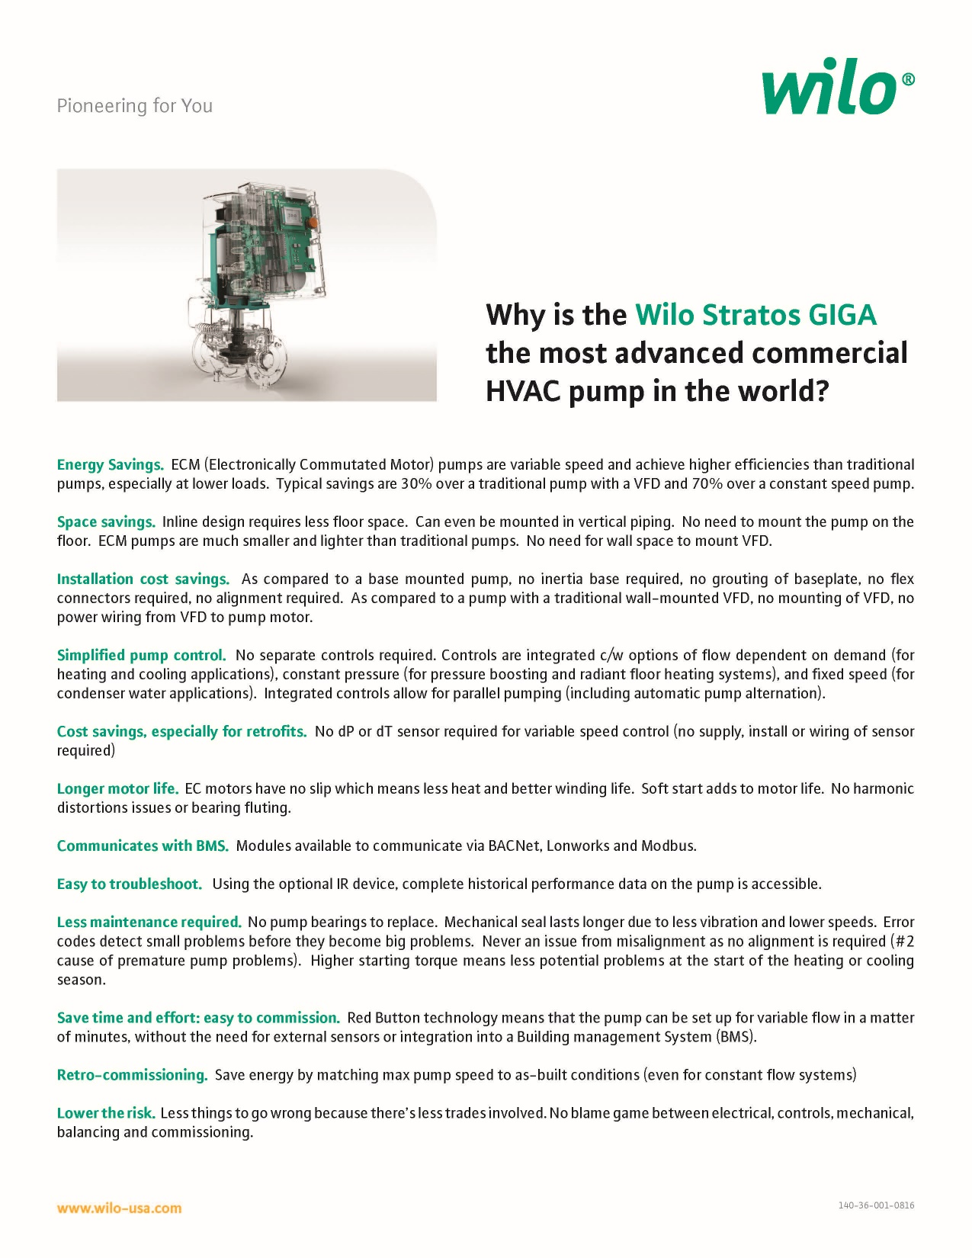

Slide 53
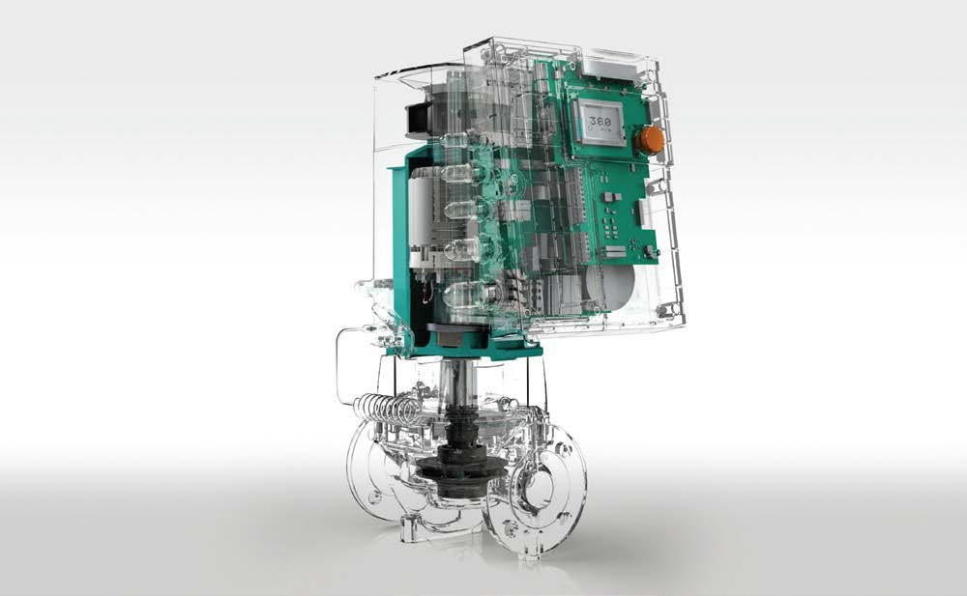
EASY Replacement selection for GIGA from Base Mounted End Suction.
Note:
Using B&G as the Reference but all will have similar capacities.
Looking at the industries most common selections from 1,000,000 – 5,000,000 BTU/HR The most common End Suction pumps have a 7” impeller or 9.5” impeller.
You can tell by the TAG or how big the opening the impeller will have to slide through.
The B&G will show the 7” as an (A) with the 9.5” as an (B). Most will be trimmed to a smaller diameter, determined by the Motor HP and RPM.
The second digit on the B&G (B,C,D, now E) will indicate the generation. (1510-2.5BB) The discharge flange size will let you know the pump size. With the suction 1 size larger. Piping revisions will be common and your local distributor can make simple suggestions.
Should the HP be less than MAX per pump you may be able to select the next smaller pump. The GIGA pumps will all be 460v/3 phase so transformers may be required.
GIGA 2 3-85 | 1510-1.5A | 1510-2A
GIGA 2.5 3-110 | 1510-1.5B | 1510-2A
GIGA 4 3-100 | 1510-2B | 1510-3A
GIGA 4 3-105 | 1510-2B | 1510-4A
GIGA B 80 1-32 | 1510-3B/10hp | 1510-4B/15hp
If you notice from the curves you can usually use the next size larger pump going ECM and still operating with a SYSTEM curve. (ie: GIGA 4 3-105 will cover 1510-2B, 3A, 4A and a lot of 3B). Let us help till you get used to how the curves work and see how oversized the existing selections really are.
This is the simple selection process we have options to cover most any application you can find. All AC motors with VFD’s still operate with pump curves not the system curves as shown prior.
Some installers can install a new ECM-DC GIGA pump cheaper than repairing or replacing an existing.
Now you have a SYSTEM Sensing variable flow pump improving SYSTEM efficiency vs a repair that may last a couple years.
Remember apples to apples flow you save 50% electrically going from AC to DC. We can cover 90% of the systems out there with 2 Giga’s.
100 – 200gpm Pick the head is the standard GIGA inline 2.5 3/87
200 – 300gpm Pick the head is the Standard GIGA B end suction 80 B 1/32 Giga B we add the pressure sensor.
Replace all the 1510-3AB to the 1510-3BB 90% of the school jobs.

Slide 54
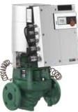
Wile-Stratos GIGA
High-Efficiency n-Line Circulators
Model Des ignation, Stratos GIGA 1.5/3-165 1.5 flange Size (in)
3 Min. Suction Pressure
165 Max. He.ad
Wilo-Stratos GIGA
Model | Volute | Flange | Power | Voltage | Skid | Approx. | Article
 |  | Type | (HP) | :15% (v) | Qty | \'.'eight (lbs) | Number
Stratos GIGA 1.5/3-80 | C,,st Iron | lYz" ANSI Oass 125 | 2.3 | 3-460V | 6 | 95 | 2124484
Stratos GIGA 1.5/3-105 | C,,st Iron | lYz" ANSI Oass 125 | 3.1 | 3-460V | 6 | 95 | 2124483
Stratos GIGA 1.5/3-125 | C,,st Iron | lYz" ANSI Oass 125 | 4.4 | 3-460V | 6 | 95 | 2124482
Stratos GIGA 1.5/3-145 | C,,st Iron | lYz" ANSI Oass 125 | 5.6 | 3-460V | 6 | 95 | 2124481
Stratos GIGA 1.5/3-165 | C,,st Iron | lYz" ANSI Oass 125 | 6.4 | 3-460V | 6 | 95 | 2124480
Stratos GIGA 2/3 -45 | C,,st Iron | 2"ANSI Class 125 | 1.2 | 3-460V | 6 | 93 | 2124488
Stratos GIGA 2/3 -65 | C,,st Iron | 2"ANSI Class 125 | 2 | 3-460V | 6 | 93 | 2124487
Stratos GIGA 2/3 -85 | C,,st Iron | 2"ANSI Class 125 | 2.7 | 3-460V | 6 | 93 | 2124486
Stratos GIGA 2/3 -105 | C,,st Iron | 2"ANSI Class 125 | 4 | 3-460V | 6 | 93 | 2124485
Stratos GIGA 2/3 -120 | C,,st Iron | 2"ANSI Class 125 | 4 | 3-460V | 6 | 97 | 2124491
Stratos GIGA 2/3 -140 | C,,st Iron | 2"ANSI Class 125 | 5 | 3-460V | 6 | 97 | 2124490
Stratos GIGA 2/3 -160 | C,,st Iron | 2"ANSI Class 125 | 6.6 | 3-460V | 6 | 97 | 2124489
Stratos GIGA 2.S/3-26 | C,,st Iron | 2Yz. ANSI Oass 125 | 0.8 | 3-460V | 6 | 106 | 2124494
Stratos GIGA 2.S/3-39 | C,,st Iron | 2Yz. ANSI Oass 125 | 1.7 | 3-460V | 6 | 106 | 2124493
Stratos GIGA 2.S/3-55 | C,,st Iron | 2Yz. ANSI Oass 125 | 2.6 | 3-460V | 6 | 106 | 2124492
Stratos GIGA 2.S/3-70 | C,,st Iron | 2Yz. ANSI Oass 125 | 3.4 | 3-460V | 6 | 108 | 2124496
Stratos GIGA 2.S/3-87 | C,,st Iron | 2Yz. ANSI Oass 125 | 4.6 | 3-460V | 6 | 108 | 2124495
Stratos GIGA 2.S/3-110 | C,,st Iron | 2Yz. ANSI Oass 125 | 4.7 | 3-460V | 6 | 108 | 2124499
Stratos GIGA 2 .5/3-125 | C,,st Iron | 2Yz. ANSI Oass 125 | 5.9 | 3-460V | 6 | 108 | 2124498
Stratos GIGA 2.S/3-135 | C,,st Iron | 2Yz. ANSI Oass 125 | 7.1 | 3-460V | 6 | 126 | 2124497
Stratos GIGA 3/3 -50 | C,,st Iron | 3 ANSI Class 125 | 3.5 | 3-460V | 6 | 123 | 2124501
Stratos GIGA 3/3 -70 | C,,st Iron | 3 ANSI Class 125 | 5.4 | 3-460V | 6 | 123 | 2124500
Stratos GIGA 3/3 -105 | C,,st Iron | 3 ANSI Class 125 | 6 | 3-460V | 6 | 148 | 2124503
Stratos GIGA 3/3 -120 | C,,st Iron | 3 ANSI Class 125 | 7.8 | 3-460V | 6 | 159 | 2124502
Stratos GIGA 4/3 -50 | C,,st Iron | 4" ANSI Class 125 | 3.5 | 3-460V | 6 | 172 | 2124505
Stratos GIGA 4/3 -55 | C,,st Iron | 4" ANSI Class 125 | 5.6 | 3-460V | 6 | 172 | 2124504
Stratos GIGA 4/3 -100 | C,,st Iron | 4" ANSI Class 125 | 7.1 | 3-460V | 6 | 174 | 2124507
Stratos GIGA 4/3 -105 | C,,st Iron | 4" ANSI Class 125 | 9.1 | 3-460V | 6 | 185 | 2124506

Slide 55
WILO Engineering 101
Click on photo

Slide 56
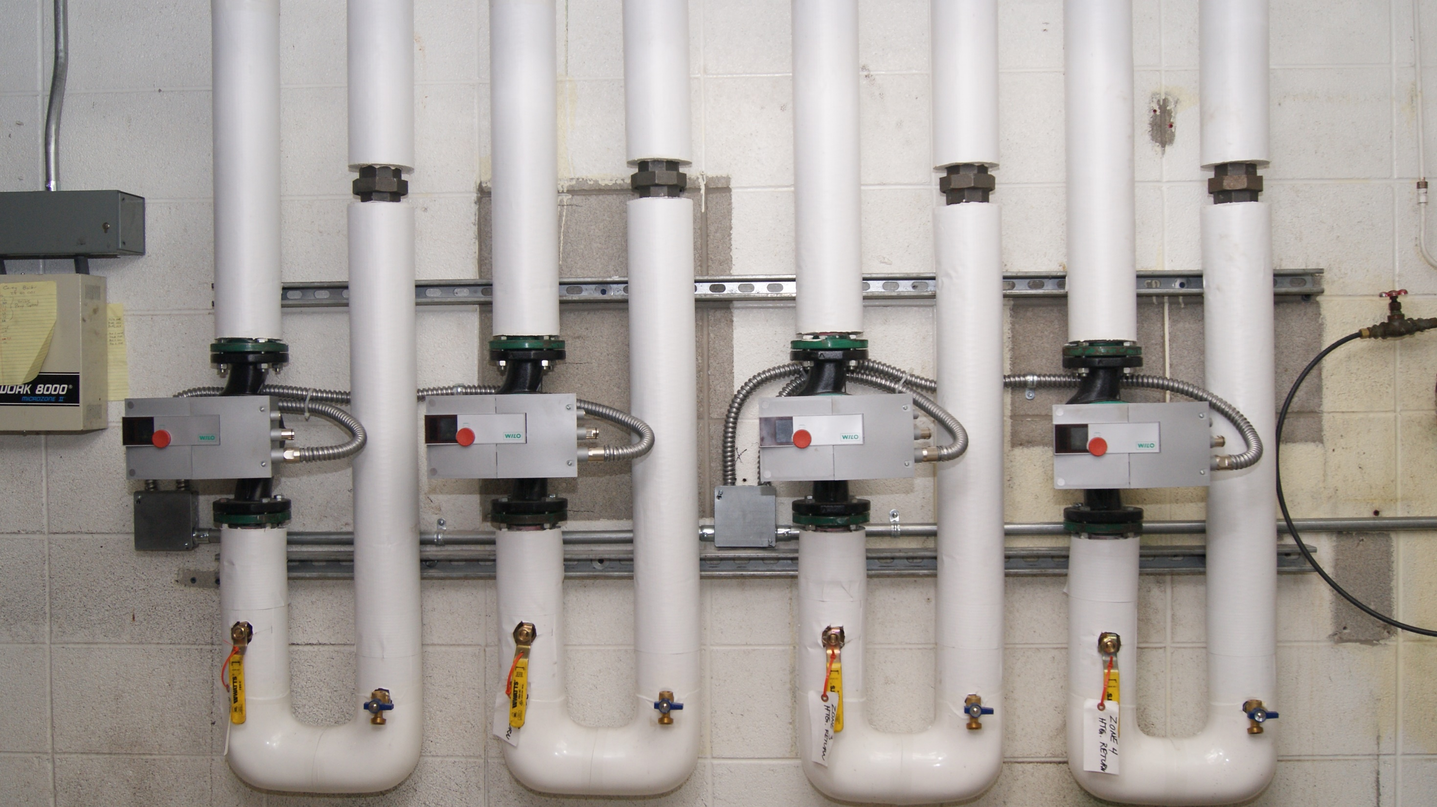
Add a Slide Title - 1

Slide 57
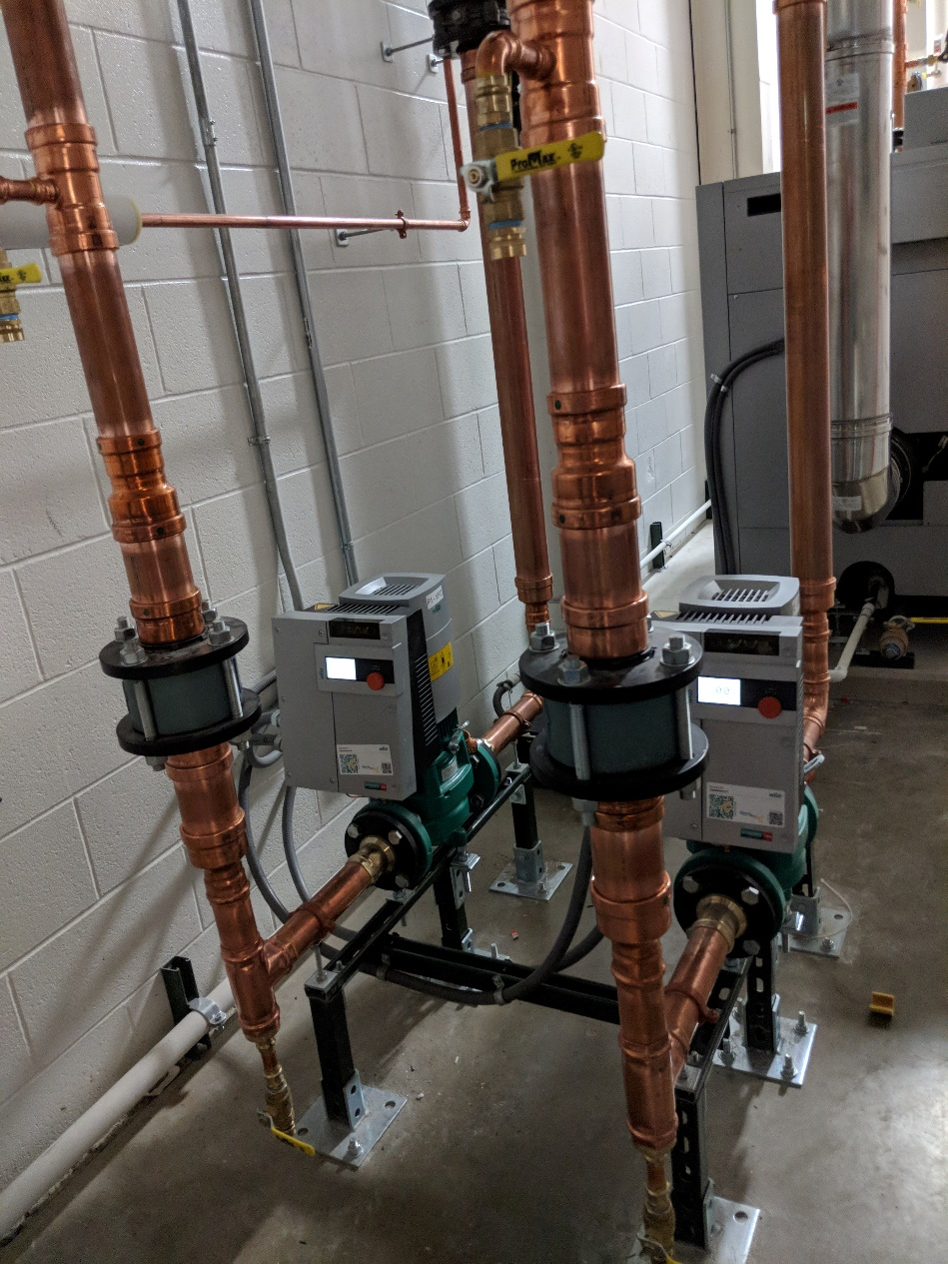
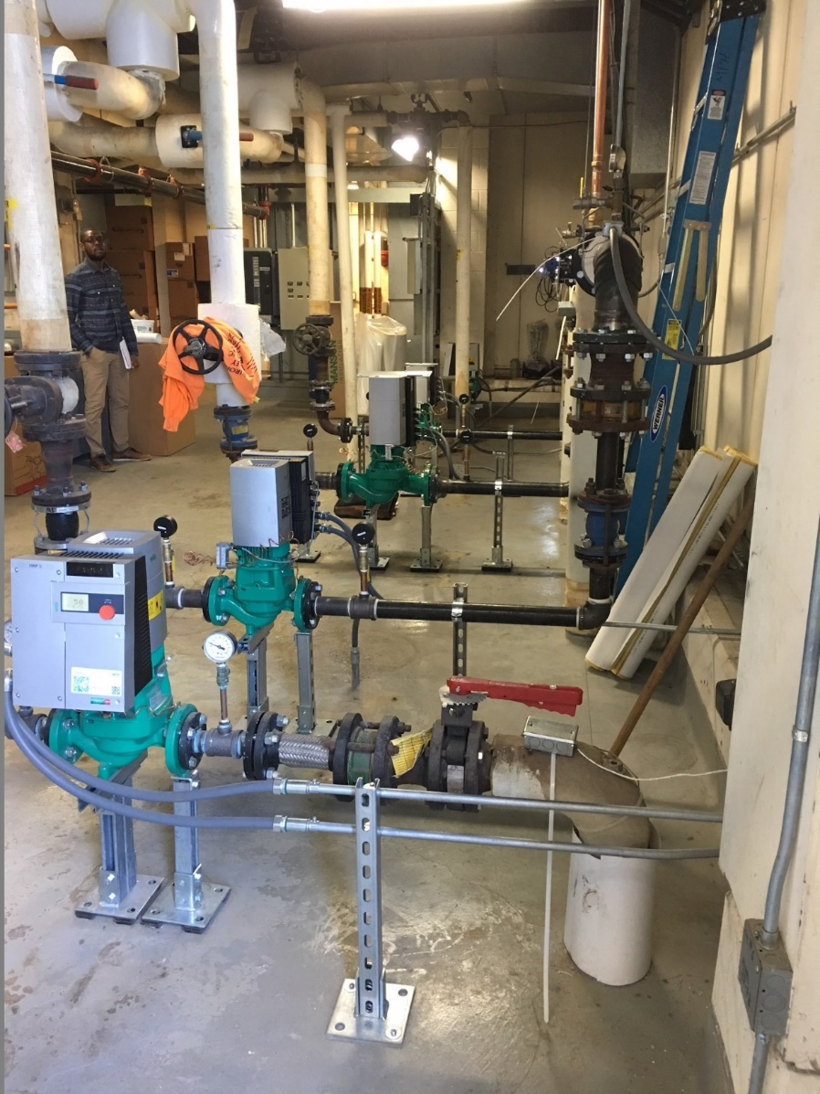
rEFERENCE
LANE AUTOMOTIVE
UniversitY OF MICHIGAN

Slide 58
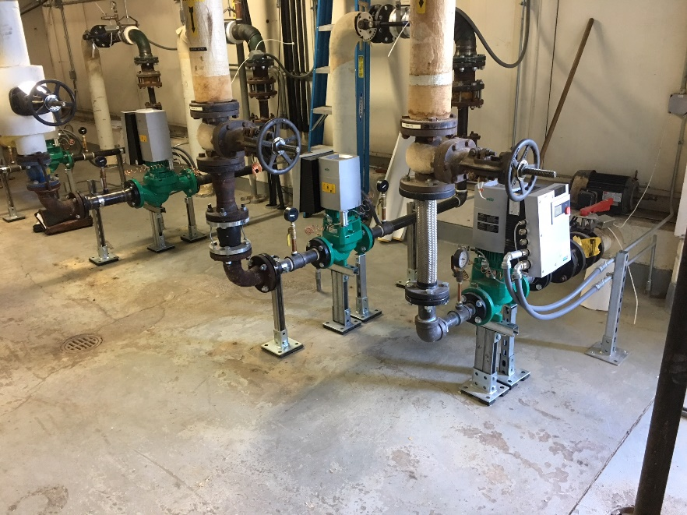
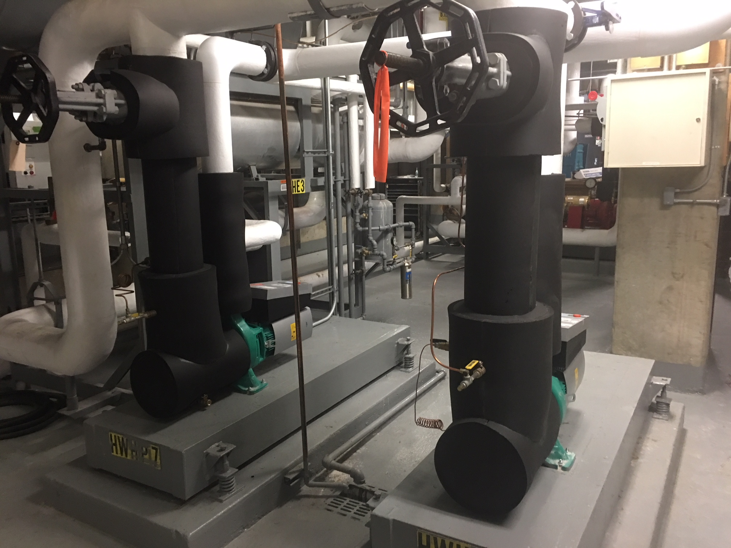
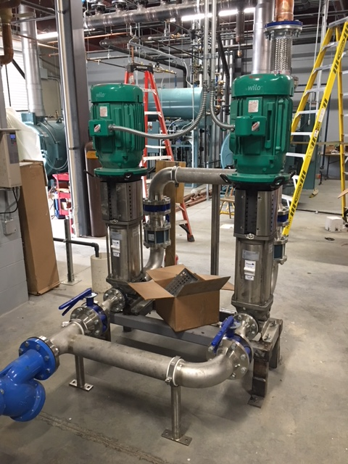

Slide 59
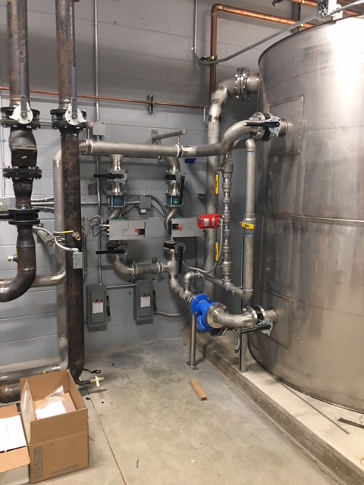
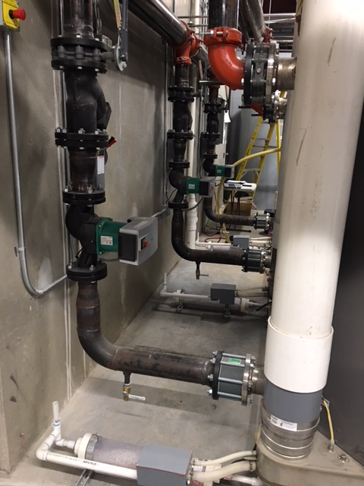

Slide 60
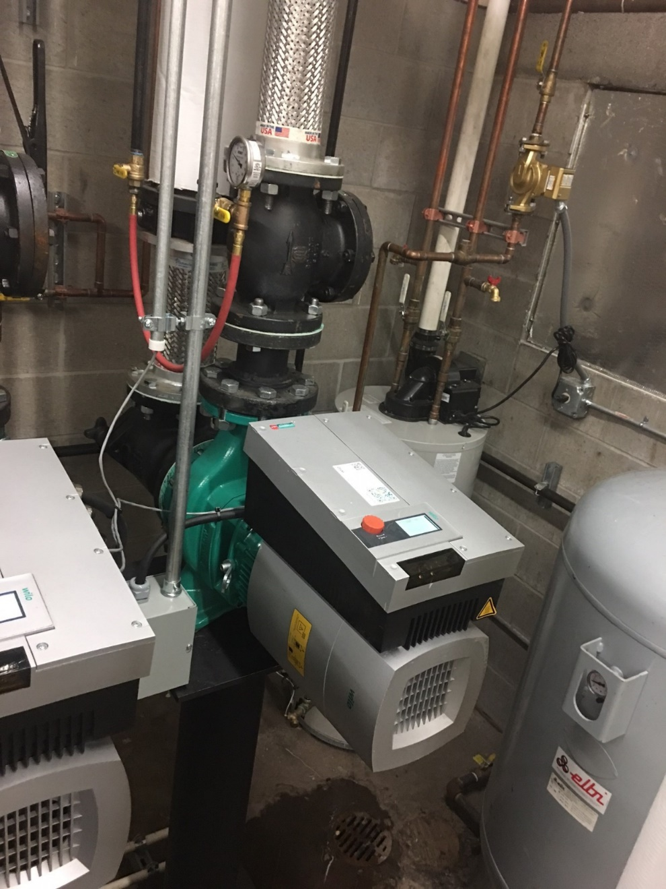

Slide 61
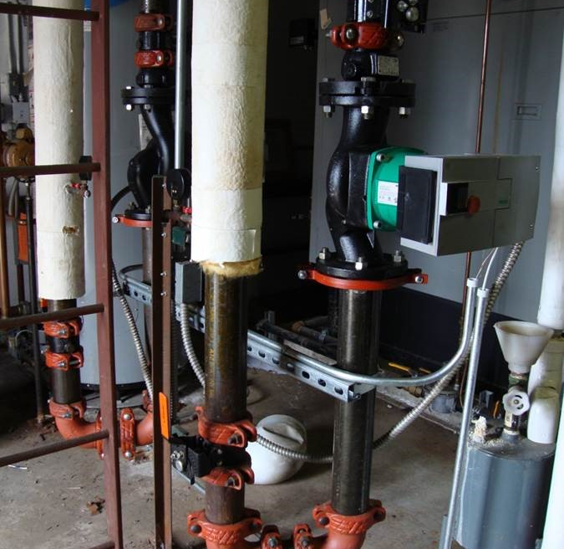
Alma
Base Mounted replaced by inline SIMPLE for anyone.

Slide 62
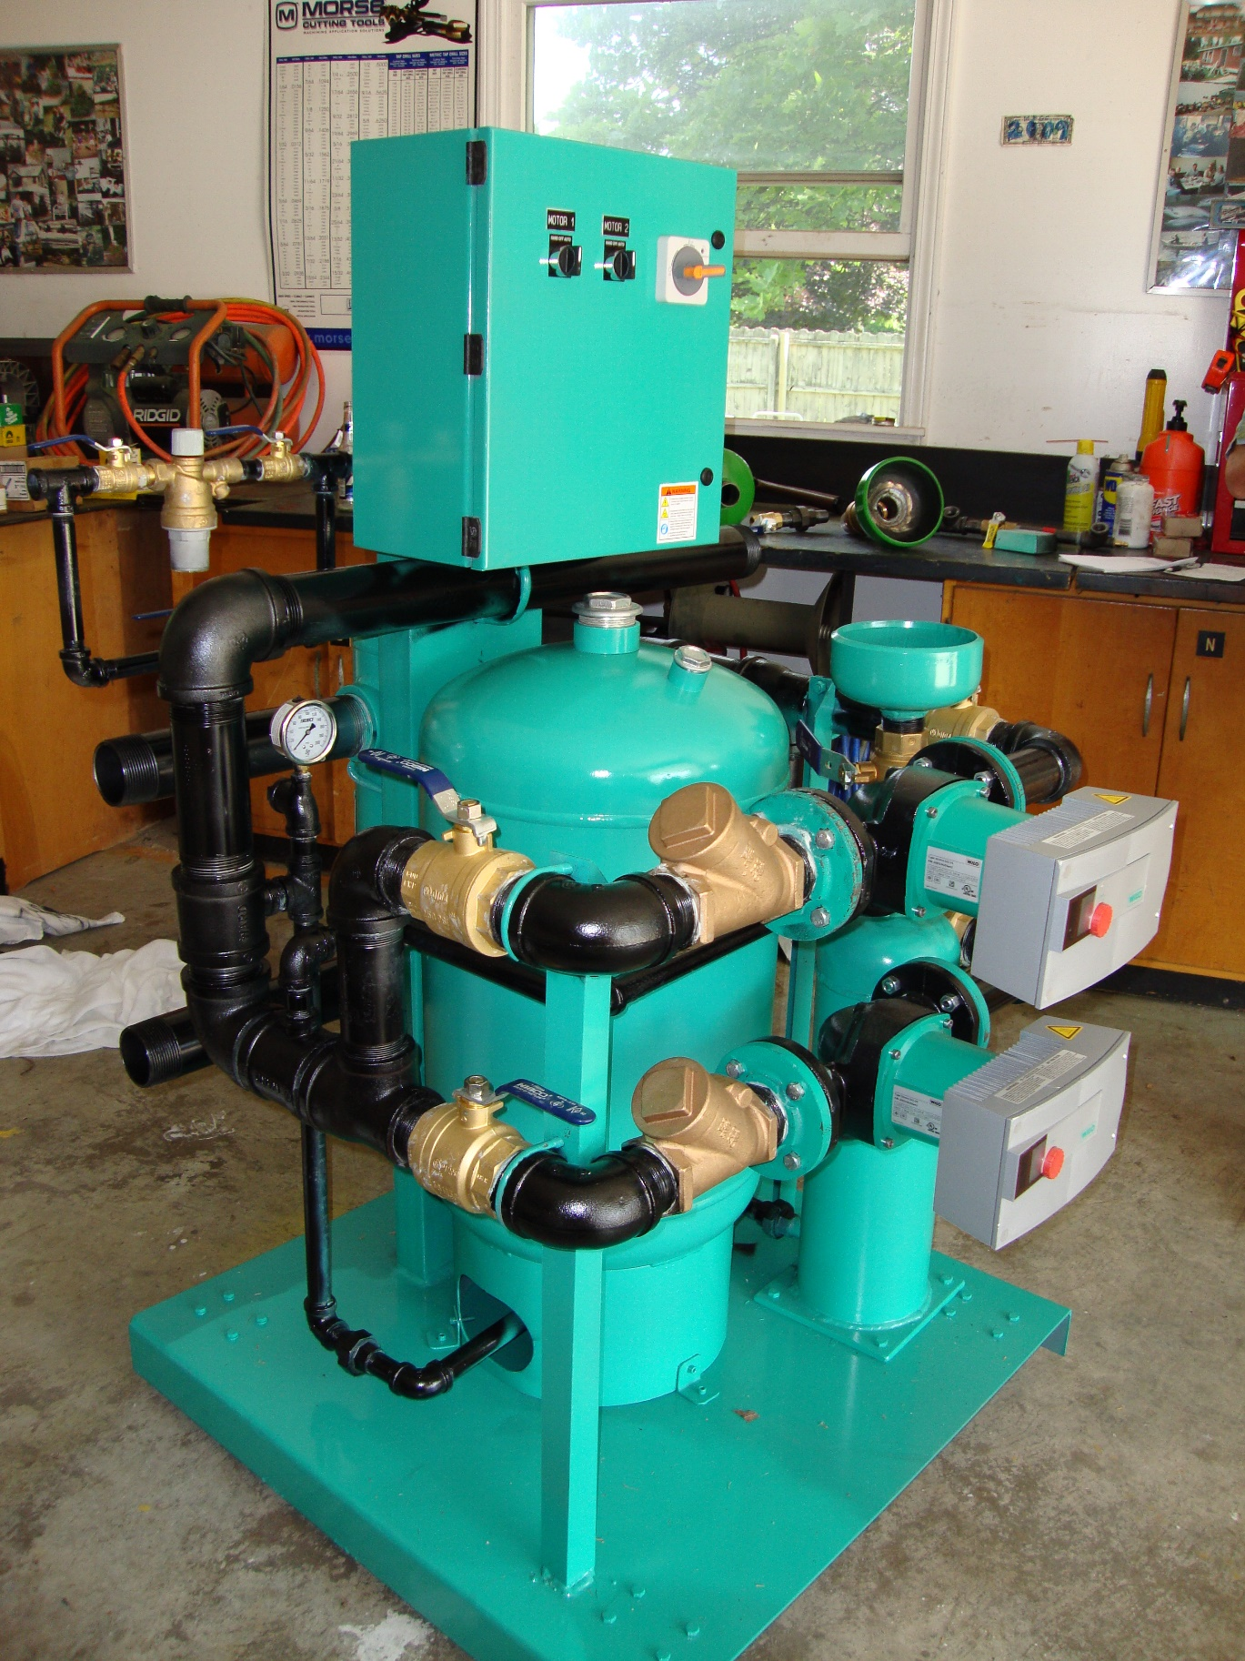

Slide 63
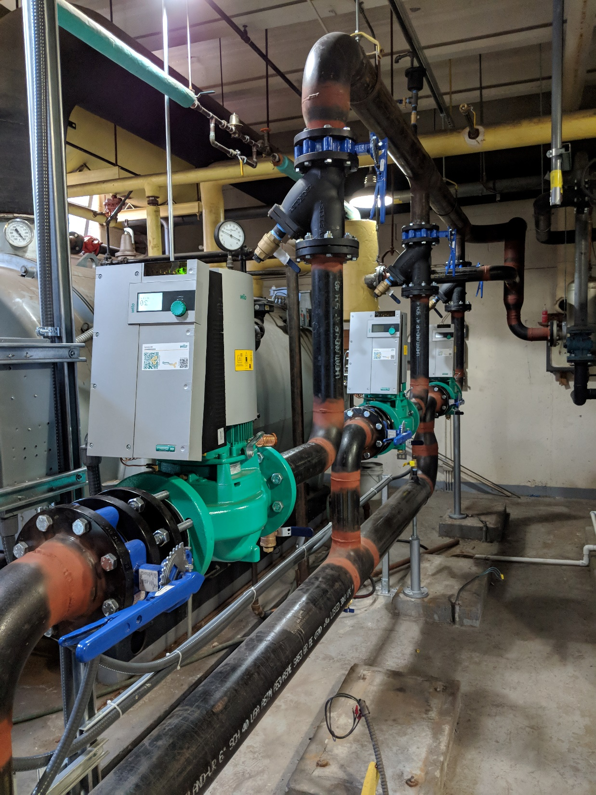
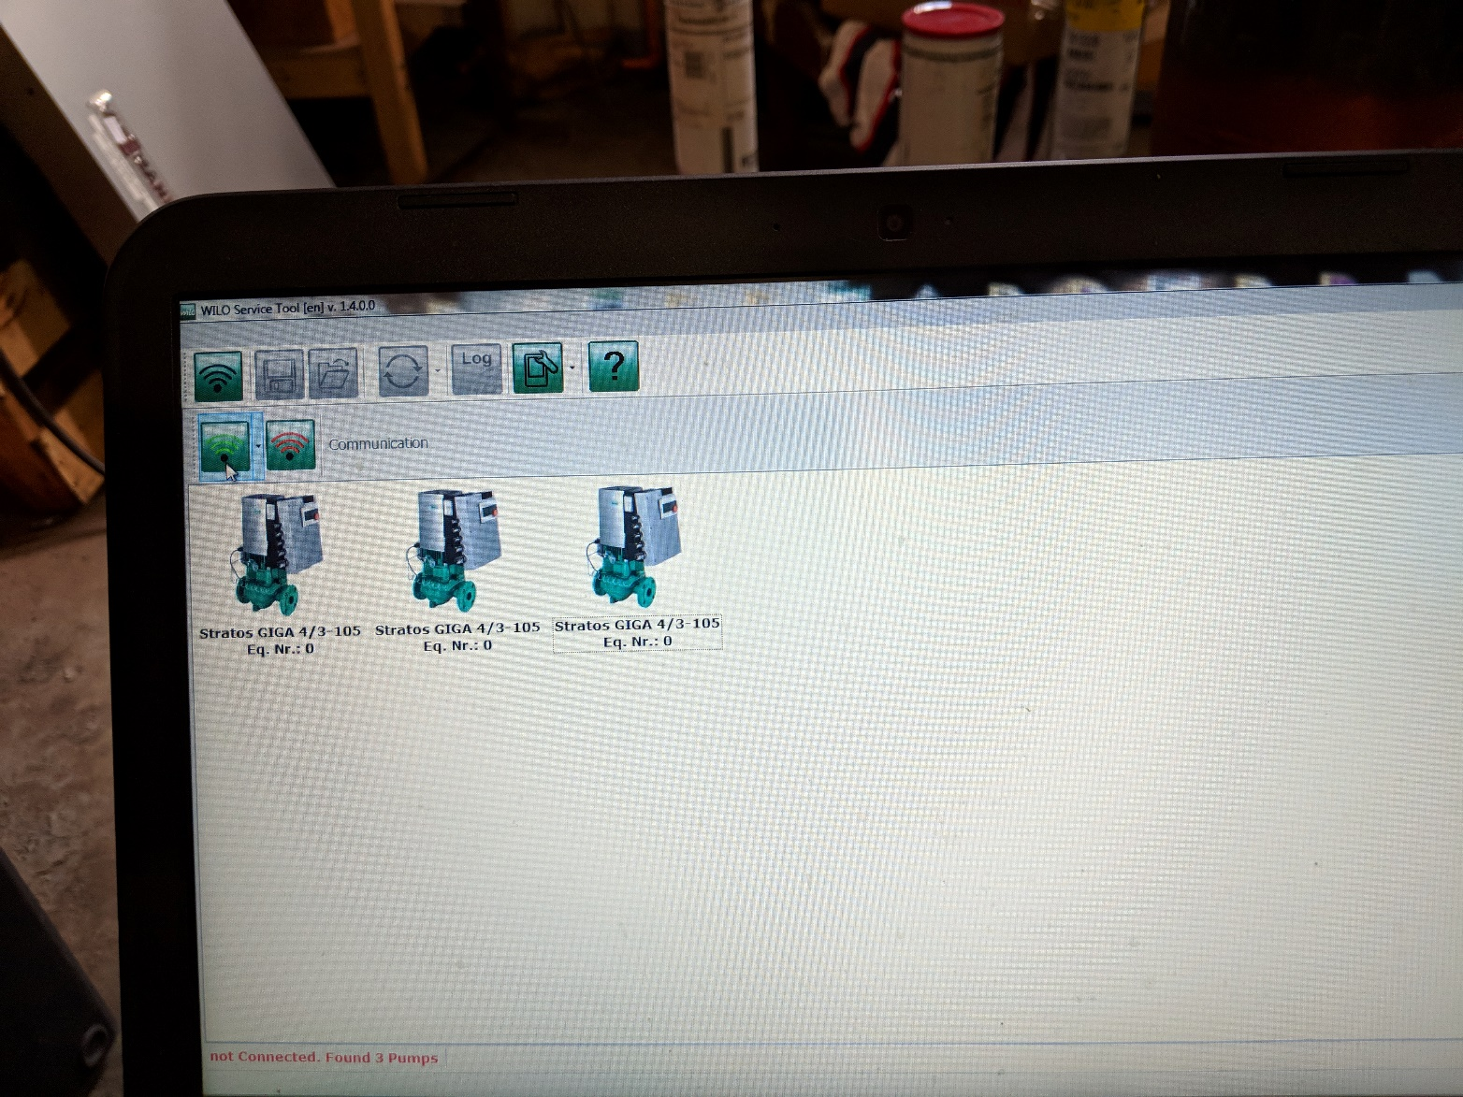
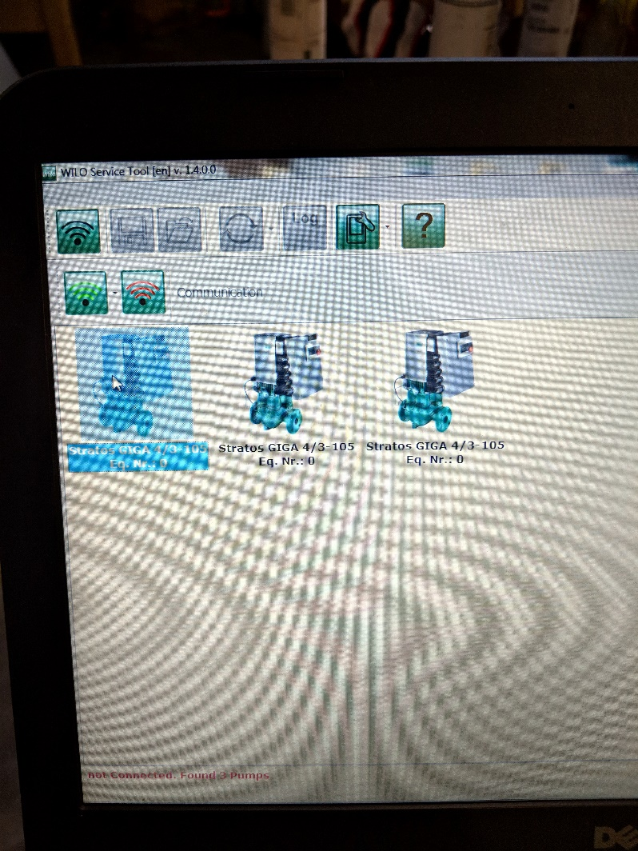

Slide 64
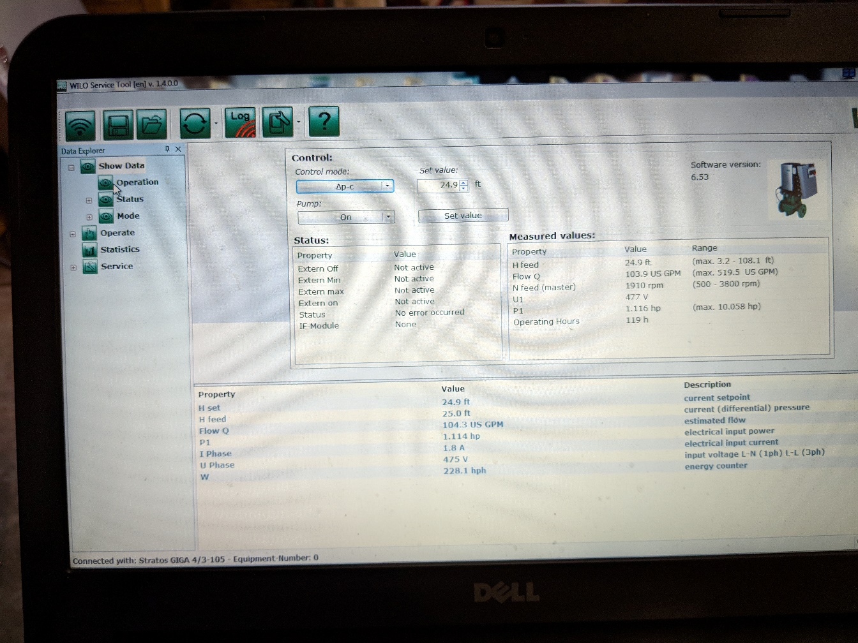
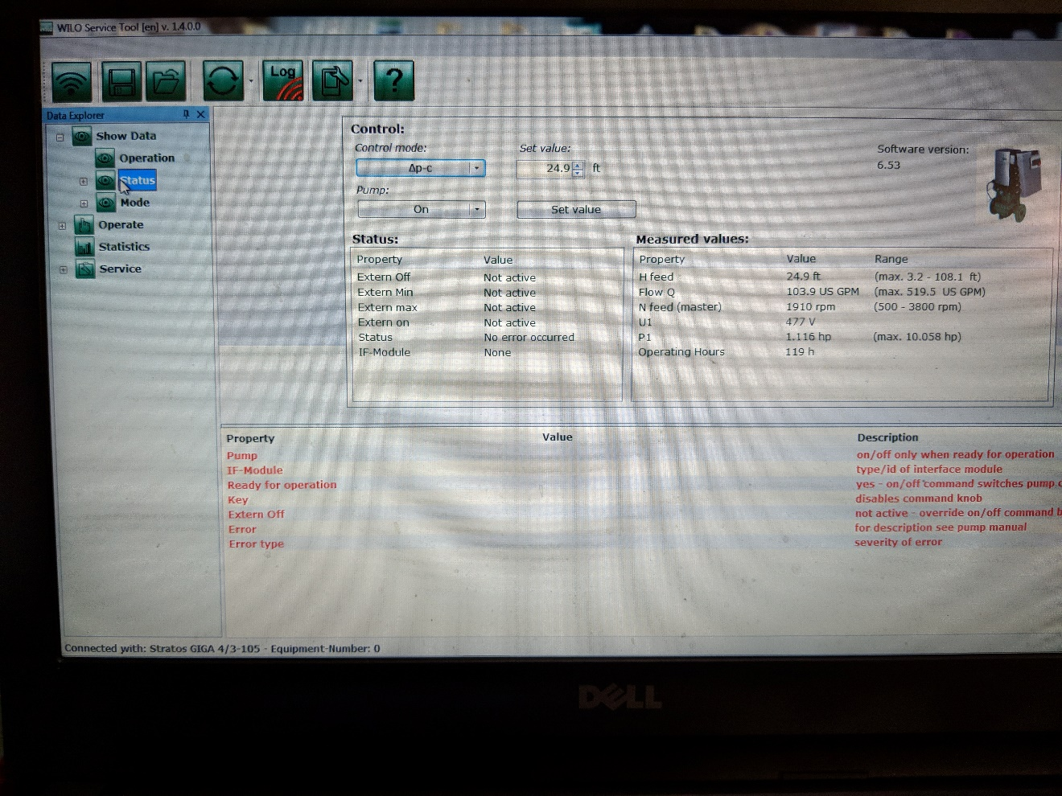


Slide 65



Slide 66



Slide 67


Slide 68


