Slide 1
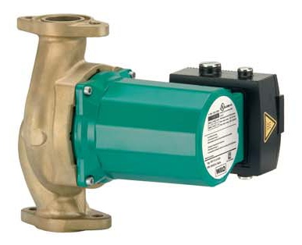
WILO Top Z Commercial Wet Rotor Training
Commercial Multi - Speed Wet Rotor Circulators for DHW Recirculation
Presentation Date – New October 2008
TOP Z

Slide 2
Overall Features and Benefits TOP Z
WILO Brain “Easy Read” Numbering System
References flange size and shut off head (max speed)
Shortest “Lay Length” in the Industry
Industry Standard Flanges
2 Bolt Oval for 1 ½” and 1 ¼”
Special “non - ANSI” 4 bolt for 2”
125 # ANSI for 3”
Cast Aluminum Terminal Box
NPT Electrical Openings
Built in Thermal Overload Sensor
Rotation Indicator (3 Phase Only)
¼” Suction & Discharge Gauge Tappings
Excellent Commercial Pump Warranty
24 months from manufacturing, 18 months from installation

Slide 3
Overall Features and Benefits TOP Z con’t
Lead Free Bronze (Cast Iron Version NOT Available)
Complies with NSF 61
Engineered Composite Impeller
Compatible with softened water
Wet Rotor “Seal less” Design
Multiple Speed
No Mechanical Seals
No Couplings
No Maintenance!
Redesigned Rotor/Can Assembly
Built in internal check valve
Eliminates internal fluid transfer
Eliminates calcium build up
Lead free bearings
Automatically Vented

Slide 4

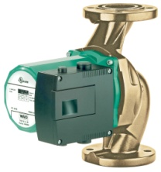
WILO Top Z Model Number System
TOP Z 1.5 x 25
TOP Z
“Z” Lead Free Bronze (no cast iron version) Multiple speed
1.5
Flange size in Inches
3” - ANSI, 125 # raised face, 4 bolt
2” pump flange - 4 bolt “grooved” pump type
1 ½” and 1 ¼” pump flange - oval 2 bolt “grooved” type
25
Approximate maximum pumping head in feet (@ max speed)

Slide 5
Top Z Technical Specifications
System Temperature
Minimum (all applications) 14 Deg F (-10 Deg C)
Maximum Temperature
176 Deg F (80 Deg C) Closed Circulating Systems
140 Deg F (60 Deg C) Open Circulating Systems
176 Deg F (80 Deg C) Potable Water Circulating Systems
Working Pressure
145 PSI (10 bar) Max
Maximum Water Hardness
18.8 Grain (gr/US Gal)
Minimum Inlet Pressure
Top Z 1 ½”
104 Deg F (40 Deg C) 7.1 PSI
176 Deg F (80 Deg C) 11.4 PSI
Top Z 2” & 3”
140 Deg F (40 Deg C) 11.4 PSI
176 Deg F (80 Deg C) 14.2 PSI
Ambient Temperature Range
32 Deg F (0 Deg C) to 104 Deg F (40 Deg C)
Materials of Construction
Volute – Bronze (CuSi Alloy – Lead Free)
Impeller – PPS, 40% Glass Filled (similar to Stratos)
Shaft – Stainless Steel (X99 CrMo17-1)
Bearings – Carbon (synthetic resin impregnated)

Slide 6
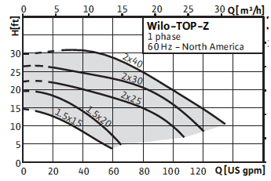
Top Z Available Single Phase Models
Note: Curves different from Top S!
All Single Phase Models Available 115 or 230 / 1 / 60 Volt
(Curves Shown @ maximum Speed)

Slide 7
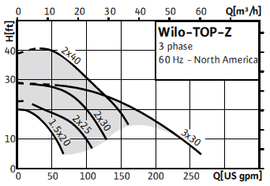
Top Z Available Three Phase Models
Note: Curves different from Top S!
All Three Phase Models Available 208/230, 460, 575 / 3 / 60 Volt
(Curves Shown @ Maximum Speed)

Slide 8
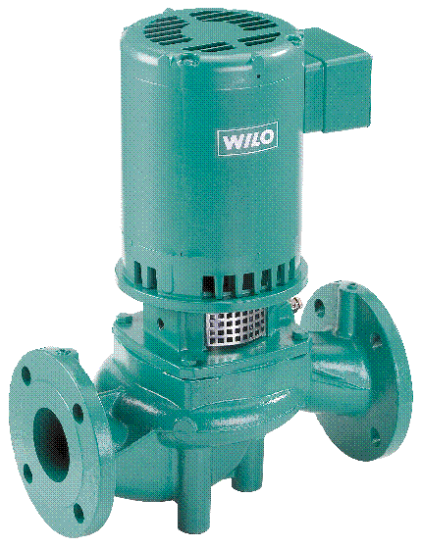
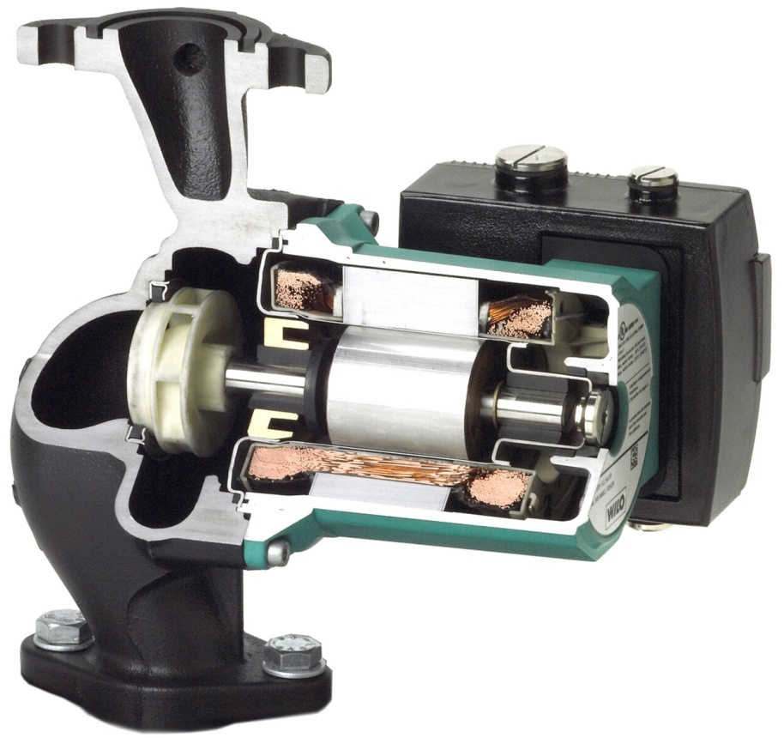
Features and Benefits TOP Z
Wet Rotor Technology
The Silent One!!
Noticeable
sound - level
for the
human ear
20 dB (A) less
means only
less than 10%
of noise !!
IPL 40-140
60 dB
Top S
40 dB

Slide 9





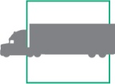



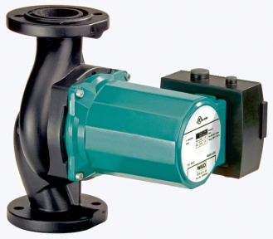

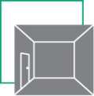
Super Silent Top Z Wet Rotor Pumps
db(A)
130
120
110
100
90
80
70
60
50
40
30
20
10
0
Siren
Aircraft Noise
Jack Hammer
Rock Concert
Factory Noise
Truck
Traffic
Office
Conversation
Top Z Sound Level From 43 to 48 db!
Trees
Sound Room

Slide 10
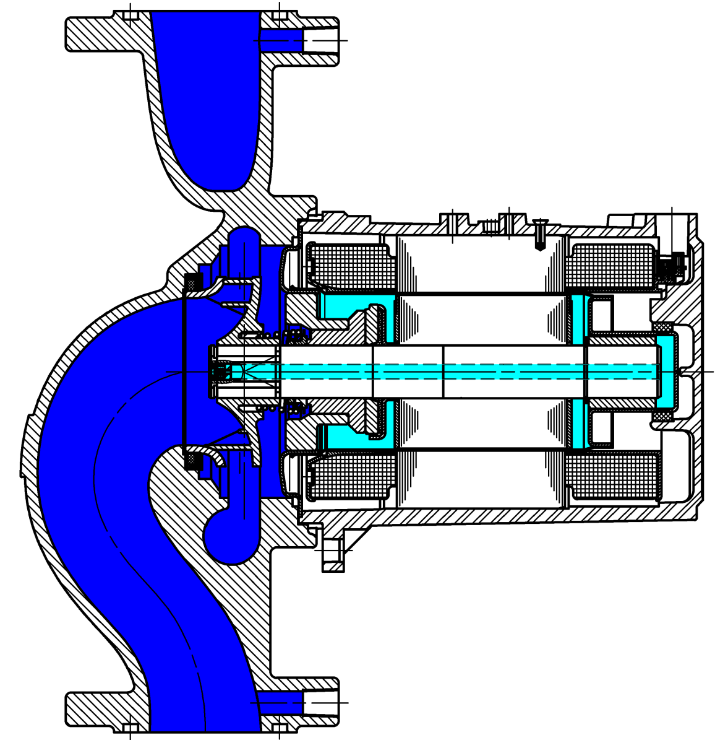
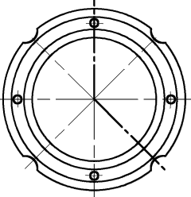
Top Z Filling and Venting
Rotor Can Fills: p _{system}> p _{cartridge}
Filling Complete: p _{system}= p _{cartridge}
T _{system 1}
P _{system}
P _{Pressure in Rotor/Can Assy}
T _{Temp Rotor/Can Fluid. 2}

Slide 11
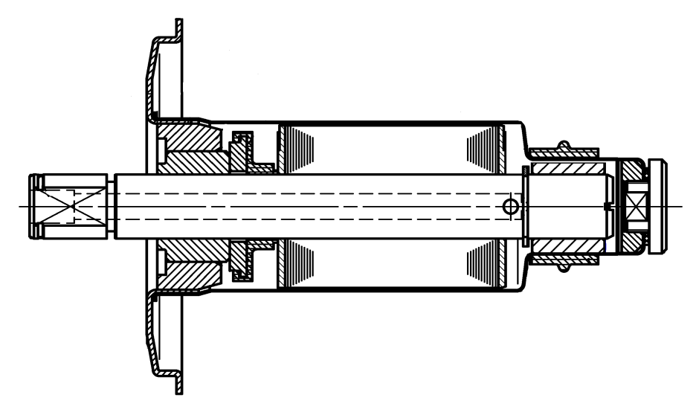
Top Z - 1 ½” Filling and Venting
Type 1
Notes:
Filling process cartridge option 1:
The fluid runs throught the check valve (the valve opens at 0-7.2 psi) into the internal shaft hole and escapes via the shaft cross-hole in front of the outboard bearing into the outboard rotor area. The rotor area is filled. The fluid runs through the grooved outboard bearing (4 longitudinal grooves at the outside diameter) into the outboard bearing area and on the other side via a gap between rotor and rotor can to the inboard bearing. The air escapes via the longitudinal grooves of the radial bearings and the gap between the rotor and the rotor can to the upper 1/3 of the inboard and accumulates there (approx. 30-40% air volume). Note the inboard bearing is still water lubricated as it remains 2/3 submerged. The valve closes when there is a pressure balance between the system and the rotor/can pressures.

Slide 12
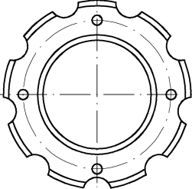
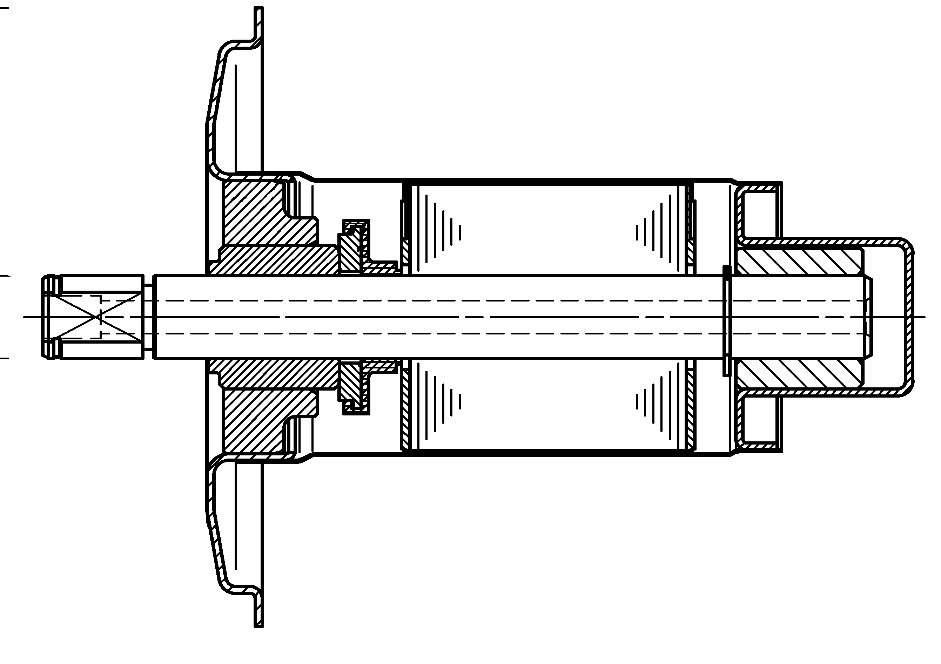
Top Z - 2” & 3” Filling and Venting
Type 2
Notes:
Filling process cartridge option 2:
The fluid runs throught the check valve (the valve opens at 0-7.2 psi) into the internal shaft hole and escapes via the shaft cross-hole in front of the outboard bearing into the outboard rotor area. The rotor area is filled. The fluid runs through the grooved outboard bearing (8 longitudinal grooves at the outside diameter) into the outboard bearing area and on the other side via a gap between rotor and rotor can to the inboard bearing. The air escapes via the longitudinal grooves of the radial bearings and the gap between the rotor and the rotor can to the upper 1/3 of the inboard and accumulates there (approx. 30-40% air volume). Note the inboard bearing is still water lubricated as it remains 2/3 submerged. The valve closes when there is a pressure balance between the system and the rotor/can pressures.

Slide 13
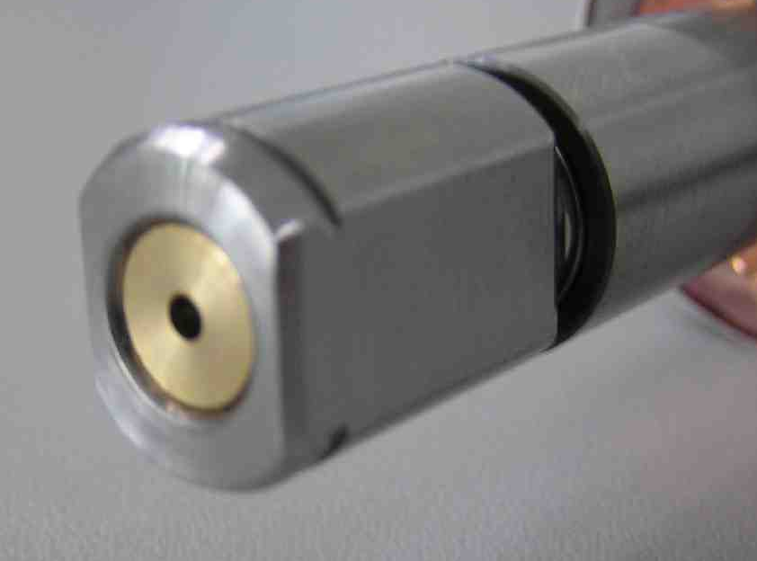
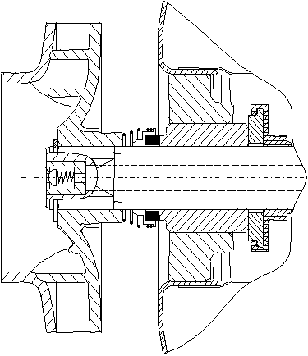
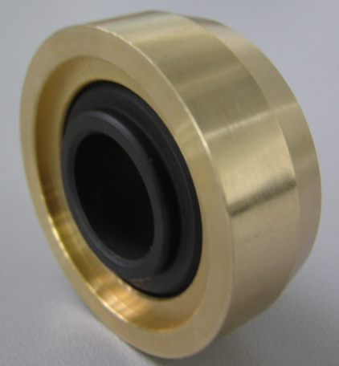
Top Z Filling and Venting
venting operation: P_{system.}< P_{cartridge}
T_{med. 1}
T_{med. 2}
mechanical seal
check valve
p_{open}
p_{hydr.}
p_{cartridge}
p_{open check valve}= 0 -7.2 psi
bearing bracket

Slide 14
Top Z Filling and Venting
Venting:
The pump rotor chamber will vent automatically with sytem pressure. The TOP-Z models (TOP-Z 1.5x15 and TOP-Z 1.5x20) equipped with a vent screw can be manually vented (see I/O manual).
Venting during operation:
During the pump operation the temperature inside the rotor area increases by heat caused by the motor, consequently the internal pressure in the cartridge increases as well. This causes a pressure difference between interior and exterior (p _{system} > p _{cartridge}). At a pressure difference of 21.8 psi the mechanical seal opens and the the fluid (including air) escapes via the front bearing slots at the bearing bracket.
This venting operation may cause a low pressure in the rotor area. The check valve opens at the pressure difference of 0-7.2 psi and the fluid enters the rotor area until the pressure is balanced.

Slide 15
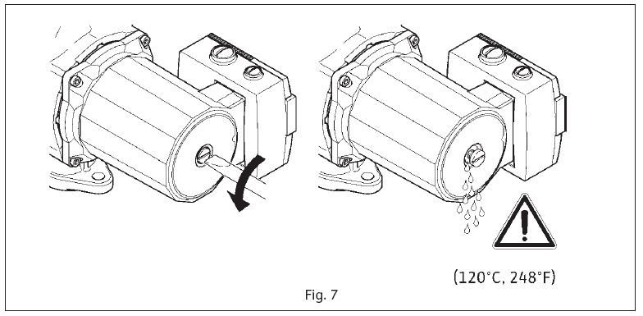
Top Z Filling and Venting
The TOP-Z is automatically vented, as is all WILO wet rotor pumps. Due to the design of the rotating assembly and operating conditions this operation may take some time. The process can be accelerated by the following measures.
Ventilation of rotor area via air-vent screw (TOP-Z 1.5x15 and TOP-Z 1.5x20). For details see installation and operating instructions, chapter „Filling and venting“.
Switching the pump on an off several times. Provide longer breaks between switching on and off so that the many small air bubbles in the rotor area can accumulate to one air bubble. Due to the pressure compensation the air escapes better.
Close the shut-off valve on the pressure side of the pump abruptly during pump operation. This causes the internal pressure on the suction side of the impeller to increase so that the valve opens (p _{system} > p _{cartridge}) and the fluid enters the rotor area. Due to the pressure increase in the rotor area the accumulated air is pressed out via the mechanical seal. Then the valve can be opened and the operation may be repeated until there are no more air noises in the pump.

Slide 16
Installation Instructions – Top Z
Install with shaft horizontal
Pump in any direction (vertical, horizontal etc.)
If pumping vertical try to pump up (with air)
Fluid should be relatively free of abrasive particles
Damages sleeve bearings in wet runners and mechanical seals in dry runners
Maximum water hardness 18.8 gr/USgal
Install with terminal box @ 9:00, 12:00 or 3:00 positions
Installing @ 6:00 can allow fluid into terminal box during air bleeding
Be careful with the suction side (laminar flow)

Slide 17
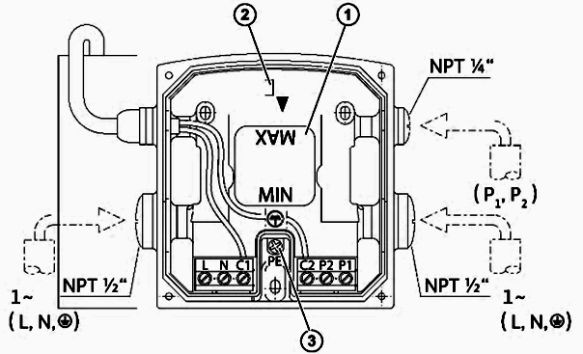
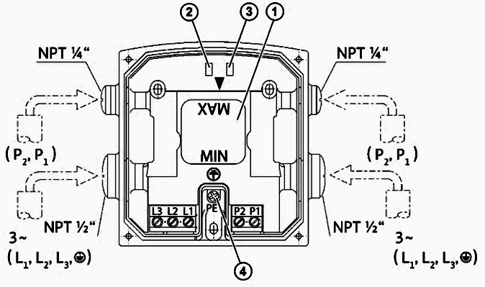
Inside the Terminal Box – Top Z
(Identical to the Top S)
Single Phase Three Phase
Speed Selector (all voltages)
Green Power on Light
Ground Screw
L & N Power Inputs
C1, C2 Pre-wired Capacitor Leads
P1, P2 Overload Circuit (no load N/C contact)
Speed Selector (all voltages)
Green Power on Light
Red Reverse Rotation (Off if OK)
Ground Screw
L1, L2 & L3 Power Inputs
P1, P2 Overload Circuit (no load N/C contact)

Slide 18
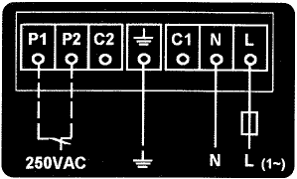
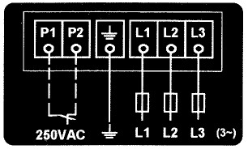
Wiring Instructions – Top Z
Sticker on the Inside of the Terminal Box Cover
Single Phase Three Phase

Slide 19
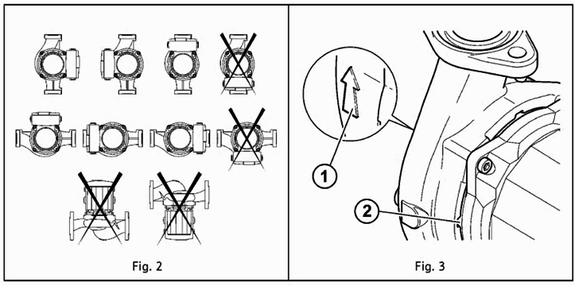
Installation Instructions – Top Z
Terminal Box and Shaft Orientation Direction of Flow & Condensate Drain

Slide 20
Application Types – Top Z
Applications
Only Bronze Models Available!
Potable Water (Domestic Hot Water Recirculation Systems)
DHW Boiler Pumps
Primary and Secondary Hot and Chilled Water Systems
Up to 50 % Maximum Glycol in Heating and Cooling Applications
For indoor use only

Slide 21
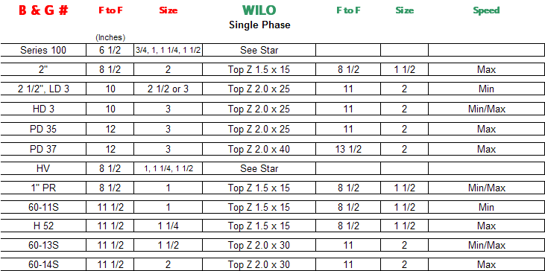
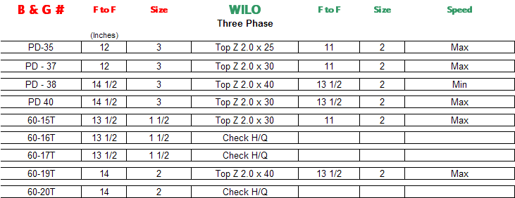
Top Z Cross References

Slide 22
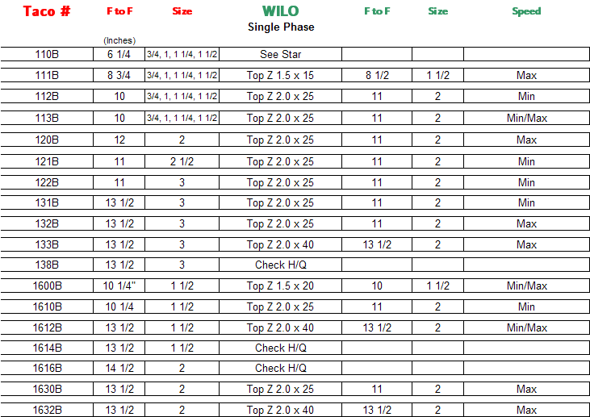
Top Z Cross References

Slide 23
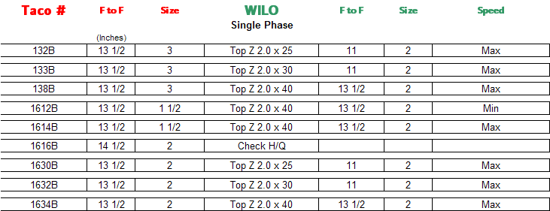
Top Z Cross References

Slide 24
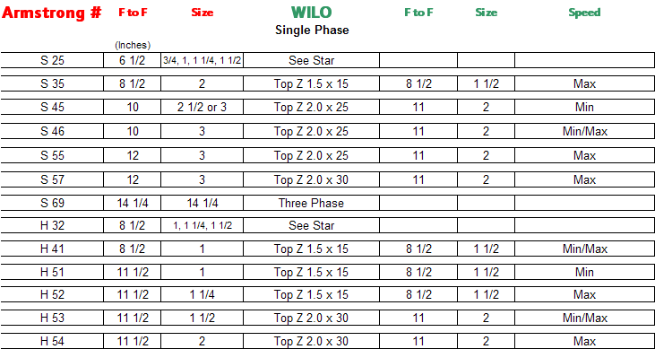
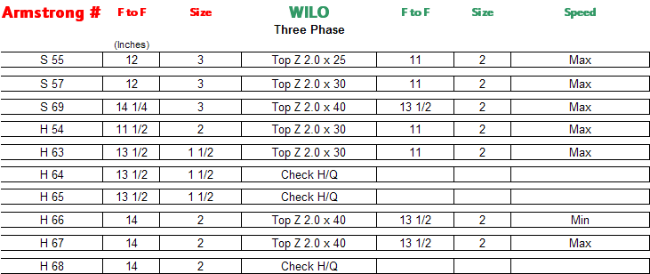
Top Z Cross References

Slide 25
Top Z - What’s the Difference (review)?
Vs Top S
No system fluid exchange
Handles hard water
Lead free
NSF 61 Compliant
DHW suitable impeller
Flatter performance curves
Same wiring etc as Top S
Same model designation as Top S
Curves designed for application
Easier to cross reference
Vs Competition
Quieter
Maintenance free
2 speed
Min speed eliminates piping erosion
Handles hard water better (no seal)
Lead free
NSF 61 Compliant
DHW suitable impeller
Flatter performance curves
Fewer models to stock
Higher flows
Top Z - What’s the Difference – You be the Judge!

Slide 26
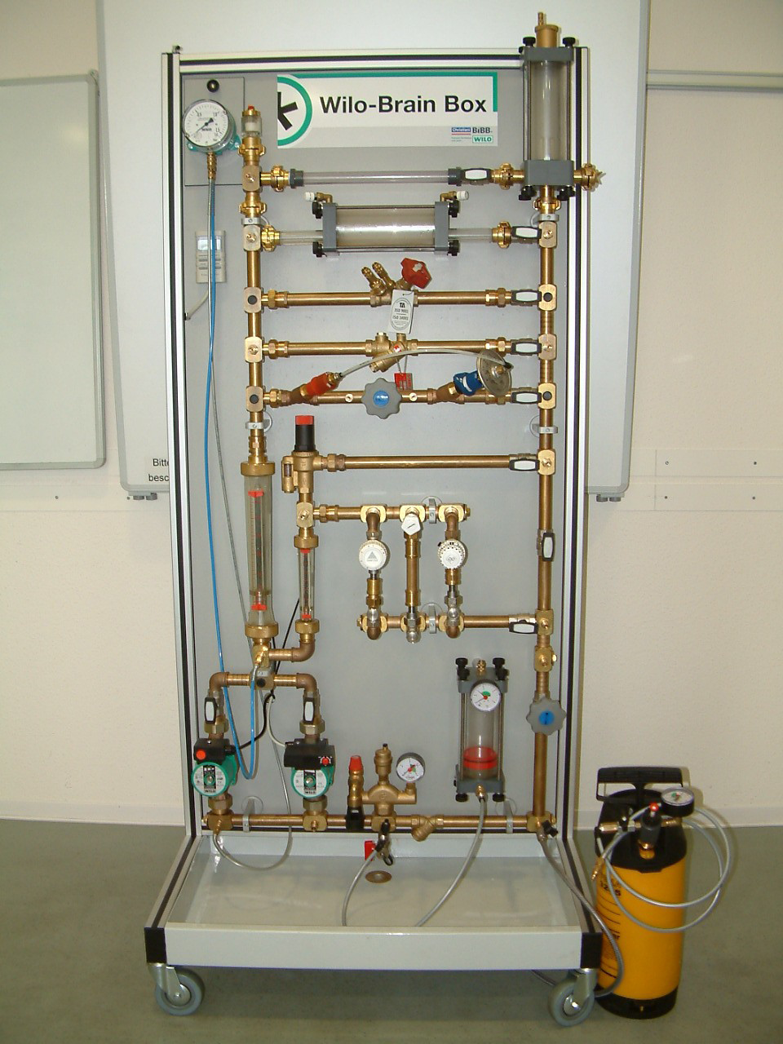
THANK YOU!
Be sure to check the WILO NA web site (www.wilo-na.com) for additional training courses and the “Ask the Trainer” section!
WILO Brain Box

