Slide 1
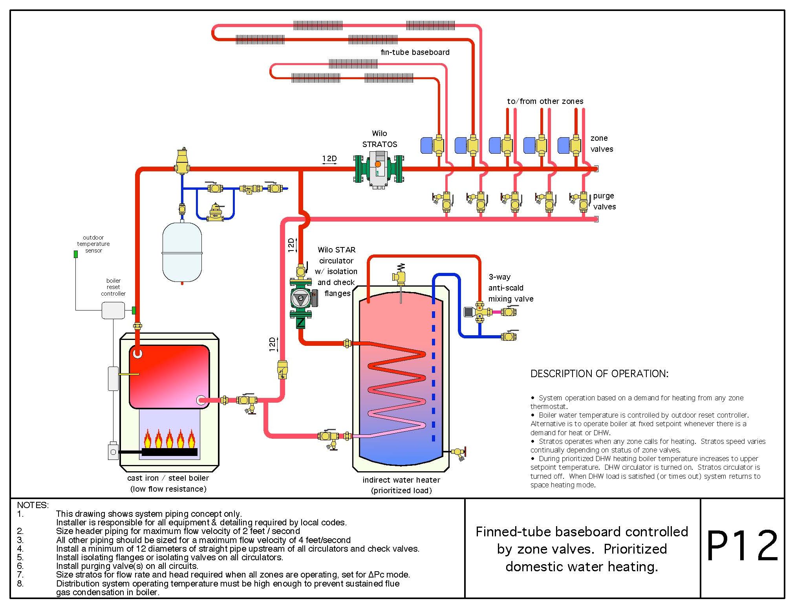
VFD and ECM Controls
Controls and Variable Speed Drives
Or the Great Delta PT vs Delta PV Debate

Slide 2

System Friction Loss (Head) Is it a Pump or a Circulator?
only one zone valve is open
Both zone valves are open
Pump performance curve
intersecting point = new operation point
Head H [Ft]
system curve
new system curve
Flow Q [USGPM]

Slide 3

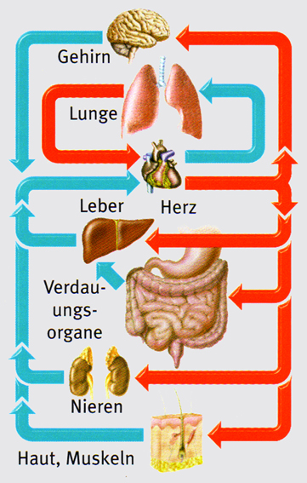
The ABC of hydraulics, human
possible lack of supply
2-pipe system
BMS system
brain
lungs
pump
liver
heart
digestive organ
power generation
kidneys
skin, muscles
possible excess supply
return
supply

Slide 4
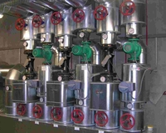

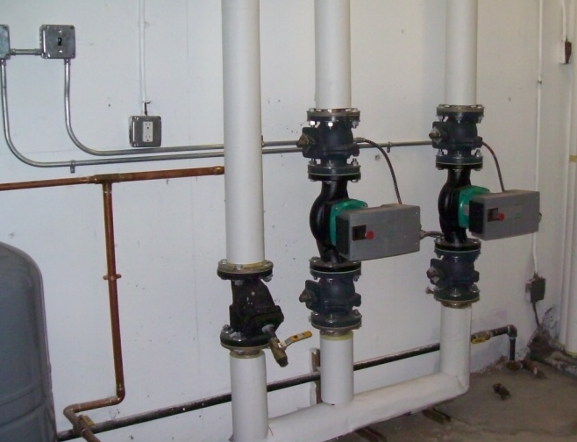
Artisan Heating Project
New York, New York
Old
New
11,152 sq ft heated area, school for Autistic children
Original Pump Specification
Three 7 ½ Hp, 250 Usgpm at 70‘ TDH, constant speed in-line pumps
Amperage (measured) 14 Amps
Retrofit ECM Pumps
“ECM” in-line pumps, SET AT 13’ TDH!
Amperage (averaged) 2.0 Amps
Operating at 340 Watts – about ½ Hp
Customer Comments
“Much better comfort due to the ability of controlling the system, hot and cold spots have been eliminated.”
Recorded Amperage/Energy Savings (based on $0.20 per Kwh, 5040 Hrs/annum)
Original pump – 2327 Watts/Hr/1,000 x 5040 Hrs x $0.20 = $2,345.62 per year for power
New ECM pump – 360/Hr/1,000 x 5040 Hrs x 0.20 = $362.88 per year
Annual savings $1,982.74! One Pump! Times three!

Slide 5
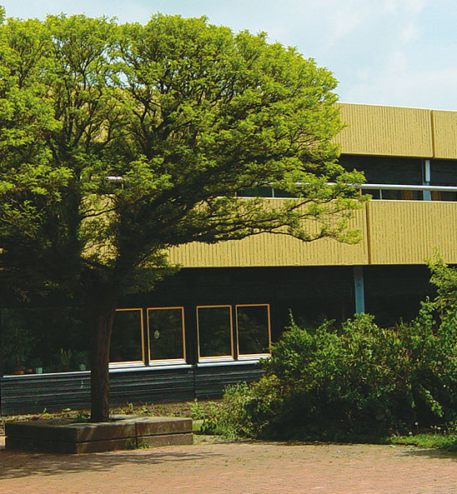
VFD vs ECM
Year built 1972
Floor Area 80,000 ft²
Building Volume 1.1 million ft³
Boilers (condensing)
One @ 800,000 Btu peak load
One @ 580,000 Btu partial
Upgrading of the heating pumps only with no boiler upgrades, additional exterior insulation or heat emitter upgrades.
Heating Power:
before refurbishment 1900 kW
After 400 kW
Notes:
Condensing Boiler 230 kW and for peal load 170 kW low temperature boiler/ Condensate Utilization of 30.000 ltrs p.a. shows that the condensation area is optimized nd runs high efficient.
Heating surfaces were kept as they were.
Heat Control was done by outside sensor and also single room control in 48 heating circuits. By a strict closure of the single room circulation the circulating volume could be reduced drastically.Further increased efficiency by by decreasing the temperature 1.5 hours after school has finished. In the spring and autumn holidays the rooms are still heated by the sun so that heating at the lowest level (14 C) is only in exceptional cases necessary.
Hydraulic: By means of an optimized calculation of the net the design of the heating surfaces could be designed newly for the variable water volume.

Slide 6
VFD vs ECM
Installed pump technology in the heating circuit North/East
Installed | until Oct. 2003 | since October 2003
Pump type | Wilo-TOP-E 65/1-10 VFD non-ECM | Wilo-Stratos 30/1-12 ECM
Application | HC North/East | HC North/East
Set head [ft] | 20 | 16
Set Volume [USGPM] | 50 | 20
Average power consumption [W] | 790 | 40
Hours of operation annually. [h] | 6.000 | 4.000
Energy consumption per year [kWh] | 4.740 | 160
Energy Costs at 0,174 ¢/kWh | 824,80 USD | 27,80 USD
Energy Costs in 10 years | 8.247,60 USD | 278,40 USD
Energy Savings of |  | 97%
Notes:
Values were given by Mr. Geese and worked into the above table.
The table shows the calculation for one pump. In the project Bad Gandersheim they changed two pumps, for both of them the same result was achieved!!
Important Information: Before optimization the system was clearly over-dimensioned; this can also be seen at the old volume and head: pump too big!
This example should show planers that a big number of existing objects are often over- dimensioned and the saving potential therefore is much bigger than with a new planned building and installation!
Over- dimensioning a single incident??
Energycost calculated for 10 years: Wilo-TOP-E 4740 kWh p.A x Energy costs 0,174 € pro kWh xEnergy price development von 3% increase p.A accumulated for 10 years!
Energycost calculated for 10 years : Wilo-Stratos 160 kWh p.A x Energy costs 0,174 € pro kWh x xEnergy price development von 3 % increase p.A accumulated for 10 years!
The Energy costs consider a capital interest of the savings at 5 %!

Slide 7
VFD vs ECM
Installed pump technology in heating circuit North/East
Results:
The electrical energy consumption for the operation of the heating system was 1,200 kWh/ft³/year before refurbishment
The electrical energy consumption for the operation of the heating system is now at 22.2 kWh/ft³/year

Slide 8
VFD vs ECM
Results:
Comparison of Costs over 18 years:
With an energy price of 0.174 USD/KWh increased 3% per year as well as a capital interest of 5% of the savings the result is the following energy and cost comparison:
 | Electronically controlled pump | Wilo-Stratos
Annual Energy Consumption | 85 MWh | 3,6 MWh
Annual Energy Costs | 48.000 USD | 2.000 USD
Notes:
Values were given by Mr. Geese and worked into the above table.
The table shows the calculation for one pump. In the project Bad Gandersheim they changed two pumps, for both of them the same result was achieved!!
Important Information: Before optimization the system was clearly over-dimensioned; this can also be seen at the old volume and head: pump too big!
This example should show planers that a big number of existing objects are often over- dimensioned and the saving potential therefore is much bigger than with a new planned building and installation!
Over- dimensioning a single incident??
Energycost calculated for 10 years: Wilo-TOP-E 4740 kWh p.A x Energy costs 0,174 € pro kWh xEnergy price development von 3% increase p.A accumulated for 10 years!
Energycost calculated for 10 years : Wilo-Stratos 160 kWh p.A x Energy costs 0,174 € pro kWh x xEnergy price development von 3 % increase p.A accumulated for 10 years!
The Energy costs consider a capital interest of the savings at 5 %!

Slide 9
VFD vs ECM
Results
Energy costs over 10 years
**
*
*
**
* Without interest on savings
** with interest on savings

Slide 10
VFD vs ECM
Results
CO₂ Emissions in kg over 10 years

Slide 11
Motor Efficiency – ECM vs Standard
ECM Technology provides an improved motor efficiency over the entire load range of the motor.
Result is between 50% to 70% increase in effeciency of ECM pumps vs pumps with VFD‘s (variable frequency drives)
η
ECM
Partial and low load conditions
exist during more than 98% of the total operating range!
ACM
Flow (or Load)
Notes:
Efiiciency grade comparison ECM/ACM in relation to the system duty point
Up to now glandless pumps had exclusively been equipped with asynchronous (AC-) motors.
Due to the ECM-technology Wilo-Stratos pumps achieve the highest efficiency when compared with that of all other available types of glandless pumps.
Special Advantage:
Circulating pump operate mainly (up to 98% of total operating hours) at partial or low load conditions.
Specially under such conditions the efficiency difference between EC- and AC-motors becomes ever more distinct.

Slide 12
Delta T vs Delta P (Sensor? Where?)

Slide 13
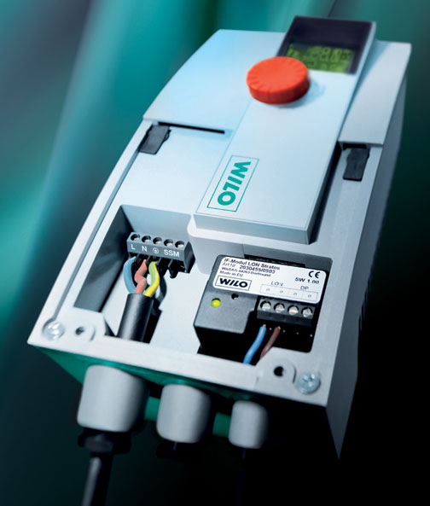
Functional – Inter Face Modules
Front access (Face-to-Face)
Freely accessible wiring connections - NPT
Large terminal box
Plug-in IF-Modules
Field installed
Interchangeable in any 8 Stratos models
Notes:
Electrical wiring connections (Face to Face)
The axially positioned control module allows easy frontal access to the terminal space of the Wilo-Stratos.
The installation of the pump thus becomes uncomplicated for the installer as the terminal space is easily accessible from the front and thus the power and control wiring can easily be connected ‘face to face‘.
Electrical wiring to existing power supply:
1~230V ± 10%, 50Hz: L, N, PE
3~230V ± 10%, 50Hz: L₁/L_{2 or} L₂/L_{3 or} L₁/L_{3, PE}

Slide 14
Functional – Inter Face Modules
LON interface for link-up to LONWORKS-networks, Transceiver FTT 10 A
PLR interface for link-up to BMS via über WILO- interface converter or onsite coupling modules
DP interface for an integrated dual pump management of 2 single-head pumps
Control input ‘ =...10V‘ for remote speed control or head setpoint adjustments
Control input ‘Ext.Off‘ for volt-free normally closed contacts
Control input ‘Ext.Min‘ for volt-free normally closed contacts
Run signal SBM as volt-free normally open contacts
Function
Module type
Ext. Off
Ext. Min
LON
PLR
SBM
•
•
•
•
•
•
•
•
•
•
•
•
•
Notes:
Plug-in module types ffor single- and twin-head pumps:
1 x Wilo-IF-Modul Stratos PLR for single-head pumps
1 x Wilo-IF-Modul Stratos LON for single-head pumps
1 x Wilo-IF-Modul Stratos Ext.Off for single-head pumps
1 x Wilo-IF-Modul Stratos Ext.Min for single-head pumps
1 x Wilo-IF-Modul Stratos SBM for single-head pumps
2 x Wilo-IF-Modul Stratos PLR for dual pump units
2 x Wilo-IF-Modul Stratos LON/PLR for dual pump units
2 x Wilo-IF-Modul Stratos Ext.Off/PLR for dual pump units
2 x Wilo-IF-Modul Stratos Ext.Min/PLR for dual pump units
2 x Wilo-IF-Modul Stratos SBM/PLR for dual pump units

Slide 15
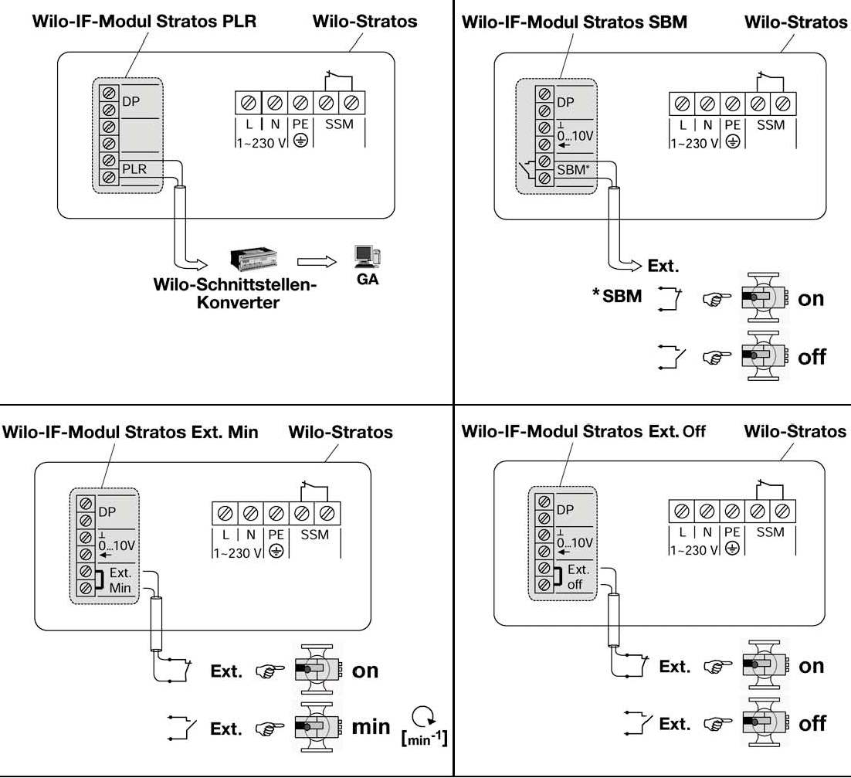
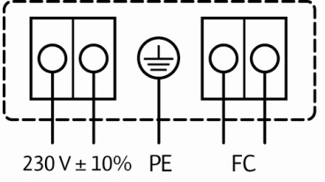
Functional – Inter Face Modules

Slide 16
0 – 10 Vdc Speed Control Mode
Remote speed adjustments
n [RPM]
3.0 V = min.
n max
1.5 V = Off
1.0 V = On, min.
n min
Off
1 1,5 3 10
Vdc
Notes:
DDC Control Mode (0-10V)
The interface standards recommendations to VDI 3814 are still valid today; analogue signals (current, voltage) and volt-free contacts (normally closed, normally open).
In the DDC control mode the for the automatic control required setpoint/actual balance will be taken over by an external controller. An analogue signal (0-10V) will be transmitted from the external controller to the Wilo-Stratos as the manipulated variable. The actual motor speed can be read off the pump display; other operations on the pump are blocked.
Required accessory: IF-Module Stratos*
* See adaption Table ‘IF-Module Wilo-Stratos‘
Wilo-Stratos features standard supplied and optionally available interface equipment for linking up to remotely located monitoring stations (e.g. building management or DDC systems)

Slide 17
0 – 10 Vdc Speed Control Mode
Remote setpoint adjustment
H [ft]
H max
H min
1 10
Vdc
Notes:
Remote setpoint control mode (0-10V)
The setpoint level for the internal differential pressure (Δp-c) control can be adjusted by an overriding control variable from an external source.
.
Required accessory: IF-Module Stratos*
* See adaption Table ‘IF-Module Wilo-Stratos‘
Wilo-Stratos features standard supplied and optionally available interface equipment for linking up to remotely located monitoring stations (e.g. building management or DDC systems)

Slide 18
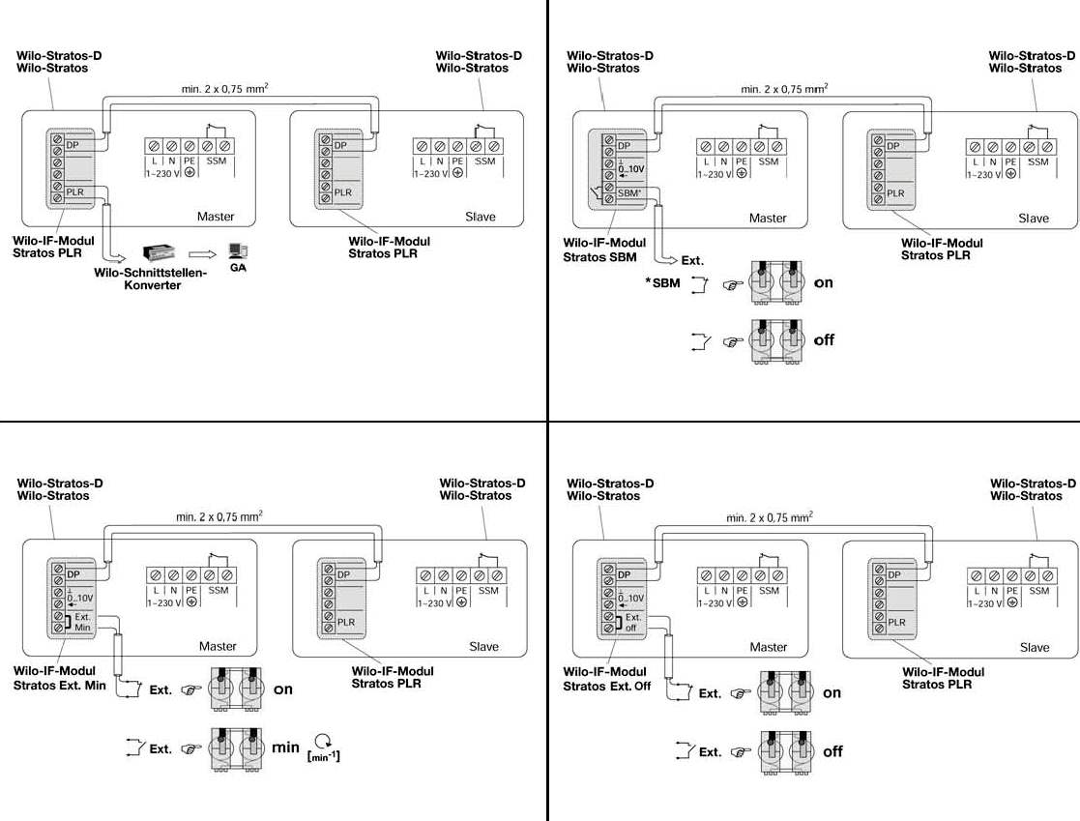
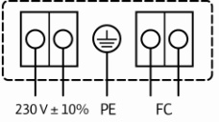
IF Module (Inter Face) - Dual
All IF modules have the capability of connection / communication to one other Stratos (IF module required for both pumps). This enables dual control (master/slave) in parallel applications. Benefits include:
Stand-by operation in the event of a failure (5 min delay)
24 hour run time automatic alternation
Optional operation of both pumps when necessary
Master/Slave function
On start-up both controllers flash “MA”
Press in either red button to set master
Slave pump follows adjustments made by master
Ext control wired to master IF Module

Slide 19
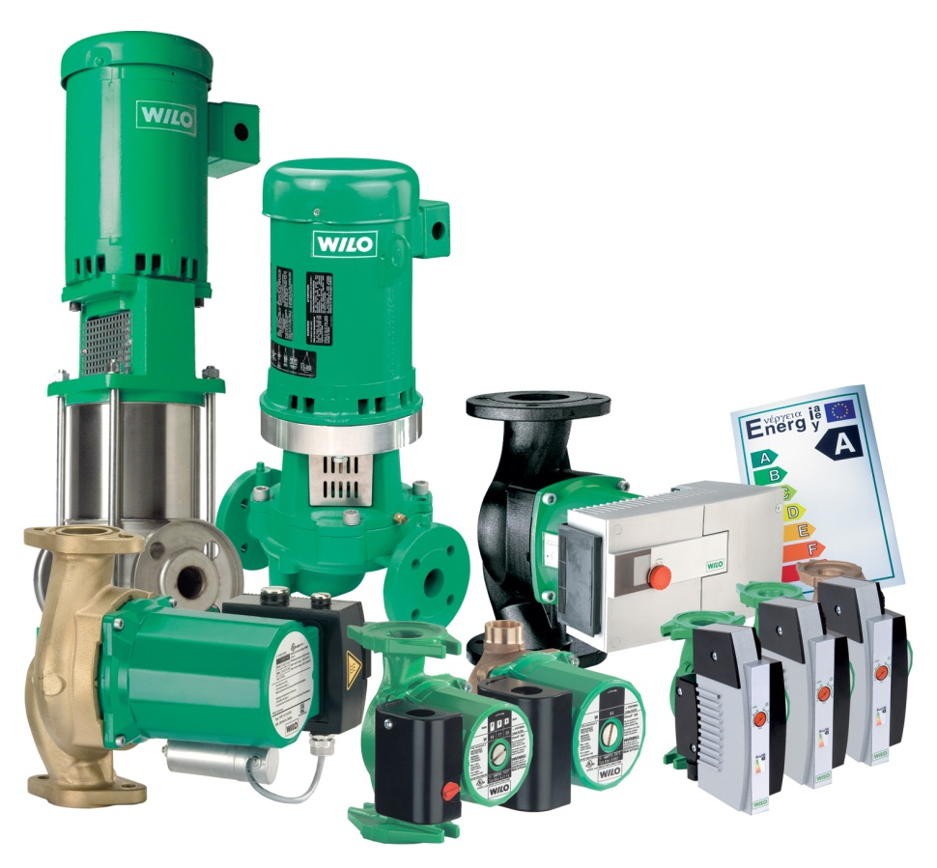
Questions/Comments?

