Slide 1
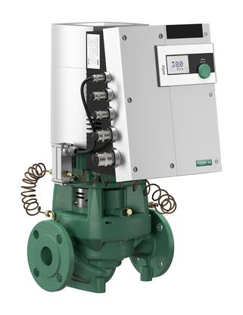
Wilo Stratos GIGA the most advanced commercial
HVAC pump in the world
2019

Slide 2
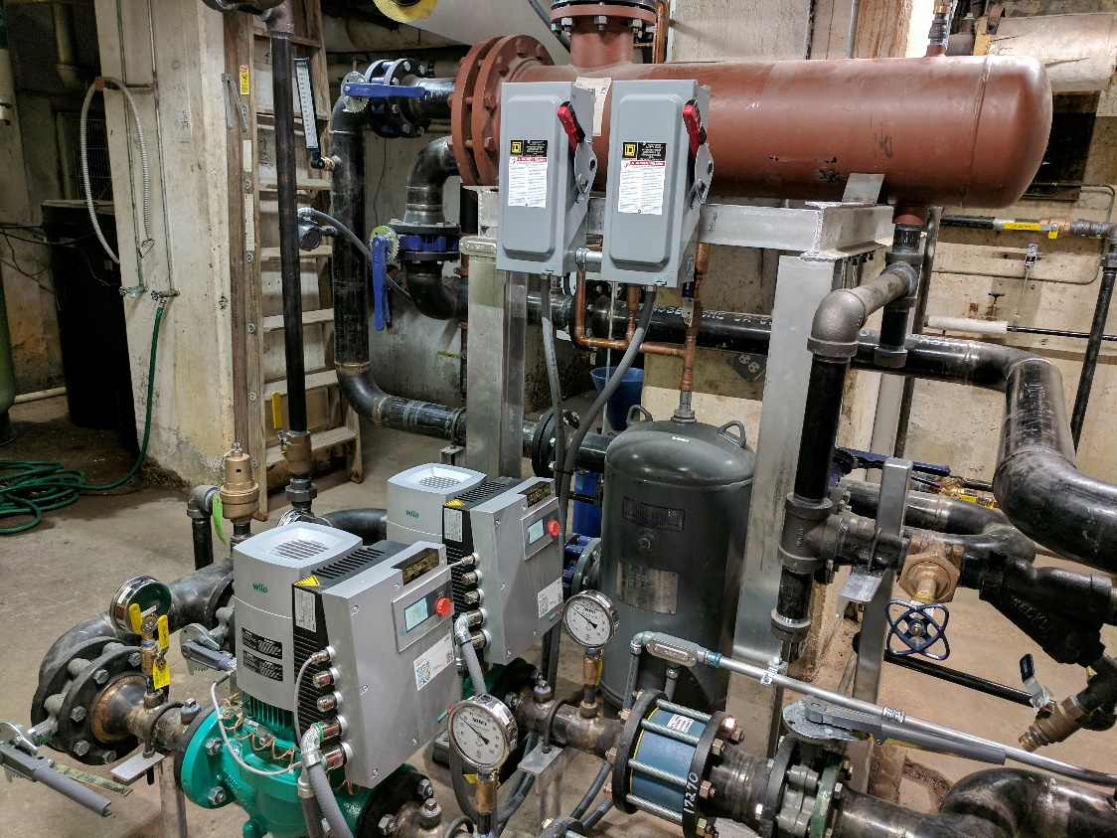
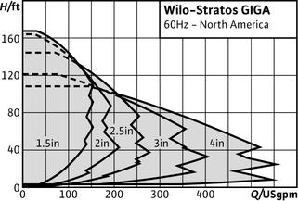
pumping creates the core of system efficiency

Slide 3
KISS
WILO starts the new era of pumping creates the core of system efficiency
And let’s be the one to talk about CORE SYSTEM EFFICIENCY getting all the components to work together through the entire transition range.
Let’s talk about the water quality issues that affect/effect all the components of a system.
Let’s talk about the required safety factor put on engineers to make sure the systems function and how WILO GIGA can make that SYSTEM WORK. (no one else can).

Slide 4
50 – 80% savings in energy in the pump alone with ECM and a little common sense.
Easy to install and easy to prove.
Direct the WILO energy towards the schools with 1,000,000 to 5,000,000BTU/HR systems and the infamous 1510-2.5BB – 5-7.5hp pumps.
If you only get 50% savings with ECM/DC over the existing AC constant speed your payback is less than 3 years PERIOD. WHY NOT
Even if you have the perfect system with VFD’s ECM will save at least 30%. I’ve never seen that perfect system yet.
You also get all the repair parts and labor savings for free.

Slide 5
Do you meet your CORE System Efficiency
Or just a few component Efficiencies?
Do you assume you’re starting from a perfect base of design?
-10F day GPM and Delta T as designed?
Can you reduce capacity to match load and keep high Efficiency?
Do you have a good ph and water quality?

Slide 6
It is very often a 98% efficient boiler is placed in a 20% efficient system resulting in little to no savings in energy consumption.
We suggest putting your energy toward balancing production (boilers) with consumption (Air Handling Units, fin tube radiation, etc) by providing the proper distribution (pumping and balance).

Slide 7
What to look for:
System supply water temperature _____________
System return water temperature _____________
Boiler Stack Temperature ____________________
Pump Suction Pressure ______________________
Pump Discharge Pressure ____________________
Pump Design/Size __________________________
Pump Horse Power and Voltage _______________
2 – Way or 3 – Way control valves _____________
Any on going system problems ________________
Any on going component problems _____________
Building comfort issues_______________________

Slide 8
ECM technology with wire to water savings up to 80%, at very effective cost points with Variable Speed, ECM motor and system control built into the pump itself.
These pumps are the one stop solution to system efficiency, correcting the system and distribution efficiency with boiler efficiency.

Slide 9

How Big do they Go ECM?

Slide 10
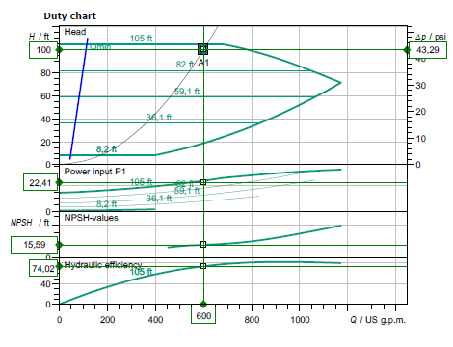
Call for
sizing

Slide 11
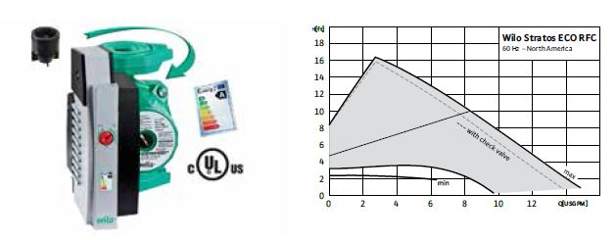
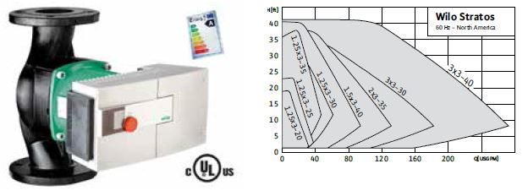
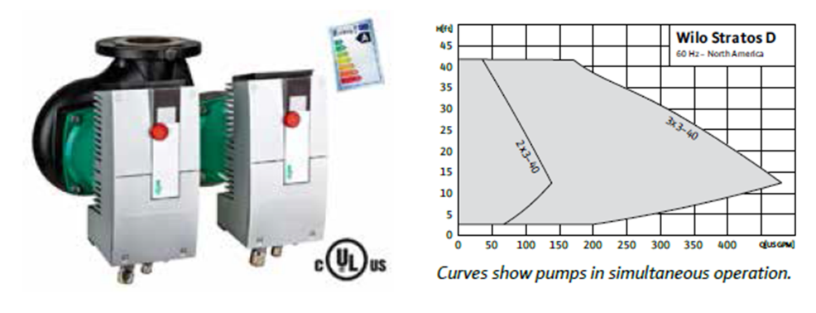
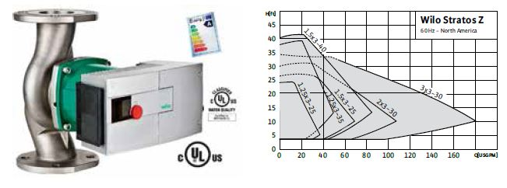
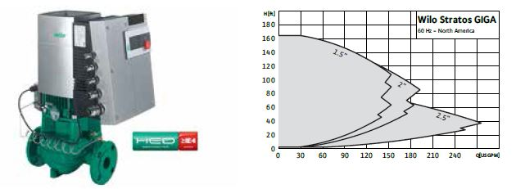
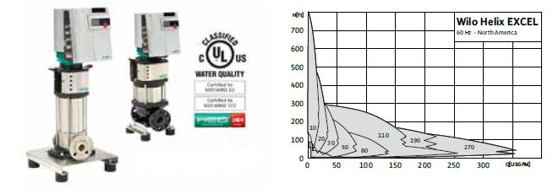

Slide 12
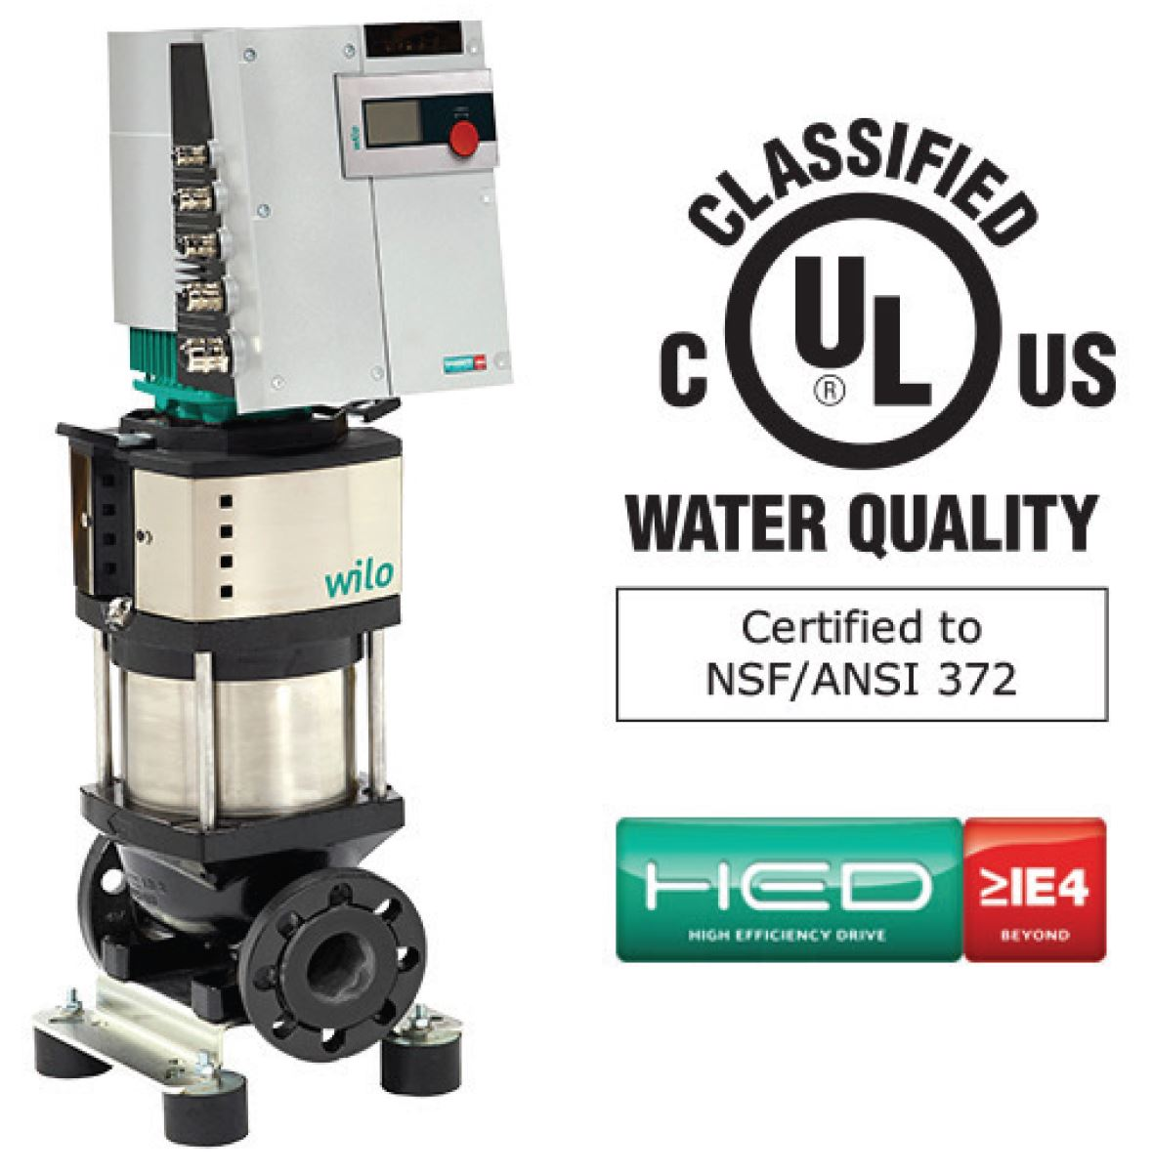
ECM or VFD
Both serve a real purpose but VFD
Must be properly applied to save
SYSTEM energy or efficiency.
ECM can operate with a very large
Window of SYSTEM Efficiency
Where VFD has a small window with
Many associated problems.
Pressureized seals.
Minimum speeds.
Pump VFD cutting odd freq’s.
And the list goes on, but not with ECM
Designed for HVAC or boosting app’s.

Slide 13
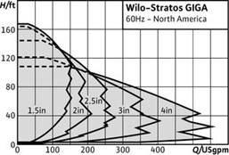
Much Bigger than this
Just call for design.

Slide 14
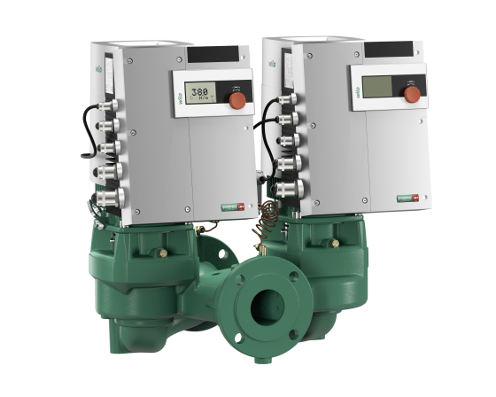

Slide 15
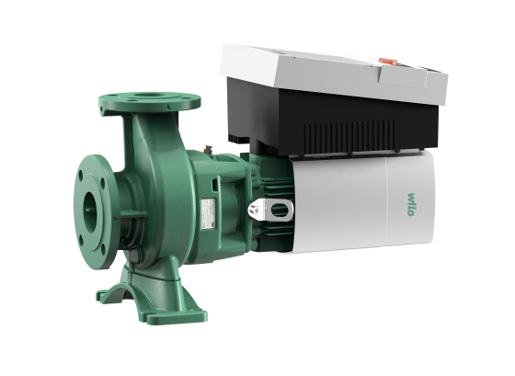

Slide 16
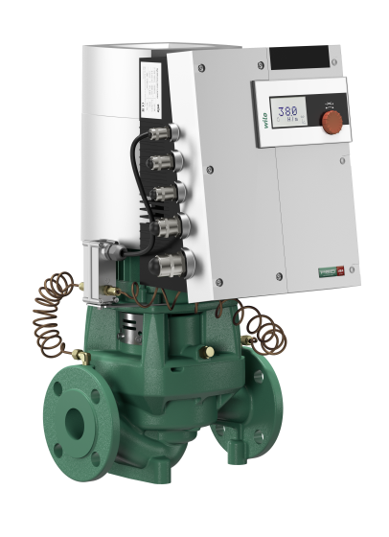

Slide 17
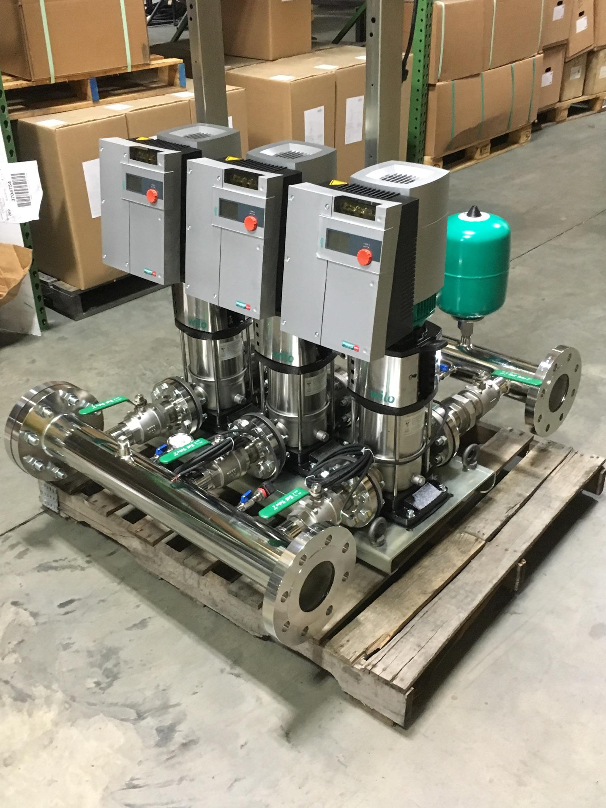

Slide 18
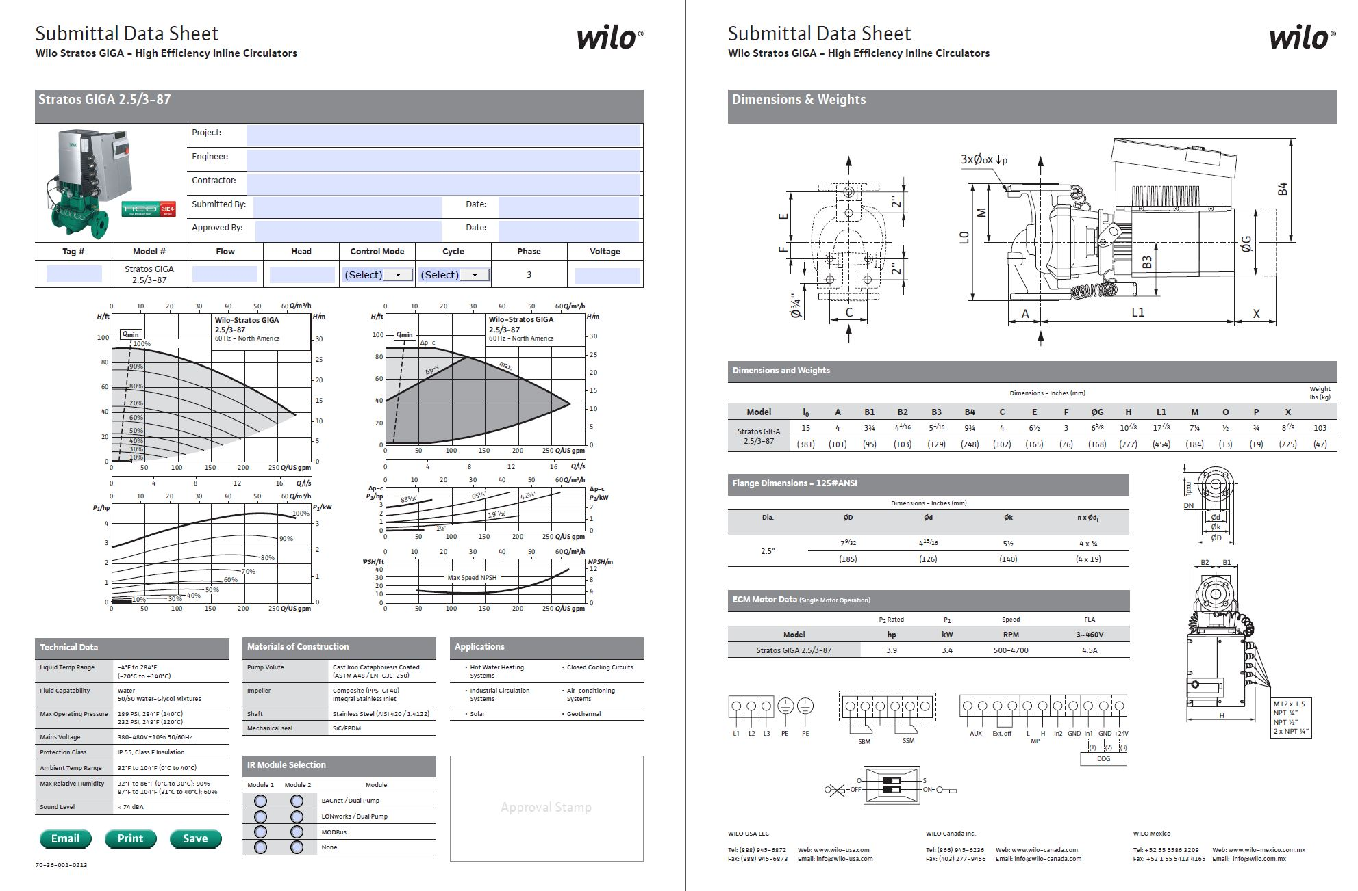

Slide 19
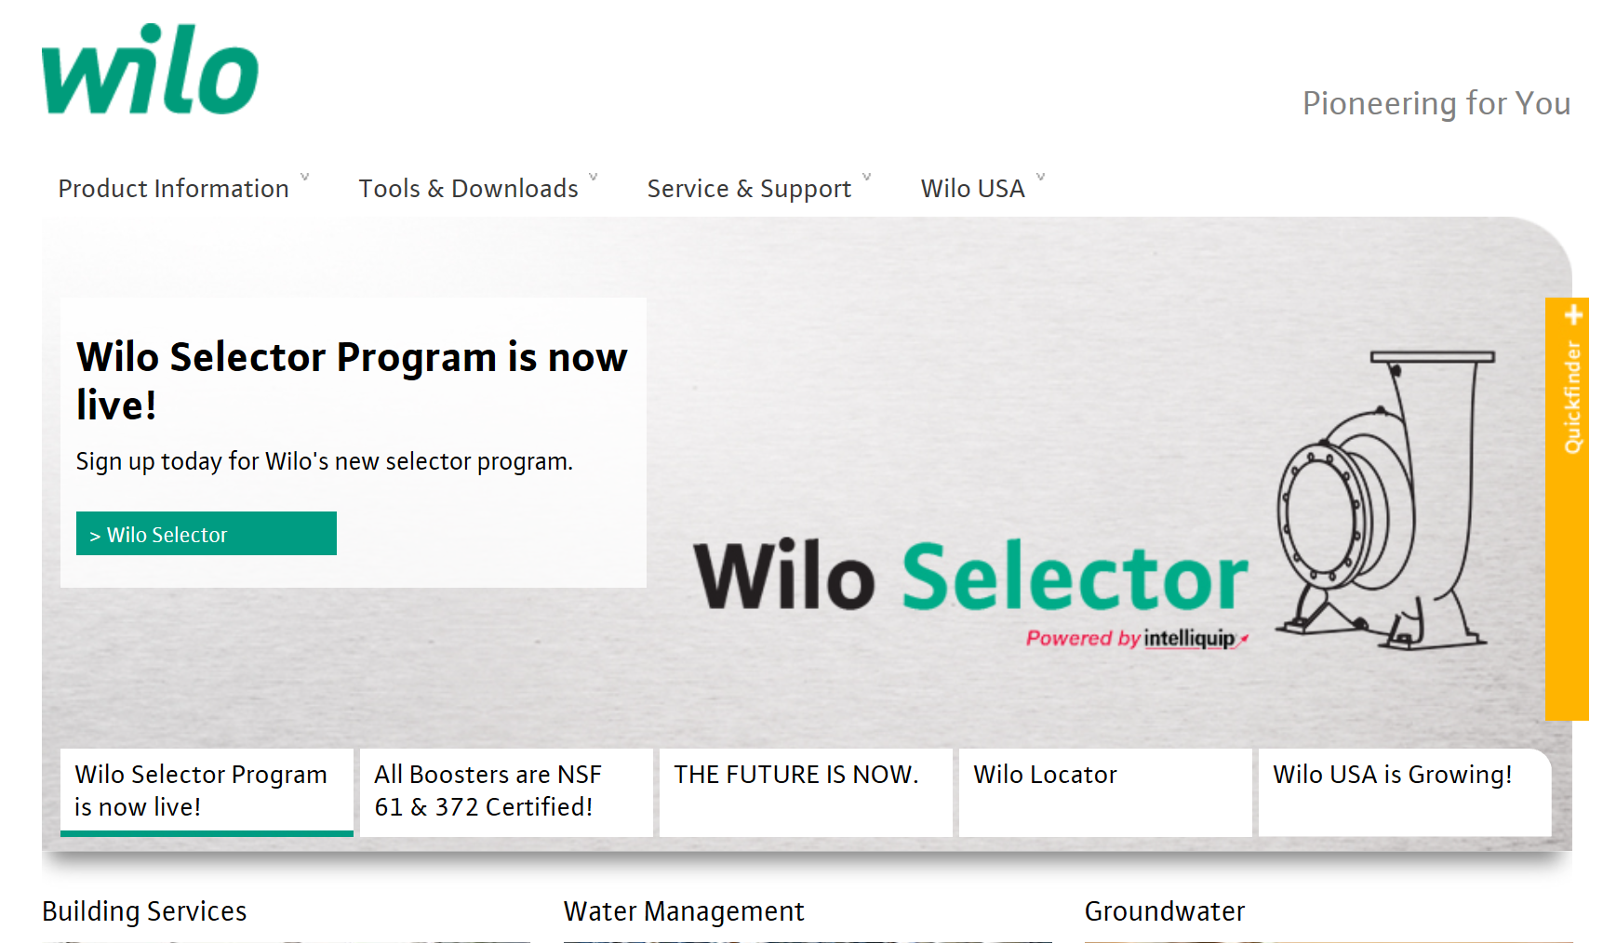
http://www.wilo-usa.com/wilo-usa-llc-home/#.W0ZouvZFzgA

Slide 20

Train
Consumption
Production
Distribution
Variable Speed Pumping
Variable Volume Pumping
Cv’s / GPM of Coil or slightly greater 1#
Coils etc / Importance of Flow Limiting
Cv =gpm/delta P square root

Slide 21
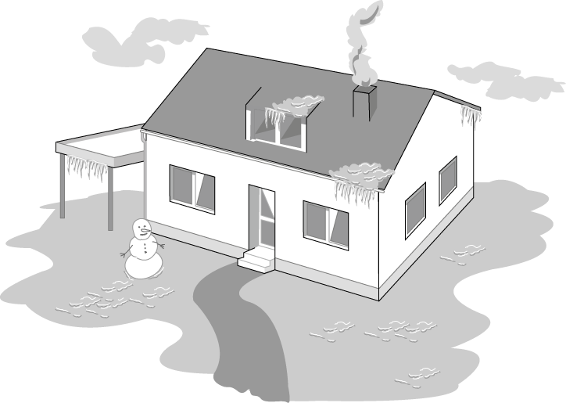

(coldest design day)
For the coldest day of the year ~2 % of the total operating period
Notes:
Load-controlled pumps - Why?
Standard pumps must be selected to meet maximum design load conditions which only occurs during 2-5 % of the total operating time. The normal operating status of the pump thus remains to meet partial and low load requirements. Non controlled pumps are incapable to adjust to such load variations and operate at their relatively high pump performance with the consequence of the thus related excess power consumption.
Consquence:
Excess power consumption
Generation of flow noise
(continued next page)

Slide 22
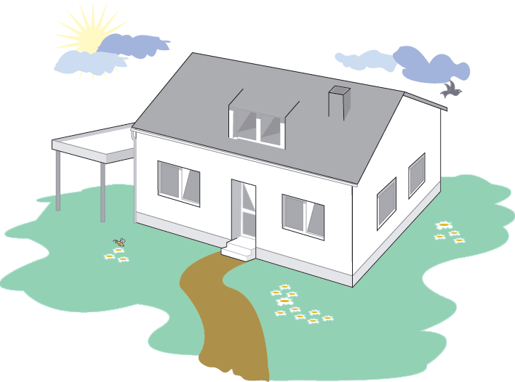
Transition period
But how is the system working during the remaining 98 % of the operating period?
Notes:
Load controlled pumps meet the requirements for increasing or at least constant pumping head. Two kinds of load controlled pumps are at present available .
Energy saving pumps had been conceived to keep abreast of the steadily further developing mechanical building services technology (thermostatic radiator valves, etc.) and to meet the growing sensibility towards energy conservation. There are three main reasons for the development and application of control systems for heating circulating pumps.
• Adapting flow rate/heat flow to the actual load
• Reducing power consumption and operating costs
• Avoiding noise generation in the system
High-efficiency pumps are the latest generation of pumps which, on top of the the benefits of energy-saving pumps, achieve enormous power savings in line with excellent efficiency. The revolutionary ECM-technology does furthermore provide more compact housings/motors, quieter operation and extended life expectancies.

Slide 23
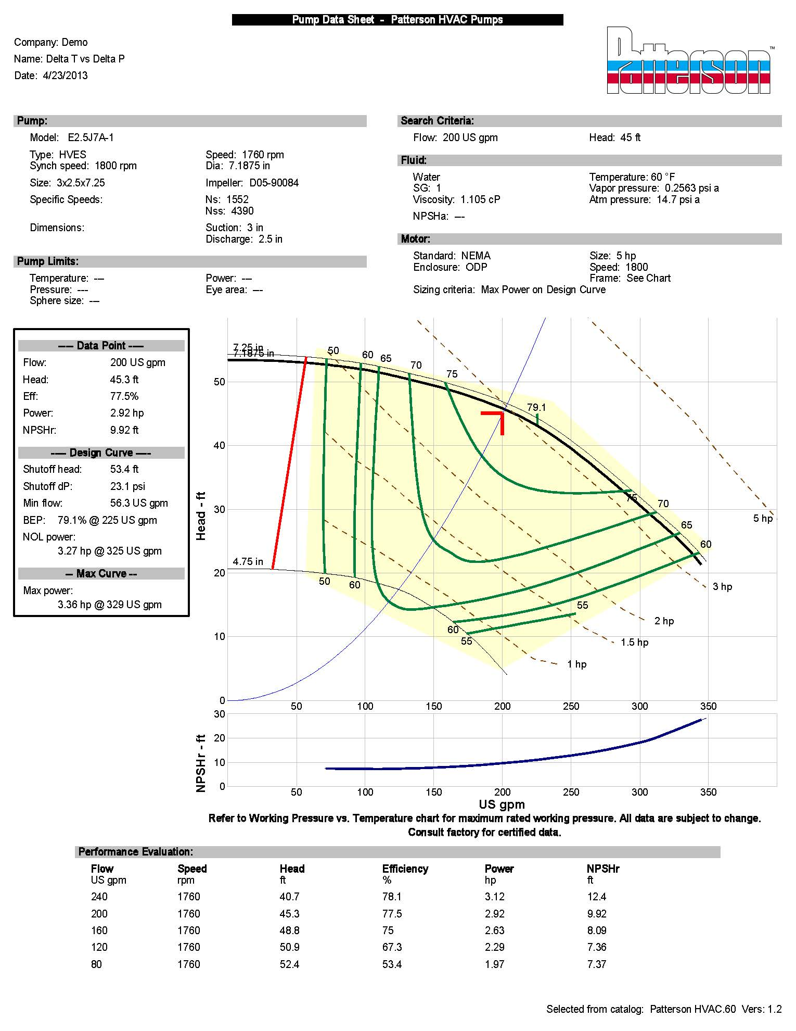

200 gpm = 2,000,000 Btu/Hr
500 x 20
300 gpm = 2,000,000 Btu/Hr
500 x 15
400 gpm = 2,000,000 Btu/Hr
500 x 10
Checking the system Delta T can suggest the system Load
Checking the Boiler Delta T vs gas consumption gives the real efficiency.
System Curve vs the Pump curve.

Slide 24
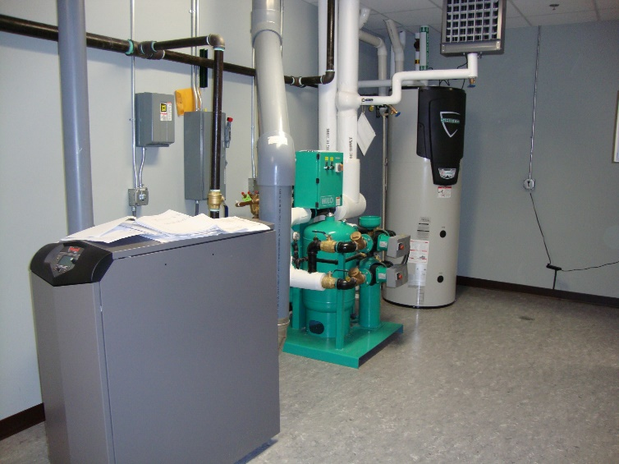
Pumps save electrical energy by properly applying them, check the HP of 200 gpm @ 45’ vs the HP of 200 gpm @ 12’.
This is really nice.
Now check out the Boiler operating at 30% vs. the Boiler operating at 85 – 95% Efficient.
Really Really REALLY NICE Savings.

Slide 25
ΔT review
Heating fluid standard is 20 degree ΔT
  Today with Energy Conservation this will vary.
  Heating systems 20 – 40 is standard, and engineers tend to use boiler efficiency standards where higher ΔT relates to higher efficiency.
  Higher ΔT relates to lower flows and lower pumping cost and lower distribution cost.
  Cooling fluid standard is 10 degree ΔT
    You have to watch for humidification issues.

Slide 26
Will Self-Sensing or Temperature control operation of VFD pumping work?
Yes with the proper set-up.
For this example I will use the most common system of HVAC heating for 2,500,000 BTU/HR.
20F Delta T, with variable outlet temperature the return will by design be 20F cooler.
(note the same principle applies to chilled water with 10-12F warmer return than supply)
Primary-Secondary with 2-Way control valves. (again other designs will also have the same principles)
Note that design depends on where your located and how the building will be used. For this example we are using a School building in Michigan designed for -10F. In Michigan alone there are thousands of buildings meeting this exact or very close design conditions.
(there are variables, this is where the research is needed as some systems with condensing boilers may be designed for lower temperatures to bring the return water back cooler so the boilers can condense).
250gpm = 2,500,000Btu/Hr
500 x 20F

Slide 27
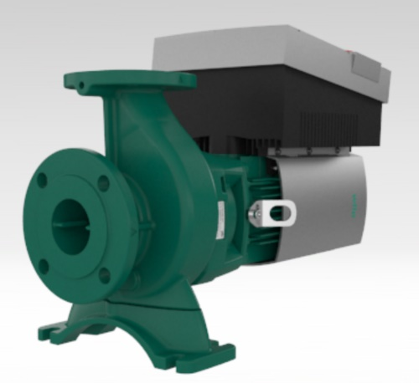
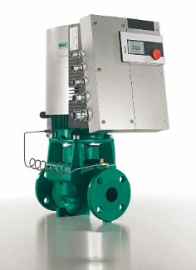
Existing retrofit
The existing system has old fire-tube boilers and we are looking to upgrade to condensing boilers.
First you can get a base line of current operation and System Efficiency. This confirms if you currently have all the components operating at peak efficiency from design through transition.
So at design we should see outlet water going to the building at 180F and returning to the boiler plant at 160F. The existing pumps were designed for 250gpm @ 65’TDH.
It is close to a design day so we should see design operation or less due to the mass of the building and all of the safety factors used during design.
Here’s what we see 90% of the time we really look.
System delta T of 10F or less and pump differential pressure of 10 – 14#.

Slide 28
Existing Pump
12 x 2.31 = 27.72’TDH
You can see by the curve and temperatures we are not operating at design. (Next Slide)
First would be to contact the Boiler Manufacture and find out what efficiency it’s operating at with over 400gpm and 170F return water.
This can be amazing, just look at the stack temperature.
30% efficiency can be expected with a system output of 750,000btu/hr vs design of 2,500,000.
Yet the system still works.
With such a high flow can the temperature control valves work?

Slide 29
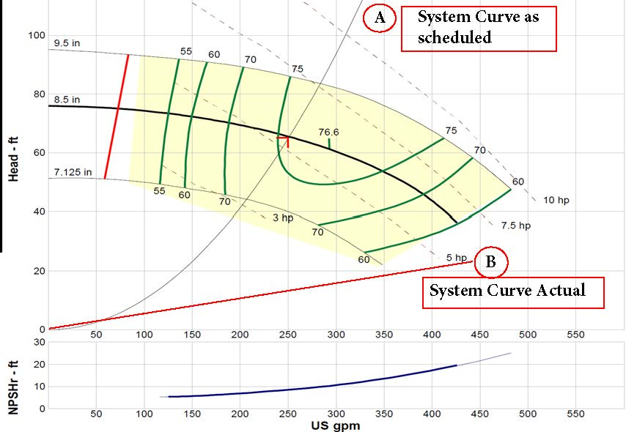
Note that if you reduce the flow by half you reduce the head by a factor of 4>>>
If you’re over pumping at 24’ when you reduce the flow you’re head drops from that point
You can’t get an AC pump and Drive to operate in that area but an ECM-DC CAN.

Slide 30
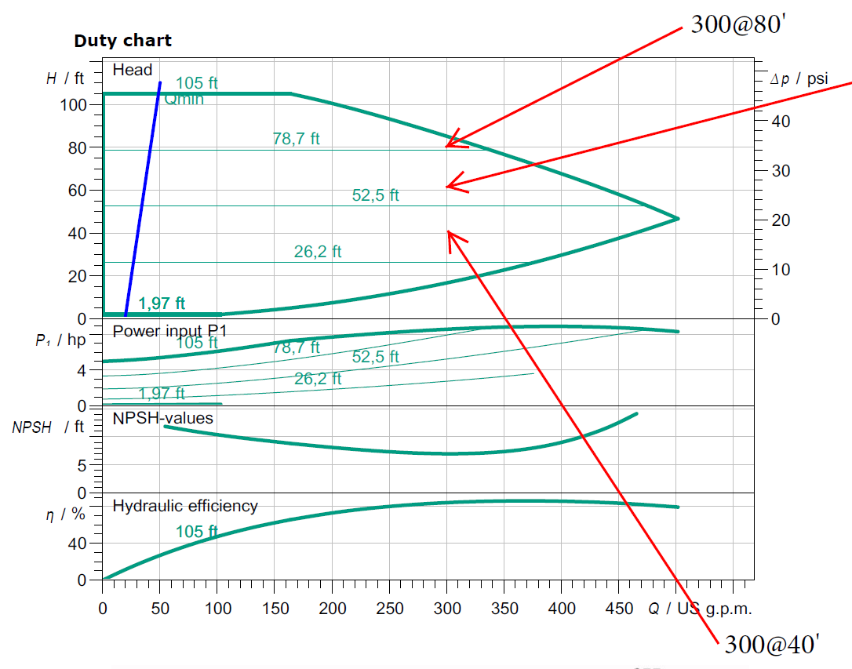

Slide 31
If your actual system curve is right of design and off the
right side of the pump operational curve as determined
at 60hz and pressure readings. Confirm with Delta T.
How can a VFD bring it back to the designed and scheduled
system curve?
It can’t and only ECM has the ability to track the actual
SYSTEM CURVE.
Scheduled System Curve
  Artifical pressure drop needed to get back on the curve.
Actual System Curve
  Note the low head required and still off the curve.

Slide 32
Now if this is maximum design day and we need to get the pump back to 250gpm we need to slow the pump down or create artificial pressure drop with a main balance valve.
If you reduce the flow by ½ you reduce the head by a factor of 4.
Guessing (since we’re off the curve) we need to get from 450 back to 250 so we’re currenty at 28’; we only need 250gpm @ 18’TDH. This means 65 – 47 = 18’, we have to waist 47’TDH just to get to the max design what about lower say 100gpm?
We should see max design no more than 2% of the operational season with the remainder operation at transition.
Now how slow can we operate the VFD? Are we limited to 50% or 30hz? If we use the max capacity of the VFD turndown for getting back to design do we have enough left for transition? Would transition be the self-sensing or Temperature controls operations control point?
We’re seeing pumping systems over 100’TDH because the engineer has to add safety because he knows the BTU’s should cover a building but don’t so he thinks the pumps are too small. That the poor operational efficiency of the boiler is the cause not under pumping.
Beware the self-sensing over-sized pump.

Slide 33
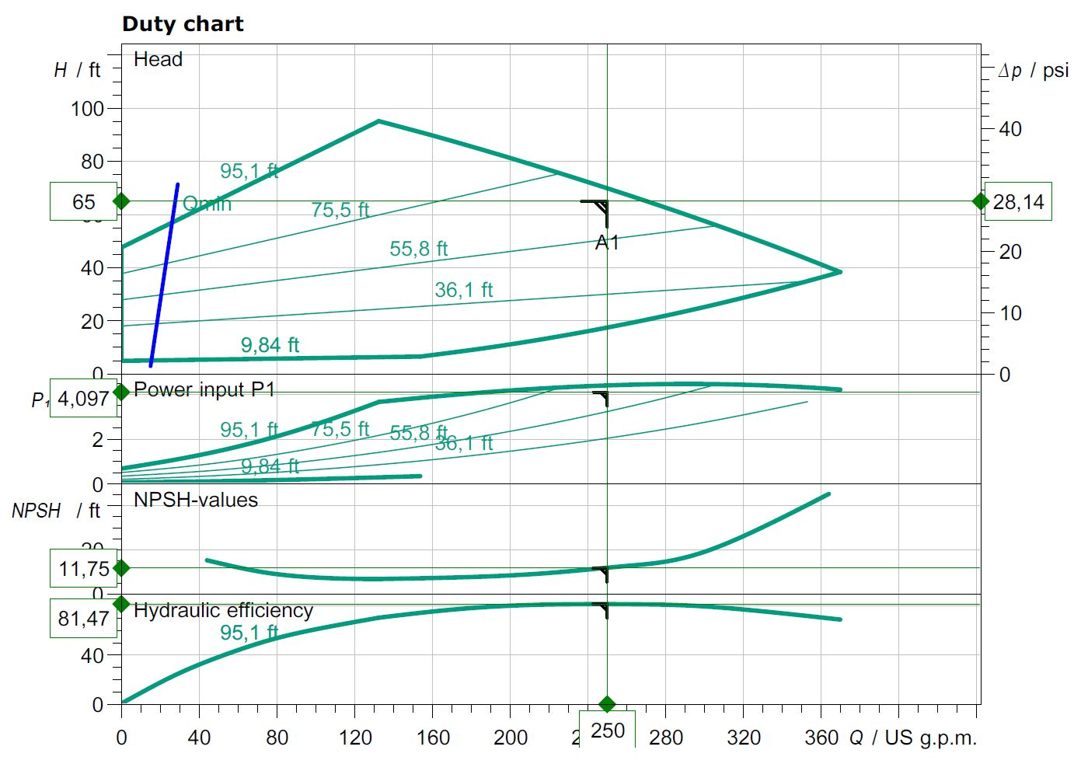
With ECM even if you want the safety of higher head pressure
for scheduling you can operate on a curve that can operate
within the System needs.

Slide 34
Energy Rebate Template - Custom
Template A -- (Tertiary Coil/Unit Pumps)
Before Retrofit
The existing pump _Taco Model CC250C, 5.5, A4B2C1TL, _75_gpm @ _25_’tdh,
Supply _var_F, Return _+4_F 4∆T
1.0_hp _460_Voltage, _3_Phase, Actual _3.2_ Amp Draw, Average Hours Operation_8760__
After Retrofit
New WILO Stratos Model __2 x 3 – 35 __, _75gpm @ _13_’tdh
Supply __var_F, Return _+9__F 9∆T
_3/4_hp _230_Voltage, _1_Phase, Actual _0.5_ Amp Draw, Average Hours Operation_8760__
TWO-PHASE
KILOWATT (kW) = VOLTS x AMPERES x POWER FACTOR x 2
1000
THREE-PHASE
KILOWATT (kW) = VOLTS x AMPERES x POWER FACTOR x 1.73
1000
New WILO Pump
0.21kW = 0.5 x 230 x .91 x 2
0.21 x 24 x 365 x 0.07 = $129.00/year
Old Taco Pump
2.32kW = 3.2 x 460 x .91 x 1.73
2.32 x 24 x 365 x 0.07 = $1,423.00/year Savings Per Year $1,294.00

Slide 35
Boiler Manufacturer _____________________, Model ___________________________
BTU Output ________________, Current ∆T Supply F______Return F_________
Efficiency at Current ______∆T, and ________Return Water Temperature.
After WILO Stratos VFD programming to Design Conditions
New Operating ∆T Supply F______Return F_______
Boiler Efficiency at Design ∆T __________________
MCF average usage at _____% Boiler Efficiency operation at lower than design ∆T and higher Return Temp.
MCF proposed usage at ____% Boiler Efficiency at Design.
All Boiler Manufacturers state their efficiency based upon given ∆T and inlet water temperature, each manufacturer will have many different designs so it is imperitave to get this information from them to deturmine design and current operating conditions. It is not uncommon to find most boilers designed to 20 degree ∆T for 80% efficiency operating at under 10 degree ∆T and 50% or lower efficiency.
The WILO Stratos VFD controller built in can correct this deficiency with no external inputs required. This pump utilizes ECM technologies for electrical savings as well as Variable Speed control and management to improve boiler efficiencies as well as pump efficiency.

Slide 36
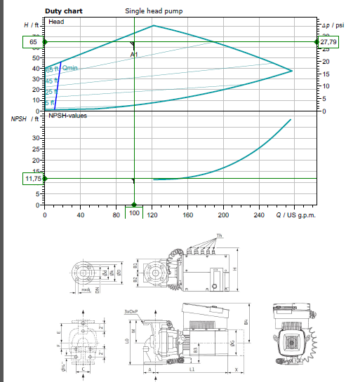

Slide 37
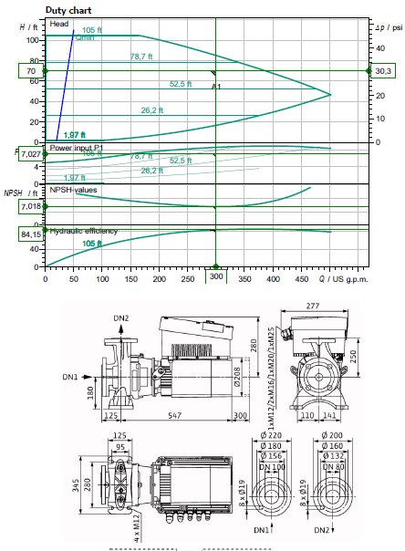

Slide 38
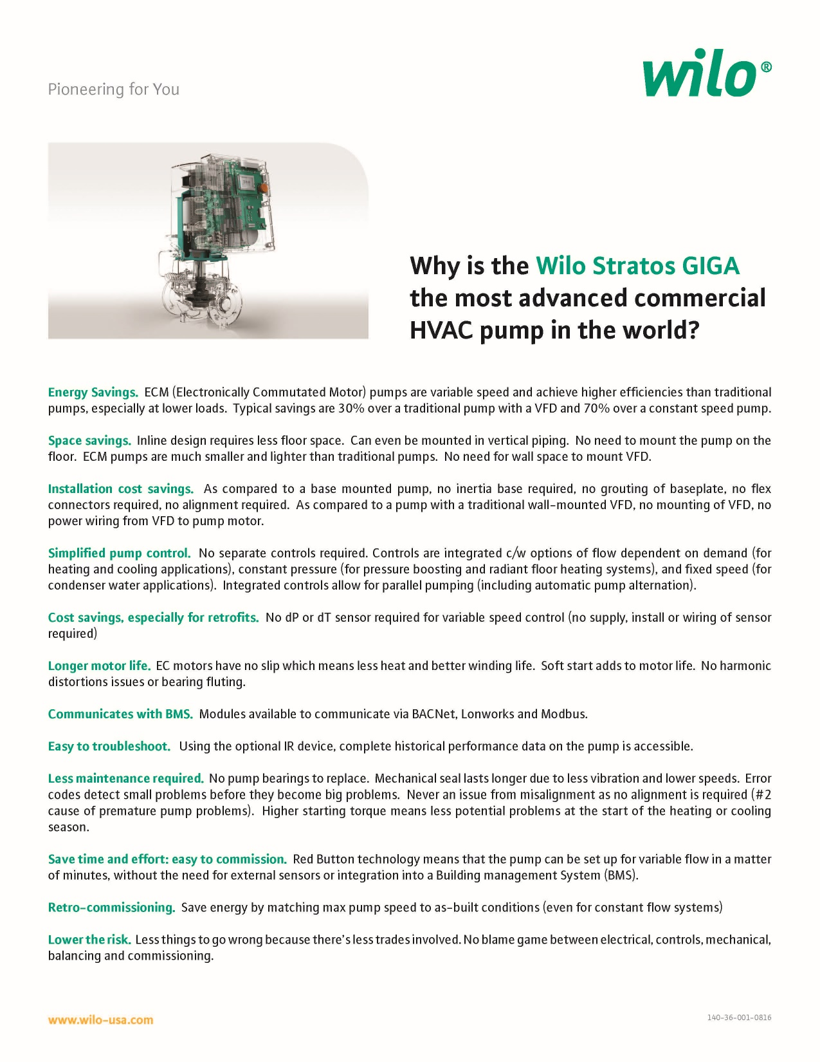

Slide 39
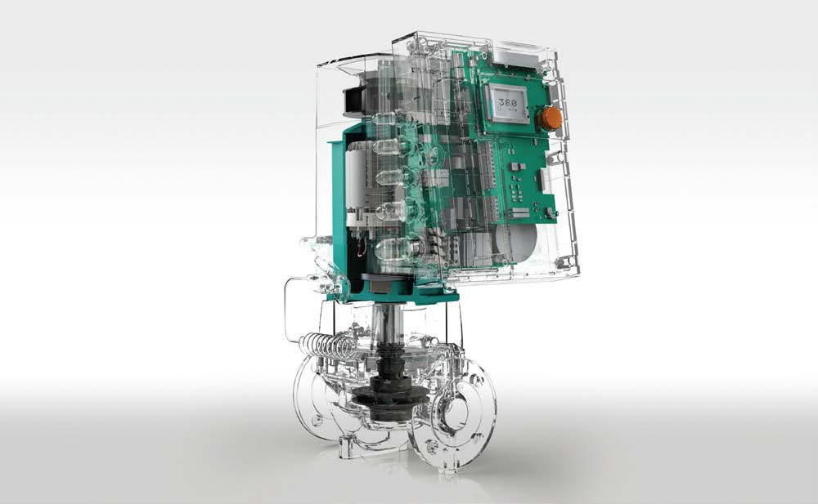
EASY Replacement selection for GIGA from Base Mounted End Suction.
Note:
Using B&G as the Reference but all will have similar capacities.
Looking at the industries most common selections from 1,000,000 – 5,000,000 BTU/HR The most common End Suction pumps have a 7” impeller or 9.5” impeller.
You can tell by the TAG or how big the opening the impeller will have to slide through.
The B&G will show the 7” as an (A) with the 9.5” as an (B). Most will be trimmed to a smaller diameter, determined by the Motor HP and RPM.
The second digit on the B&G (B,C,D, now E) will indicate the generation. (1510-2.5BB) The discharge flange size will let you know the pump size. With the suction 1 size larger. Piping revisions will be common and your local distributor can make simple suggestions.
Should the HP be less than MAX per pump you may be able to select the next smaller pump. The GIGA pumps will all be 460v/3 phase so transformers may be required.
GIGA 2 3-85 | 1510-1.5A | 1510-2A
GIGA 2.5 3-110 | 1510-1.5B | 1510-2A
GIGA 4 3-100 | 1510-2B | 1510-3A
GIGA 4 3-105 | 1510-2B | 1510-4A
GIGA B 80 1-32 | 1510-3B/10hp | 1510-4B/15hp
If you notice from the curves you can usually use the next size larger pump going ECM and still operating with a SYSTEM curve. (ie: GIGA 4 3-105 will cover 1510-2B, 3A, 4A and a lot of 3B). Let us help till you get used to how the curves work and see how oversized the existing selections really are.
This is the simple selection process we have options to cover most any application you can find. All AC motors with VFD’s still operate with pump curves not the system curves as shown prior.
Some installers can install a new ECM-DC GIGA pump cheaper than repairing or replacing an existing.
Now you have a SYSTEM Sensing variable flow pump improving SYSTEM efficiency vs a repair that may last a couple years.
Remember apples to apples flow you save 50% electrically going from AC to DC. We can cover 90% of the systems out there with 2 Giga’s.
100 – 200gpm Pick the head is the standard GIGA inline 2.5 3/87
200 – 300gpm Pick the head is the Standard GIGA B end suction 80 B 1/32 Giga B we add the pressure sensor.
Replace all the 1510-3AB to the 1510-3BB 90% of the school jobs.

Slide 40
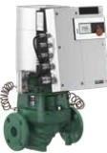
Wile-Stratos GIGA
High-Efficiency n-Line Circulators
Model Des ignation, Stratos GIGA 1.5/3-165 1.5 flange Size (in)
3 Min. Suction Pressure
165 Max. He.ad
Wilo-Stratos GIGA
Model | Volute | Flange | Power | Voltage | Skid | Approx. | Article
 |  | Type | (HP) | :15% (v) | Qty | \'.'eight (lbs) | Number
Stratos GIGA 1.5/3-80 | C,,st Iron | lYz" ANSI Oass 125 | 2.3 | 3-460V | 6 | 95 | 2124484
Stratos GIGA 1.5/3-105 | C,,st Iron | lYz" ANSI Oass 125 | 3.1 | 3-460V | 6 | 95 | 2124483
Stratos GIGA 1.5/3-125 | C,,st Iron | lYz" ANSI Oass 125 | 4.4 | 3-460V | 6 | 95 | 2124482
Stratos GIGA 1.5/3-145 | C,,st Iron | lYz" ANSI Oass 125 | 5.6 | 3-460V | 6 | 95 | 2124481
Stratos GIGA 1.5/3-165 | C,,st Iron | lYz" ANSI Oass 125 | 6.4 | 3-460V | 6 | 95 | 2124480
Stratos GIGA 2/3 -45 | C,,st Iron | 2"ANSI Class 125 | 1.2 | 3-460V | 6 | 93 | 2124488
Stratos GIGA 2/3 -65 | C,,st Iron | 2"ANSI Class 125 | 2 | 3-460V | 6 | 93 | 2124487
Stratos GIGA 2/3 -85 | C,,st Iron | 2"ANSI Class 125 | 2.7 | 3-460V | 6 | 93 | 2124486
Stratos GIGA 2/3 -105 | C,,st Iron | 2"ANSI Class 125 | 4 | 3-460V | 6 | 93 | 2124485
Stratos GIGA 2/3 -120 | C,,st Iron | 2"ANSI Class 125 | 4 | 3-460V | 6 | 97 | 2124491
Stratos GIGA 2/3 -140 | C,,st Iron | 2"ANSI Class 125 | 5 | 3-460V | 6 | 97 | 2124490
Stratos GIGA 2/3 -160 | C,,st Iron | 2"ANSI Class 125 | 6.6 | 3-460V | 6 | 97 | 2124489
Stratos GIGA 2.S/3-26 | C,,st Iron | 2Yz. ANSI Oass 125 | 0.8 | 3-460V | 6 | 106 | 2124494
Stratos GIGA 2.S/3-39 | C,,st Iron | 2Yz. ANSI Oass 125 | 1.7 | 3-460V | 6 | 106 | 2124493
Stratos GIGA 2.S/3-55 | C,,st Iron | 2Yz. ANSI Oass 125 | 2.6 | 3-460V | 6 | 106 | 2124492
Stratos GIGA 2.S/3-70 | C,,st Iron | 2Yz. ANSI Oass 125 | 3.4 | 3-460V | 6 | 108 | 2124496
Stratos GIGA 2.S/3-87 | C,,st Iron | 2Yz. ANSI Oass 125 | 4.6 | 3-460V | 6 | 108 | 2124495
Stratos GIGA 2.S/3-110 | C,,st Iron | 2Yz. ANSI Oass 125 | 4.7 | 3-460V | 6 | 108 | 2124499
Stratos GIGA 2 .5/3-125 | C,,st Iron | 2Yz. ANSI Oass 125 | 5.9 | 3-460V | 6 | 108 | 2124498
Stratos GIGA 2.S/3-135 | C,,st Iron | 2Yz. ANSI Oass 125 | 7.1 | 3-460V | 6 | 126 | 2124497
Stratos GIGA 3/3 -50 | C,,st Iron | 3 ANSI Class 125 | 3.5 | 3-460V | 6 | 123 | 2124501
Stratos GIGA 3/3 -70 | C,,st Iron | 3 ANSI Class 125 | 5.4 | 3-460V | 6 | 123 | 2124500
Stratos GIGA 3/3 -105 | C,,st Iron | 3 ANSI Class 125 | 6 | 3-460V | 6 | 148 | 2124503
Stratos GIGA 3/3 -120 | C,,st Iron | 3 ANSI Class 125 | 7.8 | 3-460V | 6 | 159 | 2124502
Stratos GIGA 4/3 -50 | C,,st Iron | 4" ANSI Class 125 | 3.5 | 3-460V | 6 | 172 | 2124505
Stratos GIGA 4/3 -55 | C,,st Iron | 4" ANSI Class 125 | 5.6 | 3-460V | 6 | 172 | 2124504
Stratos GIGA 4/3 -100 | C,,st Iron | 4" ANSI Class 125 | 7.1 | 3-460V | 6 | 174 | 2124507
Stratos GIGA 4/3 -105 | C,,st Iron | 4" ANSI Class 125 | 9.1 | 3-460V | 6 | 185 | 2124506

Slide 41
WILO Engineering 101
Click on photo

Slide 42
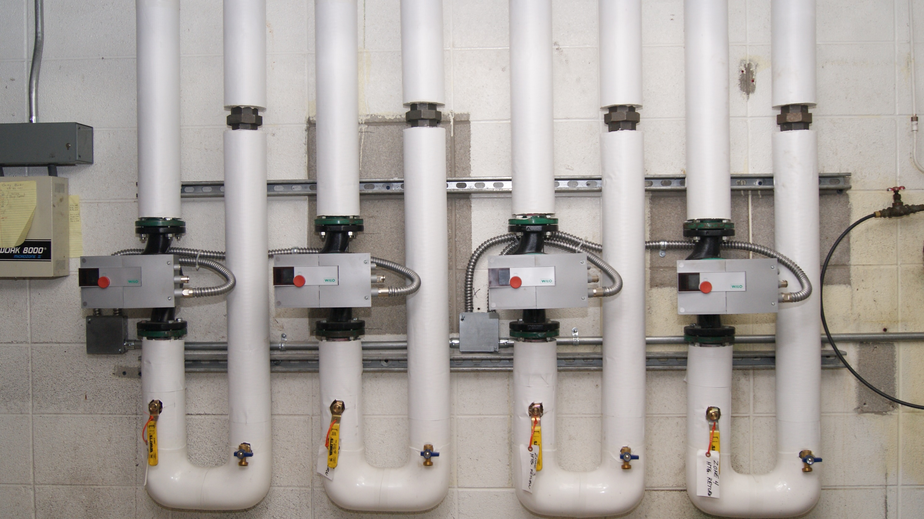
Add a Slide Title - 1

Slide 43
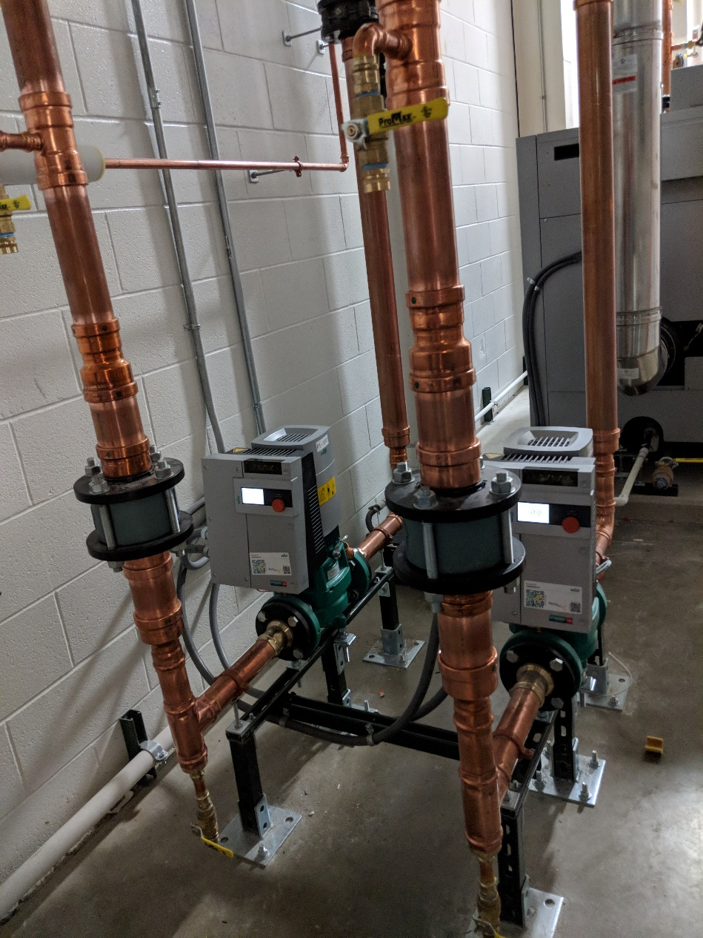
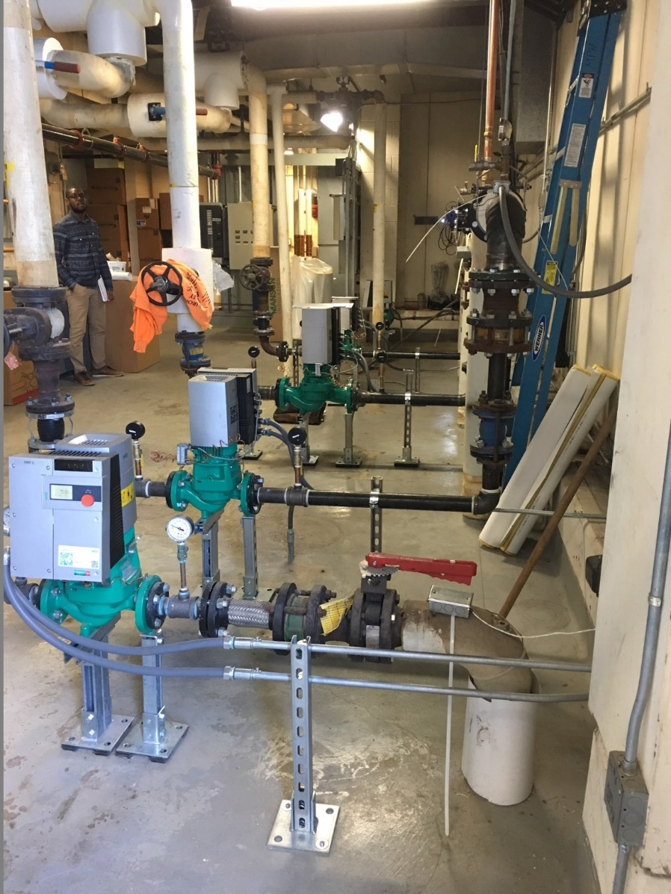
rEFERENCE
LANE AUTOMOTIVE
UniversitY OF MICHIGAN

Slide 44
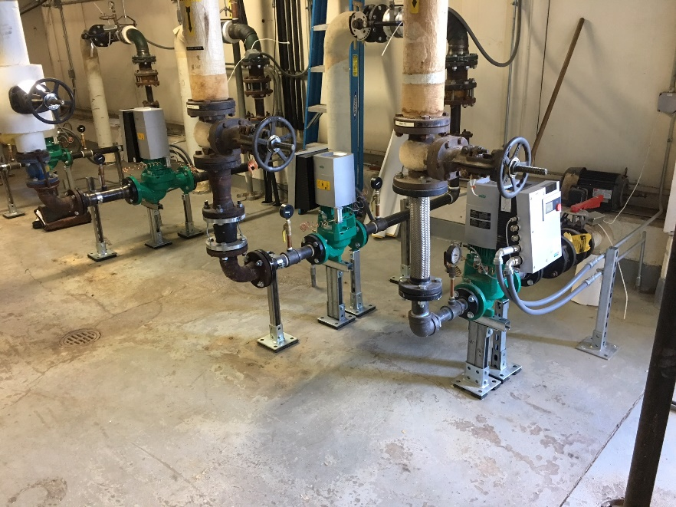
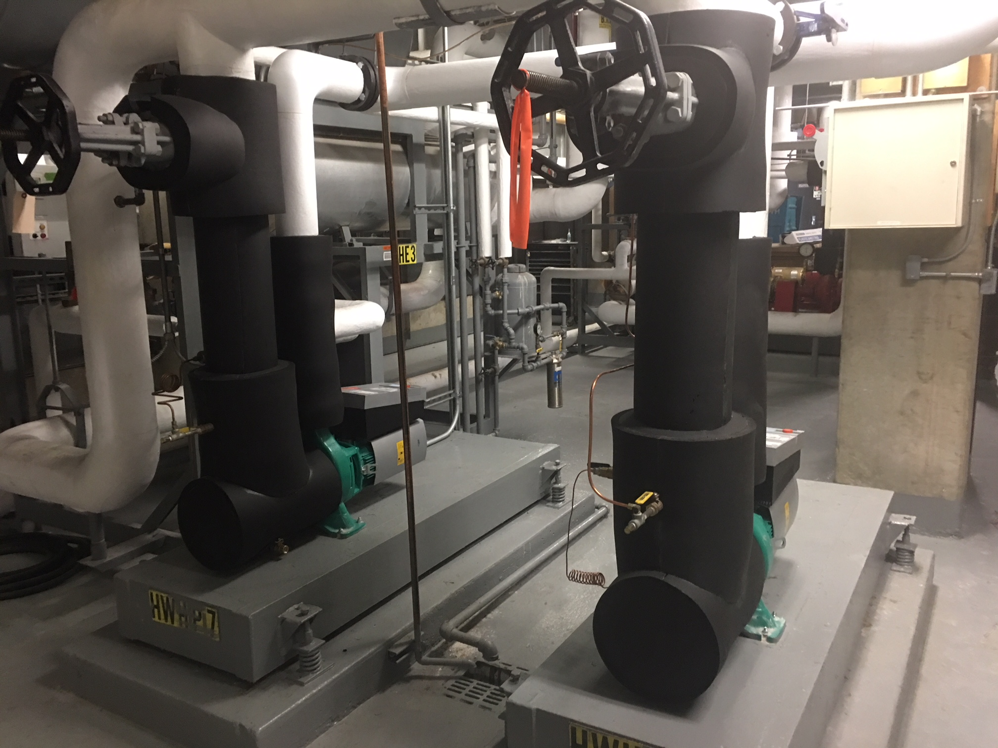
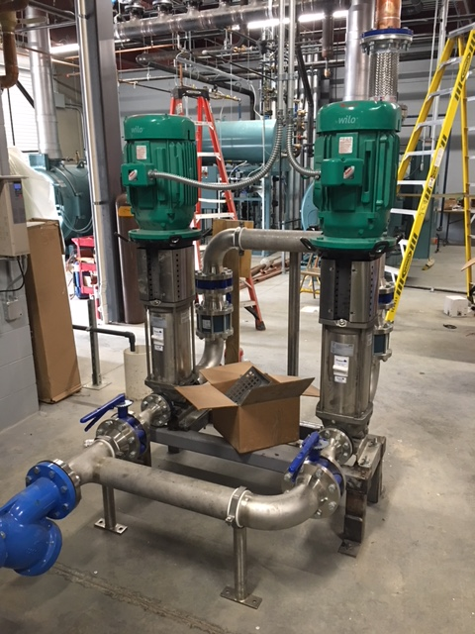

Slide 45
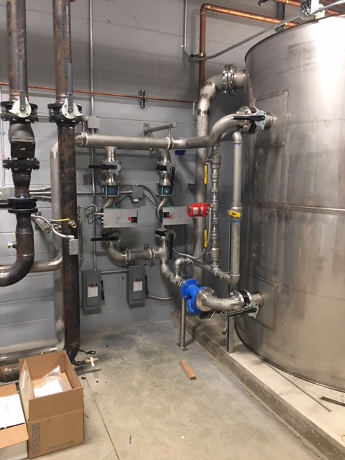
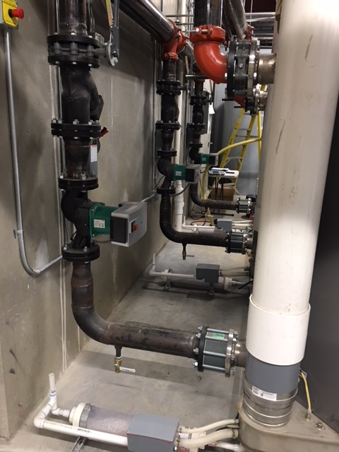

Slide 46
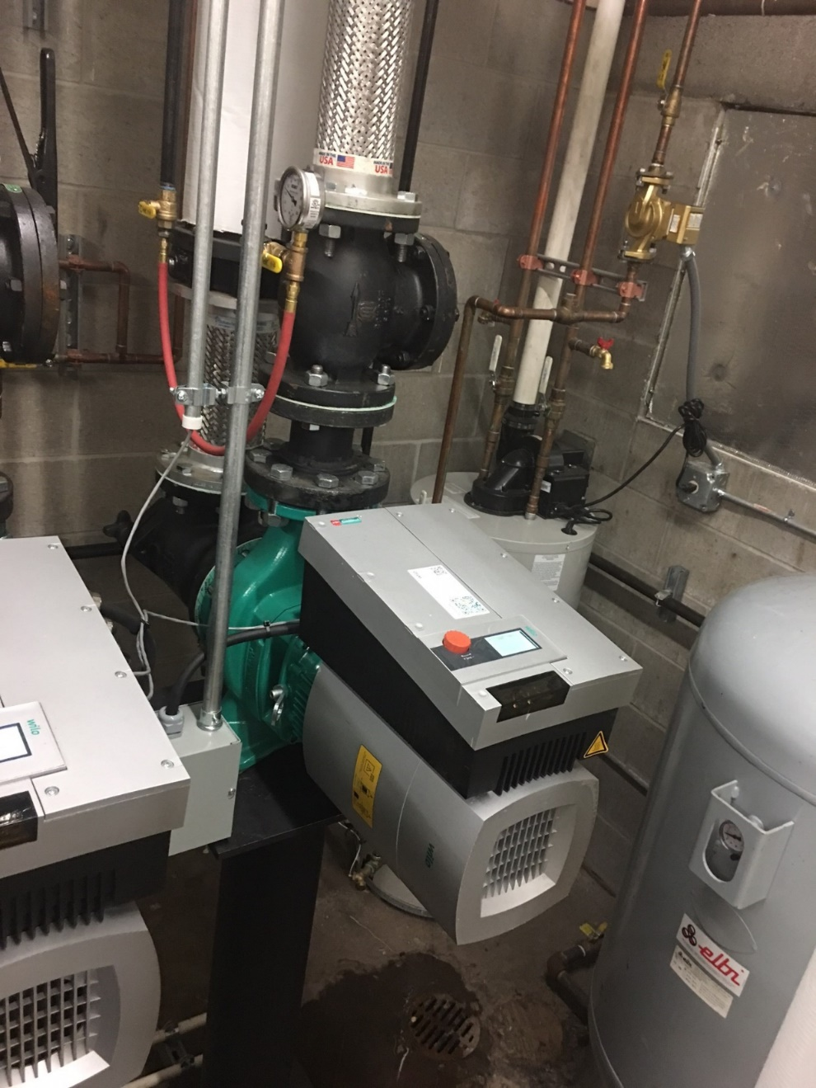
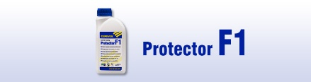
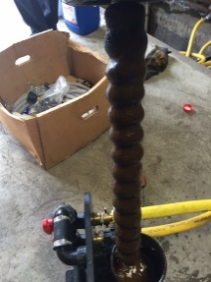

Slide 47
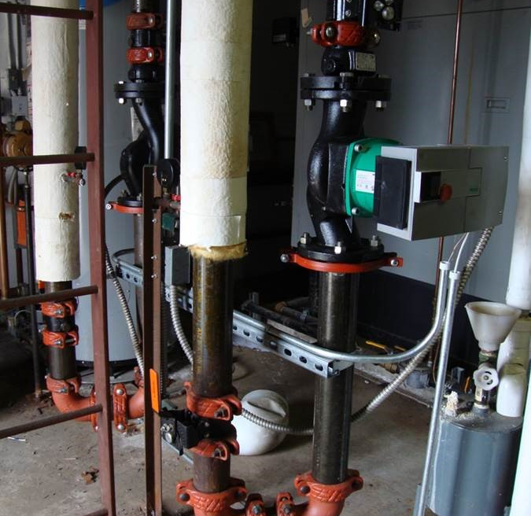
Alma
Base Mounted replaced by inline SIMPLE for anyone.

Slide 48
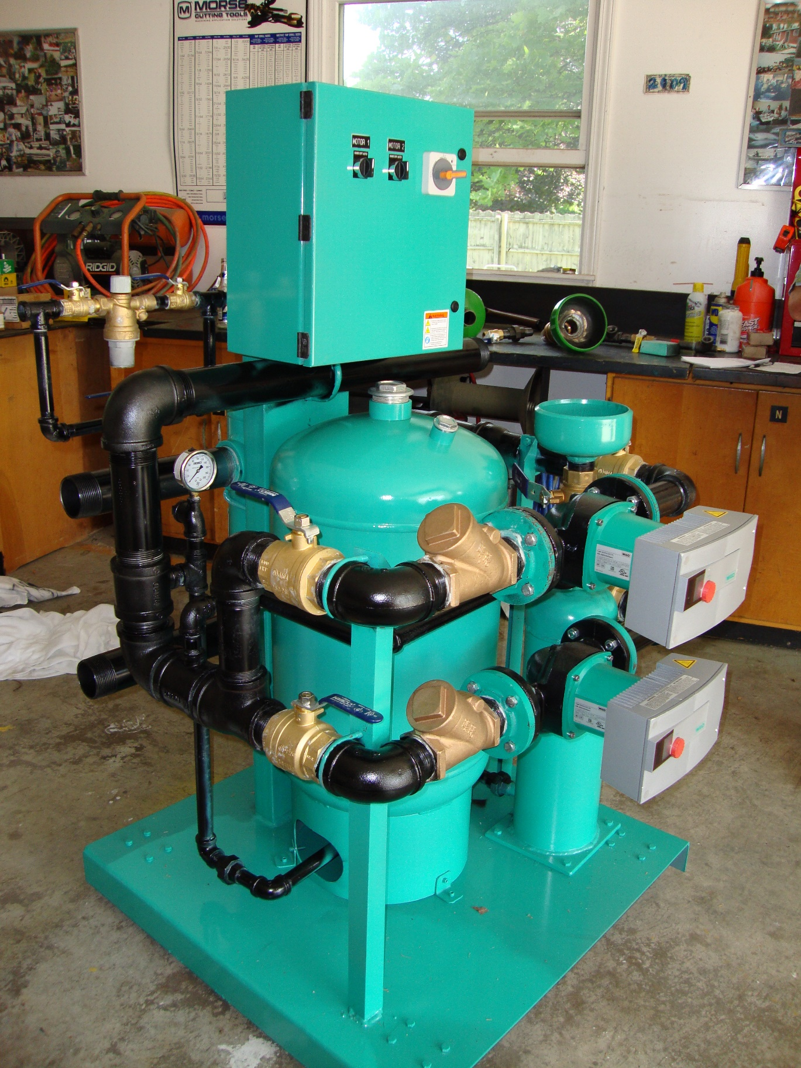

Slide 49
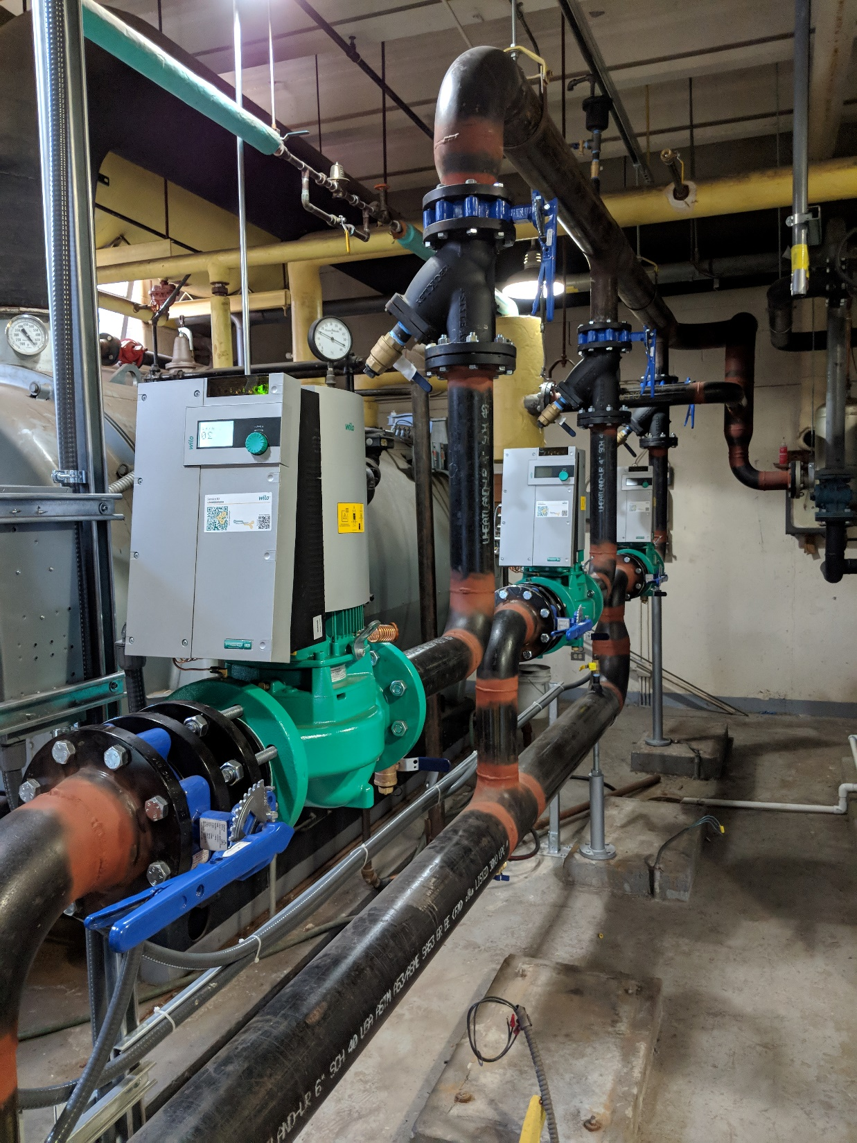
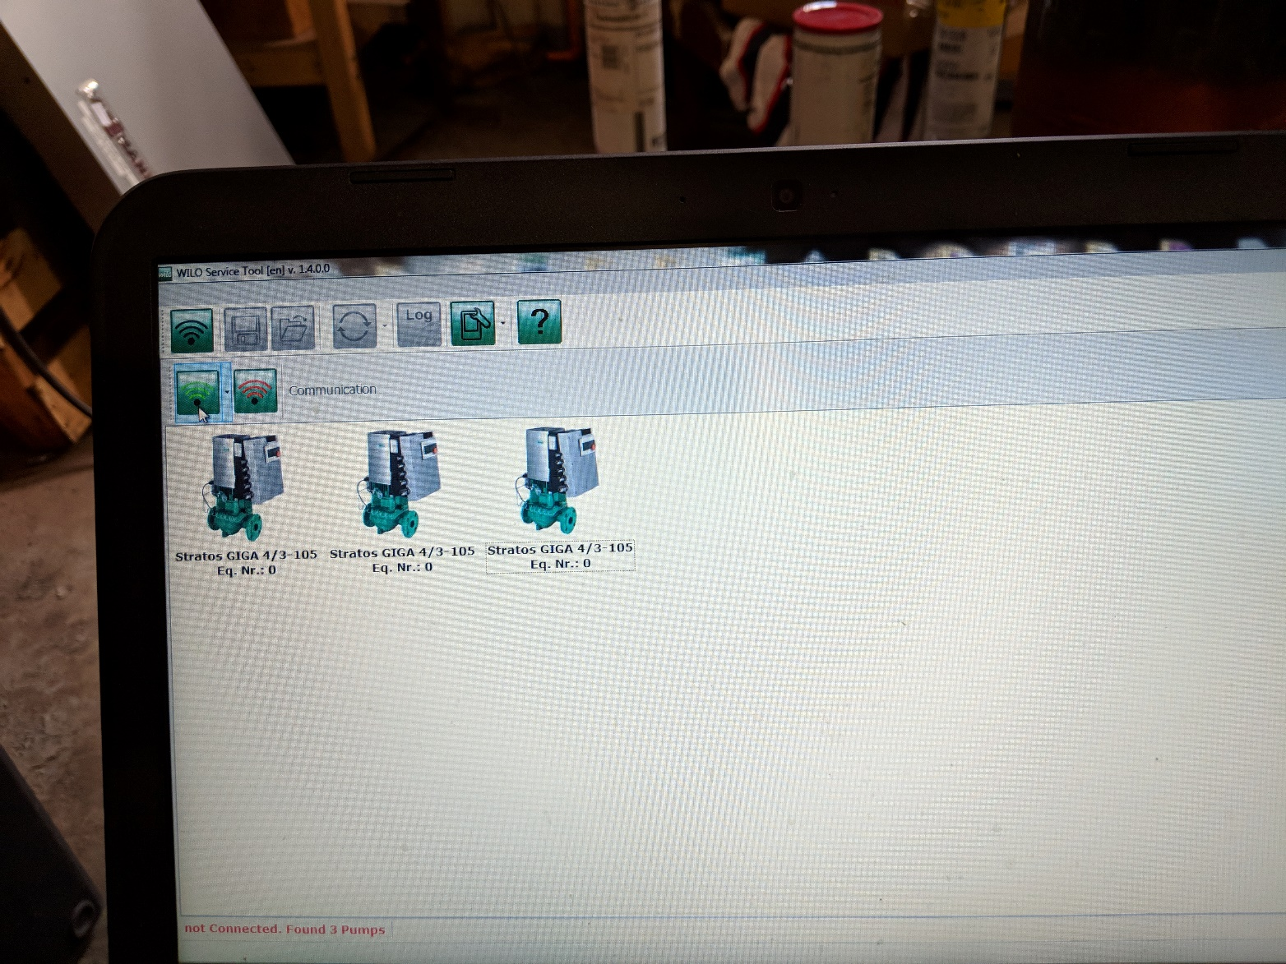
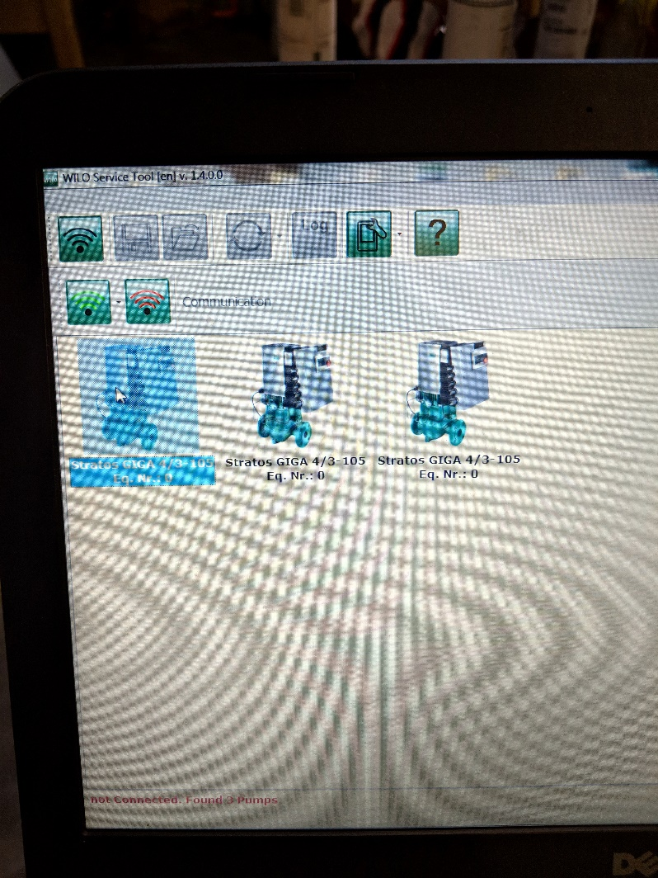

Slide 50
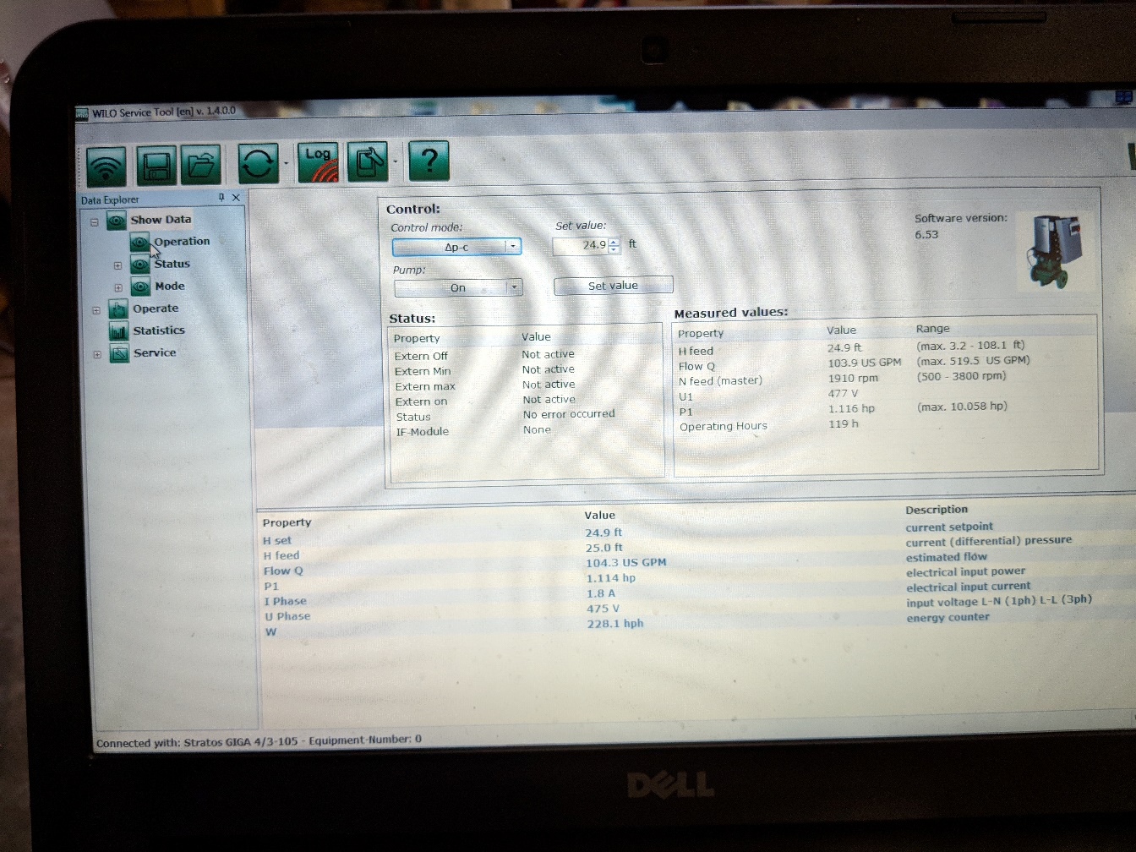
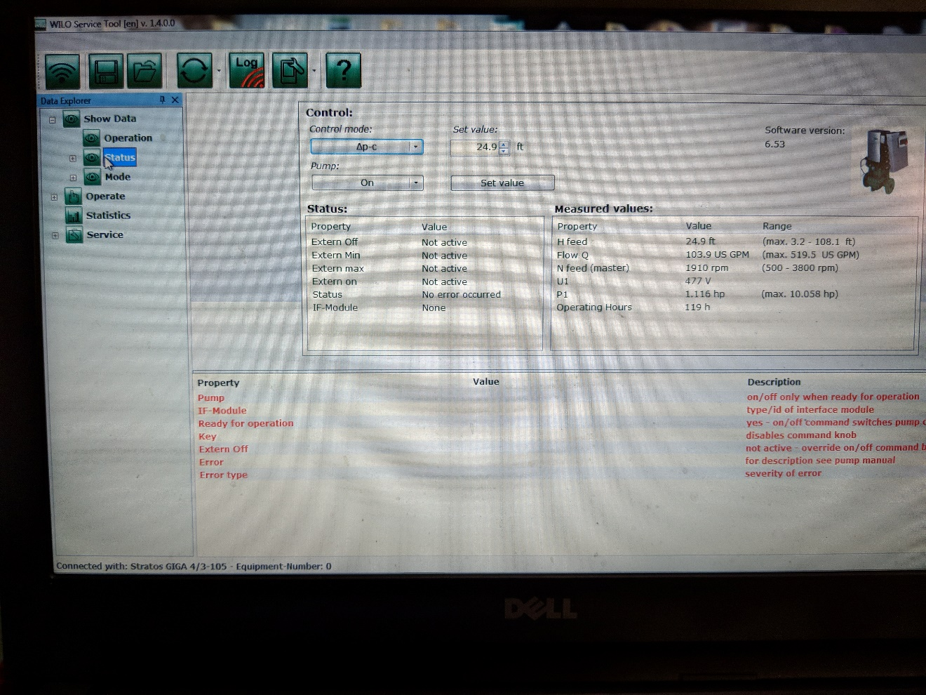


Slide 51



Slide 52



Slide 53


Slide 54


