Slide 1
System Efficiency
How do we achieve it?
Days, Heating, Cooling, Design and occupancy are
infinitely VARIABLE.
We all look for the TURNDOWN of Equipment for optimal EFFICIENCY.

Slide 2
Variables
Design Buildings and Engineers
Energy Production
Energy Consumption
Tie between Production and Consumption
NON_VARIABLE -- Meet the design of all components

Slide 3
Variable 1
Design Buildings and Engineers
  Buildings Designed for heavy gatherings of people included the heat available from humans in both heating and cooling loads?
  Due to the Corona Virus I’m guessing that may change so how can we correct existing systems?
  Variable use buildings with intermittent loading?
  Michigan weather?
  Safety Factors used by the Engineer?
Is there a System Specification to meet or Component Specifications

Slide 4


Slide 5
Variable 2
Energy Production
  TURNDOWN???
  Boilers Condensing, non-Condensing
  Chillers (too many options but Most variable)
  VRF
  You get the idea
  Steam??

Slide 6
Turndown ratio is the ratio of maximum heat output to the minimum level of heat output at which the boiler will operate efficiently or controllably.
Many boilers are designed to operate at a variety of output levels.
As the desired temperature/pressure point is approached, the heat source is progressively turned down. If pressure/temperature falls, the heat source is progressively turned up. If a boiler application requires it to operate at a low proportion of its maximum output, a high turndown ratio is required.
If the heating plant is only working at a small fraction of its maximum and the turndown ratio is too low, at some point the burner will still need to be shut off when the desired pressure/temperature is achieved.
This in turn leads to a rapid reduction in temperature/pressure, requiring the boiler to restart. Cycling frequency can be as high as 12 times per hour. This is undesirable, as flue gases are purged during both the shut-down and start-up phases, leading to energy losses and therefore inefficiency. Additionally, typical startup times for boilers are in the order of one to two minutes, leading to an inability to respond to sudden load demands.

Slide 7
Variable 3
Energy Consumption – ALL with Control Valves to provide energy needed at the point of need
  Air Handling Units
  VAV’s
  Fin tube
  Convectors
  Radiant

Slide 8
Variable 4
Tie between Production and Consumption
  PUMPS
  WATER QUALITY (Separate Training Available)
    Air
    Dirt
    Solids in suspension
    Treatment
  TURNDOWN yes TURN-DOWN

Slide 9
We’re going to dig into Variable #4
Why?
Everything in the HVAC System depends on Turndown as it’s Variable.
If you have one component that can’t equal the turndown of the other
components you are limited in efficiency to the one component limitation.
Often over looked
  PUMPS
  WATER QUALITY
    Air
    Dirt
    Solids in suspension
    Treatment

Slide 10
  WATER QUALITY
    Air
    Dirt
    Solids in suspension
    Treatment
If you have a variable flow system does your Air Separator
work efficiently at all flows? Can it turn down?
Variable Flow Dirt Separation, can a strainer or centrifugal
work at peak efficiency through a wide range?
Do you have a large enough Magnet that see’s most of the flow
to remove solids from suspension?
Do you maintain a proper pH to prevent, correct damage and
improve heat transfer of the fluid?

Slide 11
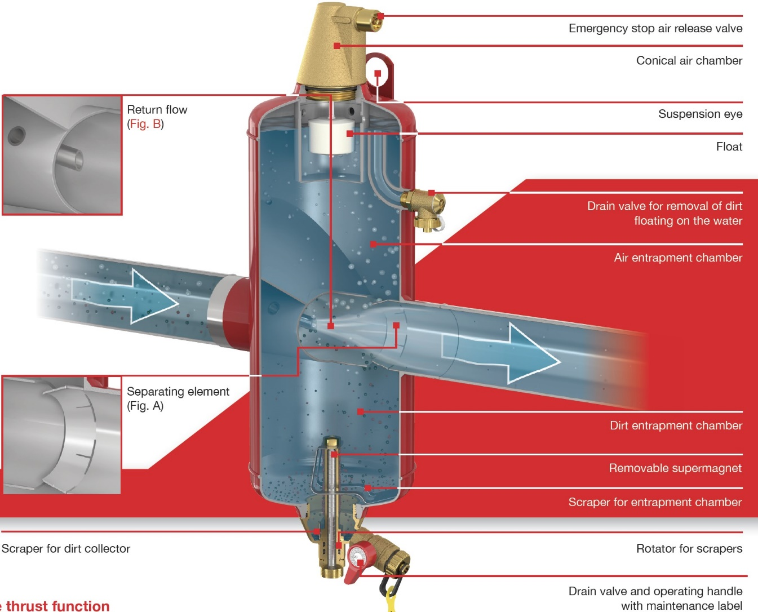

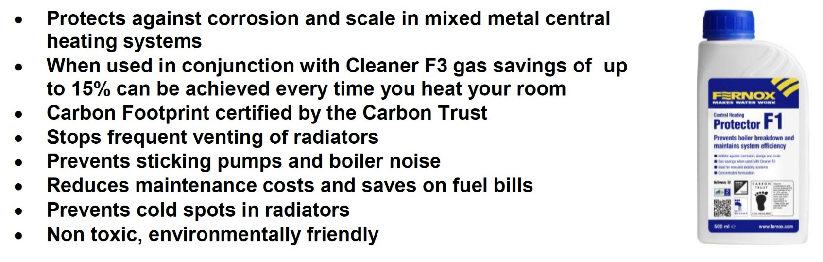

Separate Training Available
See schedule

Slide 12
PUMPS
What is the TURNDOWN you NEED for your system?????
Are you looking for 10-1? Or 25-1?
At 10/1 a 1,000,000BTU system would need to operate
From 100gpm down to 10gpm
Remember if you cut the flow by 50% you
reduce the required head by a factor of 4
Also remember there HAS to be Safety Factor added to the
pump selection when engineering 10/20/50%?

Slide 13
PUMPS
We start off on the ability of the SYSTEM pump to meet System turn-down,
we not only have to get the full actual turn-down
but also have to get from where it operates with all the safety factors.
Looking at a very simple 2,000,000BTU system
200 GPM @ 60’TDH
With 20% safety means the actual selected head was 48 / .8 = 60’
We have to see what flow we start at around 48’ with the
Pump selection that has to be trimmed/balanced out first.

Slide 14
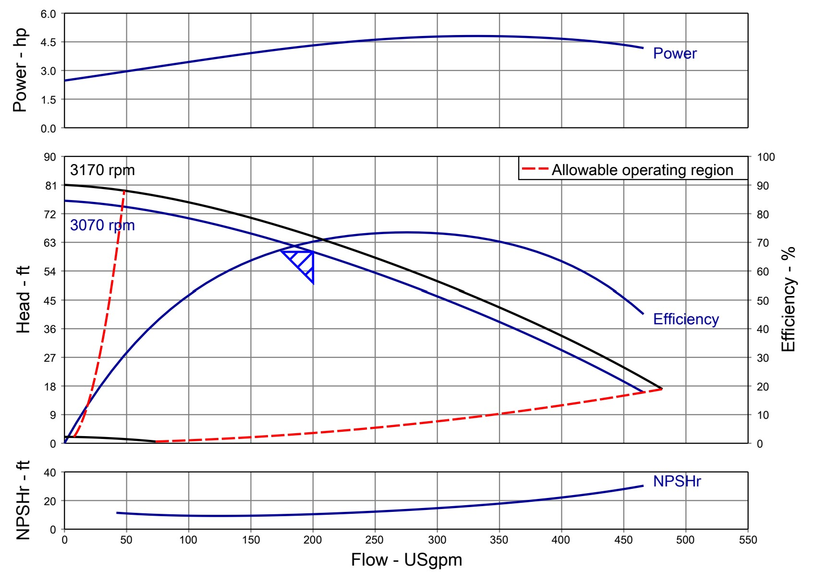
As you can see at48’ we
Are about 300gpm.
With 10/1 turn-down
Can the pump selection
Go from 300 to 20gpm?
AND still be within curve
limitations?
300 gpm @ 48’
200 gpm @ 60’or 27’?
100 gpm @ 15’ or 7’
50 gpm @ 4’
20 gpm @ 1’
Cut the flow in half cut the head by a factor of 4
This is why ECM/DC pumps work
https://wilousa.portal.intelliquip.com/

Slide 15
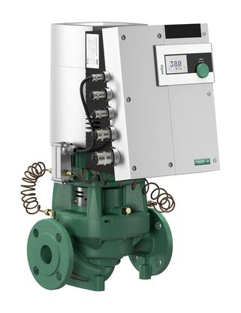
Wilo Stratos GIGA the most advanced commercial
HVAC pump in the world
2020

Slide 16
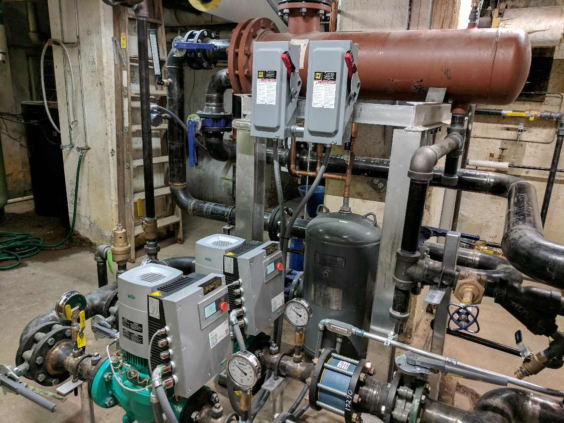
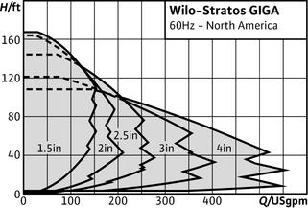
pumping creates the core of system efficiency

Slide 17
pumping creates the core of system efficiency
And let’s be the one to talk about CORE SYSTEM EFFICIENCY getting all the components to work together through the entire transition range.
Let’s talk about the water quality issues that affect/effect all the components of a system.
Let’s talk about the required safety factor put on engineers to make sure the systems function and how WILO GIGA can make that SYSTEM WORK. (no one else can).

Slide 18
GPM = BTU’s
500 x Delta T
Delta psig x 2.31 = Feet TDH
Rocket Science

Slide 19
50 – 80% savings in energy in the pump alone with ECM and a little common sense.
Easy to install and easy to prove.
Direct the WILO energy towards the schools with 1,000,000 to 5,000,000BTU/HR systems and the infamous 1510-2.5BB – 5-7.5hp pumps.
If you only get 50% savings with ECM/DC over the existing AC/VFD your payback is less than 3 years PERIOD. WHY NOT
You also get all the repair parts and labor savings for free.

Slide 20
Do you meet your CORE System Efficiency
Or just a few component Efficiencies?
Do you assume you’re starting from a perfect base of design?
-10F day GPM and Delta T as designed?
Can you reduce capacity to match load and keep high Efficiency?
Do you have a good ph and water quality?

Slide 21
It is very often a 98% efficient boiler is placed in a 20% efficient system resulting in little to no savings in energy consumption.
We suggest putting your energy toward balancing production (boilers) with consumption (Air Handling Units, fin tube radiation, etc) by providing the proper distribution (pumping and balance).

Slide 22
What to look for:
System supply water temperature _____________
System return water temperature _____________
Boiler Stack Temperature ____________________
Pump Suction Pressure ______________________
Pump Discharge Pressure ____________________
Pump Design/Size __________________________
Pump Horse Power and Voltage _______________
2 – Way or 3 – Way control valves _____________
Any on going system problems ________________
Any on going component problems _____________
Building comfort issues_______________________
Are our produced BTU’s going up the Stack
or into the water to meet system requirements?

Slide 23
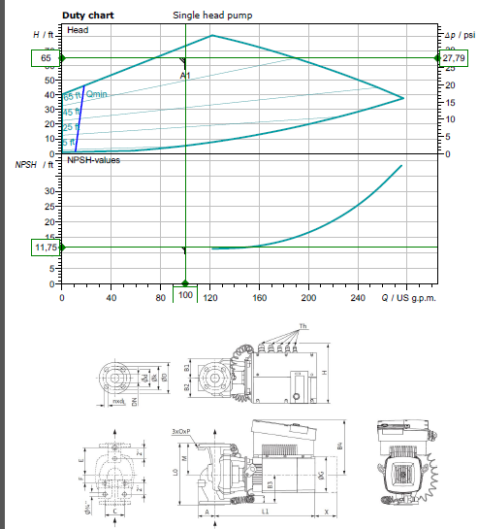
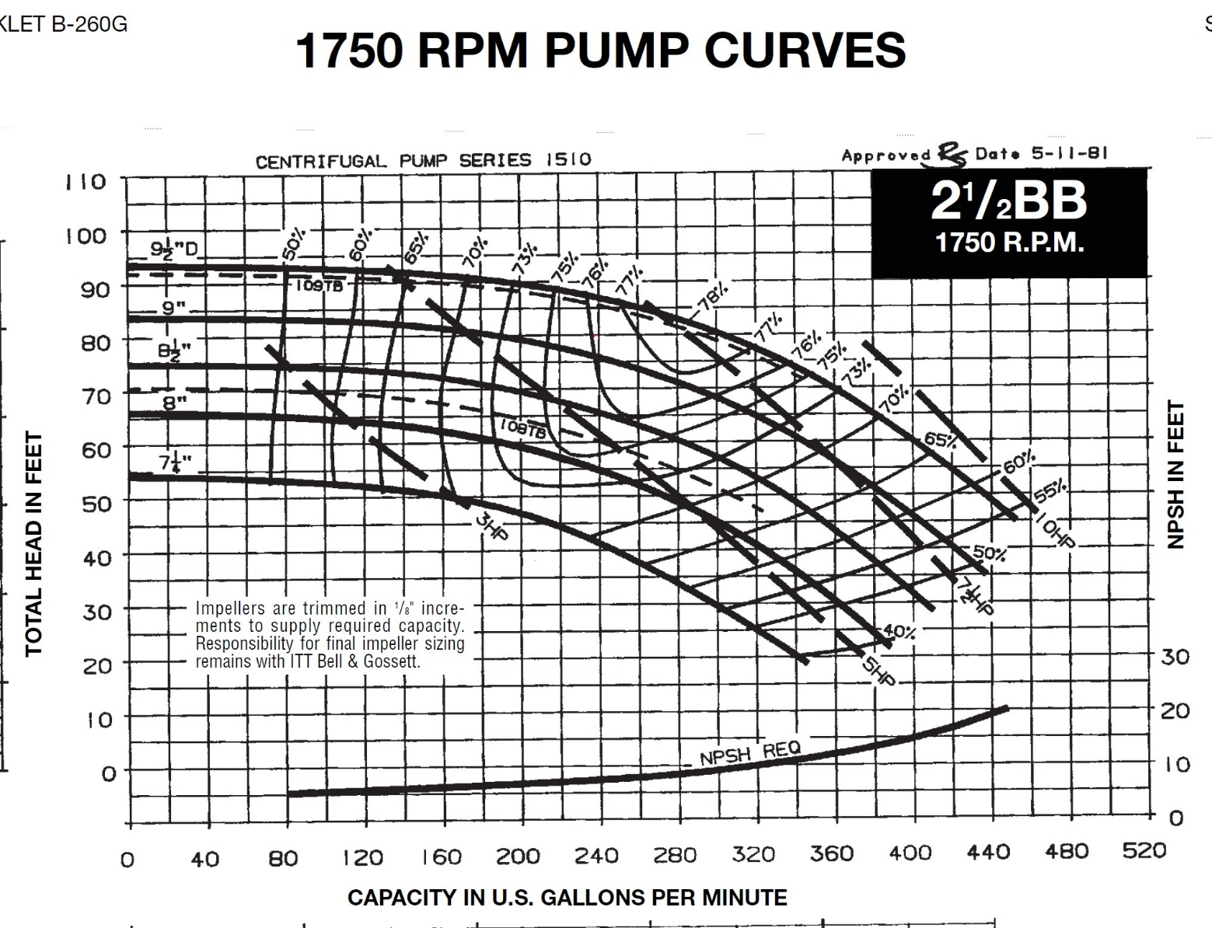

Slide 24
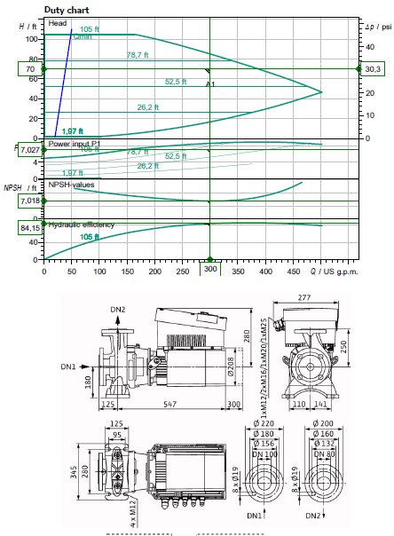


Slide 25


Slide 26
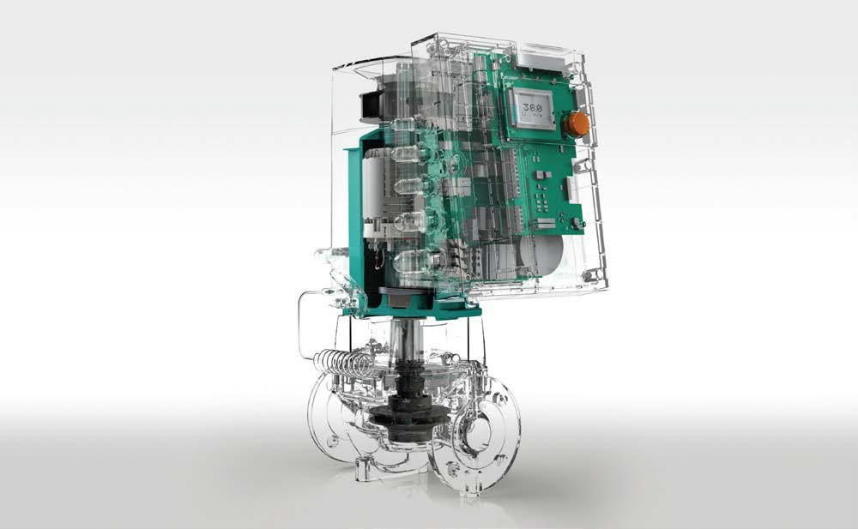
EASY Replacement selection for GIGA from Base Mounted End Suction.
Note:
Using B&G as the Reference but all will have similar capacities.
Looking at the industries most common selections from 1,000,000 – 5,000,000 BTU/HR The most common End Suction pumps have a 7” impeller or 9.5” impeller.
You can tell by the TAG or how big the opening the impeller will have to slide through.
The B&G will show the 7” as an (A) with the 9.5” as an (B). Most will be trimmed to a smaller diameter, determined by the Motor HP and RPM.
The second digit on the B&G (B,C,D, now E) will indicate the generation. (1510-2.5BB) The discharge flange size will let you know the pump size. With the suction 1 size larger. Piping revisions will be common and your local distributor can make simple suggestions.
Should the HP be less than MAX per pump you may be able to select the next smaller pump. The GIGA pumps will all be 460v/3 phase so transformers may be required.
GIGA 2 3-85 | 1510-1.5A | 1510-2A
GIGA 2.5 3-110 | 1510-1.5B | 1510-2A
GIGA 4 3-100 | 1510-2B | 1510-3A
GIGA 4 3-105 | 1510-2B | 1510-4A
GIGA B 80 1-32 | 1510-3B/10hp | 1510-4B/15hp
If you notice from the curves you can usually use the next size larger pump going ECM and still operating with a SYSTEM curve. (ie: GIGA 4 3-105 will cover 1510-2B, 3A, 4A and a lot of 3B). Let us help till you get used to how the curves work and see how oversized the existing selections really are.
This is the simple selection process we have options to cover most any application you can find. All AC motors with VFD’s still operate with pump curves not the system curves as shown prior.
Some installers can install a new ECM-DC GIGA pump cheaper than repairing or replacing an existing.
Now you have a SYSTEM Sensing variable flow pump improving SYSTEM efficiency vs a repair that may last a couple years.
Remember apples to apples flow you save 50% electrically going from AC to DC. We can cover 90% of the systems out there with 2 Giga’s.
100 – 200gpm Pick the head is the standard GIGA inline 2.5 3/87
200 – 300gpm Pick the head is the Standard GIGA B end suction 80 B 1/32 Giga B we add the pressure sensor.
Replace all the 1510-3AB to the 1510-3BB 90% of the school jobs.

Slide 27
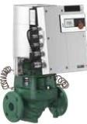
Wile-Stratos GIGA
High-Efficiency n-Line Circulators
Model Des ignation, Stratos GIGA 1.5/3-165 1.5 flange Size (in)
3 Min. Suction Pressure
165 Max. He.ad
Wilo-Stratos GIGA
Model | Volute | Flange | Power | Voltage | Skid | Approx. | Article
 |  | Type | (HP) | :15% (v) | Qty | \'.'eight (lbs) | Number
Stratos GIGA 1.5/3-80 | C,,st Iron | lYz" ANSI Oass 125 | 2.3 | 3-460V | 6 | 95 | 2124484
Stratos GIGA 1.5/3-105 | C,,st Iron | lYz" ANSI Oass 125 | 3.1 | 3-460V | 6 | 95 | 2124483
Stratos GIGA 1.5/3-125 | C,,st Iron | lYz" ANSI Oass 125 | 4.4 | 3-460V | 6 | 95 | 2124482
Stratos GIGA 1.5/3-145 | C,,st Iron | lYz" ANSI Oass 125 | 5.6 | 3-460V | 6 | 95 | 2124481
Stratos GIGA 1.5/3-165 | C,,st Iron | lYz" ANSI Oass 125 | 6.4 | 3-460V | 6 | 95 | 2124480
Stratos GIGA 2/3 -45 | C,,st Iron | 2"ANSI Class 125 | 1.2 | 3-460V | 6 | 93 | 2124488
Stratos GIGA 2/3 -65 | C,,st Iron | 2"ANSI Class 125 | 2 | 3-460V | 6 | 93 | 2124487
Stratos GIGA 2/3 -85 | C,,st Iron | 2"ANSI Class 125 | 2.7 | 3-460V | 6 | 93 | 2124486
Stratos GIGA 2/3 -105 | C,,st Iron | 2"ANSI Class 125 | 4 | 3-460V | 6 | 93 | 2124485
Stratos GIGA 2/3 -120 | C,,st Iron | 2"ANSI Class 125 | 4 | 3-460V | 6 | 97 | 2124491
Stratos GIGA 2/3 -140 | C,,st Iron | 2"ANSI Class 125 | 5 | 3-460V | 6 | 97 | 2124490
Stratos GIGA 2/3 -160 | C,,st Iron | 2"ANSI Class 125 | 6.6 | 3-460V | 6 | 97 | 2124489
Stratos GIGA 2.S/3-26 | C,,st Iron | 2Yz. ANSI Oass 125 | 0.8 | 3-460V | 6 | 106 | 2124494
Stratos GIGA 2.S/3-39 | C,,st Iron | 2Yz. ANSI Oass 125 | 1.7 | 3-460V | 6 | 106 | 2124493
Stratos GIGA 2.S/3-55 | C,,st Iron | 2Yz. ANSI Oass 125 | 2.6 | 3-460V | 6 | 106 | 2124492
Stratos GIGA 2.S/3-70 | C,,st Iron | 2Yz. ANSI Oass 125 | 3.4 | 3-460V | 6 | 108 | 2124496
Stratos GIGA 2.S/3-87 | C,,st Iron | 2Yz. ANSI Oass 125 | 4.6 | 3-460V | 6 | 108 | 2124495
Stratos GIGA 2.S/3-110 | C,,st Iron | 2Yz. ANSI Oass 125 | 4.7 | 3-460V | 6 | 108 | 2124499
Stratos GIGA 2 .5/3-125 | C,,st Iron | 2Yz. ANSI Oass 125 | 5.9 | 3-460V | 6 | 108 | 2124498
Stratos GIGA 2.S/3-135 | C,,st Iron | 2Yz. ANSI Oass 125 | 7.1 | 3-460V | 6 | 126 | 2124497
Stratos GIGA 3/3 -50 | C,,st Iron | 3 ANSI Class 125 | 3.5 | 3-460V | 6 | 123 | 2124501
Stratos GIGA 3/3 -70 | C,,st Iron | 3 ANSI Class 125 | 5.4 | 3-460V | 6 | 123 | 2124500
Stratos GIGA 3/3 -105 | C,,st Iron | 3 ANSI Class 125 | 6 | 3-460V | 6 | 148 | 2124503
Stratos GIGA 3/3 -120 | C,,st Iron | 3 ANSI Class 125 | 7.8 | 3-460V | 6 | 159 | 2124502
Stratos GIGA 4/3 -50 | C,,st Iron | 4" ANSI Class 125 | 3.5 | 3-460V | 6 | 172 | 2124505
Stratos GIGA 4/3 -55 | C,,st Iron | 4" ANSI Class 125 | 5.6 | 3-460V | 6 | 172 | 2124504
Stratos GIGA 4/3 -100 | C,,st Iron | 4" ANSI Class 125 | 7.1 | 3-460V | 6 | 174 | 2124507
Stratos GIGA 4/3 -105 | C,,st Iron | 4" ANSI Class 125 | 9.1 | 3-460V | 6 | 185 | 2124506

Slide 28
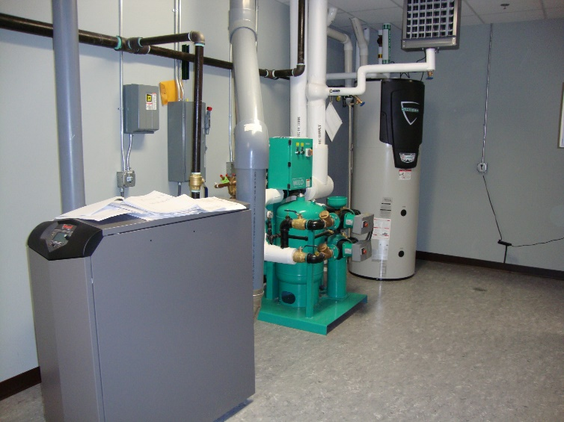
WILO Engineering 101
Click on photo

Slide 29
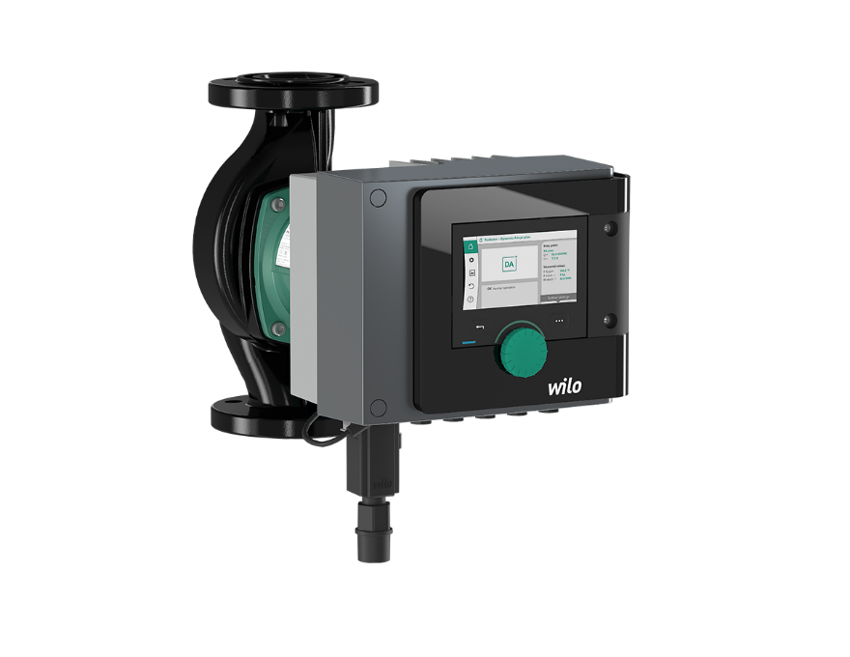
ECM technology with wire to water savings up to 80%, at very effective cost points with Variable Speed, ECM motor and system control built into the pump itself.
These pumps are the one stop solution to system efficiency, correcting the system and distribution efficiency with boiler efficiency.

Slide 30

How Big do they Go ECM?

Slide 31
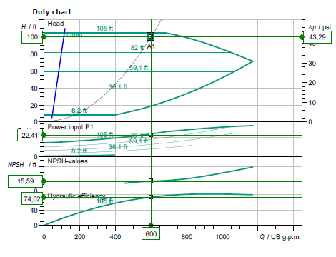
Call for
sizing

Slide 32
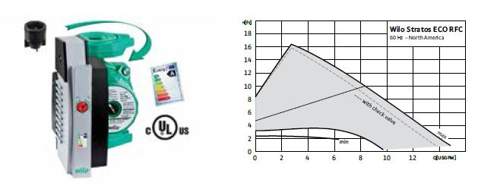
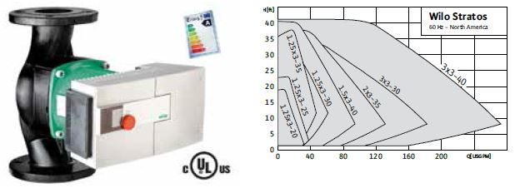
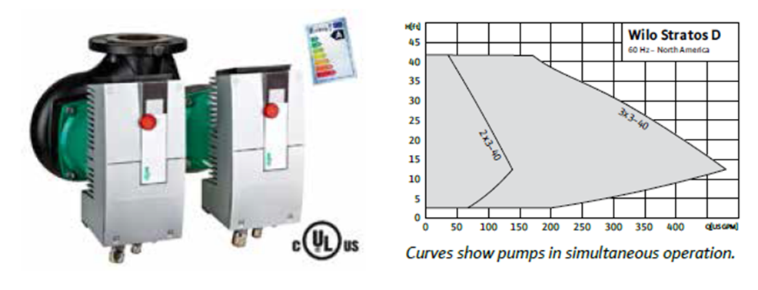
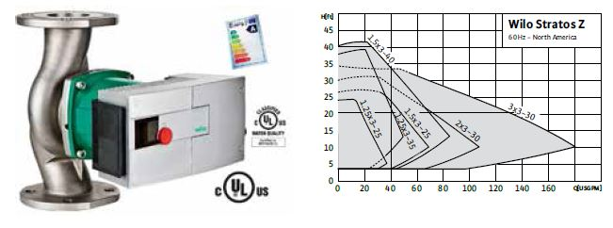
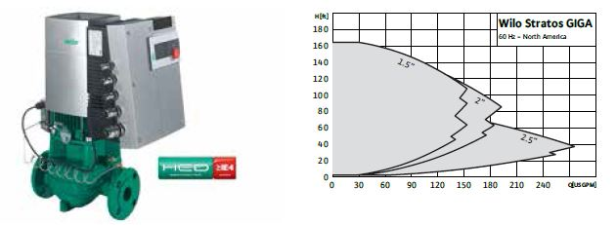
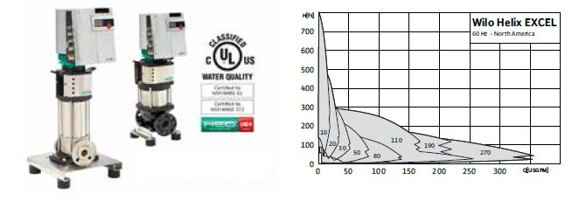
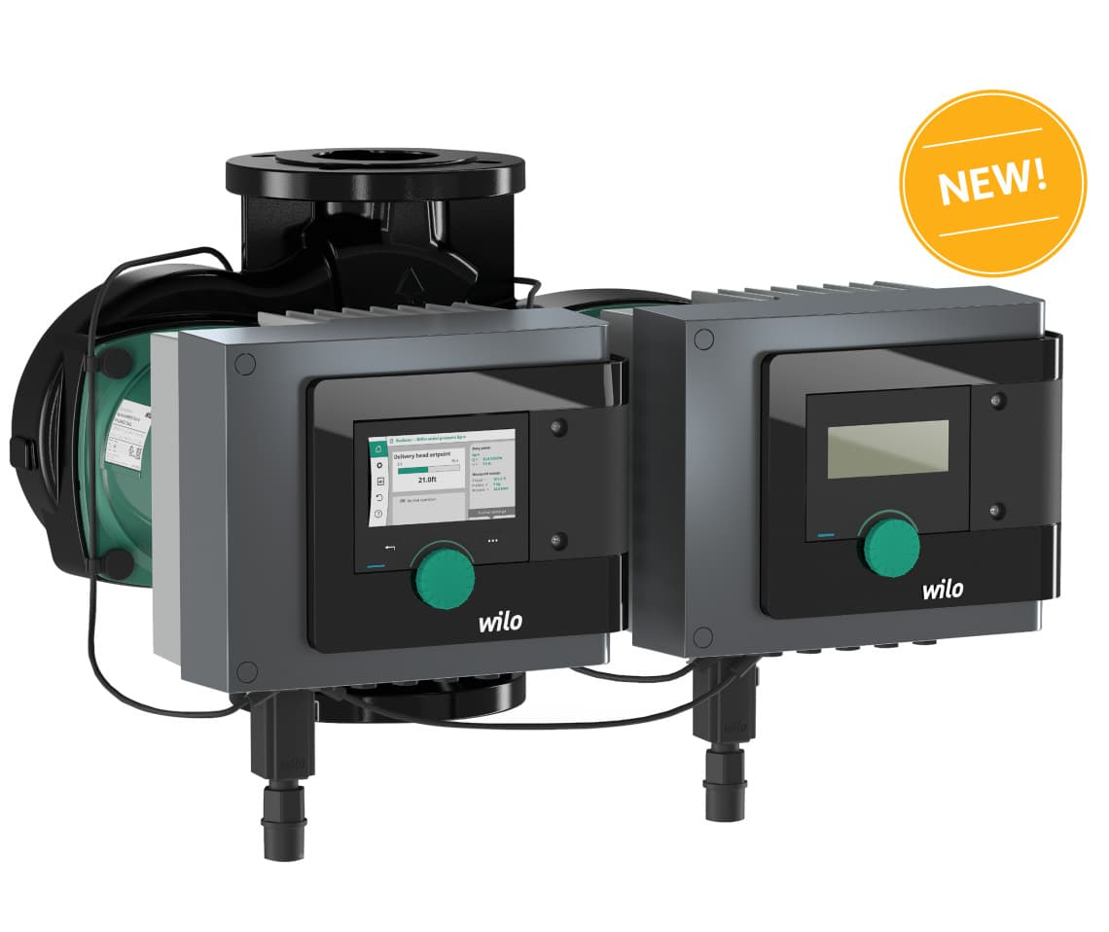
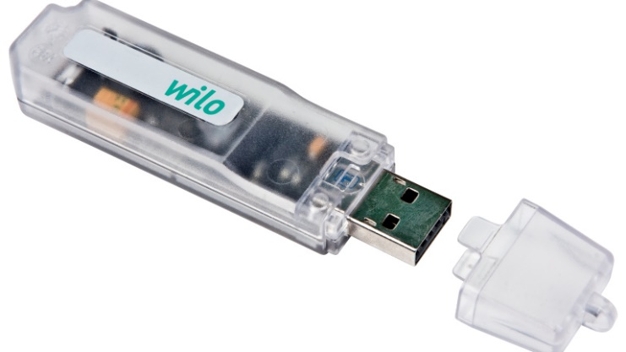
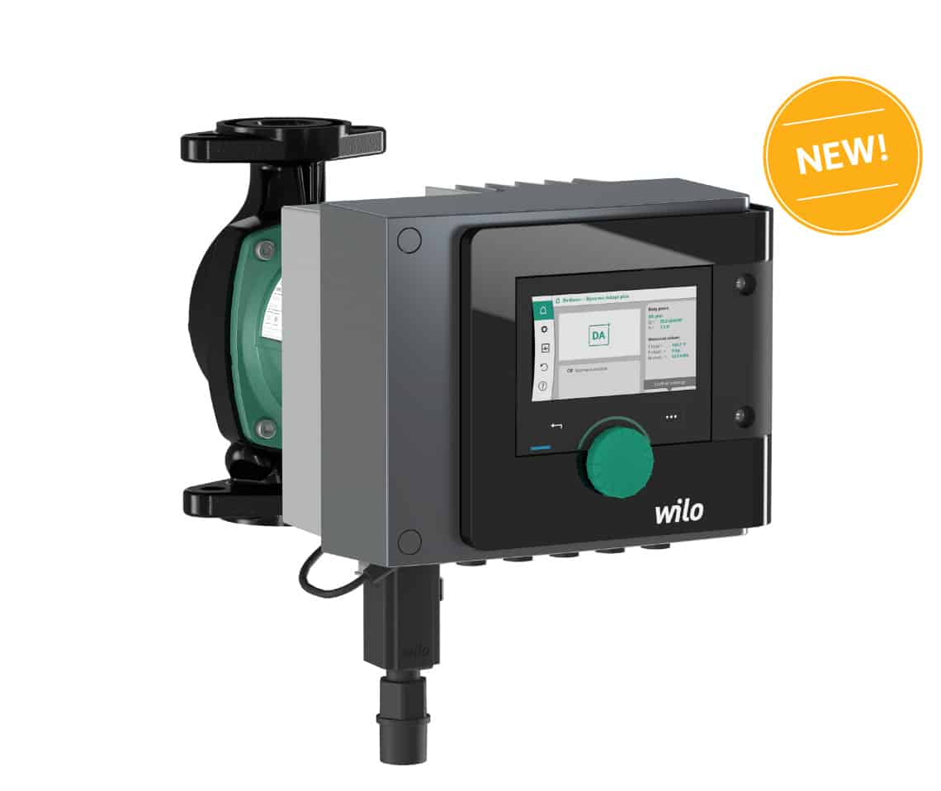
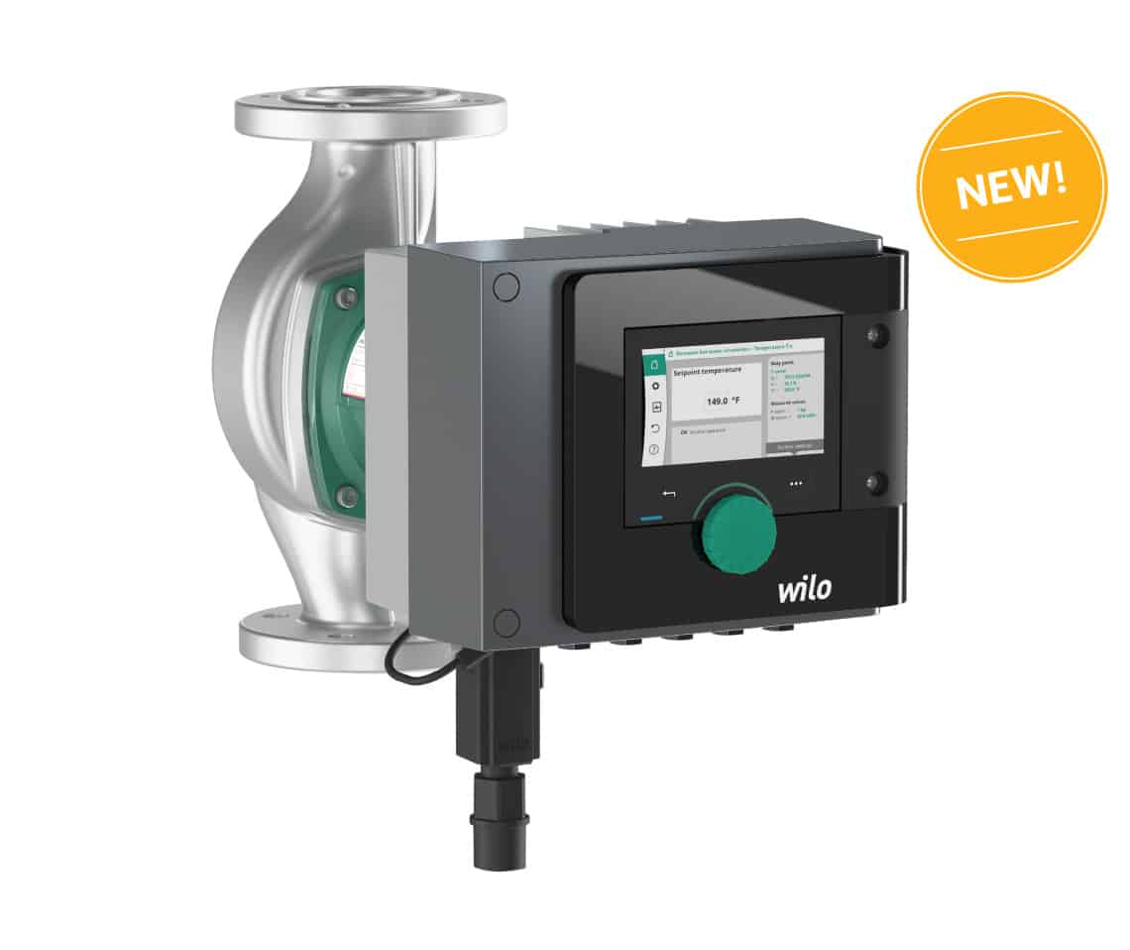

Slide 33
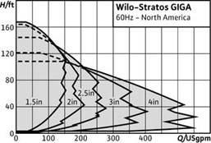
Much Bigger than this
Just call for design.

Slide 34


Slide 35
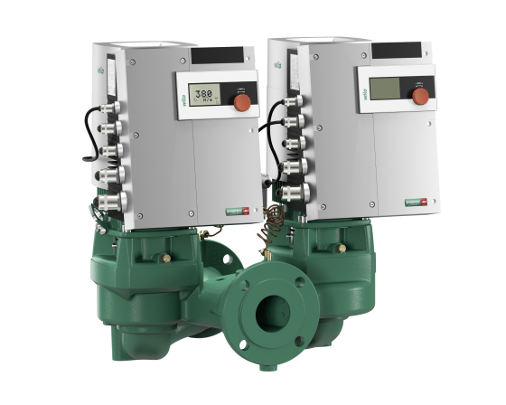

Slide 36
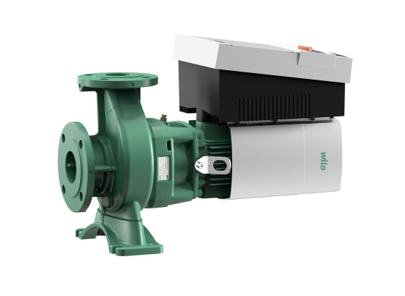

Slide 37
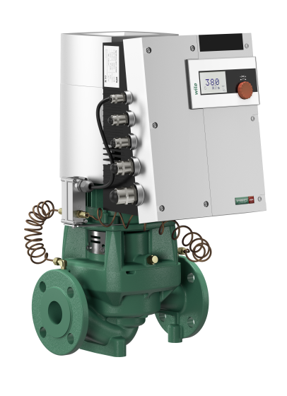

Slide 38
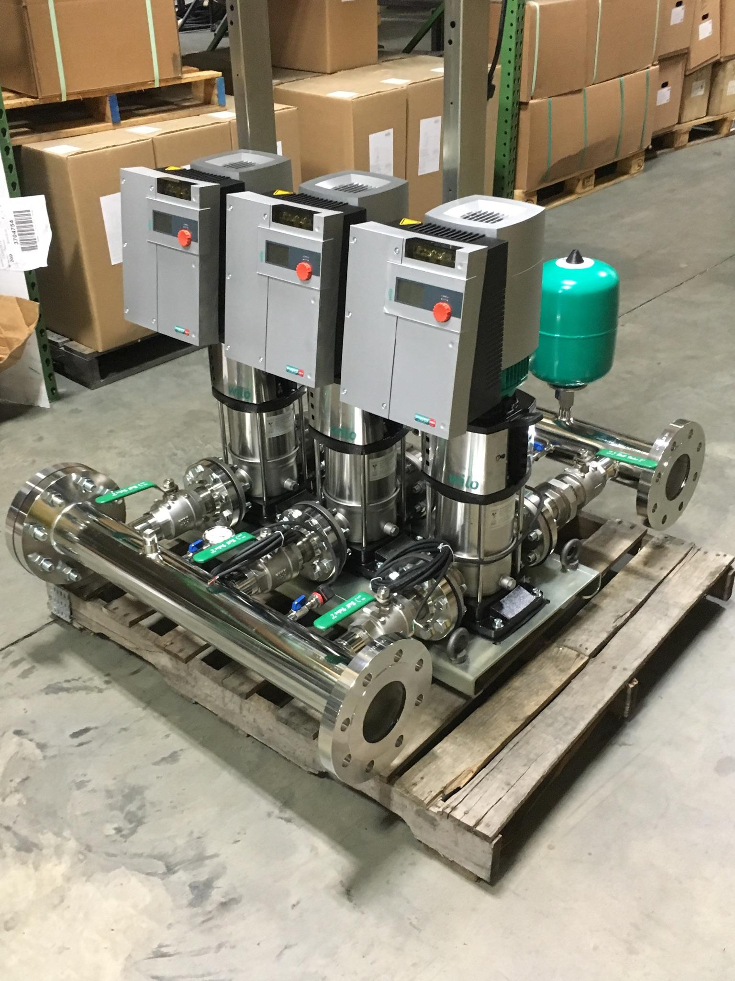

Slide 39
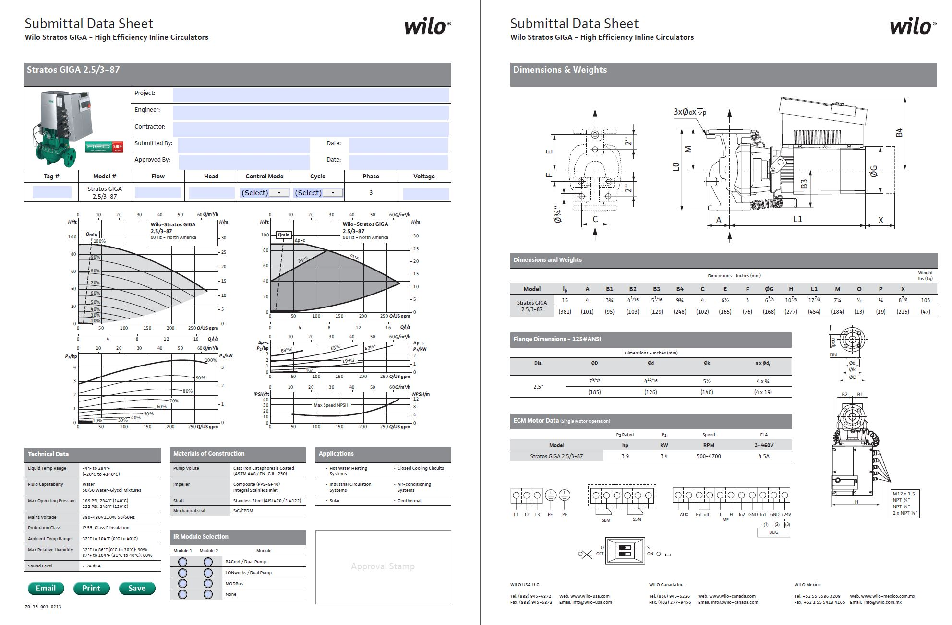

Slide 40

https://wilo.com/us/en_us/

Slide 41
Pumps save electrical energy by properly applying them, check the HP of 200 gpm @ 45’ vs the HP of 200 gpm @ 12’.
This is really nice.
Now check out the Boiler operating at 30% vs. the Boiler operating at 85 – 95% Efficient.
Really Really REALLY NICE Savings.

Slide 42
ΔT review
Heating fluid standard is 20 degree ΔT
  Today with Energy Conservation this will vary.
  Heating systems 20 – 40 is standard, and engineers tend to use boiler efficiency standards where higher ΔT relates to higher efficiency.
  Higher ΔT relates to lower flows and lower pumping cost and lower distribution cost.
  Cooling fluid standard is 10 degree ΔT
    You have to watch for humidification issues.

Slide 43
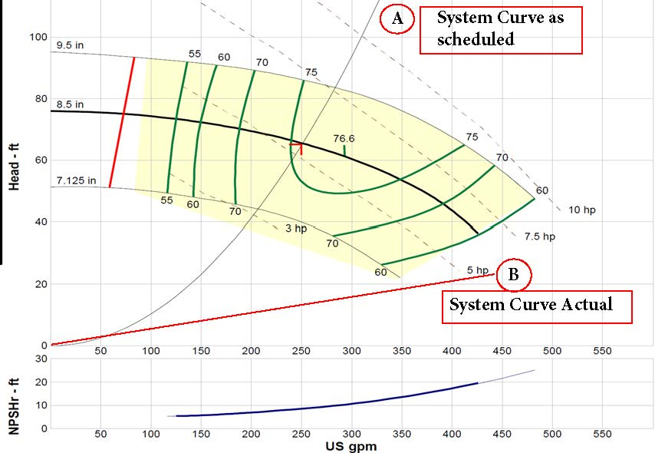
Note that if you reduce the flow by half you reduce the head by a factor of 4>>>
If you’re over pumping at 24’ when you reduce the flow you’re head drops from that point
You can’t get an AC pump and Drive to operate in that area but an ECM-DC CAN.

Slide 44
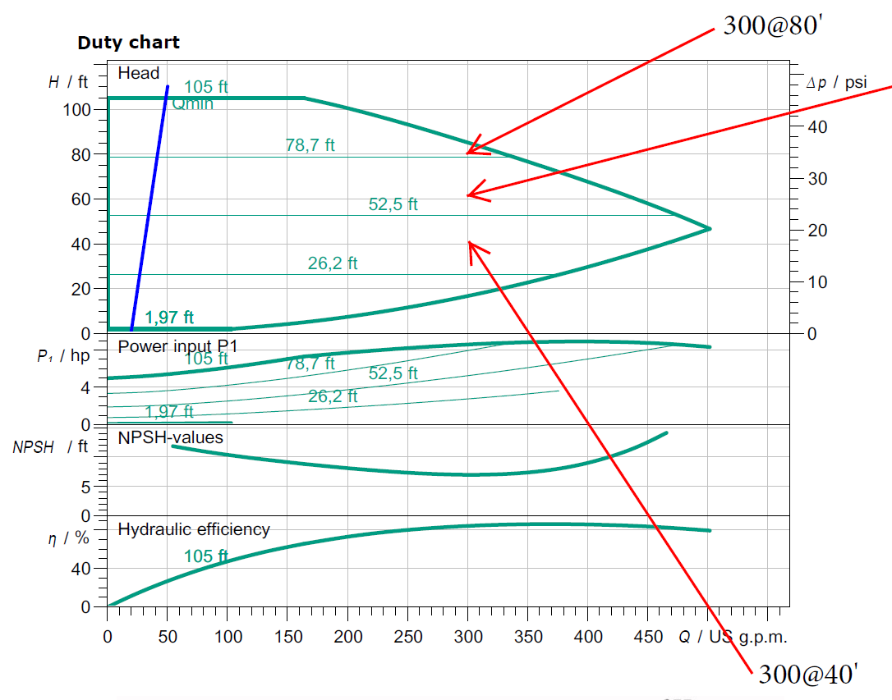

Slide 45
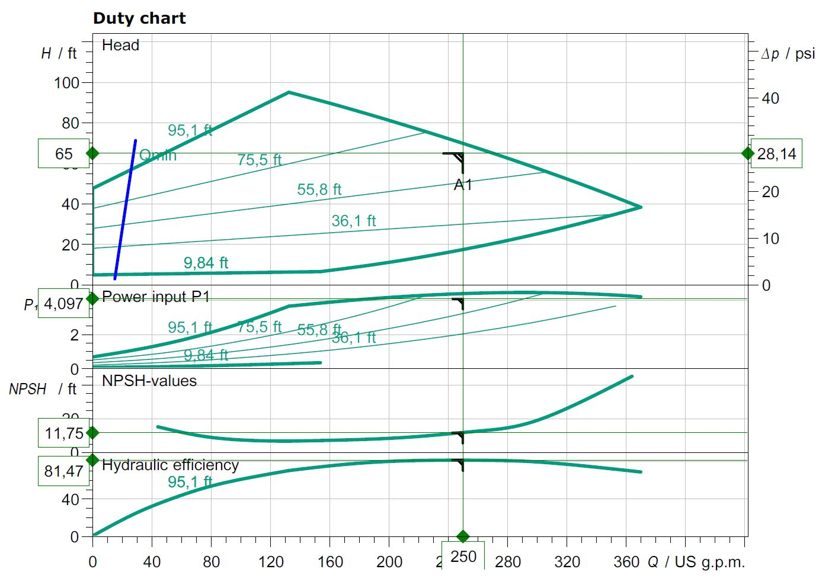
With ECM even if you want the safety of higher head pressure
for scheduling you can operate on a curve that can operate
within the System needs.

Slide 46
System Efficiency
How do we achieve it?
Designed Delta T to the Energy Producer
TURNDOWN of Equipment for optimal EFFICIENCY.
WHAT IS YOUR RETURN WATER TEMPERATURE??
GPM = BTU’s
500 x Delta T

Slide 47
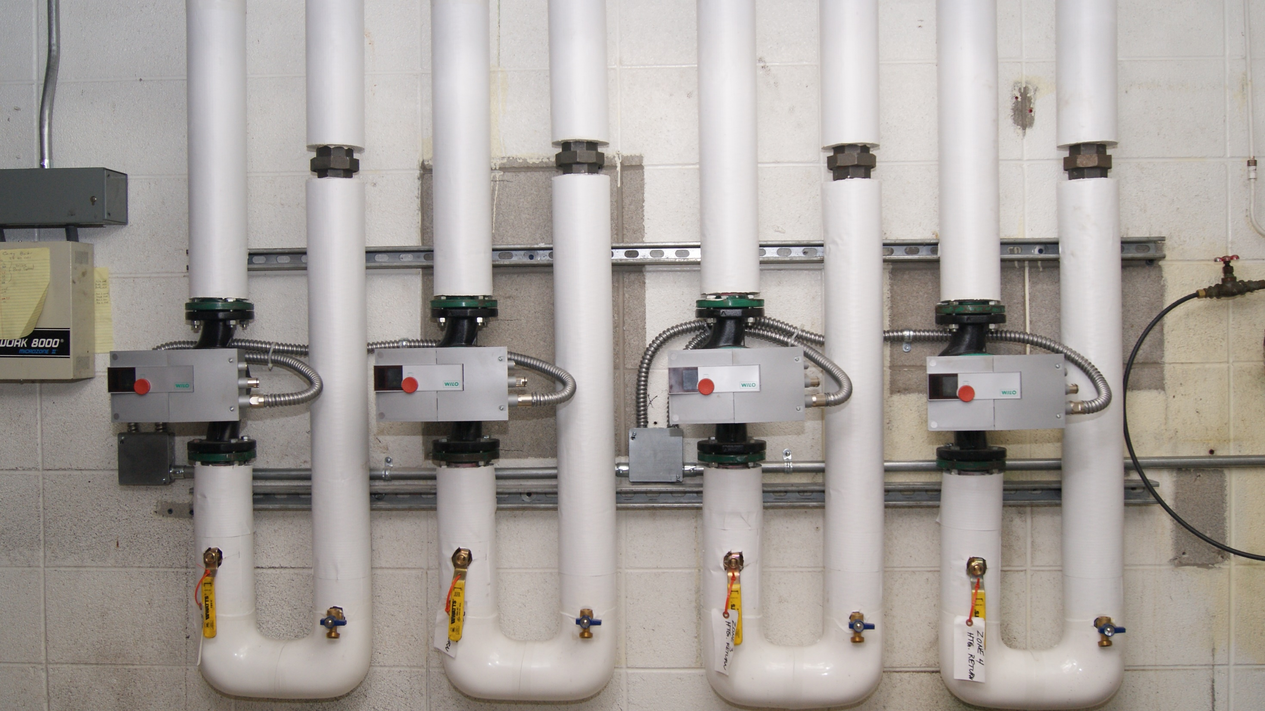
Add a Slide Title - 1

Slide 48
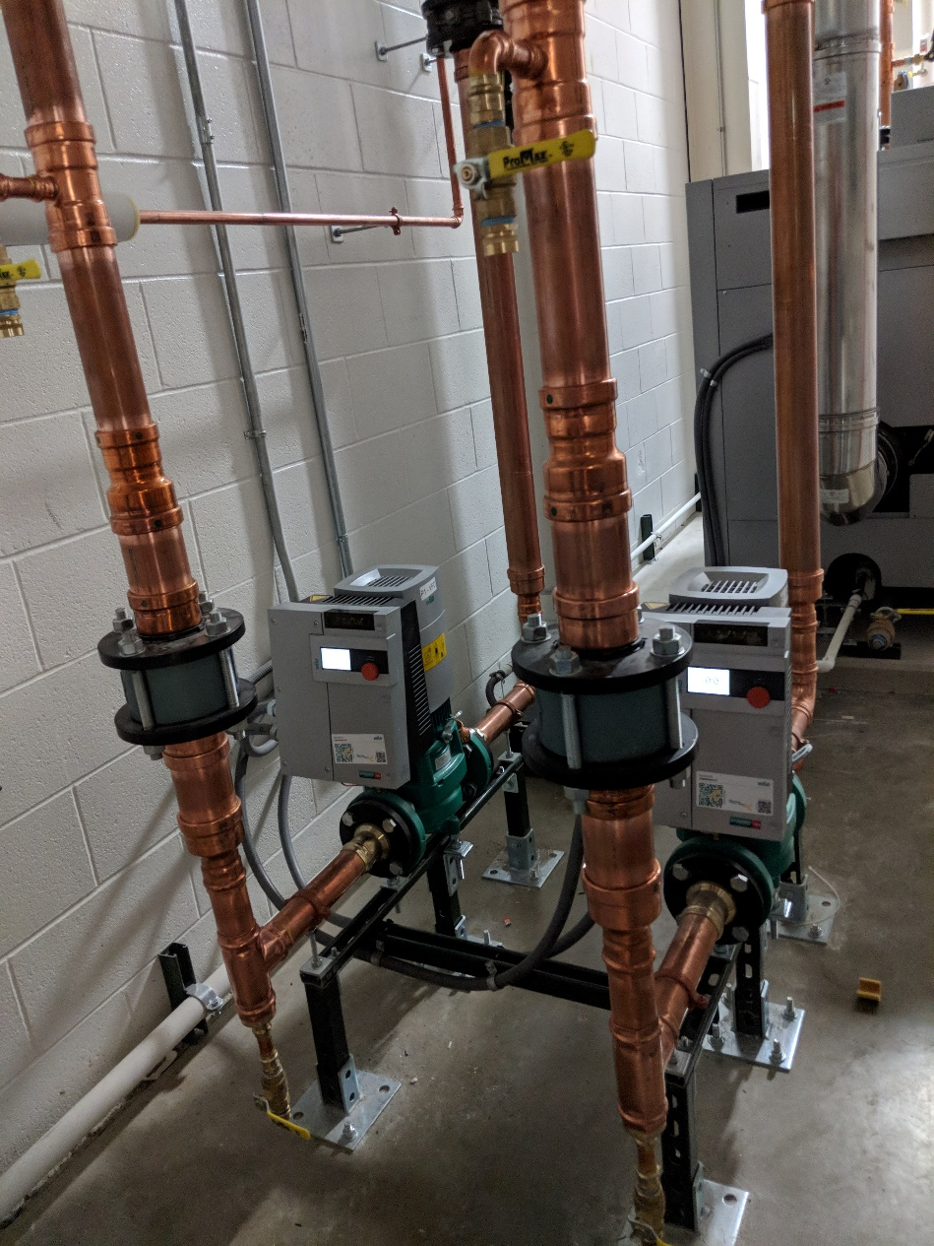
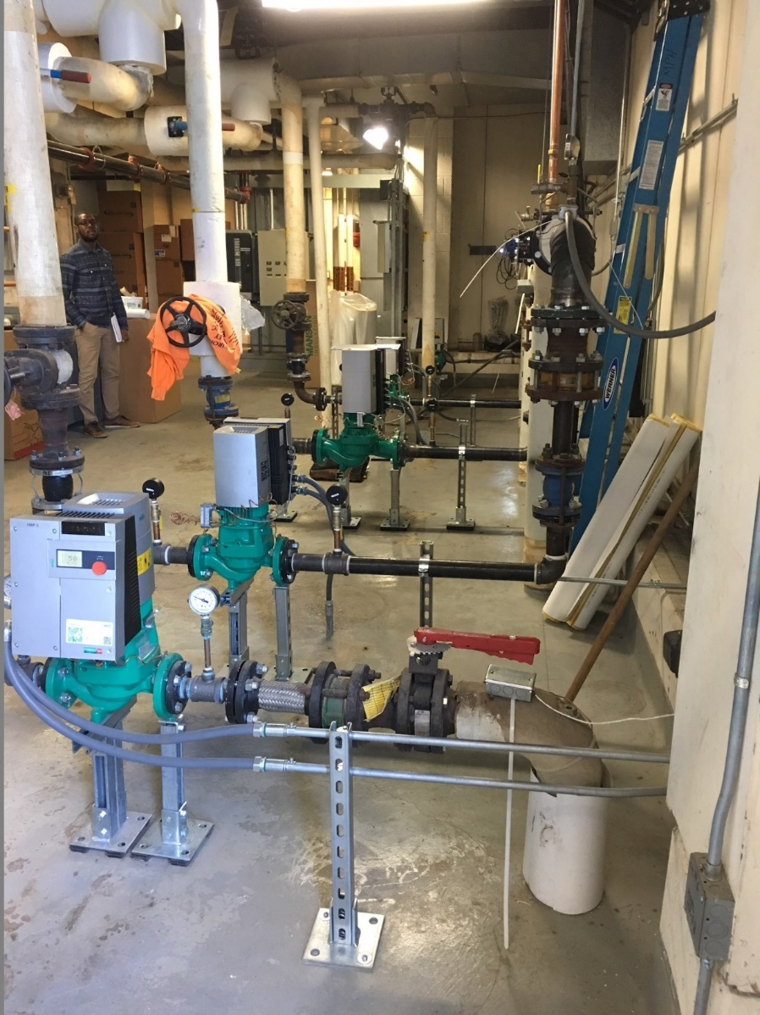

Slide 49
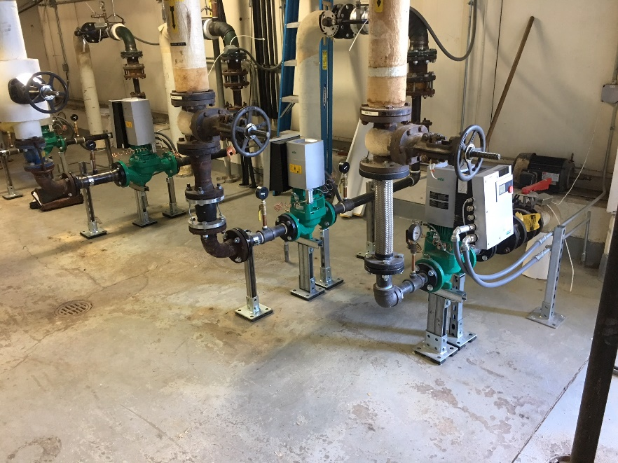
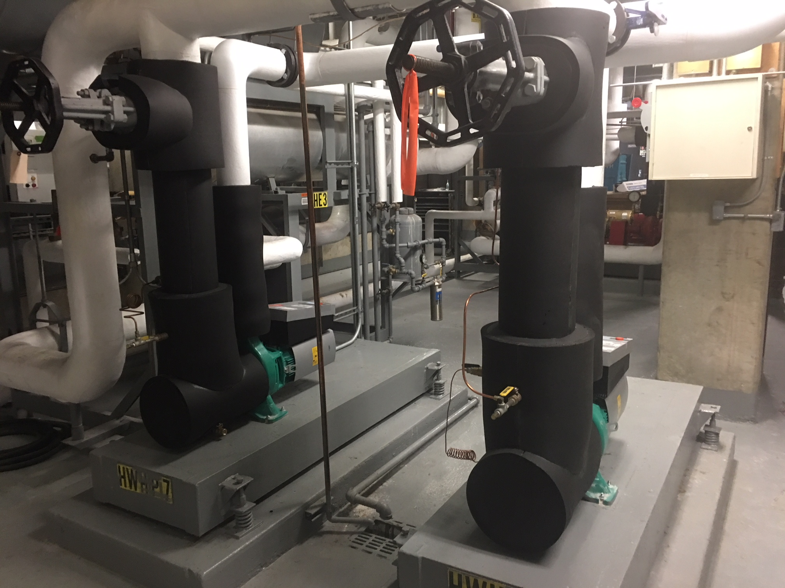
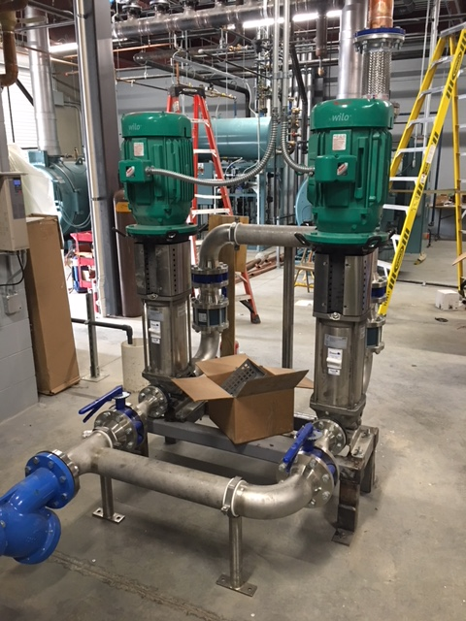

Slide 50
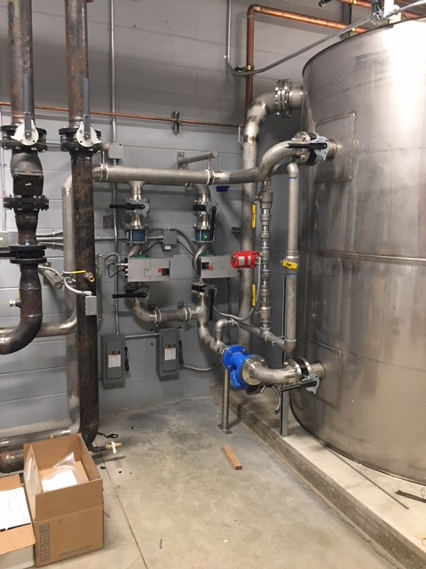
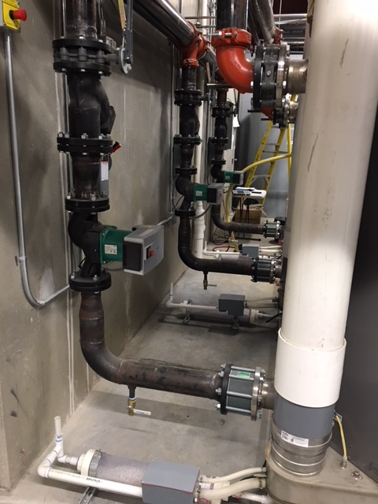

Slide 51
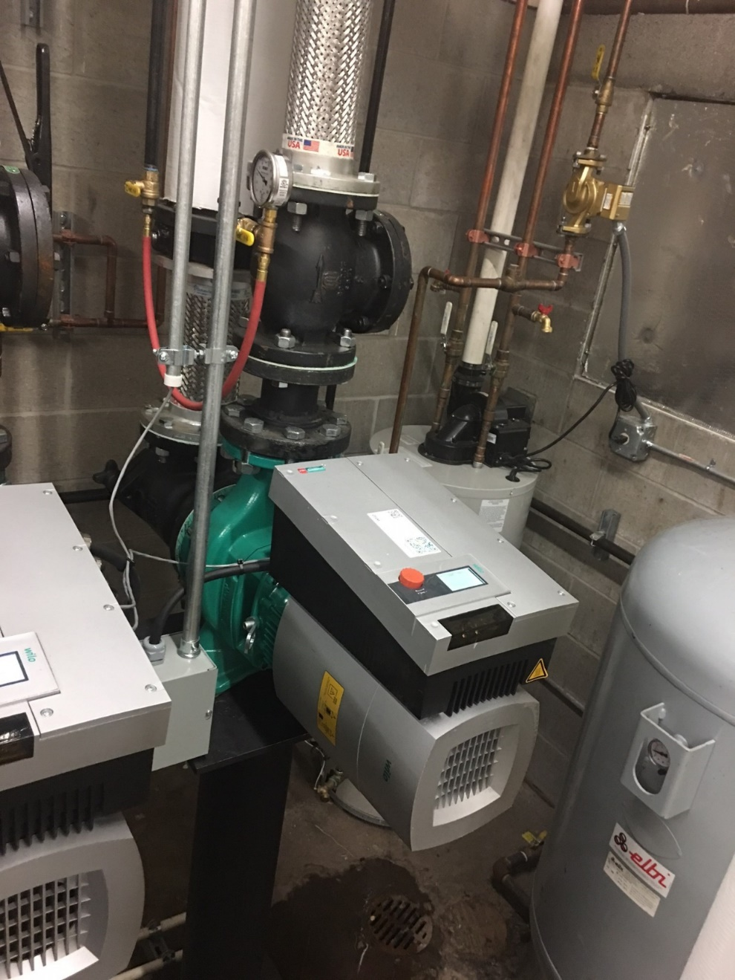
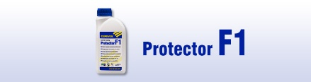
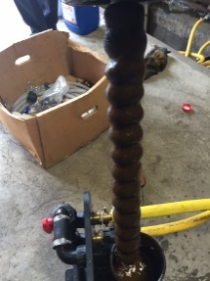

Slide 52
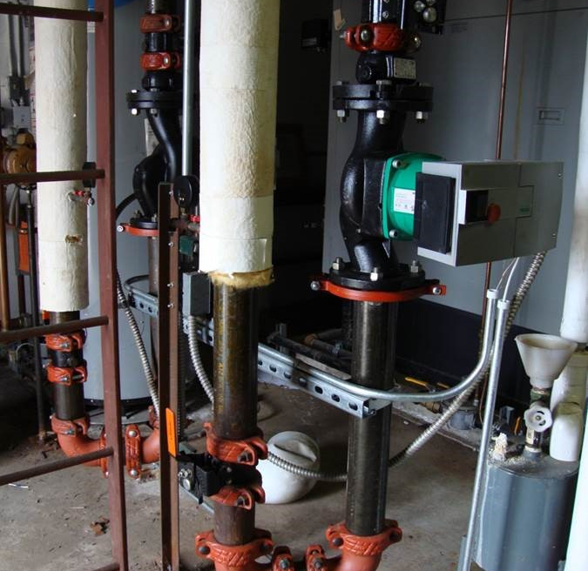
Alma
Base Mounted replaced by inline SIMPLE for anyone.

Slide 53
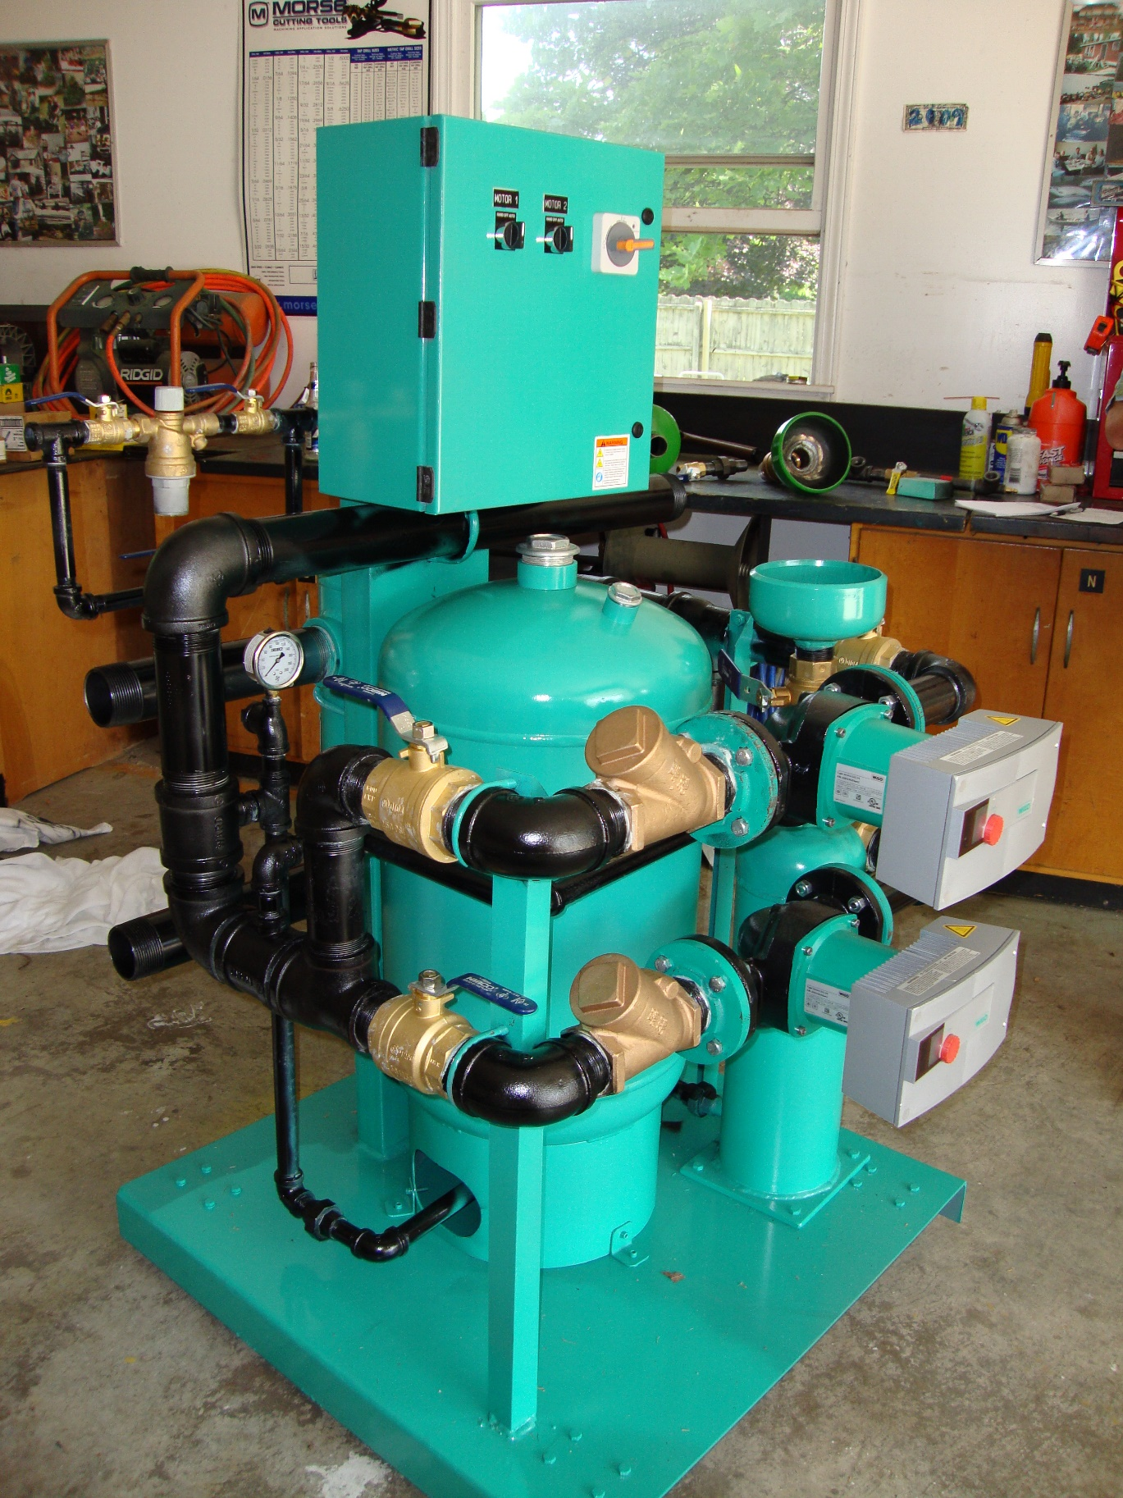

Slide 54
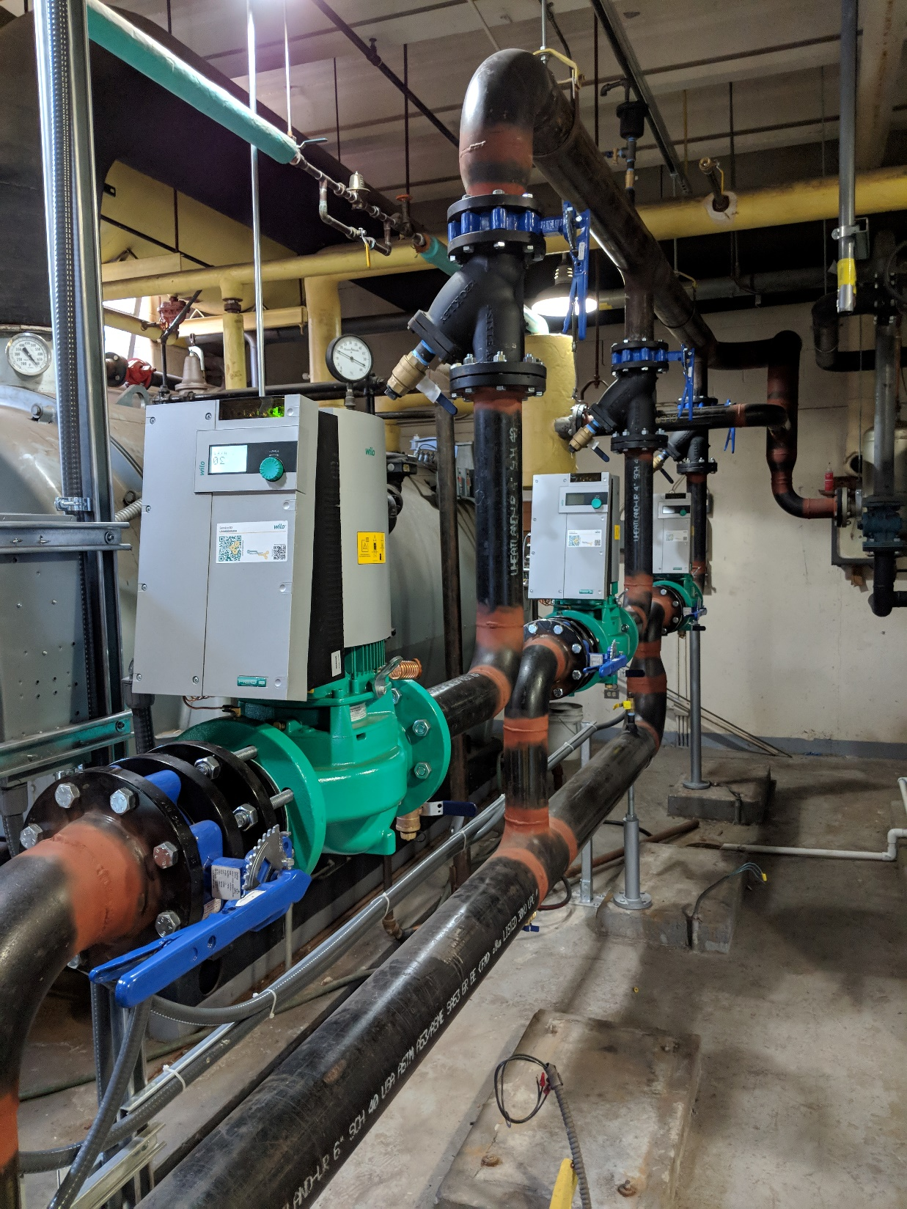
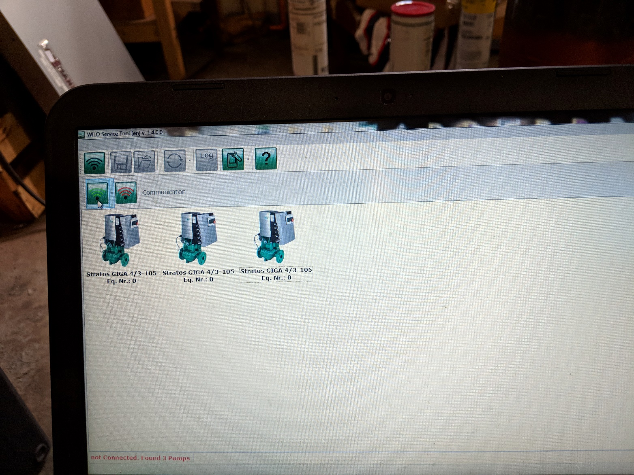
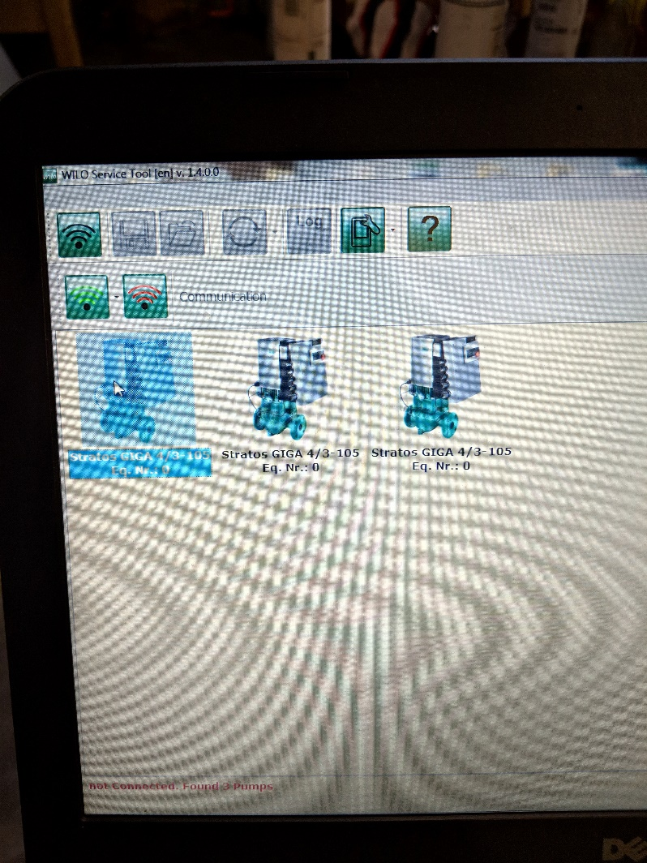

Slide 55
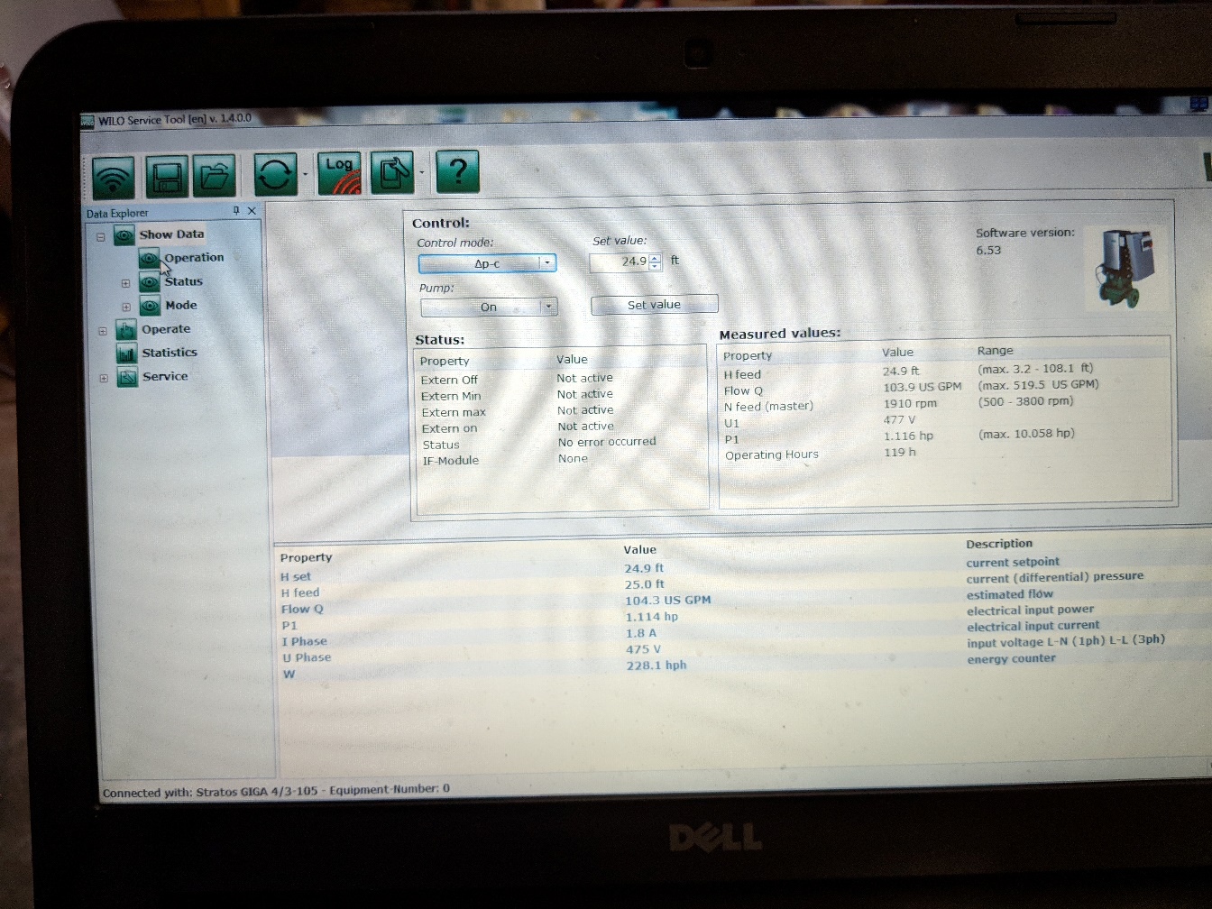



Slide 56



Slide 57



Slide 58


Slide 59


