Slide 1

Domestic Hot Water Recirculation Energy Reduction
How many DHW pumps do you stand on to change from CFL to LED?

Slide 2
Their way changing light bulbs
CFL to LED
11 kwh x 0.077 = $ 0.847 / year
Assuming we continue to have very cheap electricity???? 0.077/kwh
Our Way changing old worn out PUMPS
AC pumps to ECM
3,066 kwh x 0.077 = $ 236.082/year

Slide 3
60 watt light bulb converted to floursent then to led
66w to 15w to 11w $20.00/bulb
55wh x 2080 (avg 8hour work week) = 114,400w / year
4wh x 2080 = 8,320w / year
This is watt savings per YEAR
Wilo pump
15kwh x (365 x 24) 8760 = 131,400,000w / year
Existing pump
552kwh x (365 x 24) 8760 = 4,835,520,000w / year
Savings per year 4,704,120,000w /year

Slide 4
DOWN THE DRAIN!
D.O.E AND U.S CENSUS BUREAU ESTIMATE BETWEEN 400 BILLION AND 1.3 TRILLION GALLONS OF WATER ARE WASTED BY HOUSEHOLDS PER YEAR!
D.O.E ESTMATES THAT A “MODESTLY SIZED” RE-CIRC PUMP WILL USE 400 – 800 KWh/year (90 watts x 8760/ 1000)
MANY STATES ARE LOOKING AT PASSING LAWS REQUIRING DOMESTIC RECIRCULATION IN ALL NEW CONSTRUCTION PROJECTS (DEMAND TYPE)
TREMENDOUS ENERGY SAVING POTENTIAL WITH ECM
LOW HANGING FRUIT ¼ HP AND UP.
EASILY THE MOST OVERSIZED CIRCULATORS IN USE TODAY!

Slide 5

HOW MUCH DID YOU SAY?!?!

Slide 6
NO…..REALLY!
150,000 GALLONS PER SECOND FLOW OVER THE AMERICAN FALLS AND THE BRIDAL FALLS AT NIAGARA
600,000 GALLONS PER SECOND FLOW OVER THE HORSESHOE FALLS ON THE CANADIAN SIDE OF NAIGARA
750,000 GALLONS PER SECOND TOTAL
750,000 GPS X 60 SECONDS = 45 MILLION GALLONS PER MINUTE
45 MILLION GPM X 60 MINUTES = 2.7 TRILLION GALLONS PER HOUR
AMERICAN HOMES WASTE IN ONE YEAR THE EQUIVALENT OF WHAT GOES OVER NIAGARA FALLS IN A HALF HOUR!

Slide 7

COST IN BTU’S
BTU = BRITISH THERMAL UNIT
THOMAS TREDGOLD INTRODUCED THE MEASUREMENT TO THE WORLD IN 1827
IT IS THE AMOUNT OF ENERGY REQUIRED TO RAISE ONE POUND OF WATER ONE DEGREE FARENHEIT FROM 62 DEGREES TO 63 DEGREES
ONE GALLON OF WATER EQUALS 8.33 POUNDS
1.3 TRILLION GALLONS X 8.33 = 10,829,000,000,000 POUNDS
HEATING WATER FROM 100 DEGREES TO 120 DEGREES = 2O DEGREE DELTA TEE
10,829,000,000,000 POUNDS X 20 DEGREE RISE = 216,580,000,000,000 BTU’S USED TO HEAT THE WASTE WATER (63,473,335,228 KW OR 63,473.335 GW) (( Palo Verde produces 3.3 GW annually))
ONE CUBIC FOOT OF NATURAL GAS HAS 1,000 BTU’S (THEORETICAL)
AVERAGE COST PER CUBIC FOOT = $0.016
216,580,000,000,000 X $0.016 = $3.5 TRILLION ANNUALY

Slide 8
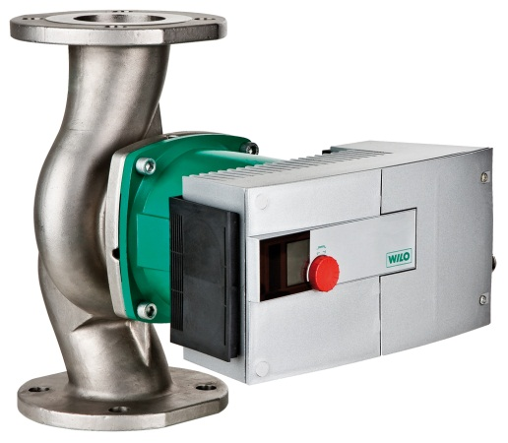
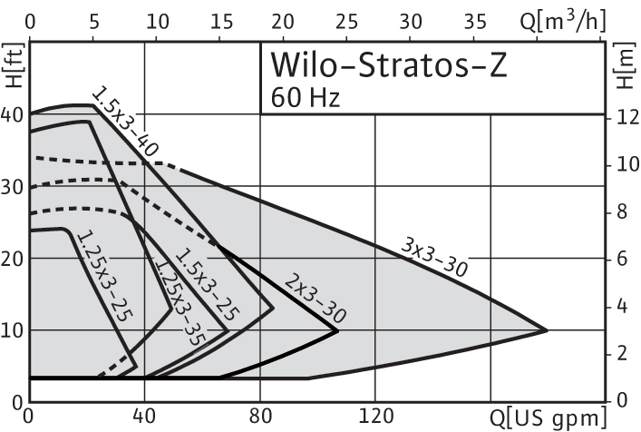
ECM Products: Stratos Z
Stratos Z (Stainless Steel Volute)
NSF 61, Annex G certified (NSF 372)
Domestic recirculation
Soft start high torque permanent magnet rotor
6 sizes available
Max head: 30 feet
Max flow: 200 GPM
208/ 230 volt single phase only
Smart pump adjusts flow to system changes (∆p-v, ∆p-c and ∆p-t)
Non-volatile memory
Flange sizes:1 ¼”, 1 ½”, 2” & 3” (High velocity)
Interface modules for 0-10Vdc, LON, BACnet and external control
Dual pump mode (Duty/Stand by, Dual pump)
Infrared service/diagnostic tool available
Pump performance and system data logging
Overload protection (voltage, dry run, locked rotor, over temperature)
Class “A” energy rating

Slide 9
Delta Pressure Temperature Mode (DPt)
T min = 60° F
P min = 36.1 Ft.
T max = 110°
P max = 12.1 Ft.
43.3
35.3
Ft
27.3
19.3
11.3
3.3
14
60
110
160
210
° F

Slide 10
Wilo Stratos Z vs. standard three piece bronze domestic recirc pump
This is a preliminary analysis of Wilo Z Domestic hot water re-circulating pumps. Following is a comparison of a Wilo Z pump with a standard pump operating at the exact same flow and head. More savings found with proper setup.
Building 1506
Wilo Z: 1/8Hp, Single Phase, 208V
Meter Installed Date: 2/10/2012
Meter Reading(03/29/2012):15KWh; $1.15
Pump Installed Cost: TFW
Electrical Rate:$.077/kwh
Building 1511
½ Hp, Single Phase, 110 V
Meter Installed Date:2/13/2012
Meter Reading(03/29/2012): 552KWh; $42.5
Pump Installed Cost: TFW
Electrical Rate:$.077/kwh

Slide 11
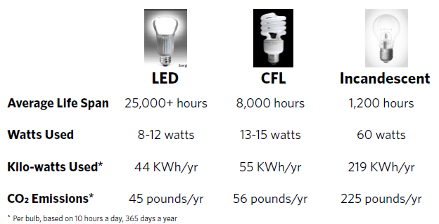

Slide 12
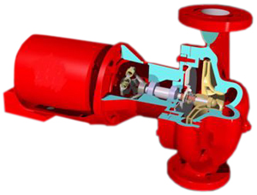
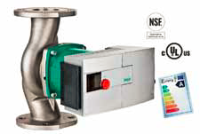
1 hp of energy = 746 Watts of energy AC
50% less ECM
1/2hp AC
AC Centrifugal Pump Domestic HW
Operation 24/7-8760 hours / year
Average Life Span 5 YEARS
Watts Used 373 watts
Kilo Watts Used 3267.48 kwh/yr
CO2 Emissions 3357 #/yr
System Efficiency ??
System Life ??
1/8hp ECM
ECM Centrifugal Pump Domestic HW
Operation 24/7-8760 hours / year
Average Life Span 25 YEARS
Watts Used 23.3 watts
Kilo Watts Used 233 kwh/yr
CO2 Emissions 226 #/yr
System Efficiency 100
System Life 25 years

Slide 13
You would have to change 279 CFL’s to LED’s
to save the same as ONE DHW Pump
Electrical Rate:$.077/kwh
Hearing $.30/kwh in neer future???
LED 12 watts x 10 hrs x 365 = 44 kwh/yr
11 kwh/yr savings
CFL 15 watts x 10 hrs x 365 = 55 kwh/yr
ECM 1/8 23 watts x 24 hrs x 365 = 202 kwh/yr
3,066 kwh/yr savings /pump
AC ½ 373 watts x 24 hrs x 365 = 3268 kwh/yr
11 kwh x 0.077 = $ 0.847 / year
3,066 kwh x 0.077 = $ 236.082/year
11 kwh x 0.30 = $ 3.30 / year
3,066 kwh x 0.30 = $ 919.80/year

Slide 14
Now figure the cost to repair the old AC pump and compare it to a NEW ECM pump.
You have payback of a few months plus you get
free proper system design and lower maintenance cost>
Last thought
How many light bulbs have to be changed to equal the savings of ONE pump?
Over 279 and what is the upfront cost of the bulbs.
Now you improve the system efficiency as a by-product,
NSF-61 and no more bearing assemblies or seals to leak.

